Slide 1
INTRODUCTION
TO
DATA MANAGEMENT
(INT217)
Lecture #0

Slide 2
Course Overview
L T P :
Reference Books:
MICROSOFT EXCEL 2016 BIBLE: THE COMPREHENSIVE TUTORIAL RESOURCE by JOHN WALKENBACH, WILEY
PROFESSIONAL MICROSOFT SQL SERVER 2014 INTEGRATION SERVICES by BRIAN KNIGHT, DEVIN KNIGHT, JESSICA M. MOSS, MIKE DAVIS, CHRIS ROCK, WILEY
FUNDAMENTALS OF BUSINESS ANALYTICS by R.N. PRASAD, SEEMA ACHARYA, WILEY
0 | 0 | 4

Slide 3
Marks Breakup
Credits : 2
Marks Breakup:
* 2 Best CA out of 3 CA each of 50 marks
* No MTE
* ETE is Project Viva
Activity | Marks
Attendance | 5
Continuous Assessment | 45
End-Term Practical (ETP) | 50
Total | 100

Slide 4
What is Data Management?
Data management is the process of ingesting, storing, organizing and maintaining the data created and collected by an organization.
The data management process includes a combination of different functions that collectively aim to make sure that the data in corporate systems is accurate, available and accessible

Slide 5
Data management Techniques
Data management is the strategic control of data.
It is typically concerned with areas such as data quality, data architecture, database management, data security, , analytics, data integration

Slide 6
Why Data Management is important?
In the digital age, data is king.
This is why it is seen as one of the most important assets of an organisation; it is the foundation of information and the basis on which people make decisions.
Hence it would follow that if the data is accurate, complete, organised and consistent, it will contribute to the growth of the organisation

Slide 7
Data is the foundation of a business' information, knowledge, and ultimately the wisdom for correct decisions and actions. ... Organizations have to manage the data cycle well because the data is created, stored, maintained, used and even destroyed.

Slide 8
Data management is important because the data your organization creates is a very valuable resource. The last thing you want to do is spend time and resources collecting data and business intelligence, only to lose or misplace that information.

Slide 9
These are some of the additional, and undeniable, benefits of the same.
1. Increases productivity: If data can be accessed easily, especially in large organisations,your company will be more organised and productive.
2. Smooth operations: A seamless operating system is every business’ dream and datamanagement can make that a reality.

Slide 10
3. Reduce security risk: It is the first time in history that so much personal information is available to those that can access it. When you store people’s credit card information, personal address, phone numbers, photos, etc. it is of paramount importance that this data is protected by the best possible security. If your data is not managed properly, it can fall into the wrong hands. Data theft will also have severe implications on the growth of your
company; nobody wants to leave their details in the hands of people that do not know how to protect it.

Slide 11
4. Minimal chance of data loss: A good data management system will reduce the chances of losing important company information. It also ensures that your data is backed up and in case of a sudden glitch or system failure, any data that is lost can be retrieved easily

Slide 12
Better decision making: When everything is in its place, and everyone knows where to look for it, the quality of your decisions improve drastically. By nature, people have different ways of processing information, but a centralised system ensures a framework to plan, organise and delegate. Additionally, a good system will ensure good feedback,
which in turn will lead to necessary updates to the process that will only benefit your company in the long run

Slide 13

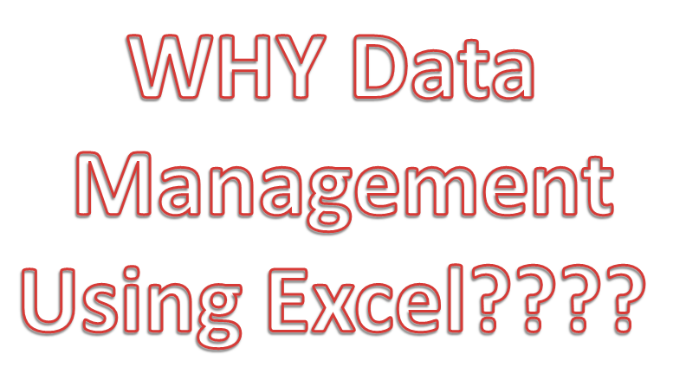

Slide 14
Data Management using Excel
The use of Excel is widespread in the industry.
It is a very powerful data analysis tool and almost all big and small businesses use Excel in their day to day functioning.
This is an introductory course in the use of Excel and is designed to give you a working knowledge of Excel with the aim of getting to use it for more advance topics in Business Statistics later.

Slide 15
Is Excel a Data Management tool?
As a spreadsheet program, Excel can store large amounts of data in workbooks that contain one or more worksheets. However, instead of serving as a database management system, such as Access, Excel is optimized for data analysis and calculation.
Frequently run calculations and statistical comparisons on your data.

Slide 16
Is Excel can be used for Data Analysis?
The ability to analyze data is a powerful skill that helps you make better decisions. Microsoft Excel is one of the top tools for data analysis and the built-in pivot tables are arguably the most popular analytic tool. ... In addition, Excel formulas can be used to aggregate data to create meaningful reports.

Slide 17
…ctd
The course is designed keeping in mind two kinds of learners –
Those who have very little functional knowledge of Excel and
Those who use Excel regularly but at a peripheral level and wish to enhance their skills.
The course takes you from basic operations such as:
reading data into excel using various data formats
organizing and manipulating data
to some of the more advanced functionality of Excel
All along, Excel functionality is introduced using easy to understand examples which are demonstrated in a way that learners can become comfortable in understanding and applying them.

Slide 18
Content of Course

Slide 19
Unit 1- Introduction to Microsoft
Excel : UI Basics
Introduction to UI basics
About excel
Workbooks and worksheets
Customizing excel
Reference styles
Number formatting
Custom number formatting
Conditional formatting, format as table

Slide 20
Unit 1- Spreadsheet functions to organize data
Cell reference styles
Creating and working with formulas
Text functions, date and time functions
Lookup and reference functions
Mathematical and statistical functions
Information and volatile functions
Formula auditing
Error handling
String functions

Slide 21
Unit 2- Data representation and manipulation
Filter
Advanced filter for complex criterion
Sorting and custom sorting
Pivot table and pivot chart
Power pivot
Import data from different sources into power pivot
Reducing file size in power pivoting
Connect to multiple different external datasets

Slide 22
Unit 3- Advanced graphing and charting
Charts, combo charts
Working with objects charts
Dynamic charts and dynamic data source for charts print areas
Views for a worksheet
Various printing techniques
Unit 3- Data protection techniques
Worksheet protection
Protect specific range
Workbook protection and encryption

Slide 23
Unit 4- Building a model
Introduction to building a model
About model and assumptions
Diagramming the flow with exercise
Wireframing with exercise, preparing the data with exercise
Linking up formulas with exercise
Sensitivity analysis with exercise
Case study: forecasting with a model

Slide 24
Unit 5- Multidimensional Data
ETL overview
Extracting data
Transformations
Loading data
Simple ETL processing
ETL tools
Data sources and destinations
OLTP and OLAP
Multidimensional data models
Data cube

Slide 25
Unit 6- Data Processing using
Tableau Prep
Introduction to tableau prep
Installing tableau prep
Basics of data preparation
Connecting to data
Creating data flow
Blend data sources
Cross-database join
Tableau prep for business
Project task

Slide 26
Learning Outcomes
Apply the various techniques and functions over spreadsheet for getting various insides of data
Understand the data representation methods like pivot table and power pivoting
Understand the need of the graphical representation in the spreadsheet by using various graphs and charts
Extend the concepts of multidimensional data and topics like OLAP, OLTP and data cube
Demonstrate the ETL process using the Tableau prep tool and able to perform pre-processing for data analysis

Slide 27
Tableau Prep
Tableau Prep Builder is a tool in the Tableau product suite designed to make preparing your data easy and intuitive. Use Tableau Prep Builder to combine, shape, and clean your data for analysis in Tableau.

Slide 28
Tableau Prep is an ETL tool (Extract Transform and Load) that allows you to extract data from a variety of sources, transform that data, and then output that data to a Tableau Data Extract (using the new Hyper database as the extract engine) for analysis.

Slide 29



