Slide 1
Sentiment Analysis on Social Media Platform
Presented by:
Ashok Sai Doredla(JH88172)
Ajay Rajaram(BD51771) Reshma Chowdary Attipatla(ZG38530)
Saroj Kumandan Kothakota(EI34057)
Swetha Manchukonda(TA08134)

Slide 2
CONTENTS
Overview
Dependencies
Data Preparation
Data Analysis & Visualization
NLP Model
Sentiment Analysis
Fine Tuning
Conclusion

Slide 3
Contd…
Gathering Dataset
Data Collecting
Data Cleaning
Data Preprocessing
Sentiment Analysis Model Building
Accuracy of the Model

Slide 4
Contd…
Data Visualization
Insights from the Visualization
Future Enhancements
Conclusion

Slide 5
Overview
Sentiment analysis, is a natural language processing (NLP) technique used to determine the sentiment or emotion expressed in text data.
In the context of a social media platform, sentiment analysis involves analyzing the sentiments (positive, negative, neutral) of user-generated content.
This technique is valuable for understanding how users feel about a particular topic, product, or brand on social media.

Slide 6
Dependencies
Python
Jupyter NotebookJupyter Notebook
Libraries like Pandas, Numpy, Matplotlib, SkLearn, BeautiSoup, transformers, NLTK (Natural Language Processing took kit), Regular Expressions.
NLP Model- BERT(Bidirectional Encoder Representations from Transformers) developed by Google.

Slide 7
Data Preparation
The data is extracted from Kaggle.
We extracted 3 lakhs reviews of mobile phones sold on Amazon.com to find out insights with respect to reviews, ratings, price and their relationships.
Content Given below are the fields:
Product Name
Brand Name
Price
Rating
Reviews

Slide 8
Contd..
Data Labelling:
In this step we clean the data and label the data as:
0 for Negative
1 for Neutral
2 for Positive

Slide 9
Contd…
Data Cleaning: Remove all the rows containing blank cells. The resultant data is stored as “labelled_dataset.csv”
Data Processing: The following text preprocessing are implemented to convert raw reviews to cleaned reviews, so that it will be easier for us to do feature extraction in the next step.
Remove html tags using BeautifulSoup to remove non-characters such as digits and symbols.
Convert to lower case to remove stop words such as “the” and “and” if needed.
Convert to root words by stemming if needed

Slide 10
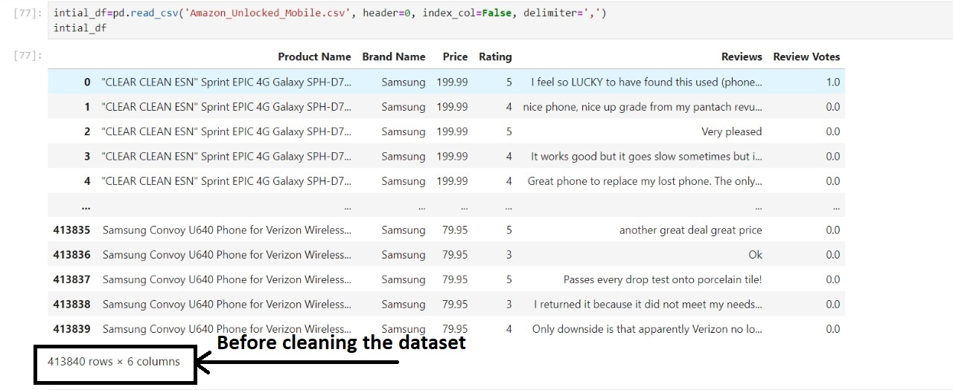
Before and After Data Cleaning and Pre Processing
Before

Slide 11
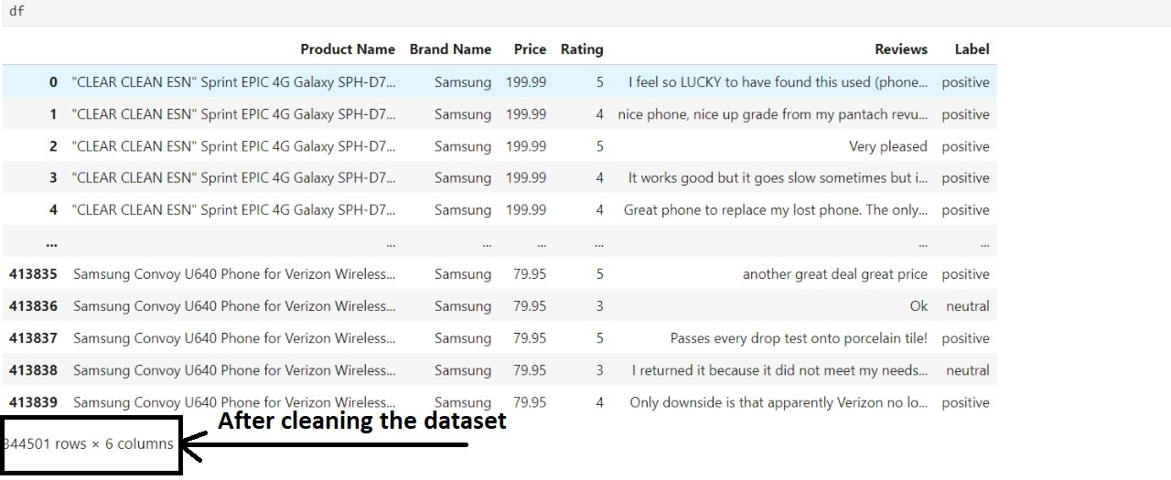
Contd…
After

Slide 12
Data Analysis & Visualization
Analysis:
Sentiment Distribution: Examined how sentiments (negative, neutral, positive) are distributed in the dataset.
Statistical Metrics: Utilized metrics like accuracy, precision, recall, and F1-score for model evaluation.
Visualization
Bar Chart: Depicted sentiment score distribution through a bar chart, revealing the prevalence of different sentiments.
Pie Chart: Illustrated the proportion of each sentiment class using a pie chart for a quick overview.

Slide 13
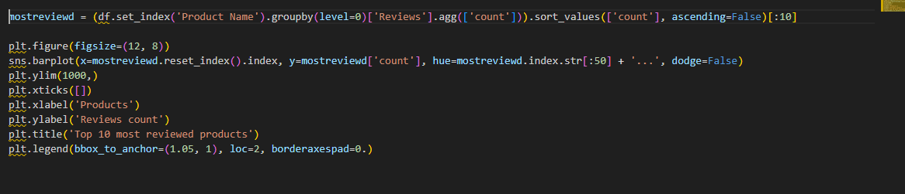
Top 10 Most Reviewed Products

Slide 14
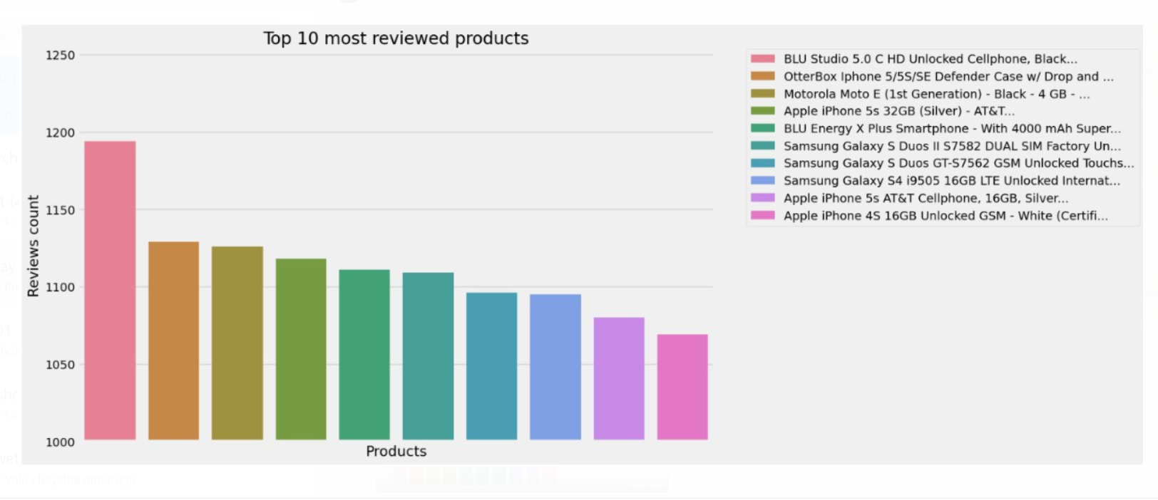
Contd…

Slide 15
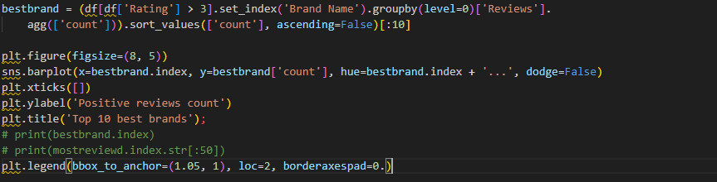
Top 10 Best Brands

Slide 16
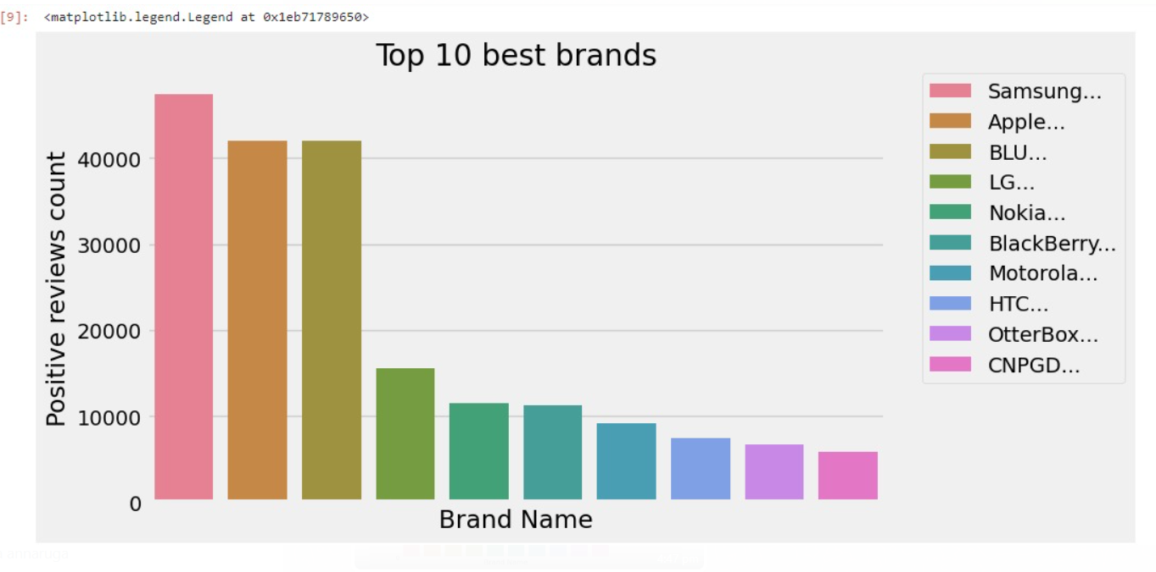
Contd…

Slide 17
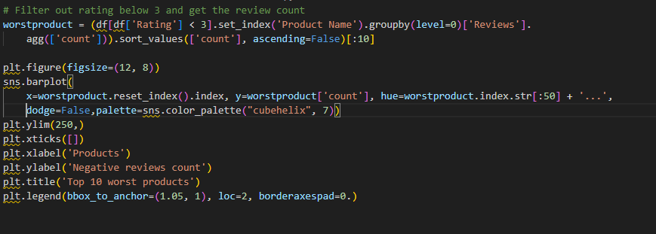
TOP 10 WORST BRANDS

Slide 18
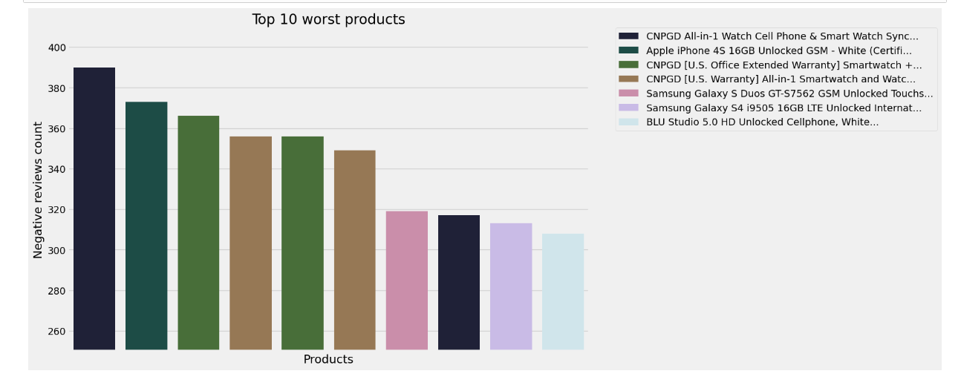
Contd…

Slide 19
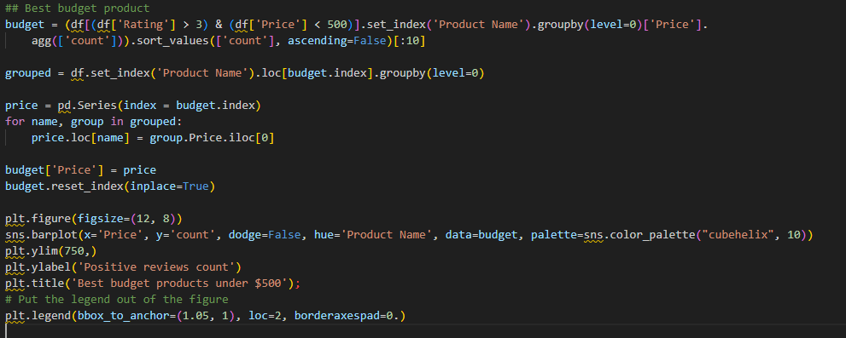
BEST BUDGET PRODUCTS UNDER $500

Slide 20
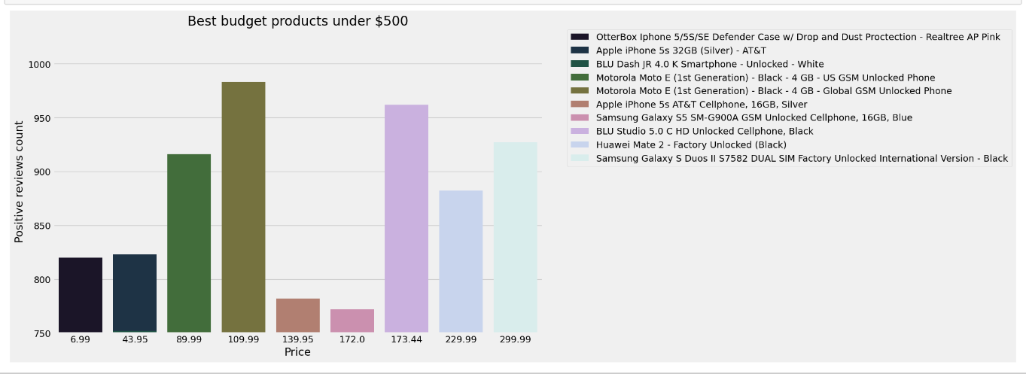
Contd…

Slide 21
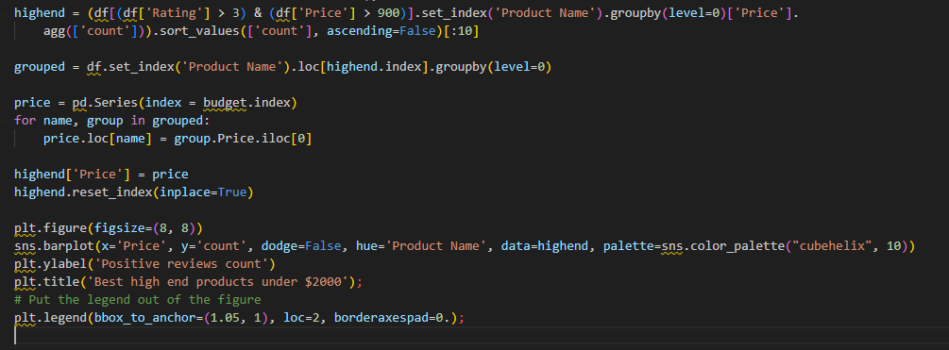
BEST HIGH-END PRODUCTS UNDER $2000

Slide 22
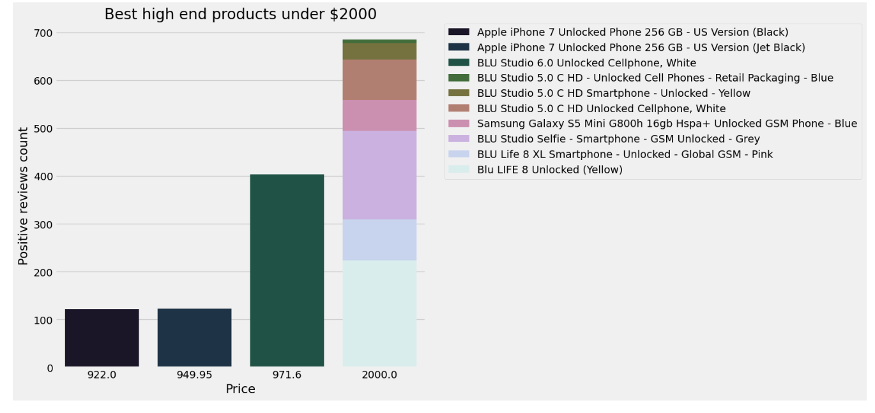
Contd…

Slide 23
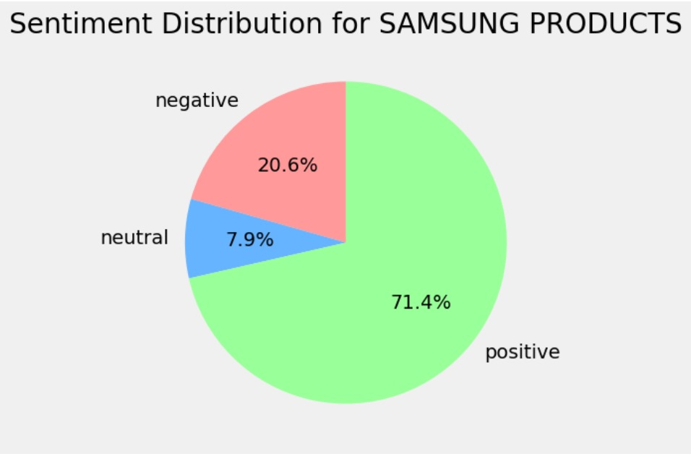
SENTIMENT DISTRIBUTION OF SAMSUNG

Slide 24
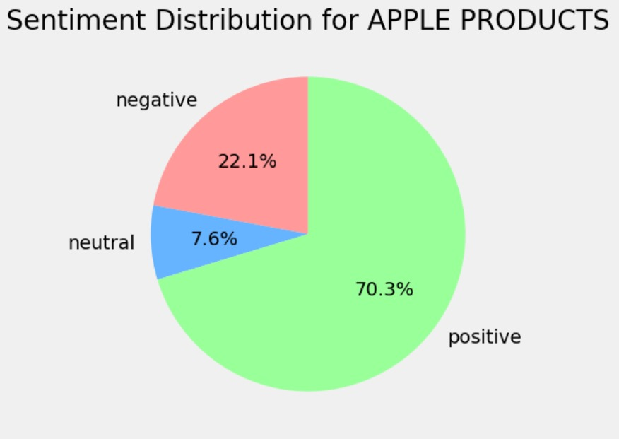
SENTIMENT DISTRIBUTION OF APPLE

Slide 25
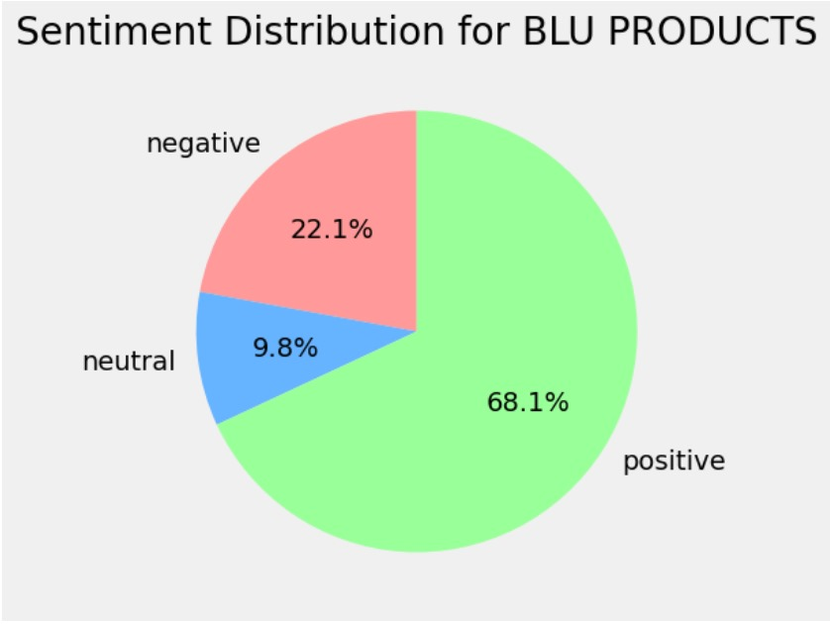
SENTIMENT DISTRIBUTION OF BLU

Slide 26
NLP - "BERT for Multilingual Sentiment Analysis"
The bert-base-multilingual-uncased-sentiment' model is the one we are utilizing. It is a variation of Google's potent language model, BERT (Bidirectional Encoder Representations from Transformers).
The term "multilingual" refers to its ability to comprehend and evaluate text in several languages. Sentiment analysis, or figuring out the sentiment or emotion conveyed in a text, requires fine-tuning the model.
Using the model's tokenizer, we tokenize a given text in our code, format it in a way the model can understand, and then run it through the model to obtain sentiment ratings.
In simpler terms, it's a pre-trained model that's really good at figuring out the sentiment (positive, negative, etc.) of text in multiple languages.
Great for applications like social media monitoring, customer feedback analysis, and more!

Slide 27
SENTIMENT ANALYSIS
Sentiment analysis is performed using a pre-trained transformer-based model from the Hugging Face Transformers library.
Specifically, it uses a BERT-based model fine-tuned for sentiment analysis (nlptown/bert-base-multilingual-uncased-sentiment).
The model takes a piece of text (a review in this case), tokenizes it, and then predicts the sentiment score out of 5.

Slide 28
FINE TUNING
Fine-tuning sentiment analysis involves adapting a pre-trained language model to a specific sentiment task using labeled data. This process optimizes the model for sentiment classification, enhancing its performance

Slide 29
PERFORMANCE METRICS
Accuracy: Accuracy measures the overall correctness of a sentiment analysis model, representing the ratio of correctly predicted sentiments to the total predictions.
Classification Report: Accuracy measures the overall correctness of a sentiment analysis model, representing the ratio of correctly predicted sentiments to the total predictions.
Confusion Matrix: The confusion matrix visually depicts the model's performance by illustrating the number of correct and incorrect predictions for each sentiment class. It aids in identifying where the model excels or struggles in sentiment classification.

Slide 30
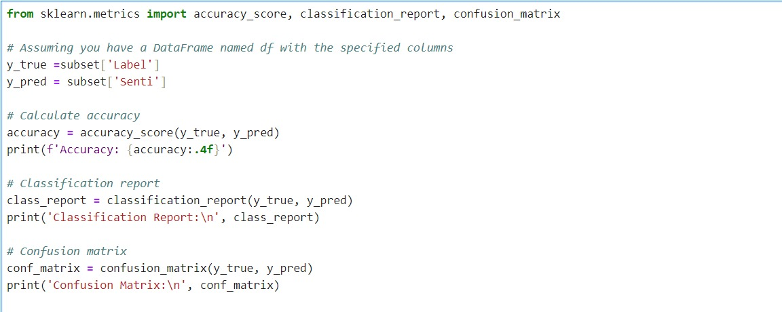
Accuracy, Classification Report, and Confusion Matrix

Slide 31
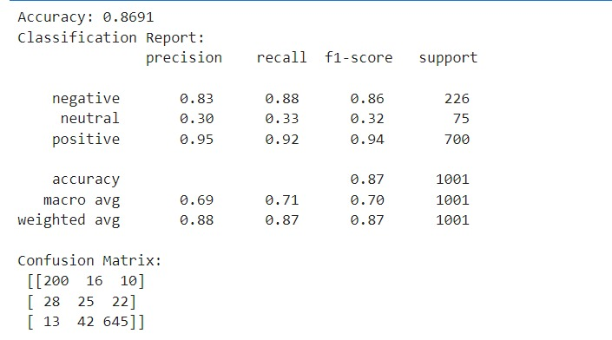
Contd…

Slide 32
Contd…
Explanation
The accuracy of 86.91% indicates that the sentiment analysis model is quite effective overall.
In the classification report, precision measures the accuracy of positive predictions, recall measures the coverage of true positive instances, and the F1-score is the balance between precision and recall.
For the "negative" sentiment class, the model achieved good precision (83%) and recall (88%), resulting in a high F1-score (86%).
However, for the "neutral" sentiment class, the model's performance is weaker, with lower precision (30%), recall (33%), and F1-score (32%).
The "positive" sentiment class shows excellent performance with high precision (95%), recall (92%), and F1-score (94%).
Analyzing the confusion matrix, it reveals specific misclassifications. For instance, in the "neutral" sentiment, there's a notable number of false negatives and false positives. Overall, the model excels in identifying "positive" sentiments but faces challenges in accurately classifying "neutral" sentiments.

Slide 33
CONCLUSION
The sentiment analysis project focused on sentiments related to unlocked mobile products on Amazon.
The model achieved an accuracy of approximately 87%, showcasing its effectiveness in discerning sentiments.
The classification report and confusion matrix provided detailed insights into the model's performance across different sentiment categories. Visualizations, such as bar charts and pie charts, were utilized to enhance the understanding of sentiment distribution.
The analysis of the 'Amazon_Unlocked_Mobile.csv' dataset contributes valuable information for stakeholders interested in comprehending consumer sentiments regarding unlocked mobile devices on Amazon.

Slide 34


