Slide 1
Music Recommendation System Using Facial Emotions

Slide 2

INTRODUCTION AND NEED
There can be many types of facial expressions ranging such as happy, sad, angry, and fear.
They provide non-verbal cues that reveal emotional states and intentions.
Technological advancements have facilitated the more accurate measurement and analysis of facial emotions, leading to a deeper understanding of their neurological roots.
55% of emotional understanding comes from visual factors, while 38% comes from audio cues like rhythm, pitch, and tone. Language plays a relatively smaller role, contributing only 7%.
This model will detect emotions and play music, accordingly, ensuring individuals' positivity at all times.

Slide 3
Technologies Used
OpenCV - Ajay Sehrawat
Flask - Sanjay Chaudhary
HTML/CSS/BOOTSTRAP - Vinit Kumar
Keras - Sahyogvir Singh
Data Gathering/Cleaning and CSV – Aryaman Negi
Data Pre-processing and Training - Vivek

Slide 4

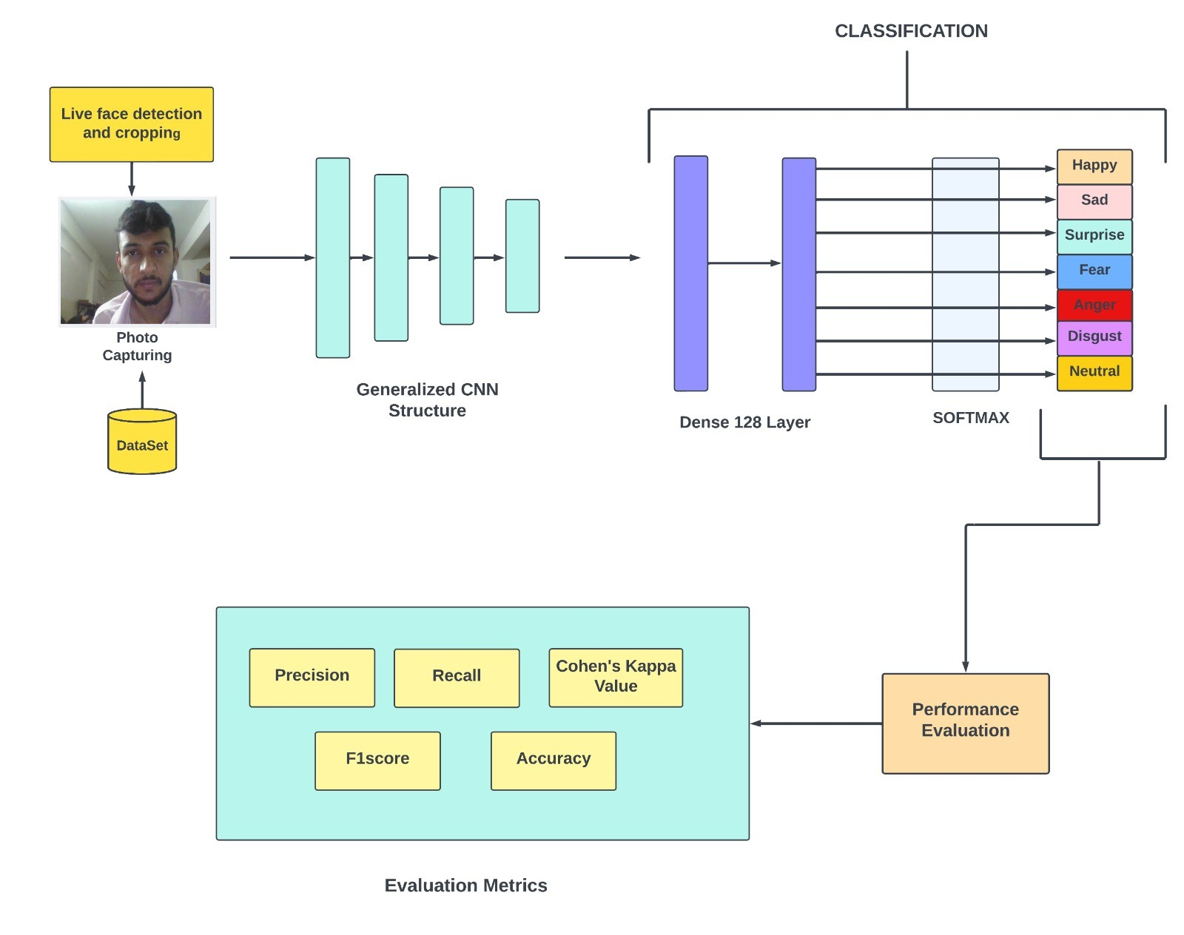
ARCHITECTURE .
This research aims to utilise a model comprising of CNN, Haar Cascade, Conv2d, Maxpool2d and Dense layers to detect and identify emotion through facial traits and expressions.
The system will utilise facial detection technology in conjunction with deep convolutional neural networks (CNN) to accurately recognise and analyse the emotions of the user.
The proposed system will use a pre-existing playlist or a custom one to generate a subset of songs that match the user's emotions.
The central idea behind the model is to efficiently identify facial emotions and suggest suitable songs with accuracy.

Slide 5
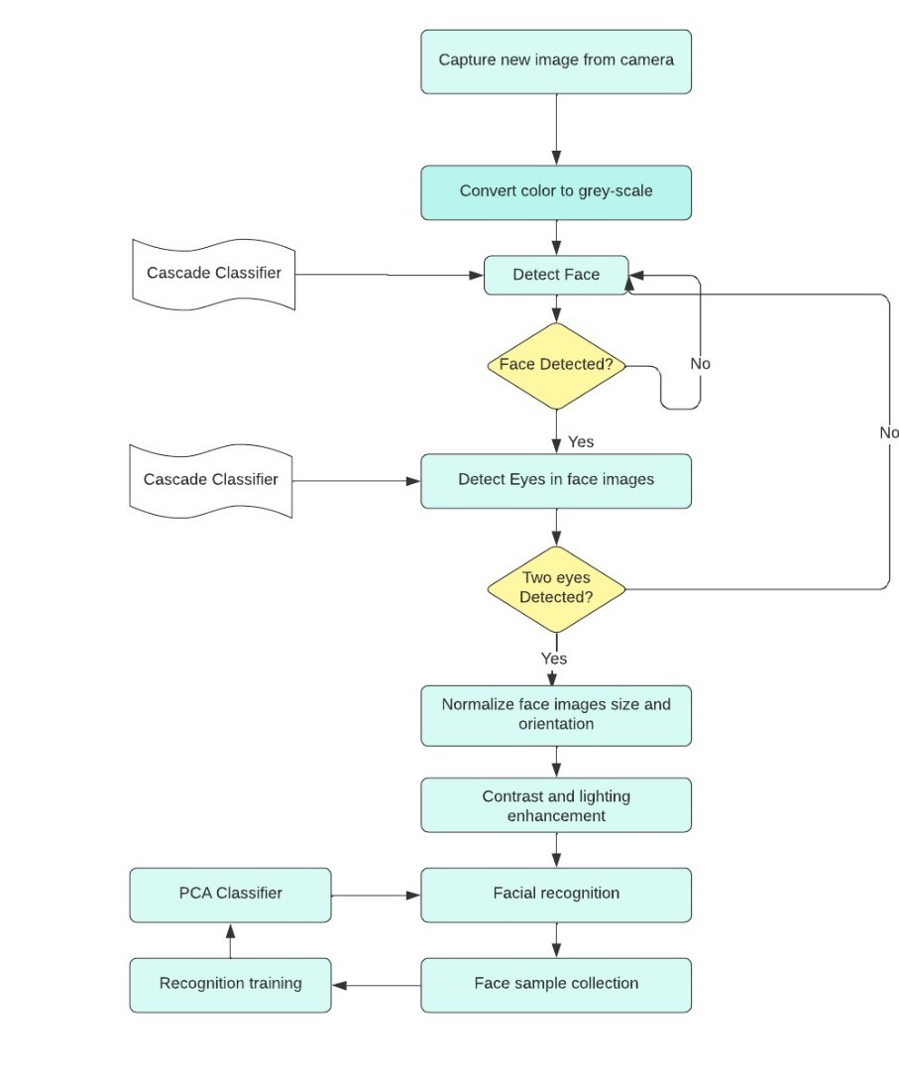
WORKING.
The model is designed to receive an input image measuring (48, 48), and generate an output vector of size (0,6).
This vector represents the probability distribution of the seven fundamental human expressions such as anger, surprise, happiness, disgust, sadness, fear, neutral detected in the input image.
The model's Conv2D layers are responsible for feature extraction from the input image.
The Dropout layer tackles this problem by randomly dropping out a portion of the neurons in the layer during training.
The model's last Dense layer utilizes 'SoftMax' activation, which standardizes the output vector to produce a probability distribution over the 7 emotions.
The model successfully shows very good accuracy, which is deemed appropriate for real-world applications.

Slide 6
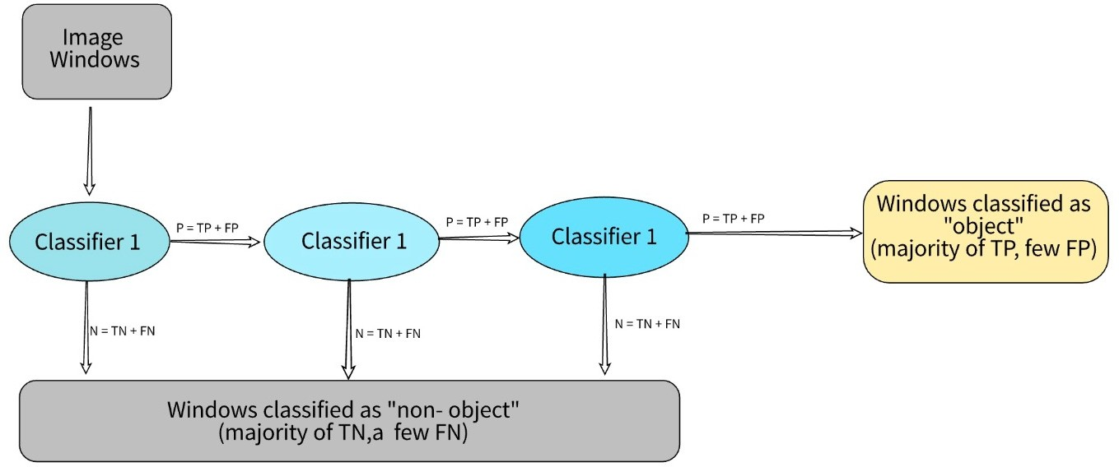
Face Detection Using Haar Cascade Method.
The Haar Cascade(Voila Jones) method is an object detection technique used in computer vision to identify objects of interest within an image.
It is based on the concept of Haar features, which are small, rectangular features that can be extracted from an image.
The Artificial Intelligence model is trained using positive along with negative examples of the subject to be identified.
The positive side includes images containing the object on the other hand negative includes images the area other than the object.
The calculation of Haar feature is done using the difference of sum of pixel values in two rectangular regions.

Slide 7
CONCLUSION AND FURTHER WORK
This study sheds light on the intricate connection between music and emotions, suggesting that by utilizing facial expression data, music recommendation systems could provide more personalized and meaningful recommendations.
In conclusion, facial emotion recognition using Conv2D layers, OpenCV and Python TensorFlow libraries is a promising approach to accurately identify human emotions. The model architecture consisting of Conv2D layers with different filter sizes, pooling layers, and a final dense layer with 'softmax' activation has demonstrated satisfactory accuracy in identifying the seven basic emotions.
Overall, the combination of Conv2D layers, pooling layers, and Haar Cascade Method provides a robust and accurate system for facial emotion recognition. While there is always room for improvement, this approach is a valuable step towards creating more sophisticated and reliable emotion recognition systems that could have practical applications in fields such as psychology, marketing, and artificial intelligence.

