Slide 1
“There are few injustices deeper than the denial of an opportunity to strive or even to hope, by a limit imposed from without, but falsely identified as lying within.”
Stephen Jay Gould

Slide 2
Introducing the STEMM Role Models Database

Slide 3

Stereotype threat
Notes:
Girls can’t do maths
Give them a test of spatial rotation – boys do better.

Slide 4
Imposter syndrome

Slide 5
Role models

Slide 6
Mentors vs Champions

Slide 7





Rosalind Franklin Appathon

Slide 8
The problem
Notes:
* Women and other minorities are less likely to be invited to speak at academic and tech conferences
* Women are less likely to promote themselves: they are more likely to suffer from the imposter syndrome
* It's difficult for conference organisers to know how good an invited speaker will be if they haven't seen them present before
So, if even the very best intentioned conference organisers (who know the powerful and supportive effects that seeing a diverse panel of presenters have for under-represented groups) have mostly seen presentations by (straight, white, cis-gendered) men then they're likely to invite men again. And so the cycle continues.

Slide 9
The solution

Slide 10
STEMM Role Models website/app/database

Slide 11
Inspire future generations by providing the most exciting and diverse speakers for your conference.

Slide 13
Role models
Caring responsibilities
Person with a disability
LGBTQ
Woman
Non-traditional career path
Person of colour

Slide 14
Testimonials

Slide 15
Batch uploader

Slide 16

Open development

Slide 17
How can you help?
www.stemmrolemodels.com
www.github.com/KirstieJane/STEMMRoleModels

Slide 18
How can you help?
Help turn our design into a working website
Write/edit applications for funding
Suggest appropriate search terms
Spread the word
Help build the database
Write/edit instructions for users
Feedback on inclusive language
www.stemmrolemodels.com
www.github.com/KirstieJane/STEMMRoleModels

Slide 19
Everyone is welcome
www.stemmrolemodels.com
www.github.com/KirstieJane/STEMMRoleModels

Slide 20
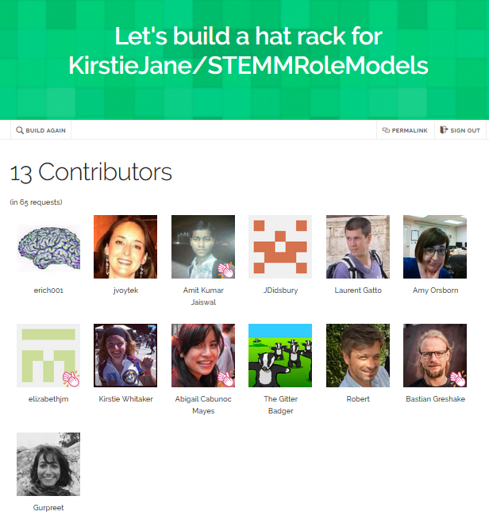
A place to hang your hat
https://hawthornlandings.org/
2015/02/13/a-place-to-hang-your-hat/

Slide 21




Thank you!
www.stemmrolemodels.com
KirstieJane/STEMMRoleModels
@kirstie_j
doi: 10.6084/m9.figshare.3188422

