Slide 1
Autonomous lawnmower
The easiest way to cut your grass
No more trouble with grass...
Adedamola AWESU - Ajay Kumar CHITTIMILLA - Chinmay KAUL - Divya PATEL - Neenu THANKACHAN - Omar Sherif Ahmed Sayed GHONEIM - Swathmika VENKATAPATHI – Sanjay VARADHARAJAN – Antoine FAUCONNIER -Vinay Maruti GARADE

Slide 2
Summary
1. Introduction
2. Solution
3. Technical part
4. Demonstration
5. Conclusion

Slide 3
1. Introduction
Team presentation – The issue

Slide 4
Introduction
Team presentation
Project Manager
Chinmay Kaul
Antoine Fauconnier
Software Engineer
Adedamola Awesu
Ajay Kumar Chittimilla
Hardware Engineer
Vinay Garde
Omar Ghoneim
Swathmika Venkatapathi
Test Engineer
Divya Patel
Neenu Thankachan
Sanjay Varadharajan

Slide 5
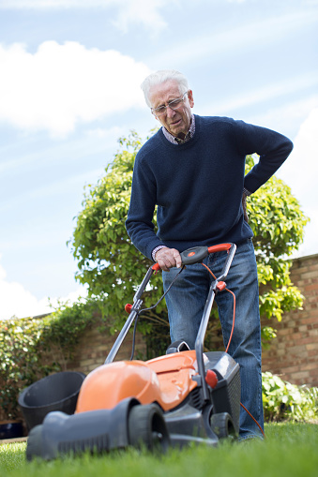
Introduction
What is the issue ?
Cutting grass is tiring and annoying. Moreover, we have to cut it again every week or two weeks. So we thought about a autonomous lawnmower.
Functionalities needed:
cut grass
Avoid obstacles
Recognize grass color

Slide 6
2. Our solution
Our robot – Different package

Slide 7
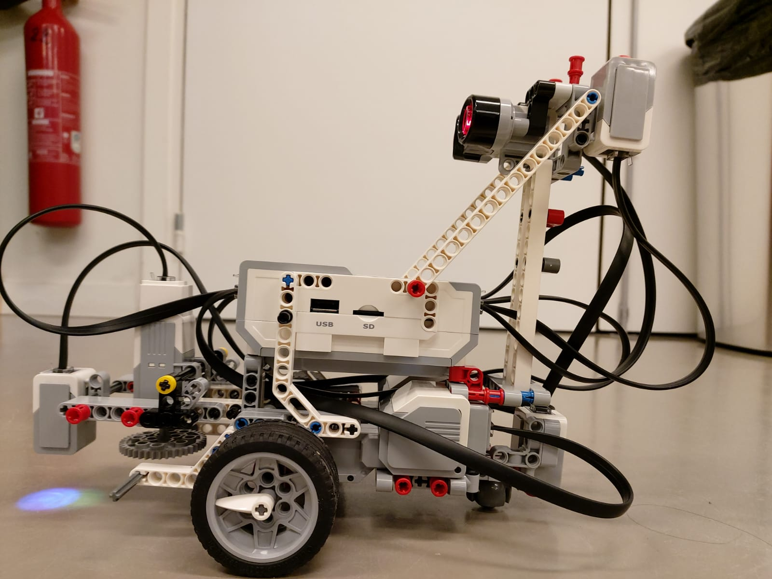
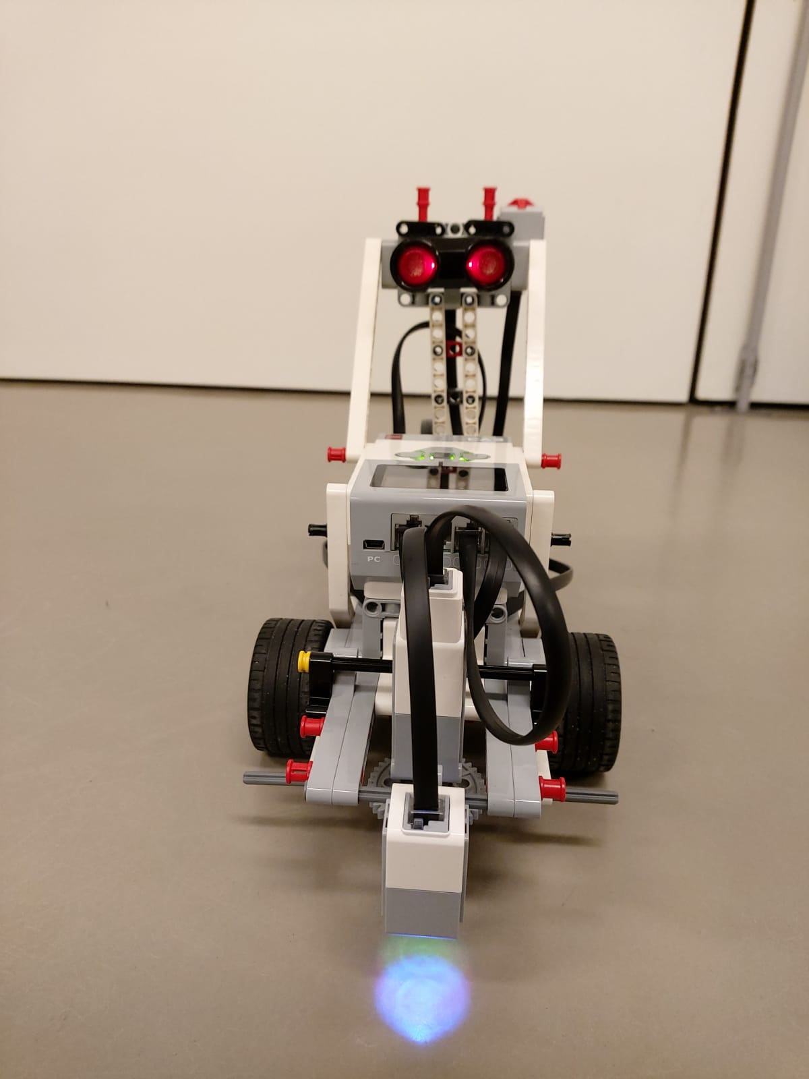
Our robot

Slide 8
What is our solution ?
BRONZE
SILVER
GOLD
Available:
Move forward in a predefined manner.
Cutting grass.
Not available:
Detect grass level.
Avoid obstacles .
Available:
Move forward
Cutting grass.
Avoid obstacles
Reconize color
Not available:
Collect the grass
Going back to the base
Available:
Move forward
Cutting grass.
Avoid obstacles
Reconize color
Collect the grass
Going back to the base

Slide 9
3. Technical Part
How we did it ? - Diagram

Slide 10
How we did it ?
Move, turn, avoid obstacles:
2 motors → Wheels
1 IR Sensor → Avoid obstacles
Cutting the grass:
1 motor
Stopping the device:
Touch sensor

Slide 11
How we did it ?
Grass cut around it:
1 touch sensor → To recognize tall grass to small ones
Recognize red color:
1 color sensor → Recognize Red color to avoid get out of limits

Slide 12
Diagram
Turn left/right
IR SENSOR
LEFT WHEEL MOTOR
Turn left/right
COLOR SENSOR
CONTROLLER
RIGHT WHEEL MOTOR
TOUCH BUTTON
Stop the device
TRIMMER MOTOR
ANOTHER TOUCH BUTTON
Action on Trimmer motor

Slide 13
4. Demonstration
Video

Slide 14
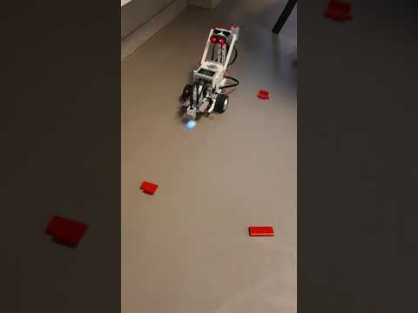
Video

Slide 15
5.Conclusion
Difficulties - Next Step

Slide 16
Challenges
Clear distinction between different colors
Choosing the best design to turn right or left
Rotate our Robot to exactly 90 degrees

Slide 17
Next Step
Collect the grass
Reconize green color
GPS use

Slide 18
THANK YOU

