Slide 1
Project Presentation of CO-OP Project at Industry (Module-2) (22CS421)
On
A Comparative Analysis of Remote vs. In-Office Work Models on Employee Productivity and Well-being
Team Members
Ajay Kumar 2210991210
Manav Singh 2210990553
Ankit Garg 2210991378
Sahil Bansal 2210992219
Supervised By: Dr. Preeti Saini
Department of Computer Science and Engineering,
Chitkara University, Punjab

Slide 2
Introduction
The modern workplace has evolved significantly due to digital technologies and flexible work culture.
The COVID-19 pandemic accelerated the adoption of remote and hybrid work models globally.
Organizations are now balancing productivity, collaboration, and employee well-being.
Choosing the right work model has become a strategic challenge for companies.
Project Focus
Remote Work
In-Office Work
Hybrid Work
based on:
Employee Productivity
Workplace Well-being
Work–Life Balance
2

Slide 3
Problem Statement & Objectives
Problem Statement
Organizations lack a clear comparative understanding of different work models.
Some studies focus only on productivity, while others focus on well-being.
Companies need evidence-based insights to design future work policies.
Objectives
Compare productivity across remote, in-office, and hybrid work.
Analyze employee well-being and work–life balance.
Conduct survey-based validation using respondent data.
Propose the most effective work model for long-term sustainability.
3

Slide 4
Research Methodology
Mixed-Method Research:
Secondary Research (Research Papers & Industry Reports)
Primary Research (Survey of 50 Respondents)
Data Sources
Peer-reviewed papers (2022–2025)
Industry reports (McKinsey, Stanford, etc.)
Online survey responses
Evaluation Metrics
Productivity Score
Well-being Score
Combined Performance Score
Tools Used
Python (Data Analysis)
Microsoft Excel
Google Forms
Matplotlib (Graphs & Charts)
4

Slide 5
Proposed Solution
Find My Buddy provides:
Event creation and management system
Smart event search using Elastic Search
Geolocation-based nearby event recommendations
Secure user authentication
Real-time chat between participants and creators
Workflow of the System
User Registration/Login
Create or Explore Events
Smart Event Recommendation
Join Event
Real-Time Chat & Interaction
Build Meaningful Connections
5

Slide 6
Proposed Hybrid Model
Model Overview
3 Remote Days → Focused individual work
2 In-Office Days → Collaboration & team interaction
Advantages
Remote Days:
Better concentration
Flexible schedule
Reduced commuting stress
Office Days:
Team collaboration
Mentoring & communication
Stronger team bonding
Why Hybrid?
The hybrid model combines: ✔ Productivity benefits of remote work ✔ Well-being benefits of office work
6

Slide 7
Comparative Analysis & Results
Performance Comparison
Work Model | Productivity | Well-being | Combined Score
Remote | 8.5 | 6.0 | 7.25
In-Office | 6.5 | 7.0 | 6.75
Hybrid | 9.0 | 8.5 | 8.75
Key Findings
Remote work gives higher productivity but lower well-being.
In-office work improves collaboration but reduces flexibility.
Hybrid work achieves the best balance between both.
Employee retention and overall job satisfaction are highest when a balanced, hybrid model is implemented.
Clear communication strategies are essential in flexible environments to prevent digital burnout and protect employee mental health.
7

Slide 8
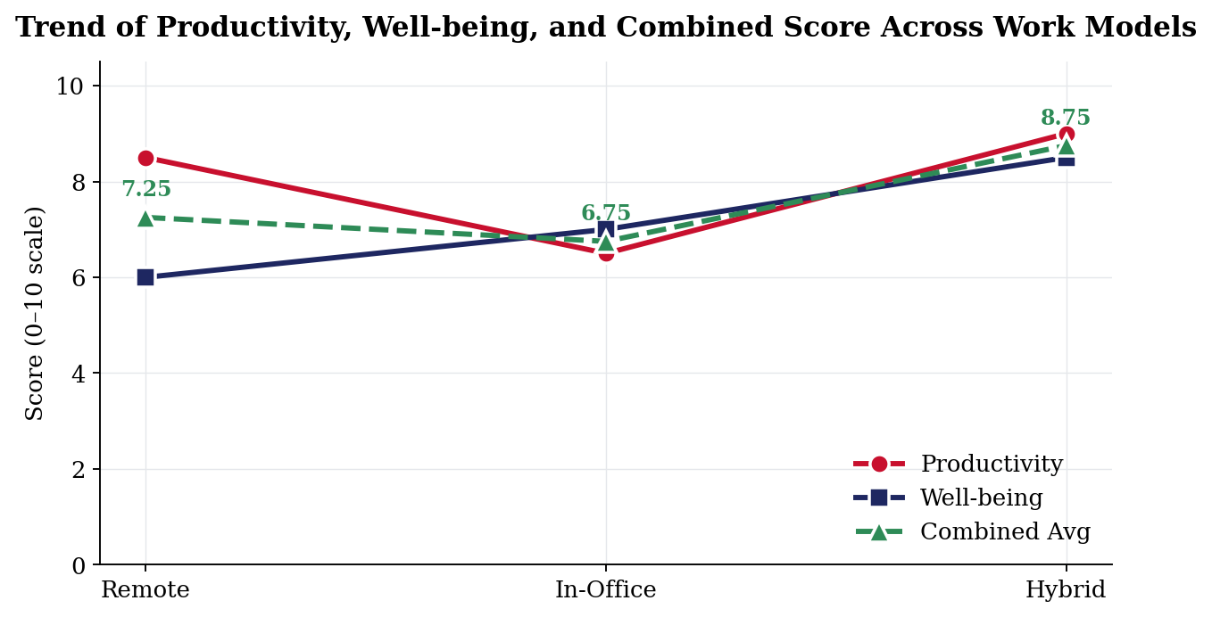
Bar Graph
8

Slide 9
Survey Analysis
Survey Results (50 Respondents)
Work Preference | Percentage
Hybrid | 68%
Remote | 22%
In-Office | 10%
Analysis
Majority of respondents preferred Hybrid Work.
Employees value both flexibility and collaboration.
Hybrid work is considered the most sustainable future work model.
A balanced schedule positively impacts overall employee well-being and reduces burnout.
Self-reported productivity levels remained stable or increased within a flexible environment.
9

Slide 10
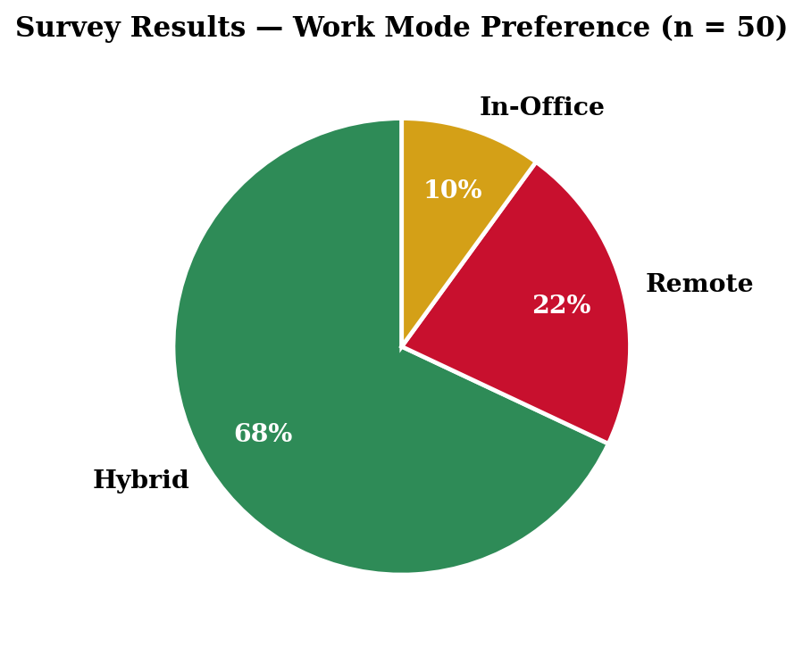
Pie Chart
10

Slide 11
Conclusion & Future Scope
Conclusion
No single pure work model is completely effective.
Remote work improves focus but reduces social interaction.
In-office work improves collaboration but creates stress and distractions.
The proposed 3:2 Hybrid Model provides the best overall performance.
Future Scope
AI-based employee productivity analysis
Industry-wise hybrid model research
Large-scale employee surveys
Smart collaboration tool integration
Mental health and burnout tracking systems
11

Slide 12
Thank You
12

