Slide 1
Birthday Remainder Bot
Department :Computer Technology
Team name :Squad Patriods
Teammates: Naveen,Ajay,Dharshini,Kanishkaa,Jayaris Raghav

Slide 2

Description
We can’t remember everyones birthday in our contact.

Slide 3
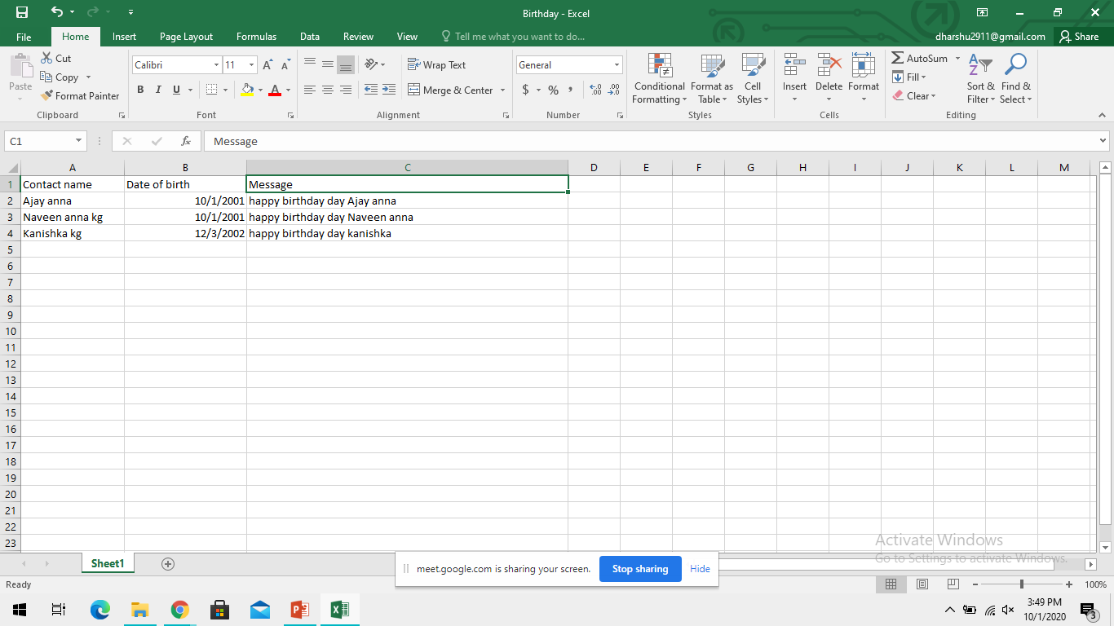
Getting Info
Gathering informations(Date Of Birth) of our contacts in excel.

Slide 4
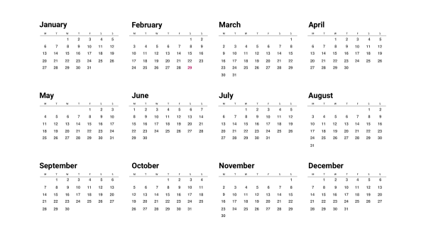

Remainder Bot
If anyones birthday matches with system date then the bot will ping a remainder.

Slide 5

Pros
Life becomes more easy having one bot created for self use.

Slide 6

Cons
If we use this we will not able remember the birthday of our special ones.

Slide 7
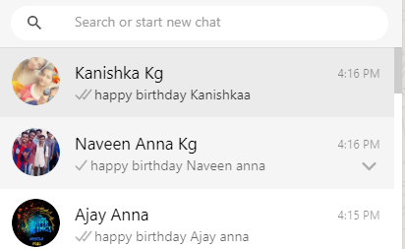
Expected Output

Slide 8
THANK YOU

