Slide 1
Behavioral Design Patterns
by Umar Lone

Slide 2
Requires
Basic knowledge of object oriented programming
Target Audience
Students who want to learn & understand basics of design patterns
Software developers, designers, who want to learn & implement patterns in their code

Slide 3
Objectives
Understand what design patterns are
How design patterns solve common design problems
Apply design patterns

Slide 4
Instructor
Umar Lone
C++, STL, Java, C#, Android, Unity, Design Patterns, Win32 API, MFC, COM, ATL, Boost, Linux…
B.E. Civil
Poash Technologies

Slide 5
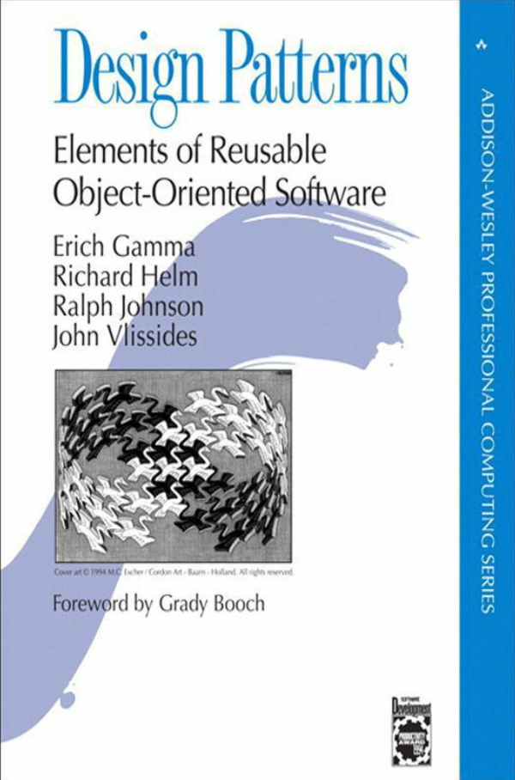
Design Patterns
Published in 1995
Known as Gang Of Four Design Patterns
Describes solutions to common OO design problems
Examples in Smalltalk & C++
Implemented directly in some languages

Slide 6
What is a pattern?
Language & domain independent strategies for solving common object-oriented design problems
These problems are recurring and can appear in all kinds of applications, irrespective of their language or platform
Patterns provide suggestions – different ways to solve these common problems

Slide 7
What is a pattern?
Developers can use these suggestions as guidelines to create solutions for their problems
The proposed solution can have different implementation alternatives, depending on the programming language, framework or specific platform

Slide 8
Catalogue
 |  | Creational | Structural | Behavioral
Scope | Class | Factory Method | Adapter(class) | Interpreter Template Method
 | Object | Abstract Factory Builder Prototype Singleton | Adapter(object) Bridge Composite Decorator Façade Flyweight Proxy | Chain Of Responsibility Command Iterator Mediator Memento Observer State Strategy Visitor

Slide 9
Pattern Structure
The original book on design patterns uses OMT
It depicts relationships between classes that make up the pattern
However, it was replaced with UML in 1996, therefore, is no longer used
It is important to understand class notations to understand the structure of the pattern

Slide 10
Class
ClassName
Attribute
Attribute
ClassName
Operation
Operation

Slide 11
Class
Account
no
name
balance
GetBalance
Withdraw
Deposit

Slide 12
Inheritance (Generalization)
Account
Savings
Current

Slide 13
Abstract class
Shape
Draw()
Line
Circle
Draw()
Draw()

Slide 14
Composition
Window
Button
Paragraph
Sentences

Slide 15
Aggregation
Training
Student
Car
Passenger

Slide 16
Association
Application
uses
Database
Driver
drives
Car

Slide 17
Note
Circle
radius
PI
position
Must be constant
Radius()
Circumference()
PositionX()
PositionY()

Slide 18
Behavioural Patterns
Most used patterns
Deal with the behaviour & interaction of objects
Help define complex control flow between objects
But you only have to concentrate on interconnection between objects
Allows classes & objects to be loosely coupled, yet still interact with each other
Reduce dependencies in code
Some behavioral patterns are implemented through inheritance which distributes behavior between different classes
Most of them are implemented through composition and this helps us define a group of objects that cooperate to perform a task

Slide 19
Strategy Pattern
A function or class may provide different implementations of a behavior through conditional statements
If a new implementation has to be added, the existing code must be modified
Over a period, the code becomes hard to understand & maintain
Violates open-closed principle
Notes:
Different compression libraries are available. Some give best results when compressing binary data while other work better when compressing documents with images. The following libraries are available
Unrarlib – gives support for RAR archives created through WinRAR
DjVuLibre Document and Image Compression Library – specifically designed for compressing documents with images
libmspak – gives support for archives created through Microsoft’s compress.exe utility. Works with cabinet files, compiled HTML, etc

Slide 20
Strategy Pattern
Each implementation can be thought of as an algorithm
The behavior of algorithms is same, but their implementation is different
Such algorithms are taken out and encapsulated inside separate classes, in addition to inheriting from a common class
Such classes are known as strategies or policies
Policy is the alternative name for this pattern

Slide 21
Define a family of algorithms, encapsulate each one, and make them interchangeable. Strategy lets the algorithm vary independently from clients that use it

Slide 22
Structure
Context
Strategy
ContextInterface()
AlgorithmInterface()
ConcreteStrategyA
ConcreteStrategyB
ConcreteStrategyC
AlgorithmInterface()
AlgorithmInterface()
AlgorithmInterface()

Slide 23
Implementation
Each algorithm is separated and put in its own class
The Context uses the concrete strategies through the Strategy interface
The strategies can be specified at runtime
Called dynamic strategies
This promotes loose coupling between the Context & a strategy

Slide 24
Implementation
Strategies will require data to operate from the Context
The data can be pushed when the Context uses a strategy
Although not all strategies may use all the data
Or the strategies can pull the data from the Context
Context can pass itself as the argument when calling a concrete strategy

Slide 25
Strategy
DataModel
Export()

Slide 26
Implementation
A strategy may not always be available
Context class may have to perform a null check and provide
a default implementation, or
a do-nothing behavior
Since, both require a null check through a conditional statement, it can make the code hard to understand

Slide 27
Null Object Pattern
An alternative to null check
It is a default strategy that the Context class uses automatically when the clients don’t specify a custom strategy
Has a default or do-nothing behavior
Simplifies the code & makes it readable as the conditional null check is not required
Can be singleton as it may not have a state

Slide 28
Static Strategy
Strategy classes can be implemented as class templates
Don’t require a common base class, only same function signature
Can be used when
the strategy can be selected at compile time
it does not have to be changed at run time

Slide 29
Dynamic Vs Static Strategy
Can be selected at both compile & run time
Can be replaced at run time
Implemented through virtual mechanism
Slow due to dynamic nature
Requires null checks
Can be selected only at compile time
Cannot be replaced at run time
Implemented through templates
Fast due to static nature
Does not require null checks

Slide 30
C++ Implementation
If strategy implementation is small, then it does not need to be a class
It can be implemented as a
Function
Functor
Lambda expression
No need to have a hierarchy of classes
But no OO advantage with function pointers
Use std::function<> to wrap any callable for flexibility without relying on templates explicitly

Slide 31
Performance
Using templates for strategies is preferable in C++
Templates are instantiated at compile time
Compiler can apply optimizations e.g. a function object can be inlined when instantiated as a template
The C++ standard library uses templates as strategies in most algorithms

Slide 32
Pros
Provides a family of algorithms that can be reused by the Context
Alternative to inheritance
Uses composition instead
Allows the algorithm to change independently of the Context
Alternative to conditional statements
indicate the need to apply the Strategy pattern
existing code need not be modified

Slide 33
Pros
Each strategy provides a different implementation of the same behavior
Clients can choose an implementation with trade-offs in time & space

Slide 34
Cons
The number of classes increase in the application
The client must understand how the strategies differ and which one to choose
Not all strategies may use all the data that a Context passes to them

Slide 35
When to use
Use when
a class is tightly coupled with different algorithms
convert into strategies
you need different variants of an algorithm
many behaviours of a class are represented through conditional statements
®

Slide 36
Template Method
Applicable to algorithms that should be customizable
varies an algorithm, but not the entire algorithm
However, allows the algorithm to be modified only at fixed points
These customization points are called hooks
This is achieved by defining the skeleton of the algorithm in a method called Template Method
Somewhat similar to Strategy Pattern
Strategy changes an entire algorithm, Template Method changes some parts of the algorithm

Slide 37
Base Class
Template Method
Algorithm Structure
Customizable Steps
(Hooks)
Fixed Steps

Slide 38
Define the skeleton of an algorithm in an operation, deferring some steps to the subclasses. Template Method lets subclasses redefine certain steps of an algorithm without changing the algorithm’s structure

Slide 39
Structure
AbstractClass
TemplateMethod()
PrimitiveOperation1()
PrimitiveOperation2()
…
PrimitiveOperation1()
…
PrimitiveOperation2()
…
ConcreteClass
PrimitiveOperation1()
PrimitiveOperation2()

Slide 40
Implementation
The base class defines the structure of the algorithm in a method
This method is called the Template Method as it defines the skeleton of the algorithm
This gives control over
number of steps
order of steps
These steps are a series of operations (function calls)

Slide 41
Implementation
The operations inside this method represent steps that
may be fixed
must be overridden
or may be optional
The Template Method itself should not be overridden
Calls to these operations leads to an inverted structure
the base class calls the child class methods
Gives partial control to the subclasses

Slide 42
Implementation
Operations that must be overridden are declared abstract or pure virtual
subclasses are forced to implement them
Optional operations are simply virtual and provide a default behavior (often empty)
These operations are also called hooks
A hook provides a way for the subclasses to provide their own implementation by overriding
optionally call the parent class behavior

Slide 43
Implementation
The operations can be functions that are concrete, virtual or abstract/pure virtual or belong to other classes
Number of operations in a template method should be kept minimum
Too many operations will make it tedious for the subclasses
To identify the operations that should be overridden, you can add a prefix to their names

Slide 44
Implementation
To use a specific customization, the client will create the instance of the corresponding class & invoke the template method
The clients only call the template method and not the operations it provides
The operations can be declared protected to prevent the client from directly calling them
Note, this pattern relies on inheritance & distributes the responsibilities in several classes
Another way of implementing the open-closed principle

Slide 45
Pros
Template Method factors out common behavior in library classes
Prevents code duplication
A class designer can allow partial customization of the class behavior
Notes:
Also called the “Hollywood Principle”, “Don’t call us, we’ll call you”
Template methods can call the following kinds of operations
concrete operations
concrete Abstract class operations
primitive operations
s
hook operations

Slide 46
When to use
Use when
you want to avoid code duplication in a class hierarchy
you need to provide a way to customize some part of your class’s behavior
you want to control how subclasses extend your class

Slide 47
Strategy & Template Method
Uses composition to vary an algorithm
The whole algorithm changes by changing the strategy
Used when the entire behavior has different implementations
New algorithms can be created by defining new classes
Replacement for if-else, switch case statements
Uses inheritance to vary an algorithm
Only the part of algorithm changes
Used when some steps of algorithm can have different implementations
The algorithm can be changed only at fixed set of points(hooks)
Avoids code duplication by factoring out the common code in parent class

Slide 48
Known Uses
Template Method is very common in libraries and frameworks
In MFC, CView::OnPaint() is a Template method that calls a primitive operation called OnDraw() which must be overridden by the subclasses
During serialization, CDocument::OnSaveDocument() calls the derived classes’ Serialize() method for document. Serialize() method represents a hook because it is only declared as virtual. If serialization support is not required, you don’t need to override it.

Slide 49
Invoker
Receiver
Function1() ;
Function2() ;
Function3() ;
Function1
Function2
Function3
Module A
Module B

Slide 50
Invoker
Receiver
fnptr = GetFunction() ;
fnptr() ;
Function1
Function2
Function3
Module A
Module B

Slide 51
Encapsulate a request as an object, thereby letting you parameterize clients with different requests, queue or log requests, and support undoable operations

Slide 52
Structure
Client
Invoker
Command
Execute()
Receiver
ConcreteCommand
receiver
Action()
Execute()
Receiver->Action();
state

Slide 53
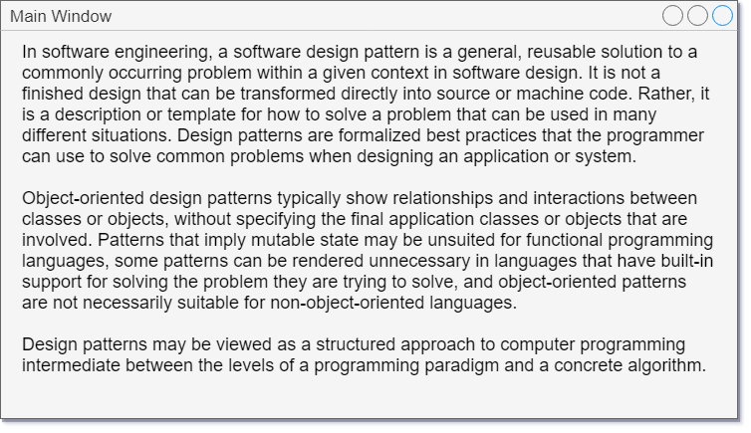
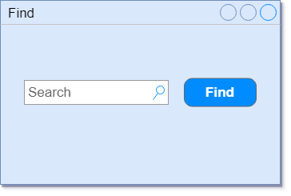
Example
Command
Receiver
Invoker

Slide 54
Example
Menu
Application
Add
Remove
Insert
Overwrite
Bold
Colorize
AddText
RemoveText
InsertText

Slide 55
Implementation
The main responsibility of the command object is to decouple the invoker & receiver
Additionally, it can
perform all the operations itself without forwarding the calls to the receiver
just forward the call to the receiver
performs some operations and then forward the call to the receiver
Sometimes, the Receiver itself can act as a command
especially if it just wants to handle the request

Slide 56
Implementation
Commands can be used to implement
undo & redo system in an application
transactions that can be rolled back
macro or composite commands
queuing of command objects

Slide 57
Implementation
Commands can support undo and redo
These operations can be implemented by storing state
the Receiver object
the arguments passed to the receiver for the action
original values in the Receiver that can change as a result of the action
One level of undo will require the application to store only the last executed command

Slide 58
Implementation
For multiple levels of undo/redo, the application needs to store the history of the commands in a list
This list has to be traversed backwards in order to reverse the effect of command execution
for redo, the list needs to be traversed in forward direction
Copies of existing commands have to be stored to implement undo/redo
these can act as prototypes
The receiver must provide operations that let the command return the receiver to its prior state

Slide 59
Implementation
If the receiver is not a class, then function pointers can be used as commands
However, undo/redo implementation will become more complex
Use the memento for storing the state since commands are not objects
Certain C++ features can help in implementing this command easily e.g. templates, std::function, std::bind
Especially if undo/redo functionality is not required

Slide 60
Basic Example
Client
Invoker
Command
Execute()
Receiver
ConcreteCommand
receiver
Action()
Execute()
Receiver->Action();
state

Slide 61
FindDialog Example
Client
FindDialog
Command
ExecuteFind()
MainWindow
ExecuteFind()
wnd->ExecuteFind ();
state

Slide 62
TextPad Example
Client
Menu
Command
Execute()
Application
CommandAdd
receiver
AddText()
Execute()
m_pApp->AddText();
state

Slide 63
DataList Example
Client
Menu
Command
Execute()
DataList
children
receiver
Sum
Macro
Sum()
Execute()
Execute()
Add(Component)
forall cmd in children
cmd.Execute() ;
state
m_pList->Sum();

Slide 64
Pros
The invoker and the handler are loosely coupled through the command object
reduces dependency
Commands are objects, therefore can be extended
create variations of commands
Command objects can be assembled
macros can be implemented as composite commands
New commands can be added without changing existing classes

Slide 65
When to use
Commands are object-oriented replacement for callbacks
procedural languages can use function callbacks to implement commands
Use for queuing requests to be executed at different times
the receive can exist in a different address space and the command object can be transferred to execute there
Create macro commands
Use for implementing undo and redo
command object can store undo & redo state

Slide 66
When to use
Can be used for transactions
command object can encapsulate a set of changes to data
In case of a failure, the system can be reverted to original state

Slide 67
Without violating encapsulation, capture and externalize an object's internal state so that the object can be restored to this state later

Slide 68
Memento Pattern
This pattern defines three classes with distinct roles
Originator – the object that knows how to save itself
Caretaker – the object that knows why and when the Originator needs to save and restore itself
Memento – the opaque object that is written and read by Originator and used by the Caretaker to save the Originator’s state
The Caretaker will not be able to modify the state of the Memento and should not do so

Slide 69
Structure
memento
Originator
Memento
Caretaker
SetMemento(Memento m)
CreateMemento()
GetState()
SetState()
state
state
state=m.GetState()
return new Memento(state)

Slide 70
Collaboration
aCaretaker
anOriginator
CreateMemento()
<<create>>
CreateMemento()
aMemento
SetState(state)
Return Memento
SetMemento(aMemento)
GetState()
<<destroy>>

Slide 71
Implementation
Memento has a wide interface for the Originator and a narrow one for the Caretaker
A wide interface allows the Originator to create and initialize a Memento with some state
The narrow interface consists of methods that allow other classes to manage the Memento
Only the narrow interface must be part of the public interface
In C++, only the narrow interface can be public; all others can be private

Slide 72
Implementation
Mementos can consume lot of memory
In some cases, it may be possible to just store incremental changes of the Originator’s state instead of storing the entire state
Mementos can be stored in a file through serialization
This is useful when the object has to be restored in a different address space (e.g. game checkpoints)

Slide 73
Structure
memento
Originator
Memento
Caretaker
SetMemento(Memento m)
CreateMemento()
GetState()
SetState()
state
state
state=m.GetState()
return new Memento(state)

Slide 74
Account
records
Account
BalanceMemento
BalanceRecord
SetMemento(Memento m)
CreateMemento()
m_Balance
m_Balance
m_Balance=m.GetState()
return new BalanceMemento(m_Balance)

Slide 75
Hangman
checkpoints
Hangman
GameState
CheckpointManager
SetMemento(GameState m)
CreateMemento()
state
state
state=m.state
return new GameState(state)

Slide 76
Pros
Memento avoids exposing internal state of the Originator which otherwise must be exposed for storing the state
Originator is kept simple and does not need to focus on storing different versions of the state itself
Provides easy-to-implement recovery capability
The Caretaker itself is responsible for deleting the mementos it cares for

Slide 77
Cons
If the Originator has large amount of state, then using the Memento might be expensive
It may be difficult to restrict the access to Memento’s state only by Originator
Caretaker has no idea of how much state the Memento holds, so it might incur storage costs while storing the Mementos

Slide 78
When to use
Use the Memento pattern when
You want to manage an object’s state without exposing its internal details
You want to add undo/recovery capability to a class so that its state can be restored

Slide 79
Chain Of Responsibility
Just like Command, this pattern also reduces coupling between the sender of a request and the objects that can handle it
One major difference is that there may be multiple objects that can handle the requests
It may not be possible to couple the sender with multiple handlers
The handlers may not be known until runtime
Sender is not interested in know how many handlers can handle its request
The handlers don’t want to deal with dispatching logic that decides which handler should handle the request

Slide 80
Chain Of Responsibility
Instead of coupling the sender with multiple handlers, we can create a chain of handlers
Each handler will have a link to its successor
This will form a chain and this chain is referred to as chain of responsibility
The sender will send a request only to the head of the chain
If a specific handler cannot handle the request, it will automatically propagate to the next handler
This process will repeat until the request reaches a handler capable of handling it
Exception handling example

Slide 81
Avoid coupling the sender of a request to its receiver by giving more than one object a chance to handle the request. Chain the receiving objects and pass the request along the chain until an object handles it

Slide 82
Structure
successor
Client
Handler
HandleRequest()
ConcreteHandler1
ConcreteHandler2
HandleRequest()
HandleRequest()

Slide 83
Collaboration
aSender
handler1
handler2
handler3
Request()
Request()
Request()

Slide 84
Implementation
Each handler requires a successor
Successor chain can be implemented by defining links in the Handler class
The requests are usually simple function calls
For complex requests, a parameter can be passed that may contain information about the request
To avoid the request from falling off the chain, use a null object

Slide 85
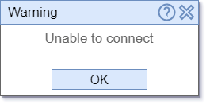
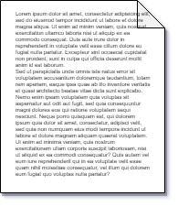
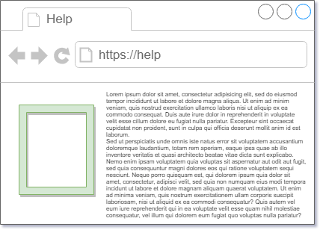

Help System
Help System
Request help
Local Help
Online Help
Quick Help

Slide 86
Structure
successor
Client
Handler
HandleRequest()
ConcreteHandler1
ConcreteHandler2
HandleRequest()
HandleRequest()

Slide 87
Help System
m_pNext
Button
HelpHandler
ShowHelp()
QuickHelp
LocalHelp
ShowHelp()
ShowHelp()

Slide 88
Logging System
m_pNext
Application
Logger
Log()
FileLogger
DbLogger
Log()
Log()

Slide 89
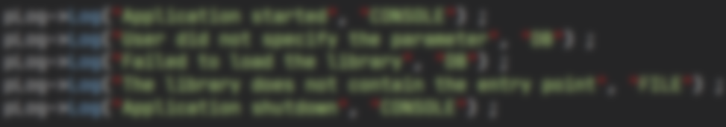




Logging System
File Logger
Database Logger
Console Logger
Null Logger

Slide 90
Pros
Sender does not have now about all the receivers
It only knows about the head of the chain.
This makes it easy to change the chain.
The sender is free from knowing which receiver handles a request.
Sender and receiver have no explicit knowledge of each other.
Sender and receiver are independent of the structure of the chain

Slide 91
Pros
Responsibilities can be distributed among objects
Responsibilities can be added or changed by changing the chain at runtime
Notes:
Since a request has no explicit receiver, there’s no guarantee it’ll be handled – the request may fall off the chain without ever being handled (usually happens in chains that are not configured correctly)

Slide 92
Cons
A misconfigured chain may lead to a request falling off the chain without ever being handled

Slide 93
Decorator
Chain Of Responsibility
Add more behaviors to an object at runtime
All the decorators take part in adding behaviors
A decorator does not prevent other decorators from adding new behavior
Some behavior is always executed
Handle a request without specifying an explicit handler
Not all handlers may handle the request
A handler may terminate the chain anytime
There is no guarantee the request will be handled
Notes:
, thus preventing other handlers from handling the request

Slide 94
When to use
Use when
a request has to be handled, but the handler is not known and should be ascertained automatically
a request has to be issued without specifying an explicit receiver from a group of objects
the receiver should be selected dynamically
responsibilities have to be distributed among objects

Slide 95
Known Uses
Chain of Responsibility is used frequently in handling GUI events from various controls
MFC uses message mapping to handle events. If a subclass does not handle the event, the request is forwarded to the next class in the chain
In exception handling, an exception can be rethrown if a catch handler is incapable of handling the exception
Java servelet filter framework uses CoR for calling filters in the chain

Slide 96
Iterator
Iterator is simply an object that allows access to the elements inside an aggregate
An aggregate object stores other objects as elements and provides operations to add, remove or access those elements
Without this pattern, an aggregate may have to expose its underlying implementation to the user, just to allow access to the elements

Slide 97
Iterator
The aggregate itself can provide functions to access the elements, but this violates SRP
It is also difficult to modify the traversal algorithm inside the aggregate
So, there are two things
Provide access to elements without exposing implementation of the aggregate
Avoid putting the responsibility of access inside the aggregate

Slide 98
Iterator
With iterator pattern, the responsibility of traversal is put in a different class, called iterator
Iterator has knowledge of the aggregate’s internal structure and will know how to traversal the elements
Provides a uniform way to access elements inside different kinds of aggregates
Also known as cursor

Slide 99
Provide a way to access the elements of an aggregate object sequentially without exposing its underlying representation

Slide 100
Structure
Aggregate
Client
Iterator
CreateIterator()
First()
Next()
IsDone()
CurrentItem()
ConcreteAggregate
CreateIterator()
ConcreteIterator
return new ConcreteIterator(this) ;

Slide 101
Implementation
Iterators can be internal or external
Internal iterators are internally used by language constructs or libraries
Their iteration is not controlled by the user, but is controlled internally
External iterators are explicitly managed by the clients & they control their iteration

Slide 102
Implementation
The traversal algorithm may be implemented
inside the iterator itself
Or the aggregate may define this algorithm & the iterator may just hold the state (cursor)
Iterators can use static & dynamic polymorphic iteration
Null iterators can be used to represent boundary condition (called end iterator in STL)

Slide 103
C++ Implementation
Additional operations can be supported such as traversing backwards, capability to add/modify elements, etc (e.g. through iterator adapter)
Using operator overloading
traversal through overloading ++, --, += operators
modification of the data through the iterator by overloading * operator
access to underlying objects’ methods through -> operator

Slide 104
C++ Implementation
Iterators can be made friends of the aggregates so that they can have privileged access
Memory management can be handled by a proxy (smart pointer) in case of dynamic polymorphic iteration
Templates can be used for static polymorphic iteration in C++
type-safe, fast, and don’t require memory management

Slide 105

Example
ORGANISATION
Employees

Slide 106
Containers
Array
List

Slide 107
Issues
Implementation details are exposed
clients have to deal with the traversal algorithm
Array – use index
List – use nodes
Tree – use nodes

Slide 108
Issues
Inconsistent API
each container provides a different way to access its elements
Array – operator []
List – Node traversal
Tree – Inorder, preorder, postorder traversal

Slide 109
Issues
Encapsulation is violated
clients can see the internal state and modify it directly without objects knowledge
auto node = numbers.GetHead() ;
node->m_pNext = node->m_pNext->m_pNext ;
List<int>::Node * pHead = list.GetHead() ;
delete pHead ;

Slide 110
Structure
Aggregate
Client
Iterator
CreateIterator()
First()
Next()
IsDone()
CurrentItem()
ConcreteAggregate
CreateIterator()
ConcreteIterator
return new ConcreteIterator(this) ;

Slide 111
Structure
Client
Array
begin()
return Iterator{ptr} ;
Iterator
operator++()
operator *()

Slide 112
Pros
The traversal can be done in various ways by adding new iterators
an array can be traversed in reverse direction
a tree can be traversed inorder or preorder by changing the iterator
Iterators can provide more operations such as modification or addition of elements in the aggregate
Aggregates don’t need to implement the traversal algorithm.
makes their interface clean and simple.
You can have concurrent traversals on the same aggregate because each iterator has its own state

Slide 113
Pros
In C++, iterators behave like pointers, and provide common operators for easy traversal & access to elements
Consistency, ease of use
aggregates use the same interface for iteration through iterators.
easy to use different aggregates without the need to understand their internal structure
Possibility of writing generic algorithms that operate on any kind of aggregate through iterators

Slide 114
Cons
Changes to the aggregate (insertion/deletion) may invalidate the iterators
depends on the type of aggregate and the position of the iterator

Slide 115
When to use
Use the Iterator pattern to
access an aggregate without depending on its internal implementation
support concurrent traversals of aggregate objects
provide a uniform & consistent interface for traversing different aggregate structures
support polymorphic iteration

Slide 116
Observer Pattern
In an OO system, with a set of cooperating objects, you’ve to maintain consistency between them
This should be achieved without tightly coupling the classes, otherwise it will have a negative impact on reusability & extensibility
E.g. alarm system in a game
If the alarm is tripped, it notifies all the enemy NPCs in the area and they become aware of the player’s presence

Slide 117
Observer Pattern
If the alarm keeps track of all NPCs, it will get tightly coupled with them
Difficult to update/modify the alarm system
Difficult to add new NPCs
Observer pattern can be used in this situation (also known as publisher-subscriber)
Alarm is the Subject & the NPCs are the Observers
When the alarm sounds, it state will change & send a notification to NPCs
The Observers will update their state based on the notification
Flexible enough to add or remove Observers at runtime

Slide 118





Enemy Alert System
Icons made by Eucalyp from www.flaticon.com

Slide 119
Define a one-to-many dependency between objects so that when one object changes state, all its dependents are notified and update automatically

Slide 120
Structure
Subject
observers
Observer
Attach(Observer)
Detach(Observer)
Notify()
Update()
for all o in observers{
o->Update()
}
ConcreteSubject
subject
ConcreteObserver
GetState()
SetState()
Update()
return subjectState
observerState=subject->GetState()
observerState
subjectState

Slide 121
Collaboration
subject
observer1
observer2
StateState()
SetState()
Notify()
Update()
GetState()
Update()
GetState()

Slide 122
Implementation
The Subject will have a pointer/reference of each Observer stored in a list or array
Instead of one to many dependency, there could be many to many dependency i.e. one Observer may depend on more than one Subject
The notification can contain information that helps Observer identify which Subject sent the notification

Slide 123
Implementation
Who decides to raise the notification?
Client
Subject when its state is changed either externally or internally
Observer
All the observers receive a notification by default (might be undesirable in some cases)

Slide 124
Implementation
Notification is a function call and may contain parameters
These parameters can be used to represent
Data for the Observers
Subject that sent the notification
Metadata for identifying the change in the Subject
Its up to you to decide what to use the parameters for

Slide 125
Push Model
The Subject sends Observers detailed information about the change
not efficient (for large data)
not all observers may require the data
difficult to generalize data for different types of observers
Better use a general type (Object, void *, std::any) as a hint for the type of data changed

Slide 126
Pull Model
Only the notification is sent to the Observer
Observer asks for details explicitly thereafter
Can be used with all types of Observers
It may be difficult for the Observers to ascertain what data has changed

Slide 127




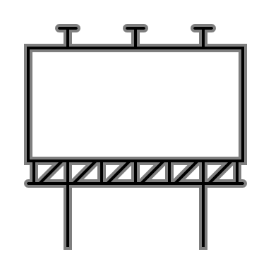

Temperature Sensor
Subject
Observers

Slide 128
Implementation
To optimize notification mechanism, Observers can register for specific events only
more efficient as it avoid unnecessary updates
only those observers will be updated that are dependent on the data that has changed
Before notifying the Observers, the Subject should be in a valid state
use Template Method to achieve consistency

Slide 129
Change Manager
In some complex scenarios, you may want to keep Subjects and Observers completely oblivious of each other
In this case, the Subject will not notify Observers directly
The interaction can be managed by another class called Change Manager
It acts as a Mediator between the Subjects & Observers
This is useful in case there are multiple Subjects & Observers

Slide 130
Temperature Sensor
Subject
Observers

Slide 131




Temperature Sensor
Subjects
Observers

Slide 132




Temperature Sensor
Subjects
Change Manager
Observers

Slide 133
ChangeManager
ChangeManager will maintain the mapping between the Subjects & their Observers
Therefore, the Subjects don’t have to maintain a list of Observers
The Observers will register with ChangeManager
When the state of a Subject changes, it will notify the ChangeManager that will in turn send update to the Observers

Slide 134
Structure
Subject
observers
Observer
Attach(Observer)
Detach(Observer)
Notify()
Update()
for all o in observers{
o->Update()
}
ConcreteSubject
subject
ConcreteObserver
GetState()
SetState()
Update()
return subjectState
observerState=subject->GetState()
observerState
subjectState

Slide 135
Pros
Notification mechanism is like a broadcast
Subject doesn’t have to
specify a receiver
wait for a result
Loose coupling between Subject & Observers
Observers can be added or removed dynamically
Subjects can be used without their Observers
Subject & Observers can belong to different layers

Slide 136
Cons
Observers don’t have any knowledge of each others’ presence
They must be careful about triggering updates
With simple update interface, Observers will find it difficult to ascertain the change
On the other hand, specific notifications will entail conditional logic in Observers that will make them more complex
Too many changes in the Subject may cause a flurry of updates in the Observers

Slide 137
When to use
The Observer pattern can be used when
a change to one object requires changing others, and you don’t know how many objects need to be changed
an object should be able to notify other objects without depending on those objects
several objects should synchronize their state with other objects

Slide 138
Mediator Pattern
In object-oriented design, we strive for distribution of behavior among objects
This is helpful as each object handles a specific behavior making the system easier to extend & reuse
For the overall functionality of the system, these objects have to communicate with each other
This may lead to interconnections between objects; every object may have to know about the other
This increases coupling between objects
the application becomes monolithic
it is difficult to change the behavior of the application

Slide 139
Mediator Pattern
To reduce this coupling, the objects can communicate with a central object
This central object is the mediator
It is responsible for controlling and coordinating the interactions of objects
Thus, the objects don’t have to refer to each other explicitly
Instead, each object only knows the mediator, thus reducing the number of interconnections

Slide 140


Example
Icons made by smalllikeart from www.flaticon.com

Slide 141
Example
Icons made by smalllikeart from www.flaticon.com

Slide 142
Define an object that encapsulates how a set of objects interact. Mediator promotes loose coupling by keeping objects from referring to each other explicitly, and it lets you vary their interaction independently

Slide 143
Structure
Mediator
mediator
Colleague
ConcreteMediator
ConcreteColleague1
ConcreteColleague2

Slide 144
Collaboration
colleague1
mediator
colleague2
colleague3
Invoke()
OnInvoke()
SendMessage()
SendMessage()

Slide 145
Implementation
Usually, there is no need to define an abstract Mediator class.
required only if the Colleagues need to work with different Mediators
Colleagues have to communicate with their Mediator when an event of interest occurs
The Mediator in turn will inform the other Colleagues
This interaction can be implemented in two ways
hardcoded interaction in the Mediator between Colleagues
through the Observer pattern

Slide 146
Implementation
Hardcoded interaction leads to tight coupling
Instead, Command pattern can help the Mediator handle the event from the Colleague
Alternatively, use the Observer pattern - Colleague is the subject and Mediator is the observer
The Mediator will be responsible for taking action on the event from a Colleague and generating a response for other Colleagues
This implementation uses implicit invocation style, therefore, becomes more complex & requires more developmental effort

Slide 147


Chat System

Slide 148

Chat System

Slide 149
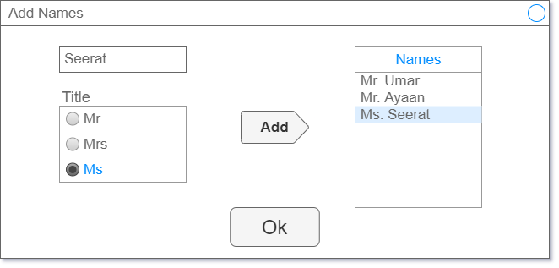
Dialog Mediator

Slide 150
Structure
Mediator
mediator
Colleague
ConcreteMediator
ConcreteColleague1
ConcreteColleague2

Slide 151
Chat Server
server
Server
Participant
ChatServer
Person
Bot

Slide 152
Dialog
Command
command
Widget
Dialog
ListBox
EditBox

Slide 153
Pros
Mediator centralizes the behavior that otherwise would have been distributed among several objects
can be changed easily by subclassing the mediator
Colleagues do not have to keep explicit connections to each other
Replaces many-to-many interactions with one-to-many interaction which is easier to understand and maintain
Promotes loose coupling between Colleagues

Slide 154
Cons
Mediator can become complex because all the interactions are localized
Can lead to performance bottleneck
It makes the mediator harder to maintain
Notes:
All the communication between the objects must pass through the mediator. This may impact the performance of the application

Slide 155
When to use
Apply Mediator pattern when
many objects have to communicate with each other
an object has references to many other objects, thereby making it difficult to reuse
some behavior is distributed among several classes and you want to customize it without a lot of subclassing
instead, just subclass the Mediator

Slide 156
State
Some objects in a system are state-driven
They behave differently based on their current state
This is commonly implemented through flags & conditional statements inside the object
For more complex objects, this might lead to large, monolithic conditional statements, distributed or possibly repeated across several methods
The lifecycle of such objects can be thought of as a state machine

Slide 157
State
The state machine is commonly implemented through conditional statements
code is hard to maintain and reuse
State pattern moves each state into a separate class and the state changes are distributed among the classes
Also known as objects for states
The object is divided, and each state-dependent behavior is separated from the representation of instance data
The data holding object will forward the calls to the state objects that will provide the state-related behavior

Slide 158
Allow an object to alter its behavior when its internal state changes. The object will appear to change its class

Slide 159
Structure
Context
state
State
Request()
Handle()
state->Handle() ;
ConcreteStateA
ConcreteStateB
Handle()
Handle()

Slide 160
Implementation
The main object, called the Context is split, and state related behavior is moved to different classes
Context retains its data, but is forwarded to the state objects so that they can provide the implementation of their behavior
These objects are called objects for states or state objects
After the behavior is executed, a state object may change the state in the Context

Slide 161
Implementation
State pattern does not explicitly specify which participant defines the transition
If there are few transitions, then the Context class can implement them
But it is more flexible to let the State classes themselves specify the transition
If the transition logic is more complicated, it can be moved to a separate class
Since the transition logic becomes distributed, it is easy to modify & extend the State classes

Slide 162

Off
On

Slide 163
Off
On

Slide 164
Lamp States
SwitchOn
Off
SwitchOn
On
SwitchOff
SwitchOff

Slide 165
Implementation
State objects can either be created only when they’re needed
This is preferable if the states are unknown until runtime & there are fewer state changes
This will avoid creating State objects that are not needed, and is useful if they carry a lot of information

Slide 166
Implementation
If there are too many state changes, State objects will be created & destroyed repetitively
In such case, you can create the State objects ahead of time and never destroy them
State objects can also be implemented as singletons
State objects usually operate on the state of the Context; therefore they behave as flyweights

Slide 167
Implementation
An alternative implementation is through a transition table
This table maps the inputs to state transitions
The input is the State & the action invoked; and the table maps it to the succeeding state & the operation to execute
This way the virtual function mechanism is converted into table look-up

Slide 168
Transition Table
Current State | Event | Action | Next State
off_state | SwitchOff | No action | off_state
off_state | SwitchOn | Switch on lamp | on_state
on_state | SwitchOn | No action | on_state
on_state | SwitchOff | Switch off lamp | off_state

Slide 169
State Pattern
Transition Table
Focuses on state-specific behavior
State classes manage the behavior and the transition
Lots of classes are required
Decentralizes transition logic
State specific behavior is easy to follow
Useful when state transitions are less
Focuses on transitions
Only manages the transitions; the behavior is implemented elsewhere
Lesser number of classes required
Centralizes transition logic
May get more complex due to central transition logic
Useful for large number of state transitions

Slide 170
Methods For States
A variation of the table-based approach
Does not use objects for state behavior
Instead, the behavior is realized as internal functions within a single object
Function pointers are grouped together to define the object’s behaviour in a particular state
The state is represented by some value instead of an object (enum, integer, string, etc)
Works with non object-oriented languages

Slide 171
Structure
Context
state
State
Request()
Handle()
state->Handle() ;
ConcreteStateA
ConcreteStateB
Handle()
Handle()

Slide 172
Structure
Lamp
state
State
SwitchOn()
SwitchOff()
SwitchOn()
SwitchOff()
state->SwitchOn() ;
OnState
OffState
YellowState
SwitchOn()
SwitchOff()
SwitchOn()
SwitchOff()
SwitchOn()
SwitchOff()

Slide 173
Pros
Replaces large monolithic conditional statements with classes
State-specific behavior is localized in a corresponding class
new states can be added easily
State transitions are represented by objects and not variables
makes the states more consistent as only one variable(state object) represents the state
State objects can be shared if they don’t store any state
behave as flyweights

Slide 174
Cons
Less compact as more classes are added
State classes may have to know about each other so that state transitions can take place
May lead to dependency between state classes
When state objects are created on the fly, it leads to repetitive construction & destruction
performance may be effected (use as singleton instead)
When used as flyweights, runtime-costs will be incurred in transferring, finding or computing extrinsic state

Slide 175
When to use
Use when
object’s behavior depends on its state and its behavior must change at runtime
behavior is decided by conditional statements
internal state is defined by some values in a variable
behavior is distributed in several operations and each operation contains the same conditional statements

Slide 176
Represent an operation to be performed on the elements of an object structure. Visitor lets you define a new operation without changing the classes of the elements on which it operates

Slide 177
Structure
Visitor
Client
VisitConcreteElementA(ConcreteElementA) VisitConcreteElementB(ConcreteElementB)
ConcreteVisitor1
ConcreteVisitor2
VisitConcreteElementA(ConcreteElementA) VisitConcreteElementB(ConcreteElementB)
VisitConcreteElementA(ConcreteElementA) VisitConcreteElementB(ConcreteElementB)
Element
Object Structure
Accept(Visitor)
ConcreteElementA
ConcreteElementB
v->VisitConcreteElementA(this)
Accept(Visitor)
OperationA()
Accept(Visitor)
OperationB()
v->VisitConcreteElementB(this)

Slide 178
Implementation
This pattern requires two hierarchies
Each object structure will have an associated Visitor class
The Visitor class will define the operations for visiting objects
An operation for each object must be defined
The Element & its subclasses in turn will provide an operation for accepting visitors

Slide 179
Implementation
A Visitor visits each element
It can accumulate state during visitation
To simplify traversal, Iterator can help a Visitor visit each element
The traversal algorithm will depend on the object structure

Slide 180
Geometric Shapes
Render
Serialize
Area
Deserialize
Perimeter
Object Structure

Slide 181
Structure
Visitors
Operation
Client
VisitLine(Line)
VisitCircle(Circle)
Render
Area
VisitLine(Line)
VisitCircle(Circle)
VisitLine(Line)
VisitCircle(Circle)
Shape
Geometry
Accept(Operation)
Line
Circle
v->VisitLine(this)
Accept(Operation)
GetStart()
GetEnd()
Accept(Operation)
GetRadius()
GetPosition()
v->VisitCircle(this)

Slide 182
Single/Double Dispatch
Single dispatch is just like runtime polymorphism
A function is invoked based on its name & the type of the receiver object
In double dispatch, the function that is invoked depends on two kinds of receiver objects
This is the key to implementing the Visitor pattern

Slide 183
Double Dispatch
In the Visitor pattern, there are two types of objects – Element & the Visitor
The Element subclasses implement the Accept() method through which they receive a Visitor
A Visitor in turn will invoke the corresponding Visit() method
But the final Visit() method that gets invoked will depend on two objects – type of Element & Visitor
This is the implementation of double dispatch

Slide 184
Cyclic Dependency
The classic Visitor pattern leads to a cycle of dependencies between the visitors & the visitable classes
The Visitor class will depend on the type of all visitable classes
The base visitable & its children depend on the base Visitor class
These are compile-time dependencies and cannot be resolved
Adding a new visitable class will cause a change to the all Visitor classes
This in turn will force a recompilation of all visitable classes

Slide 185
Partial Visitation
Every possible combination of the object type & the visitor must be handled
There could be a case where a certain object must not be visited
This is impossible with the classical visitor pattern
All Visitor classes must define every Visit() method and apply some action

Slide 186
Acyclic Visitor
Variation of the visitor pattern
Helps break the dependency cycle
Allows partial visitation
Requires a marker interface to act as a placeholder for the actual visitor
Uses multiple inheritance & RTTI

Slide 187
Variant
Represents a type-safe union
Can store multiple types of values, but only one is active at a time
Knows the active type & works correctly with objects
Operations on the contained elements can be performed through a visitor class
This class provides overloaded function call operator for each type inside the variant

Slide 188
Structure
Visitor
Client
VisitConcreteElementA(ConcreteElementA) VisitConcreteElementB(ConcreteElementB)
ConcreteVisitor1
ConcreteVisitor2
VisitConcreteElementA(ConcreteElementA) VisitConcreteElementB(ConcreteElementB)
VisitConcreteElementA(ConcreteElementA) VisitConcreteElementB(ConcreteElementB)
Element
Object Structure
Accept(Visitor)
ConcreteElementA
ConcreteElementB
v->VisitConcreteElementA(this)
Accept(Visitor)
OperationA()
Accept(Visitor)
OperationB()
v->VisitConcreteElementB(this)

Slide 189
Shapes
Visitors
Operation
Client
VisitLine(Line)
VisitCircle(Circle)
Render
Area
VisitLine(Line)
VisitCircle(Circle)
VisitLine(Line)
VisitCircle(Circle)
Shape
Geometry
Accept(Operation)
Line
Circle
v->VisitLine(this)
Accept(Operation)
GetStart()
GetEnd()
Accept(Operation)
GetRadius()
GetPosition()
v->VisitCircle(this)

Slide 190
Variant Visitor
Client
Visitor
operator()(Circle)
operator()(Rect)
operator()(Line)
Geometry
Shape
Line
Circle
GetStart()
GetEnd()
GetRadius()
GetPosition()

Slide 191
Pros
New operations can be added easily by adding a new visitor
Related behavior of the classes is localized in a visitor
No need to overload classes with multiple responsibilities
Visitors can accumulate state as they visit each element in an object structure

Slide 192
Cons
Circular dependency between Element & Visitor hierarchies
Difficult to add new subclasses of the Element
Requires modifications of all subclasses of Element & the Visitors
Visitor pattern requires access to the state of the Element classes
Difficult to restrict visitation to certain classes
Requires boilerplate code in the Element subclasses

Slide 193
When to use
A hierarchy contains subclasses with different interfaces
you want to perform operations on the concrete subclasses
Different, unrelated operations have to be performed on objects in the hierarchy
adding these operations in the classes will pollute their interface
The classes defining the object structure rarely change, but new operations need to be added often

Slide 194
Given a language, define a representation for its grammar along with an interpreter that uses the representation to interpret sentences in the language

Slide 195
Structure
Context
Client
AbstractExpression
Interpret(Context)
TerminalExpression
NonterminalExpression
Intepret(Context)
Intepret(Context)

Slide 196
Implementation
The language grammar/rules are represented by different kinds of classes
The TerminalExpression represents a literal expression or a symbol in the grammar
Each symbol will its own instance of the TerminalExpression
A NonTerminalExpression is a collection of Expression
In this case, it behaves like a Composite as it can recursively compose Expression instances
The Context class contains the information that is available globally to the interpreter

Slide 197
Implementation
The interpreter pattern does not address how to parse an expression
This has to be done manually using a parser
If the interpretation of a rule can change, then the Interpret operation may be implemented in a Visitor
The terminal symbols may be implemented as Flyweights because there might be multiple instances of the same symbols in the grammar

Slide 198
Expression Evaluation
Nonterminal Expression
AND
3 5
Terminal Expression

Slide 199
Lexical Analysis
Lexing or lexical analysis is a process of tokenizing a stream of text
The output is a new stream with standalone tokens
A simple process that can be implemented in different & simple ways
Some parts of the stream may be ignored (whitespaces, comments, etc)
The meaning of tokens & their order is handled by a parser

Slide 200
Parsing
The parser analyzes the tokens and creates a parse tree showing their syntactic relation to each other
The parser recognizes the structure of the tree through rules of a grammar
Grammar is a formal description of a language that can be used to recognize its structure

Slide 201
Example
INTERPRETER
3 AND 5
TRUE
0 AND 3
FALSE
10 AND 89 AND 23
TRUE
54 AND 0 AND 72
FALSE

Slide 202
Abstract Syntax Tree
54 AND 0 AND 72
AND
Nonterminal Expression
Terminal Expression
AND
72
54
0

Slide 203
Structure
Context
Client
AbstractExpression
Interpret(Context)
TerminalExpression
NonterminalExpression
Intepret(Context)
Intepret(Context)

Slide 204
Boolean Expression Evaluation
3 AND 5 OR 1
Client
Expression
Interpret()
ValueExpression
AndExpression
Intepret()
Intepret()

Slide 205
RPN Evaluation
5 3 + 9 -
Client
Expression
Interpret()
Number
Plus
Intepret()
Intepret()

Slide 206
Pros
Since the grammar rules are represented by classes, it is easy to change or extend them
Adding new rules is as simple as adding a new corresponding class

Slide 207
Cons
Does not define how parsing should be done
Not suitable for complex grammar
Not efficient

Slide 208
When to use
Use when you want to interpret some grammar, and
the grammar is not too complex
efficiency is not critical
parsing tools are easily available

