Slide 1
Machine Learning Algorithms-Linear Regression
ENROLLMENT NO : 185690693001

Slide 2
What is Supervised Learning?
Basically supervised learning is a learning in which we teach or train the machine using the data that is well labeled which means some data is already tagged with the correct answer.
Let’s understand this Supervised Learning by taking an example, Suppose you are given a basket filled with different kinds of fruits.
Now our first step is to train the machine with all datasets (different fruits one by one).
At the time of training, this machine will give labels by the given data to the fruits. If the shape of the object is rounded and depression at the top having color Red then it will be labeled as –Apple and If the shape of the object is a long curving cylinder having color Green-Yellow then it will be labeled as –Banana.

Slide 3
Since the machine has already learned the things from previous data. It will first classify
the fruit with its shape and color and classifying the variables it will label accordingly.
Thus the machine learns the things from training data and then applies the knowledge
to test data(new fruit).
E.g.: Google assistant, weather app ,etc.
Supervised learning classified into two categories of algorithms:
1. Classification: A classification problem is when the output variable is a category,
such as “Red” or “blue” or “disease” and “no disease”.
2. Regression: A regression problem is when the output variable is a real value,
such as “dollars” or “weight”.

Slide 4
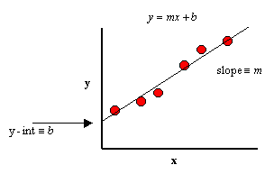
Linear Regression
Linear Regression is a linear approach to modeling the relationship between a scalar response (or dependent variable or y) and one or more explanatory variables(or independent variables or x).
Simple Linear Regression
The case of one explanatory variable is called Simple Linear Regression( e.g it is a linear relationship between x and y).
Mathematically speaking, everyone must have heard about the straight line equation:
y = mx + c
where y is the dependent variable,
x is the independent variable,
m is the slope of the line
c is y-intercept( value of y when x=0)

Slide 5
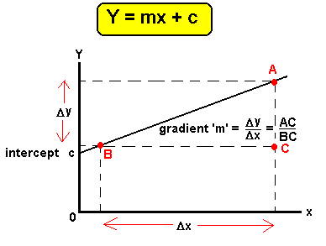
This equation is the basis of Linear Regression. Now, Let us understand the algorithm differently.
The core idea is to obtain a line that best fits the data. The best fit line is the one for which total prediction error (all data points) are as small as possible. The error is the distance between the point to the regression line.

Slide 6
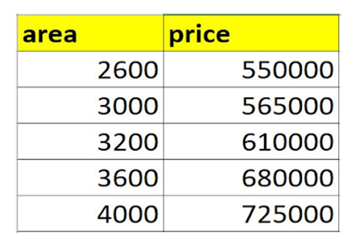
As we only have one variable in our data set as shown in the figure below.
That is area and price. Here the equation will be:
y = m*area + b, But as here we are predicting the price of the house according to the area on the basis of a given price.
Suppose we have a dataset in which area and price are given.

Slide 7
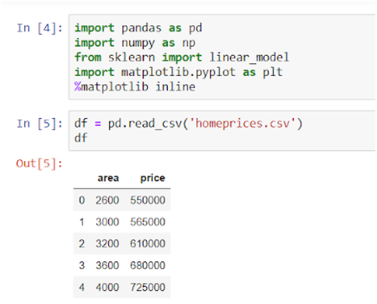
Step 1: Importing the Libraries and loading the Datasets

Slide 8
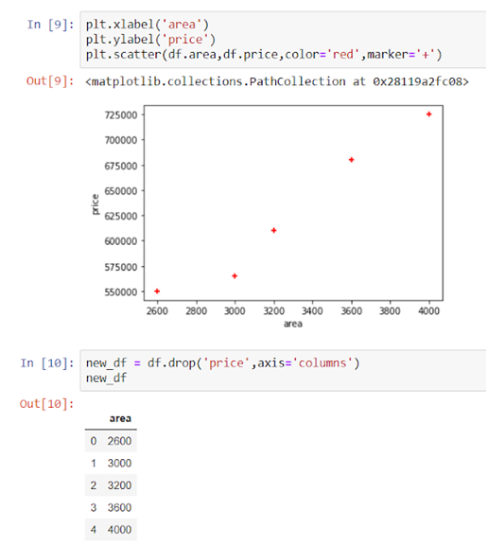
Step 2: Visualization of the given data in the Scatter Plot
After the visualization, Inline 10 we’re dropping the price columns by using the drop() function.

Slide 9
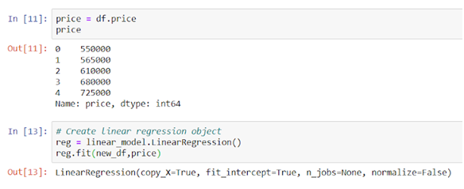
Step 3: Implementing the Linear Regression and Fitting the variable (price)

Slide 10
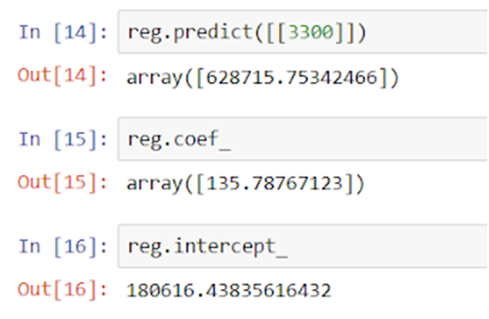
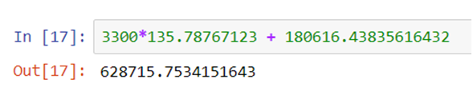
Step 4: Predicting the price
Here, coef_ = coefficient = m and intercept_ = intercept = b
Equation: y =mx + b, m is the prediction value, x is coefficient, and b is the intercept.
m = 135.78767123,, x =3300 and b = 180616.43835616432
Thus Linear regression performs the task to predict a dependent variable value (y) based on a given independent variable (x). So, this regression technique finds out a linear relationship between x (input) and y(output).

Slide 11


