Slide 1
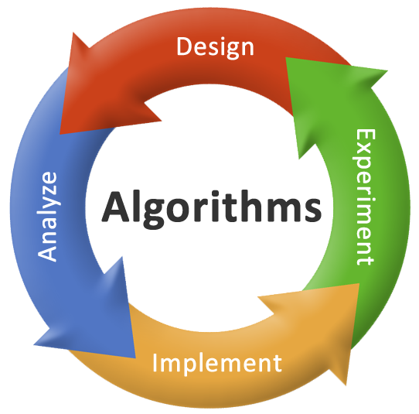
Unit – 1 Analysis of Algorithms

Slide 2
Topics to be covered
The efficient algorithm
Average, Best and Worst case analysis
Asymptotic Notations
Analyzing control statement
Sorting Algorithms and analysis: Bubble sort, Selection sort, Insertion sort, Shell sort and Heap sort
Sorting in linear time : Bucket sort, Radix sort and Counting sort
Amortized analysis

Slide 3
Analysis of Algorithm

Slide 4
Analysis of Algorithm
What is the analysis of an algorithm?
Analyzing an algorithm means calculating/predicting the resources that the algorithm requires.
Two most important resources are computing time (time complexity) and storage space (space complexity).
Why analysis is required?
By analyzing some of the candidate algorithms for a problem, the most efficient one can be easily identified.

Slide 5
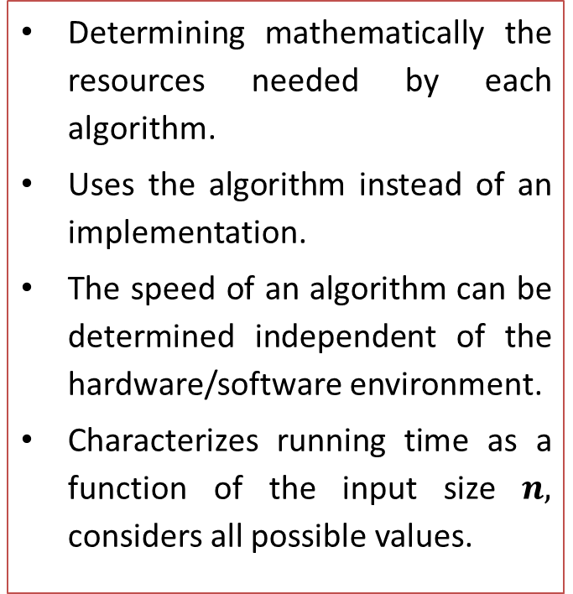
How Analysis is Done?
Empirical (posteriori) approach
Theoretical (priori) approach
Programming different competing techniques & running them on various inputs using computer.
Implementation of different techniques may be difficult.
The same hardware and software environments must be used for comparing two algorithms.
Results may not be indicative of the running time on other inputs not included in the experiment.
Determining mathematically the resources needed by each algorithm.
Uses the algorithm instead of an implementation.
The speed of an algorithm can be determined independent of the hardware/software environment.
Characterizes running time as a function of the input size $n,$ considers all possible values.
5

Slide 6
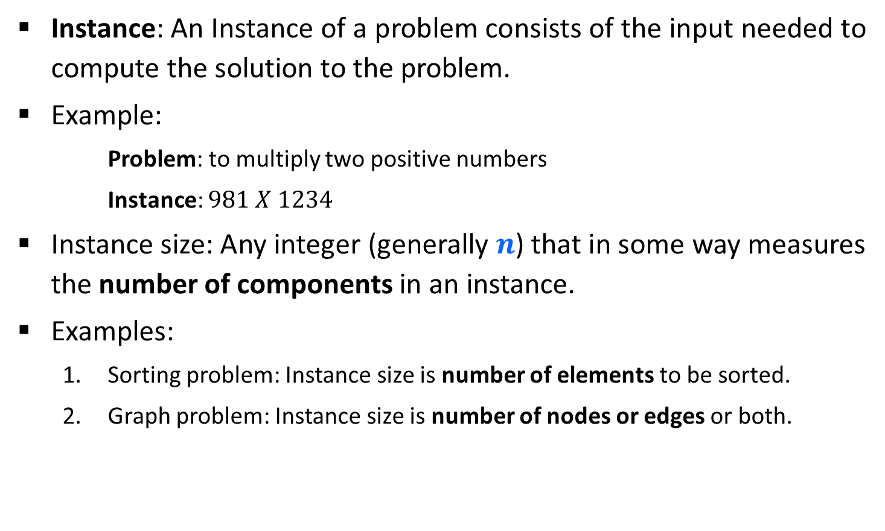
Problem & Instance
Instance: An Instance of a problem consists of the input needed to compute the solution to the problem.
Example:
Problem: to multiply two positive numbers
Instance: $981 X 1234$
Instance size: Any integer (generally $n$) that in some way measures the number of components in an instance.
Examples:
Sorting problem: Instance size is number of elements to be sorted.
Graph problem: Instance size is number of nodes or edges or both.

Slide 7
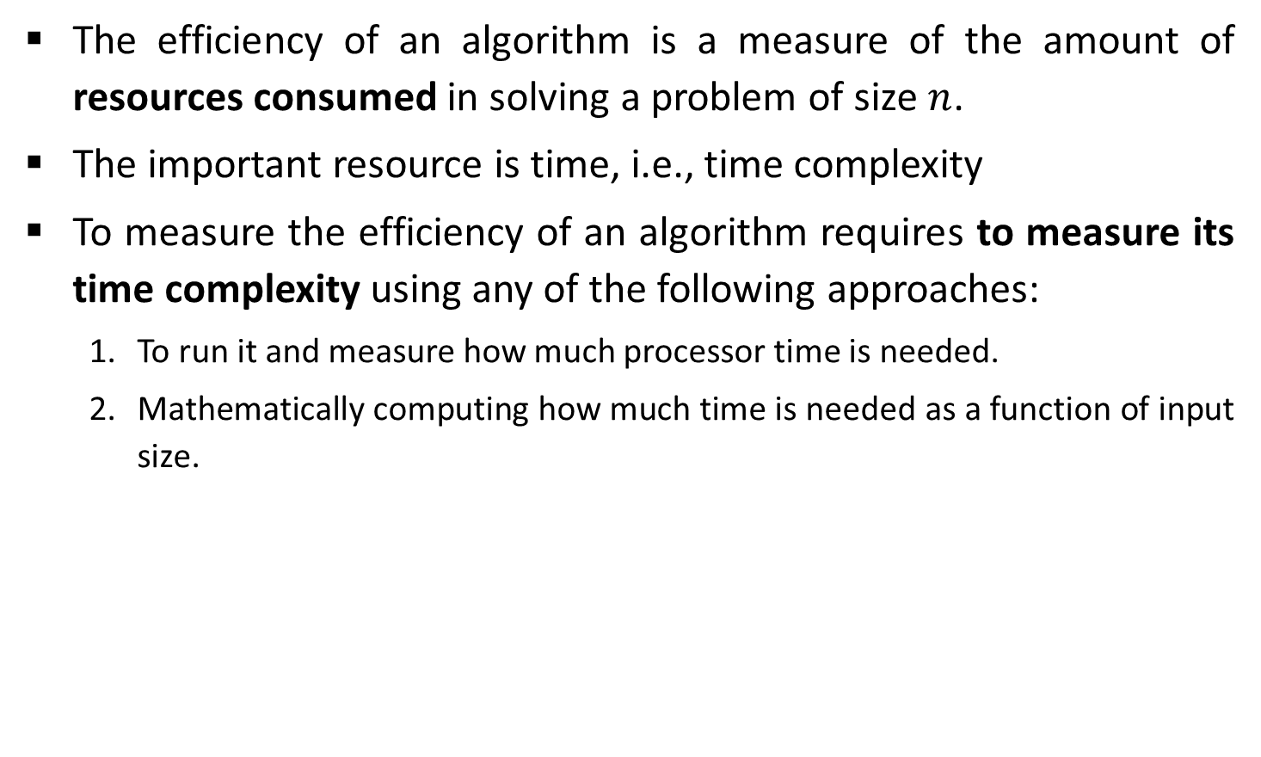
Efficiency of Algorithm
The efficiency of an algorithm is a measure of the amount of resources consumed in solving a problem of size $n$.
The important resource is time, i.e., time complexity
To measure the efficiency of an algorithm requires to measure its time complexity using any of the following approaches:
To run it and measure how much processor time is needed.
Mathematically computing how much time is needed as a function of input size.
Empirical Approach
Theoretical Approach

Slide 8
Efficiency of Algorithm
Running time of an algorithm depends upon,
Input Size
Nature of Input
Generally time grows with the size of input, for example, sorting 100 numbers will take less time than sorting of 10,000 numbers.
So, running time of an algorithm is usually measured as a function of input size.
In theoretical computation of time complexity, Running time is measured in terms of number of steps/primitive operations performed.

Slide 9

Linear Search
Suppose, you are given a jar containing some business cards.
You are asked to determine whether the name “Mukesh Ambani" is in the jar.
To do this, you decide to simply go through all the cards one by one.
How long this takes?
Can be determined by how many cards are in the jar, i.e., Size of Input.

Slide 10
Linear Search
Linear search is a method for finding a particular value from the given list.
The algorithm checks each element, one at a time and in sequence, until the desired element is found.
Linear search is the simplest search algorithm.
It is a special case of brute-force search.

Slide 11









Linear Search - Example
Search for $1$ in given array
$$2$$ | $$9$$ | $$3$$ | $$1$$ | $$8$$
Comparing value of i^{th} index with the given element one by one, until we get the required element or end of the array
Step 1: i=0
Step 3: i=2
$$2$$ | $$9$$ | $$3$$ | $$1$$ | $$8$$
$$2$$ | $$9$$ | $$3$$ | $$1$$ | $$8$$
i
i
$$2≠1$$
$$3≠1$$
Step 2: i=1
Step 4: i=3
$$2$$ | $$9$$ | $$3$$ | $$1$$ | $$8$$
$$2$$ | $$9$$ | $$3$$ | $$1$$ | $$8$$
$$1$$
i
i
$$9≠1$$
Element found at i^{th} index, i=3

Slide 12
Linear Search Algorithm
# Input : Array A, element
# Output : First index of element in A or
-1 if not found
Algorithm: Linear_Search
for i = 1 to last index of A:
if A[i] equals element:
return i
return -1

Slide 13
Linear Search
The required element in the given array can be found at,
E.g. 2: It is at the first position
Best Case: minimum comparison is required
E.g. 3 or 1: Anywhere after the first position
Average Case: average number of comparison is required
E.g. 8 or 7: Last position or does not found at all
Worst Case: maximum comparison is required
Worst Case
2
2 | 9 | 3 | 1 | 8
Best Case
Average Case

Slide 14
Analysis of Algorithm
Best case | Average case | Worst case
Resource usage is minimum | Resource usage is average | Resource usage is maximum
Algorithm’s behavior under optimal condition | Algorithm’s behavior under random condition | Algorithm’s behavior under the worst condition
Minimum number of steps or operations | Average number of steps or operations | Maximum number of steps or operations
Lower bound on running time | Average bound on running time | Upper bound on running time
Generally do not occur in real | Average and worst-case performances are the most used in algorithm analysis.

Slide 15
Asymptotic Notations

Slide 16
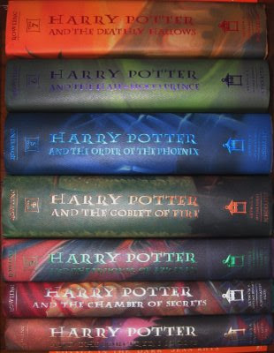
Book Finder
Suppose, you are writing a program to find a book from the shelf.
For any required book, it will start checking books one by one from the bottom.
If you wanted Harry Potter 3, it would only take 3 actions (or tries) because it’s the third book in the sequence.
If Harry Potter 7 — it’s the last book so it would have to check all 7 books.
What if there are total 10 books? How about 10,00,000 books? It would take 1 million tries.

Slide 17
Number Sorting
Suppose you are sorting numbers in Ascending / Increasing order.
The initial arrangement of given numbers can be in any of the following three orders.
Numbers are already in required order, i.e., Ascending order
No change is required – Best Case
Numbers are randomly arranged initially.
Some numbers will change their position – Average Case
Numbers are initially arranged in Descending or Decreasing order.
All numbers will change their position – Worst Case
5 | 9 | 12 | 23 | 32 | 41
9 | 5 | 12 | 32 | 23 | 41
5 | 9 | 12 | 23 | 32 | 41
41 | 32 | 23 | 12 | 9 | 5

Slide 18
Analysis – Best Case
Linear search
Element at the first position
Element in any of the middle position
Element at last position or not present
Finding book from shelf
The first book
Any book in-between
The last book
Sorting numbers
Already sorted
Randomly arranged
Sorted in reverse order
Best Case:
Minimum number of search / swap is required.
Minimum time is consumed to find solution.
Known as the LOWER BOUND of running time.
Running time is denoted as Ω (Omega) - Notation

Slide 19
Analysis – Average Case
Linear search
Element at the first position
Element in any of the middle position
Element at last position or not present
Finding book from shelf
The first book
Any book in-between
The last book
Sorting numbers
Already sorted
Randomly arranged
Sorted in reverse order
Average Case:
Average number of search / swap is required.
Average time is consumed to find solution.
Known as the TIGHT BOUND of running time.
Running time is denoted using θ (Theta) - Notation

Slide 20
Analysis – Worst Case
Linear search
Element at first position
Element in any of the middle position
Element at last position or not present
Finding book from shelf
The first book
Any book in-between
The last book
Sorting numbers
Already sorted
Randomly arranged
Sorted in reverse order
Worst Case:
Maximum number of search / swap is required.
Maximum time is consumed to find solution.
Known as the UPPER BOUND of running time.
Running time is denoted using O-Notation (Big O notation)

Slide 21
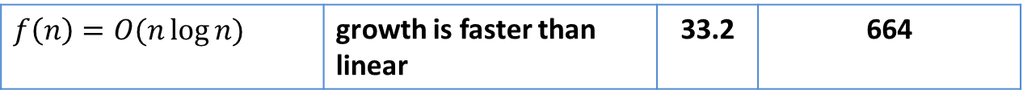
Asymptotic Notations
Asymptotic Notations (Big O, θ - Theta and Ω - Omega) allow us to analyze an algorithm’s running time.
This is also known as an algorithm’s growth rate.
The running time of an algorithm is compared with some common orders of growth in the complexity analysis. Such as,
Time Complexity | Growth rate | n=10 | n=100
$$f(n)=O(1)$$ | growth is constant | Does not depend on n
$$f(n)=O(\log{n})$$ | growth is logarithmic | 3.32 | 6.64
$$f(n)=O(n)$$ | growth is linear | 10 | 100
$$f\left(n\right)=O(n\log{n)}$$ | growth is faster than linear | 33.2 | 664
$$f(n)={O(n}^{2})$$ | growth is quadratic | 100 | 10000
$$f\left(n\right)= {O(2}^{n} or n!)$$ | growth is exponential | 1024 | 1.2676506e+30

Slide 22
Asymptotic Notations
Asymptotic Notations are used,
To characterize the complexity of an algorithm.
To compare the performance of two or more algorithms solving the same problem.

Slide 23
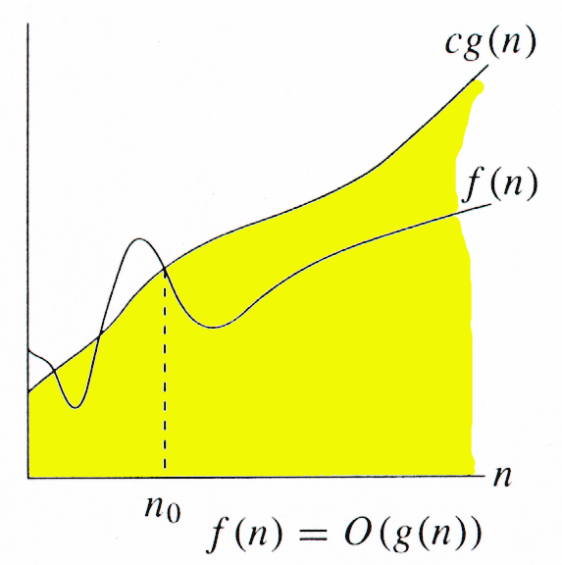
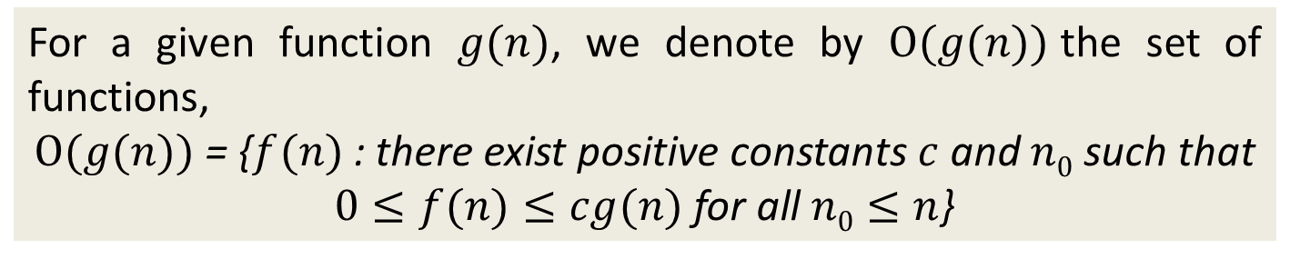
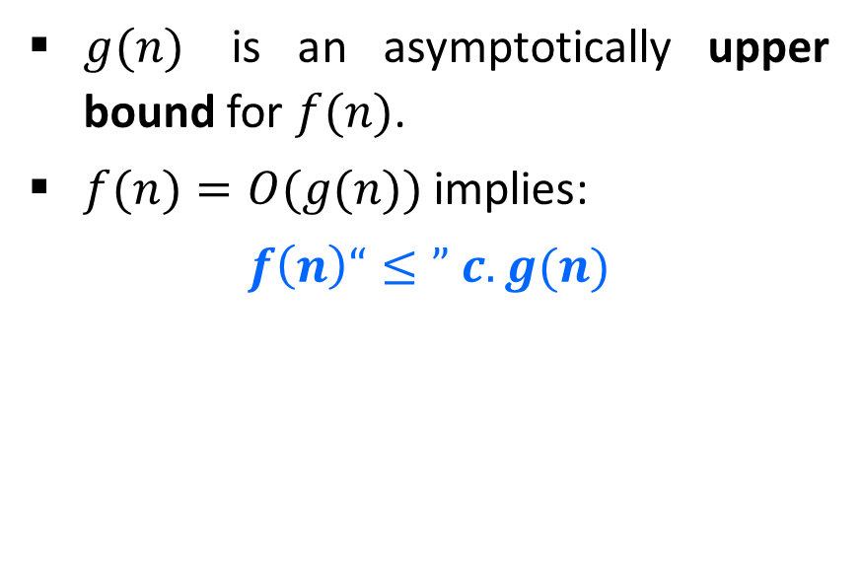
O-Notation (Big O notation) (Upper Bound)
For a given function $g(n)$, we denote by $Ο(g(n))$the set of functions,
$Ο(g(n))$= {$f(n)$ : there exist positive constants $c$ and $n0$ such that
$0≤f(n)≤cg(n)$for all $n0≤n$}
$g(n)$ is an asymptotically upper bound for $f(n)$.
$f(n)=O(g(n))$implies:
$$f\left(n\right)“≤” c.g(n)$$

Slide 24
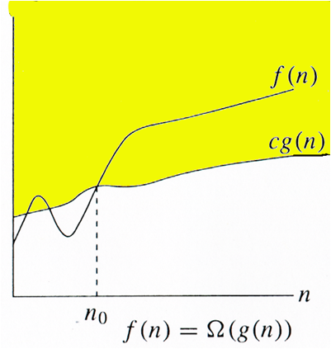
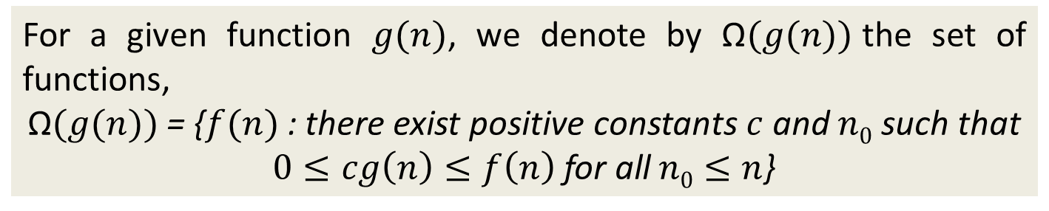
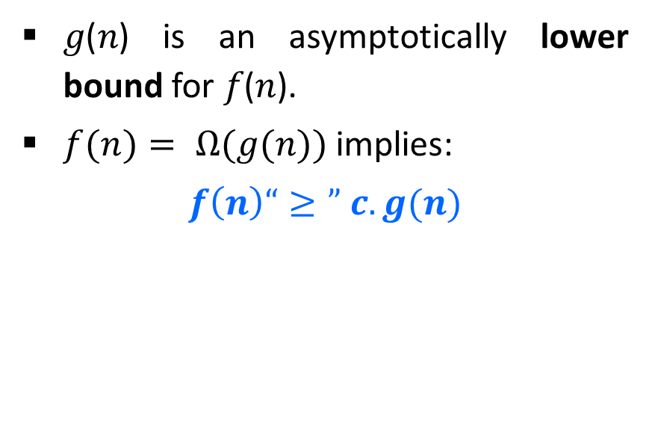
Ω-Notation (Omega notation) (Lower Bound)
For a given function $g(n)$, we denote by Ω$(g(n))$the set of functions,
$\text{Ω}(g(n))$= {$f(n)$ : there exist positive constants $c$ and $n0$ such that
$0≤cg\left(n\right)≤f\left(n\right)$for all$n0≤n$}
𝑔(𝑛) is an asymptotically lower bound for 𝑓(𝑛).
$f(n)= Ω(g(n))$implies:
$$f\left(n\right)“≥” c.g(n)$$

Slide 25
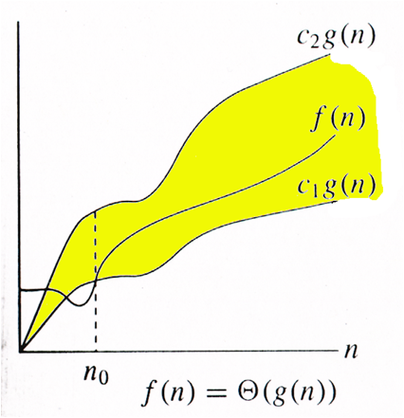
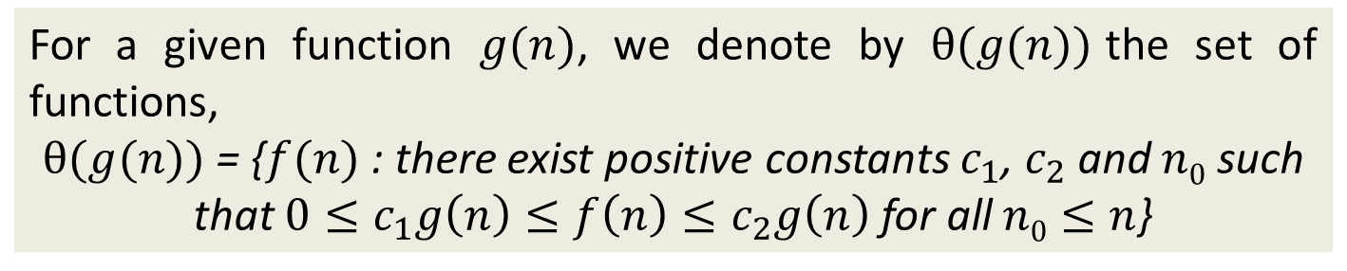
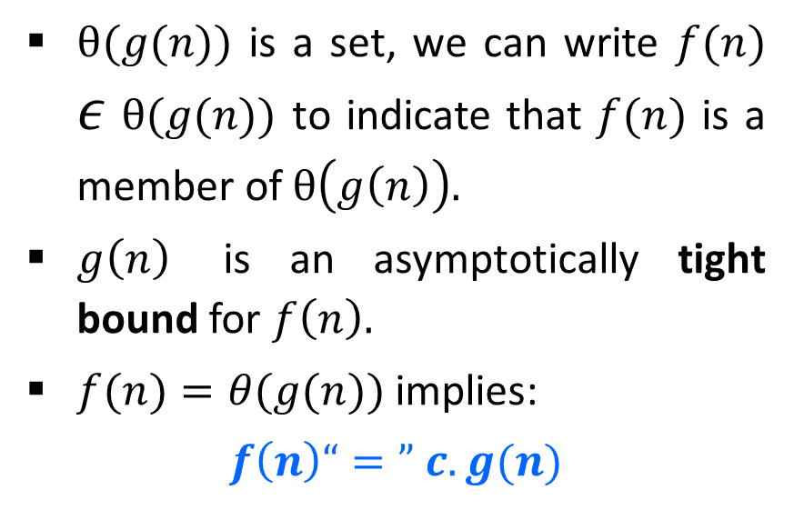
θ-Notation (Theta notation) (Same order)
For a given function $g(n)$, we denote by $θ(g(n))$the set of functions,
$θ(g(n))$ = {$f(n)$ : there exist positive constants $c_{1}$, $c_{2}$ and $n0$ such that $0≤c_{1}g\left(n\right)≤f\left(n\right)≤c_{2}g\left(n\right)$ for all$n0≤n$}
$θ(g(n))$ is a set, we can write $f(n)$ $ε$ $θ(g(n))$ to indicate that $f(n)$ is a member of $θ\left(g\left(n\right)\right).$
$g\left(n\right)$ is an asymptotically tight bound for $f\left(n\right).$
$f(n)=θ(g(n))$implies:
$$f\left(n\right)“=” c.g(n)$$

Slide 26
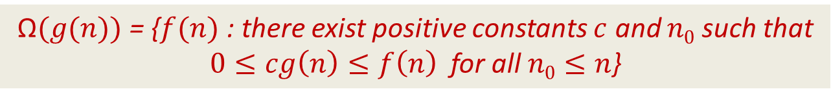
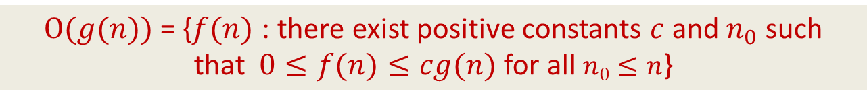
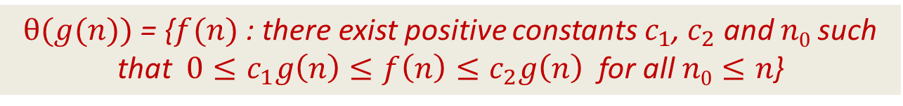
Asymptotic Notations
O-Notation (Big O notation) (Upper Bound)
Ω-Notation (Omega notation) (Lower Bound)
θ-Notation (Theta notation) (Same order)
$Ο(g(n))$= {$f(n)$ : there exist positive constants $c$ and${ n}_{0}$ such that$0≤f(n)≤cg(n)$for all$n0≤n$}
$\text{Ω}(g(n))$= {$f(n)$ : there exist positive constants $c$ and $n0$ such that
$0≤cg\left(n\right)≤f\left(n\right)$ for all$n0≤n$}
$θ(g(n))$ = {$f(n)$ : there exist positive constants $c_{1}$, $c_{2}$ and $n0$ such that $0≤c_{1}g\left(n\right)≤f\left(n\right)≤c_{2}g\left(n\right)$ for all$n0≤n$}

Slide 27
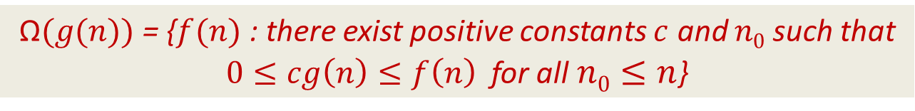



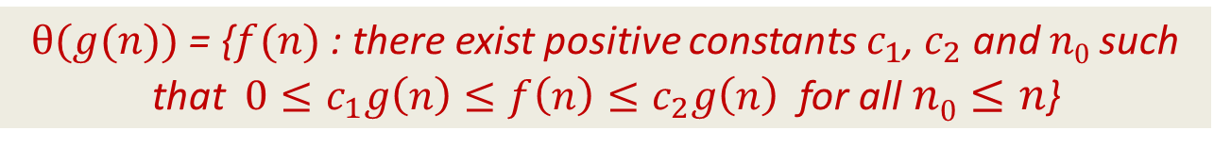
Asymptotic Notations
$$f(n)=O(g(n))$$
$Ο(g(n))$= {$f(n)$ : there exist positive constants $c$ and${ n}_{0}$ such that$0≤f(n)≤cg(n)$for all$n0≤n$}
$$f(n)=\text{Ω}(g(n))$$
$\text{Ω}(g(n))$= {$f(n)$ : there exist positive constants $c$ and $n0$ such that
$0≤cg\left(n\right)≤f\left(n\right)$ for all$n0≤n$}
$$f(n)=θ(g(n))$$
$θ(g(n))$ = {$f(n)$ : there exist positive constants $c_{1}$, $c_{2}$ and $n0$ such that $0≤c_{1}g\left(n\right)≤f\left(n\right)≤c_{2}g\left(n\right)$ for all$n0≤n$}

Slide 28
Asymptotic Notations
Asymptotic Notations are used,
To characterize the complexity of an algorithm.
To compare the performance of two or more algorithms solving the same problem.

Slide 29

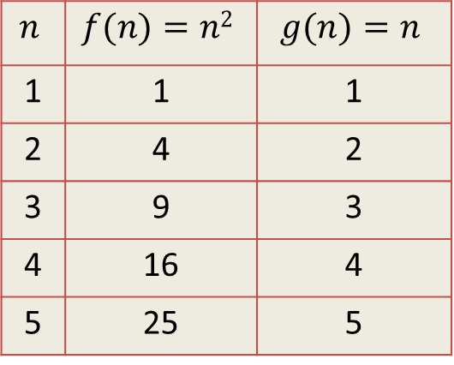





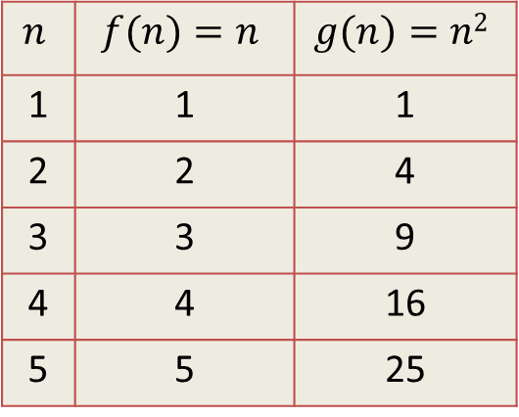
Asymptotic Notations - Example
Example 1:
$f(n)=n^{2}$ and $g\left(n\right)=n$
Example 2:
$f(n)=n$ and $g\left(n\right)=n^{2}$
Algo. 1 running time
Algo. 2 running time
Algo. 1 running time
Algo. 2 running time
$$f\left(n\right)≥g\left(n\right)$$
$$f\left(n\right)=\text{Ω}(g(n))$$
$$f\left(n\right)≤g\left(n\right)$$
$$f\left(n\right)=\text{O}(g(n))$$
$$n$$ | $$f(n)=n2$$ | $$g(n)=n$$
1 | 1 | 1
2 | 4 | 2
3 | 9 | 3
4 | 16 | 4
5 | 25 | 5
$$n$$ | $$f(n)=n$$ | $$g(n)=n2$$
1 | 1 | 1
2 | 2 | 4
3 | 3 | 9
4 | 4 | 16
5 | 5 | 25

Slide 30
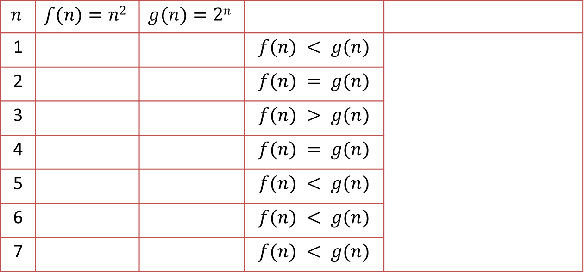



Asymptotic Notations - Example
Example: Let $f\left(n\right)=n^{2}$ and $g\left(n\right)= 2^{n}$
$$f\left(n\right)=\text{O}\left(g\left(n\right)\right)$$
Algo. 1 running time
Algo. 2 running time
$$n$$ | $$f(n)=n2$$ | $$g(n)=2n$$
1 |  |  | $$f(n) < g(n)$$
2 |  |  | $$f(n) = g(n)$$
3 |  |  | $$f(n) > g(n)$$
4 |  |  | $$f(n) = g(n)$$
5 |  |  | $$f(n) < g(n)$$
6 |  |  | $$f(n) < g(n)$$
7 |  |  | $$f(n) < g(n)$$
1
2
4
4
9
8
16
16
Here for $n≥4$, $f\left(n\right)≤g\left(n\right)$
$$so, n0=4$$
25
32
36
64
49
128

Slide 31
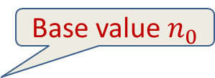



Asymptotic Notations - Example
Example:
$f(n)=30n+8$is in the order of $n$, or $O(n)$.
$g(n)=n^{2}+1$is order $n^{2}$, or $O(n^{2})$.
$$f(n) = O(g(n))$$
g (n)=n²+1
f(n)=30n+8
In general, any $O(n^{2})$ function is faster-growing than any $O(n)$ function.
Value of function →
Base value $n_{0}$
Increasing n →

Slide 32
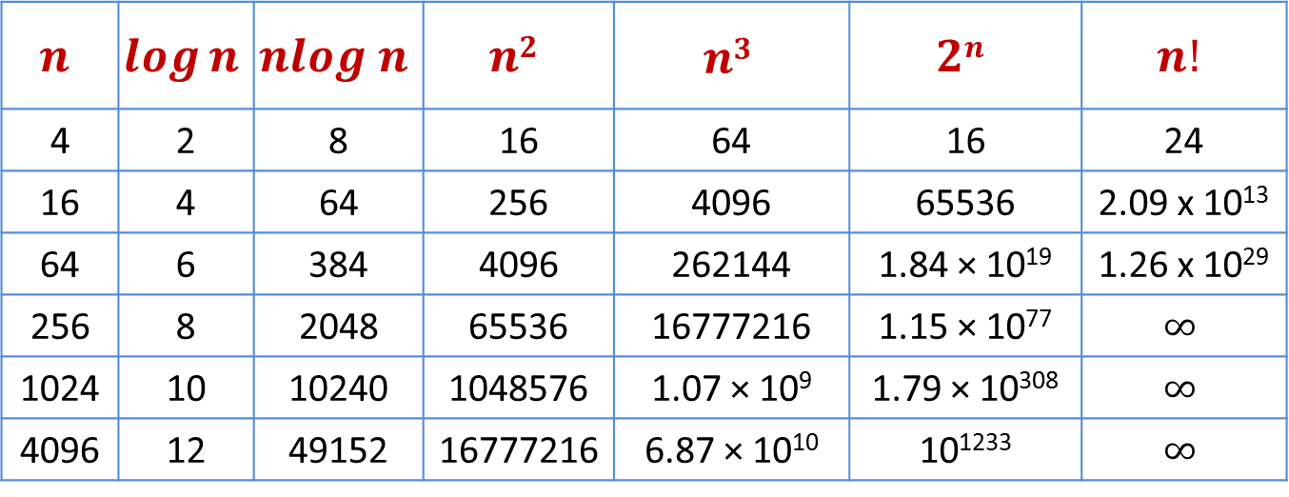
Common Orders of Magnitude
$$n$$ | $$\log{n}$$ | $$nlog n$$ | $$n2$$ | $$n3$$ | $$2n$$ | $$n!$$
4 | 2 | 8 | 16 | 64 | 16 | 24
16 | 4 | 64 | 256 | 4096 | 65536 | 2.09 x 10¹³
64 | 6 | 384 | 4096 | 262144 | 1.84 × 10¹⁹ | 1.26 x 10²⁹
256 | 8 | 2048 | 65536 | 16777216 | 1.15 × 10⁷⁷ | $$∞$$
1024 | 10 | 10240 | 1048576 | 1.07 × 10⁹ | 1.79 × 10³⁰⁸ | $$∞$$
4096 | 12 | 49152 | 16777216 | 6.87 × 10¹⁰ | 10¹²³³ | $$∞$$

Slide 33
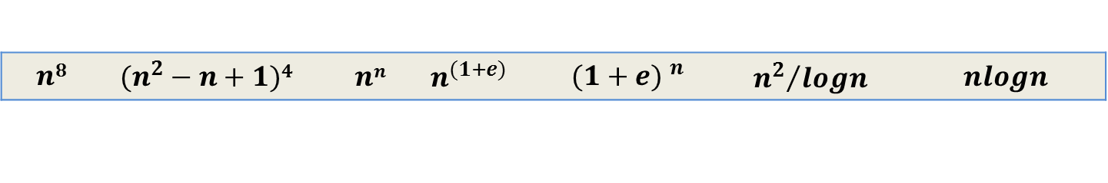
Growth of Function (HW)
Arrange the given notations in the increasing order of their values.
1
$$n$$ | $$nlogn$$ | $$2n$$ | $$logn$$ | $$\sqrt{n}$$ | $$en$$ | $$n2+logn$$ | $$n2$$ | $$loglogn$$ | $$n3$$ | $$(logn)2$$ | $$n!$$
2
$$n8$$ | $$(n^{2}−n+1)4{}^{}$$ | $$nn$$ | $$n^{(1+e)}$$ | $${(1+e) }^{n}$$ | $${n^{2}}/{logn}$$ | $$nlogn$$

Slide 34
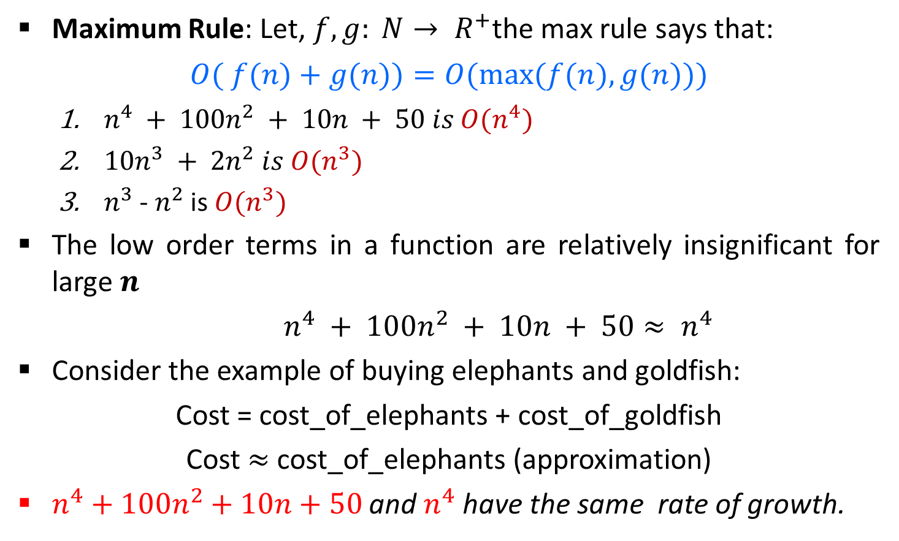
Asymptotic Notations in Equations
Maximum Rule: Let, $f, g: N→ R^{+}$the max rule says that:
$$O( f(n)+g(n))=O(max⁡(f(n),g(n)))$$
$n^{4} + 100n^{2} + 10n + 50 is O(n^{4})$
$10n^{3} + 2n^{2} is O(n^{3})$
$n^{3}$ - $n^{2}$ is $O(n^{3})$
The low order terms in a function are relatively insignificant for large $n$
$n^{4} + 100n^{2} + 10n + 50≈ n^{4}$
Consider the example of buying elephants and goldfish:
Cost = cost_of_elephants + cost_of_goldfish
Cost $≈$ cost_of_elephants (approximation)
$n^{4}+100n^{2}+10n+50$ and $n^{4}$ have the same rate of growth.
Negligible

Slide 35




Exercises
Express the function $n3/1000 − 100n2 − 100n + 3$in terms of θ notation.
Express $20n3 + 10n log⁡n + 5$in terms of O notation.
Express $5n log⁡n + 2n$in terms of O notation.
$$θ(n3)$$
$$O(n3)$$
$$O(n log⁡n)$$

Slide 36
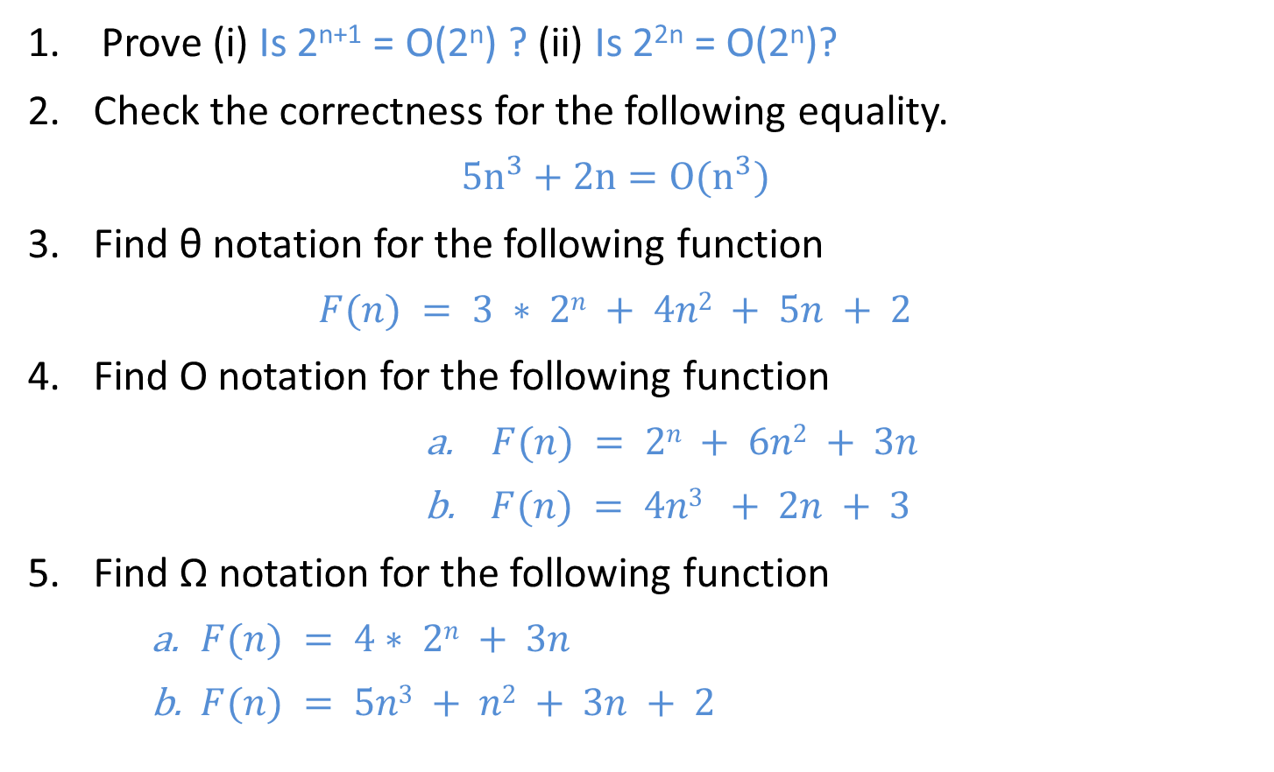
Home Work
Prove (i) Is 2^{n+1} = O(2^{n}) ? (ii) Is 2^{2n} = O(2^{n})?
Check the correctness for the following equality.
$$5n^{3}+2n=O(n^{3})$$
Find θ notation for the following function
$$F(n) = 3 ∗ 2n + 4n2 + 5n + 2$$
Find O notation for the following function
$F(n) = 2n + 6n2 + 3n$
$F(n) = 4n3 + 2n + 3$
Find Ω notation for the following function
$F(n) = 4∗ 2n + 3n$
$F(n) = 5n3 + n2 + 3n + 2$

Slide 37
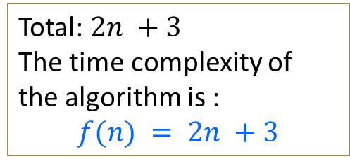
Sum of n Elements of Array
Algorithm
//Input: int A[n], array of n integers
//Output: Sum of all numbers in array A
int Sum(int A[], int n)
{
int s=0;
for (int i=0; i<n; i++)
s = s + A[i];
return s;
}
n
1
Total: $2n +3$
The time complexity of the algorithm is :
$$f(n) = 2n +3$$

Slide 38

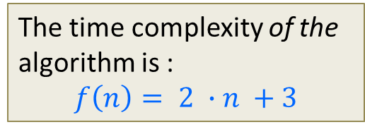








Running Time of Algorithm
Estimated running time for different values of $n$:
As $n$ grows, the number of steps grow in linear proportion to $n$ for the given algorithm Sum.
The time complexity of the algorithm is :
$$f\left(n\right)= 2 ∙n +3$$
$$n=10$$
$23$ steps
$$n=100$$
$203$ steps
$$n=1000$$
$2,003$ steps
$$n=10000$$
$20,003$ steps

Slide 39
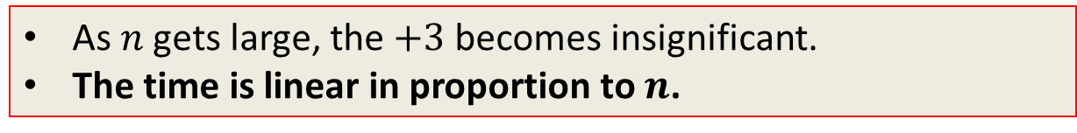

Running Time of Algorithm
The dominating term in the function of time complexity is $n$:
The time complexity of the algorithm is :
$$f\left(n\right)= 2 ∙n +3$$
$$n=10$$
$23$ steps
$$n=100$$
$203$ steps
$$n=1000$$
$2,003$ steps
$$n=10000$$
$20,003$ steps
As $n$ gets large, the $+3$ becomes insignificant.
The time is linear in proportion to $n$.

Slide 40


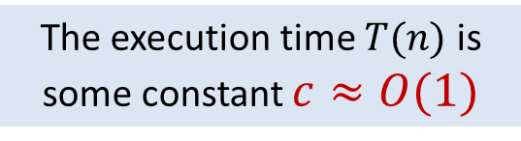





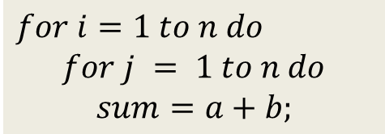

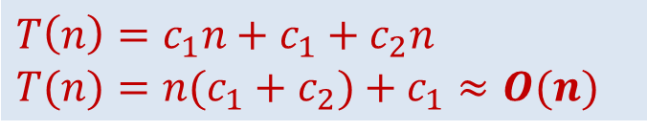

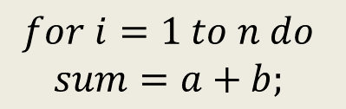


Analyzing Control Statement
Example 1:
$$sum=a+b$$
$$c$$
Example 3:
$$c_{1} \left(n+1\right)$$
$$for i=1 to n do$$
$$for j = 1 to n do$$
$$sum=a+b;$$
Statement is executed once only
$$c_{2} n \left(n+1\right)$$
The execution time $T(n)$ is some constant $c≈O(1)$
$$c_{3}∗n∗n$$
Analysis
$$T(n)=c_{1}(n+1)+c_{2}n(n+1)+c_{3}n(n)$$
Example 2:
$$T(n) =c_{1}n+c_{1}+c_{2}n2+c_{2}n+c_{3}n2$$
$$∗\left(n+1\right)$$
$$for i=1 to n do$$
$$sum=a+b;$$
$$c_{1}$$
$$T(n) = n2(c_{2}+c_{3}) + n(c_{1}+c_{2}) +c_{1}$$
$$∗\left(n\right)$$
$$T(n) = an2 + bn + c$$
$$c_{2}$$
Total time is denoted as,
$$T(n)=O\left(n^{2}\right)$$
$$T\left(n\right)=c_{1}n+c_{1}+c_{2}n$$
$$T(n)=n(c_{1}+c_{2})+c_{1}≈O(n)$$

Slide 41

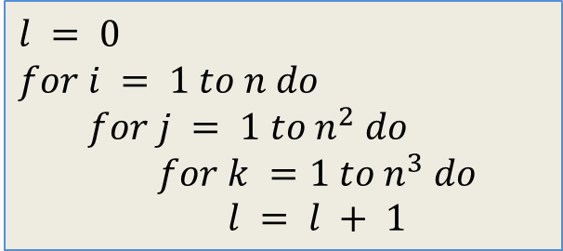

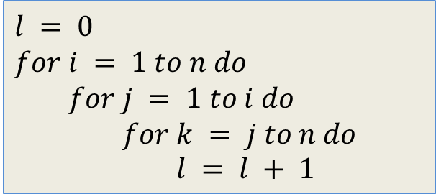


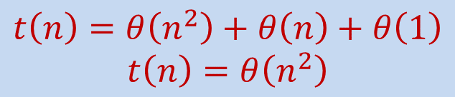


Analyzing Control Statement
Example 4:
Example 6:
$$l = 0$$
$$for i = 1 to n do$$
$$for j = 1 to i do$$
$$for k = j to n do$$
$$l = l + 1$$
$$for j = 1 to n do$$
$$for k = 1 to j do$$
$$sum = sum + j∗k$$
$$for l =1 to n do$$
$$sum=sum− l + 1$$
printf(“sum is now %d”,$sum$)
$$θ\left(n^{2}\right)$$
$$θ\left(n\right)$$
$$t\left(n\right)=θ\left(n^{3}\right)$$
$$θ\left(1\right)$$
Example 5:
$$t\left(n\right)=θ\left(n^{2}\right)+θ\left(n\right)+θ\left(1\right)$$
$$t\left(n\right)=θ\left(n^{2}\right)$$
$$l = 0$$
$$for i = 1 to n do$$
$$for j = 1 to n^{2} do$$
$$for k =1 to n^{3} do$$
$$l = l + 1$$
$$t\left(n\right)=θ\left(n^{6}\right)$$

Slide 42
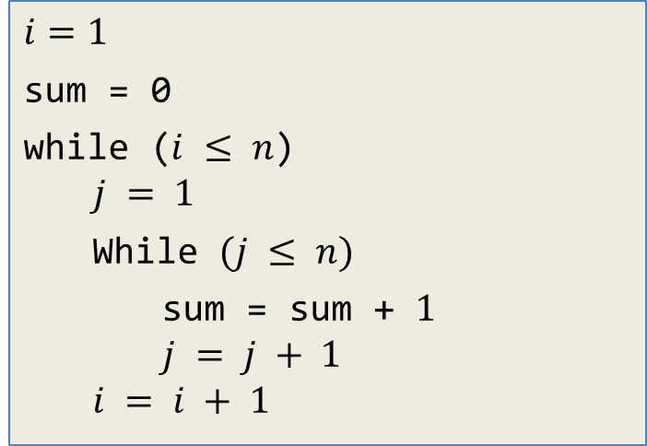
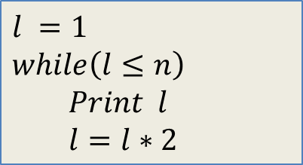

Home Work
Example 7:
Example 8:
$$l =1$$
$$while\left(l≤n\right)$$
$$Print l$$
$$l=l∗2$$
$$i=1$$
sum = 0
while ($i ≤ n$)
$$j = 1$$
While $(j ≤ n)$
sum = sum + $1$
$$j = j + 1$$
$$i = i + 1$$
Example 9:
$$for\left(i=0;i<n;i++\right)$$
$$for(j=n;j>0;j−−)$$
$$if\left(i<j\right)$$
$$c=c+1$$

Slide 43


