Slide 1
Insurance AGENT SAMURAI
Power Point Presentation On
Swami Keshvanand Institute of Technology
Submitted to
Mr. Shubham Gupta
CSE Department
Submitted by
Vishal Chauhan 12ESCS762
Ajay Sharma 12ESKCS704
Amit Jangir 12ESKCS708
Manoj Kumar Gupta 12ESKCS732

Slide 2
Introduction
The Insurance agent’s Samurai system meant for insurance agent that automate most of the functionalities in the insurance policy related activities.
This system have the facility to enter the customer details who wants to take an insurance scheme.
The system is able to provide necessary illustrations and calculate the premium amount.

Slide 3
Key Features
Giving sound financial advisory service and customer support to the client.
Client friendly environment of System
Admin Supervision over Insurance Agents
Agent is provided with interactive user interface

Slide 4
Software Requirement
Client on Internet
Web Browser, Operating System (any)
Client on Intranet
Web Browser, Operating System (any)
Web Server
Apache Tomcat version 7.0
Data Base Server
MySQL Server version 5.0.67
Development End
RSA(Rational Software Architecture),HTML,JSP & other supporting language

Slide 5
Tools Required
Development tool – NetBeans IDE
Eclipse
Microsoft Visual Studio
IBM Rational Software Architect
Web browsing tool- Google chrome

Slide 6
Users Charactistics
End Users
No specific knowledge or skills are required from the end user.
End user only needed to have basic idea about computer operations.
Administrator
Administrator must be having good knowledge of Database.
The product should be installed properly at web server.
Recovery of the client data can be done if proper backups of DB2 are taken regularly

Slide 7
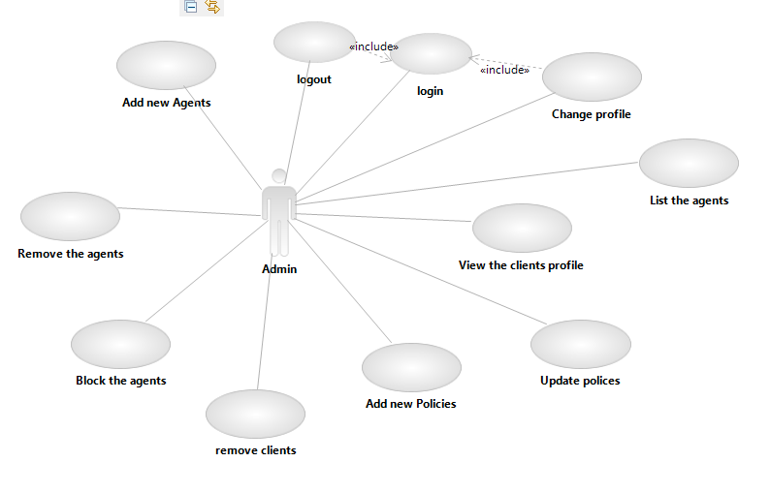
Admin :Use Case

Slide 8
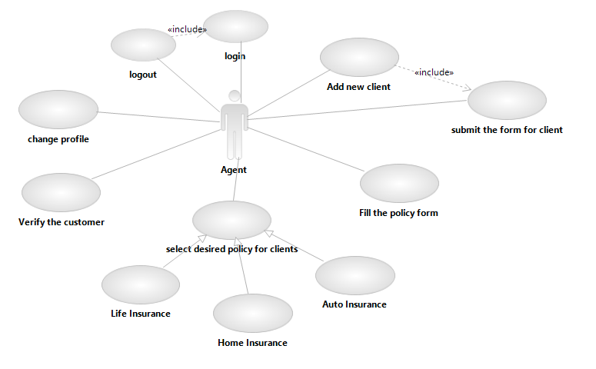
Agent: Use Case

Slide 9
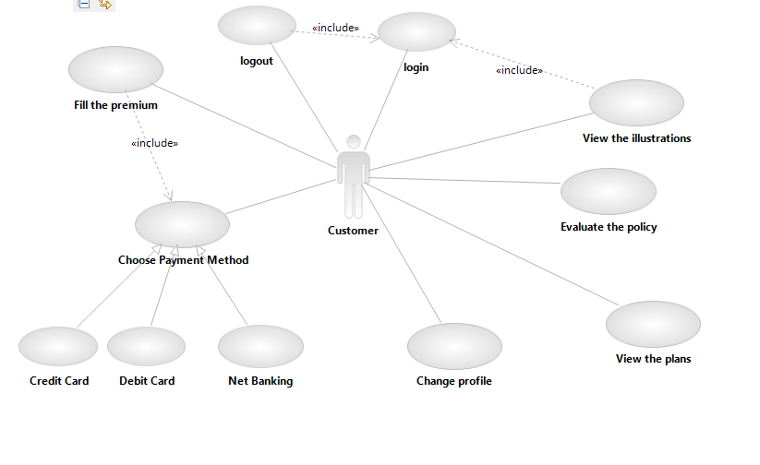
Client :Use Case

Slide 10
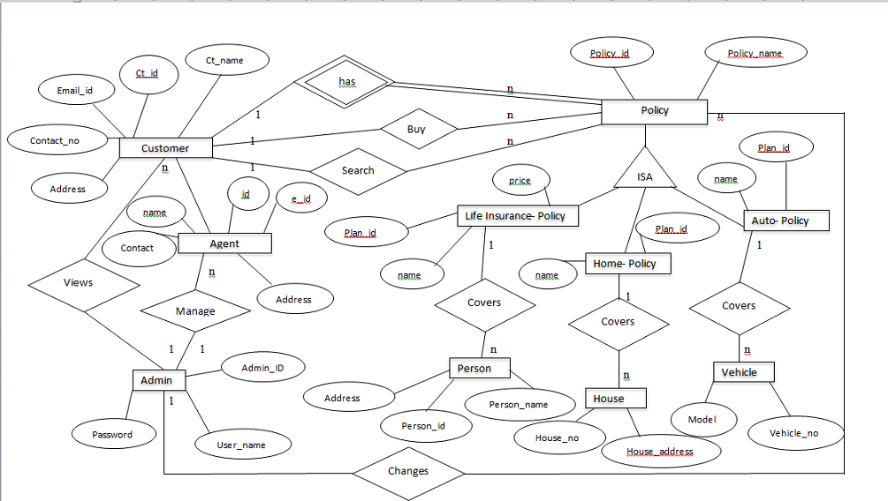
Entity Relationship Diagram

Slide 11
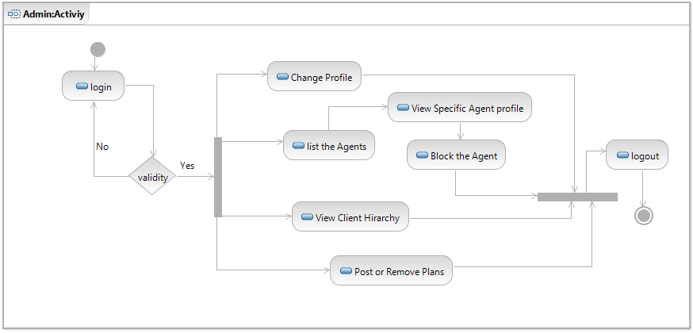
Admin : Activity

Slide 12
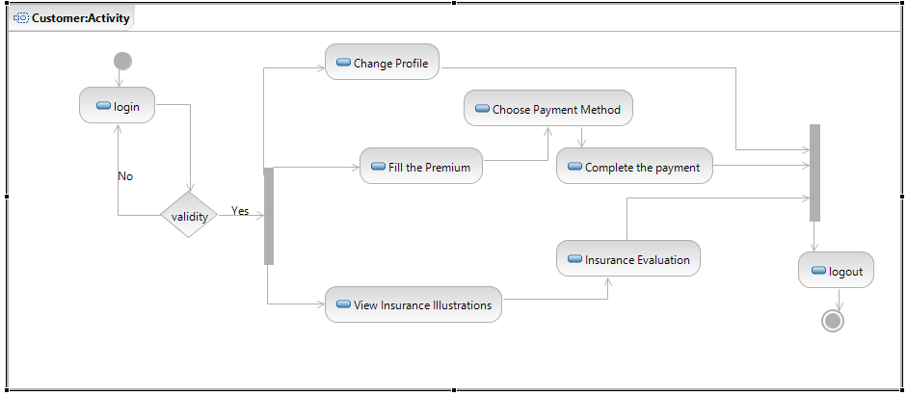
Agent : Activity

Slide 13
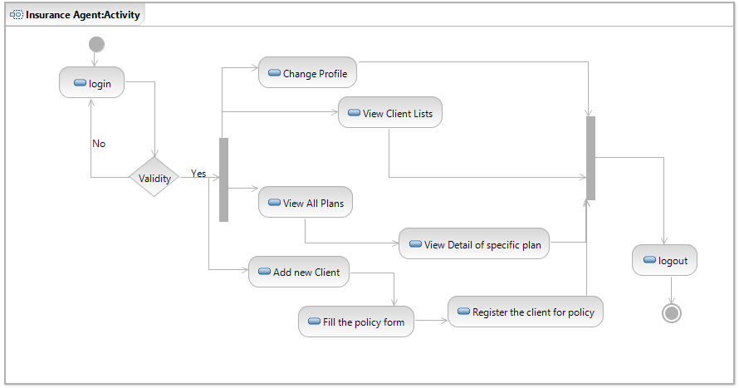
Client : Activity

Slide 14
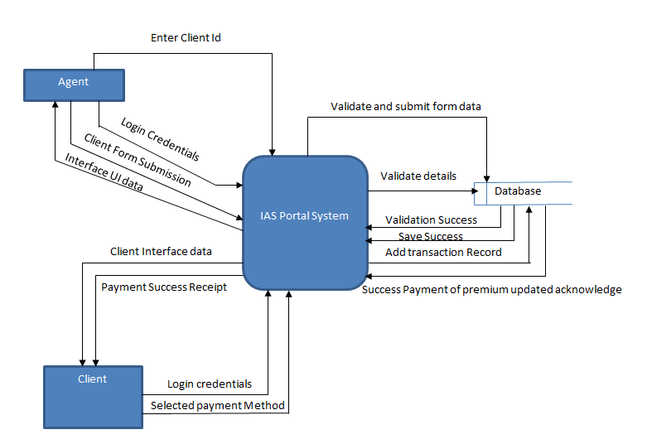
Data Flow Diagram:0 level

Slide 15
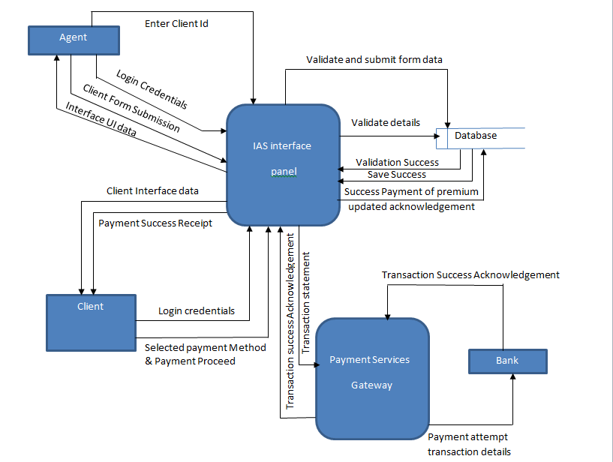
Data Flow Diagram: Level 1

Slide 16
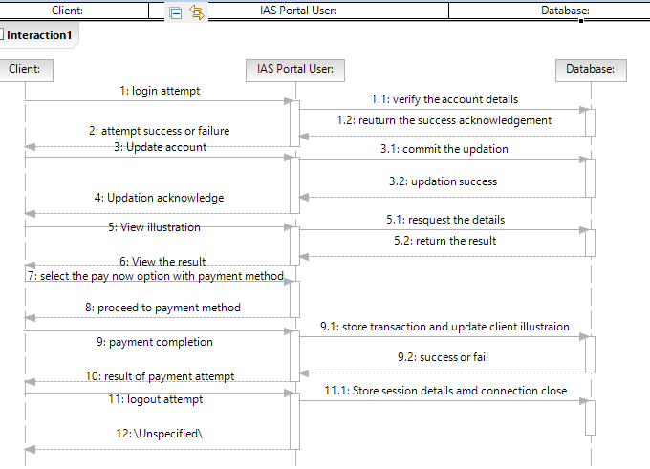
Client Sequence Diagram

Slide 17
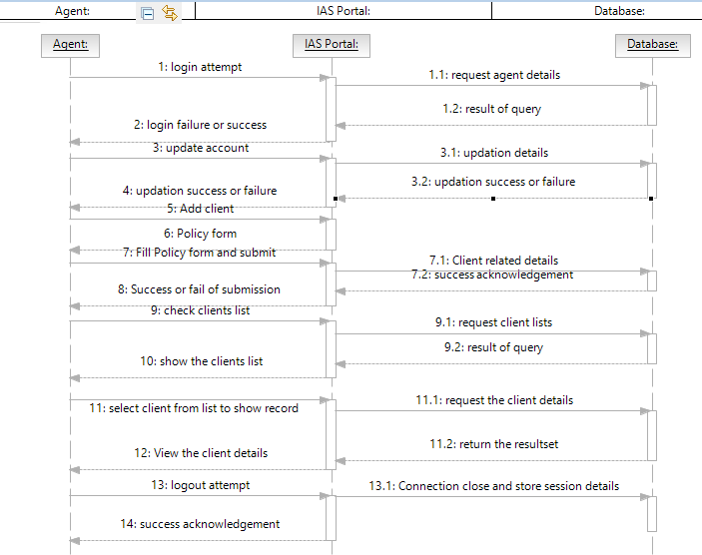
Agent Sequence Diagram:

Slide 18
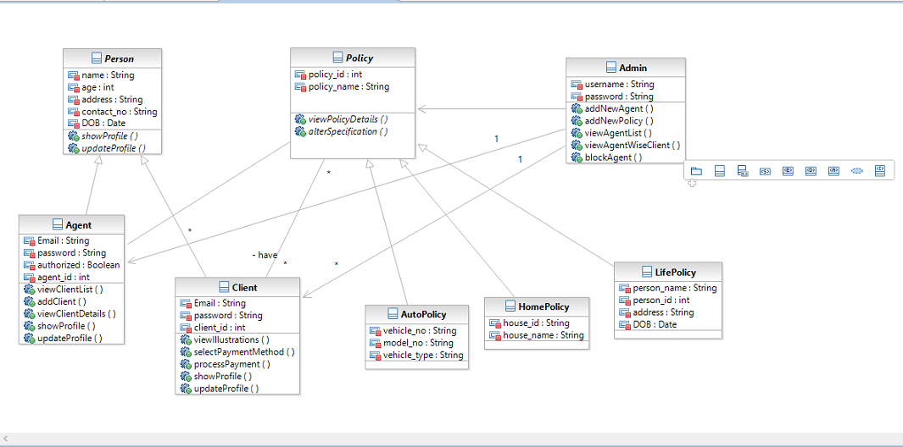
Class Diagram IAS

Slide 19
Conclusion
This system takes responsibility to provide a very friendly environment for insurance agent to automate various facilities.
The IAS system has a very interactive design for the clients.
The IAS system proves to be a very great alternative for a insurance policies facilities.

Slide 20
Thank You…..

