Slide 1

Digital Marketing Training Slide

Slide 2
Outline
Introduction to Digital Marketing
Plan and Create Content
Publish and Engage
Analyze and Improve

Slide 3
Digital Marketing

Slide 4
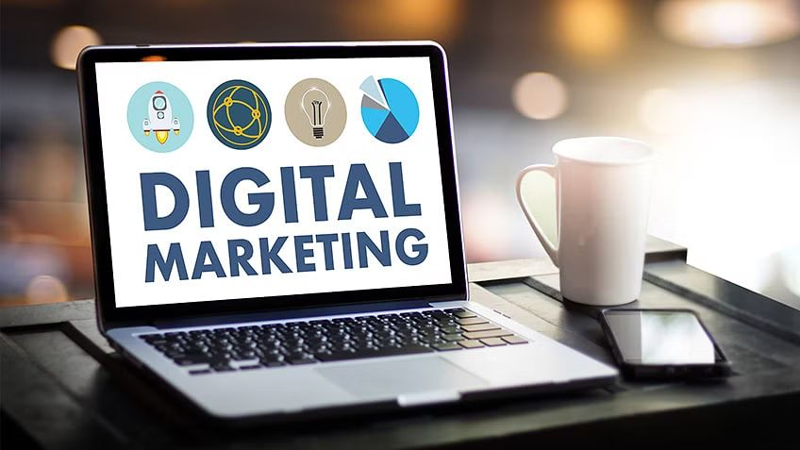
What is Digital Marketing?
Digital marketing refers to the use of digital technologies and platforms to promote products or services to a target audience

Slide 5
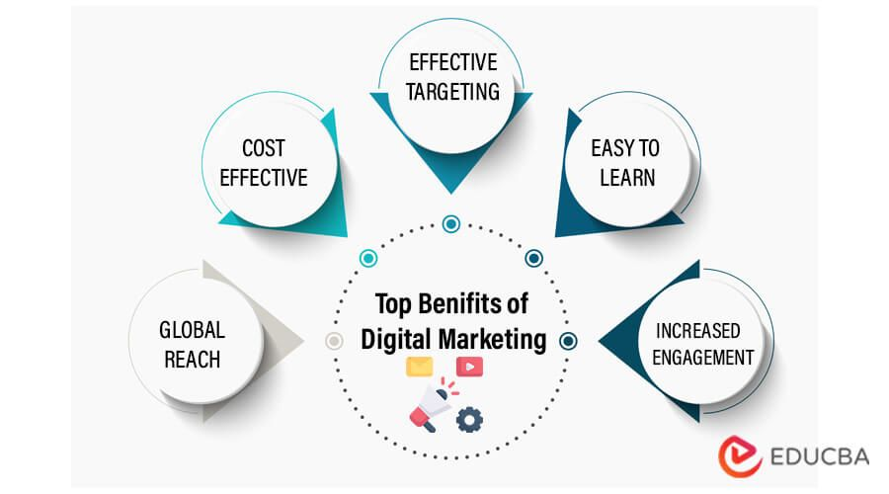
Advantages of Digital Marketing
Others
Analytics
Flexibility

Slide 6
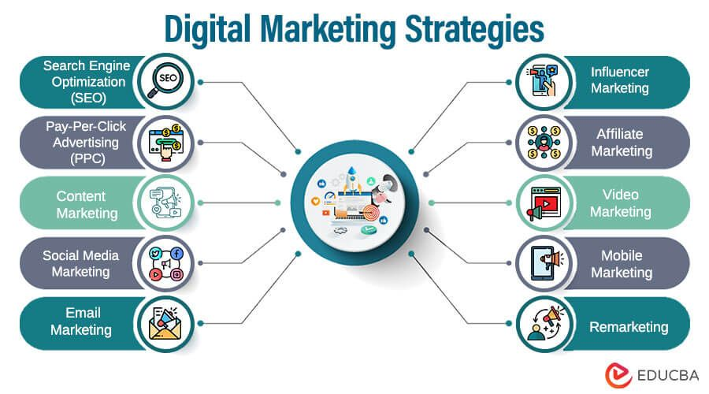

Slide 7
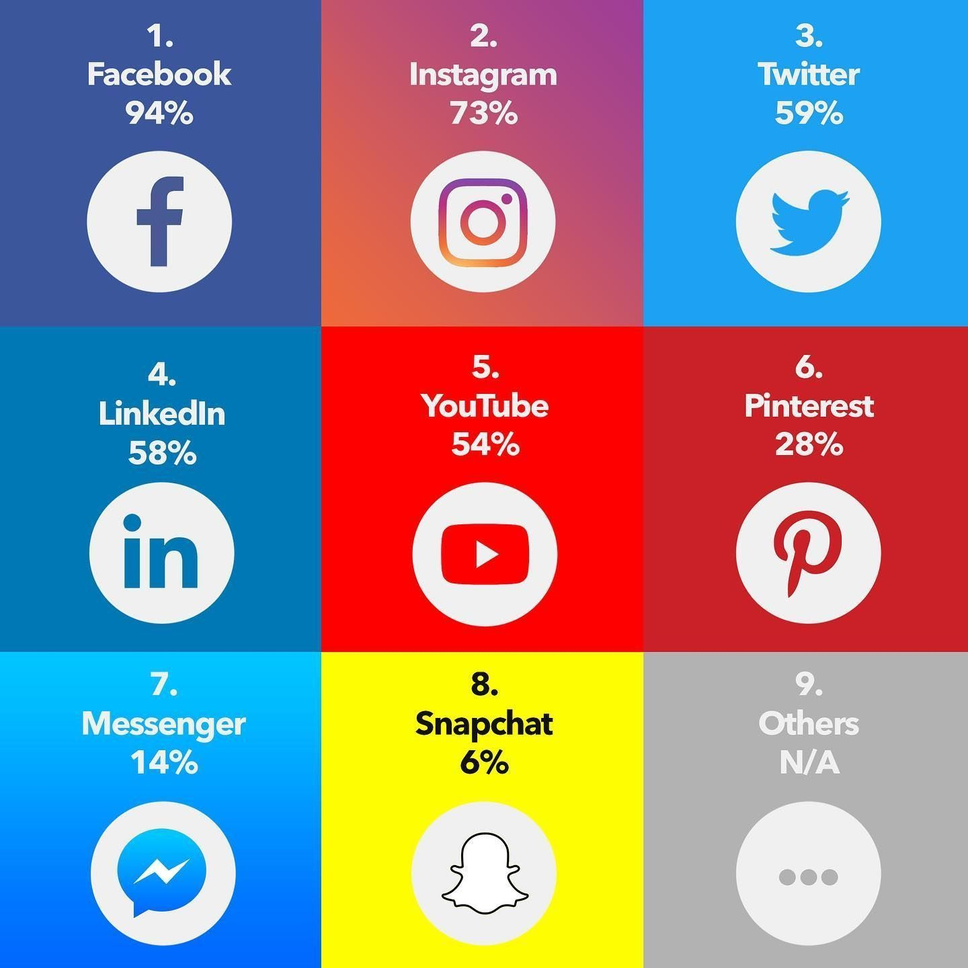
Most Popular Social Media Platforms used for Digital Marketing in 2019

Slide 8
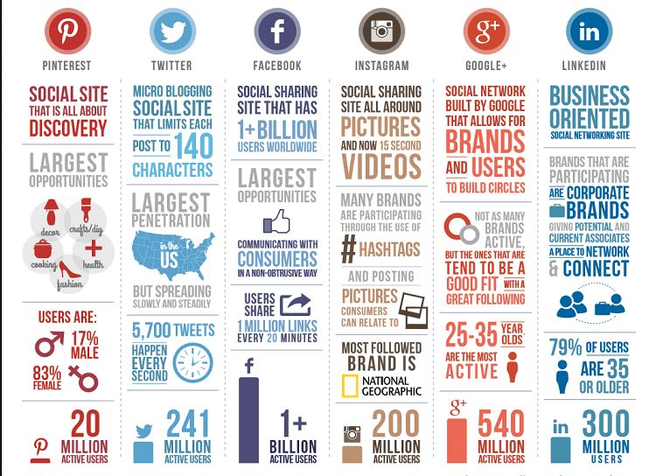

Some Quick Facts
As the largest video-sharing platform,

Slide 9
Social
Media
Marketing
Process
Plan and Create Content
Publish and Engage
Analyze and Improve

Slide 10
Plan and Create Content
Goals, audience, platform, content creation

Slide 11
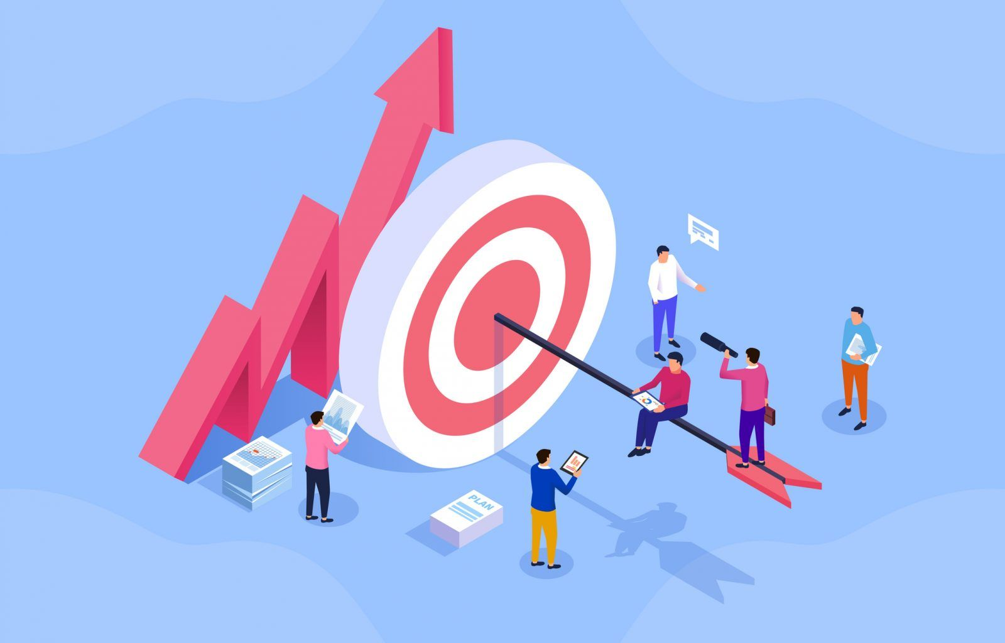
Goals
Desired outcomes that businesses aim to achieve through their social media marketing efforts.

Slide 12
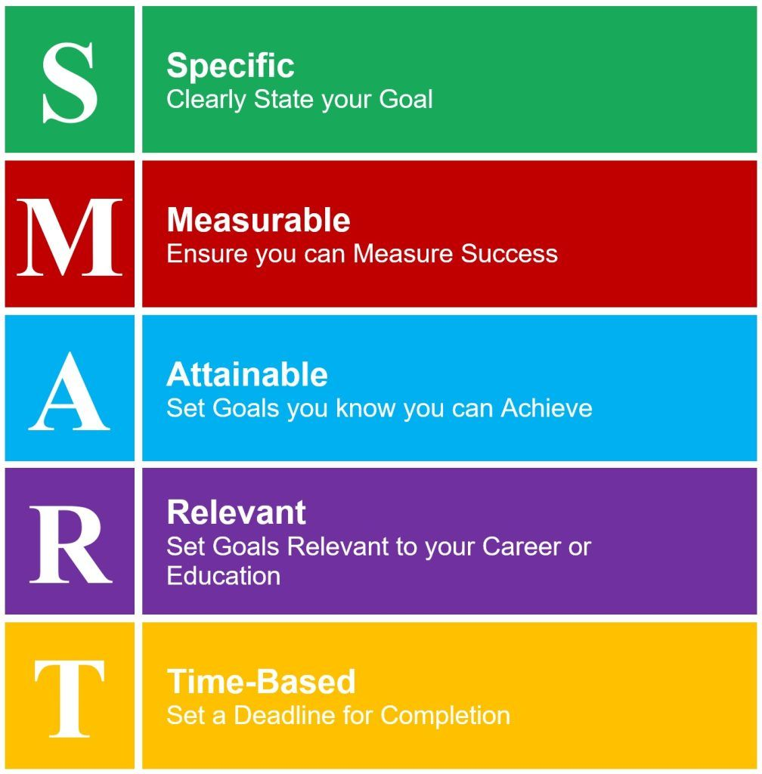
Set SMART Goals

Slide 13
Goals: Examples of Goals
Increasing brand awareness
Driving website traffic,
Generating leads,
Boosting sales,
improving customer engagement and loyalty.

Slide 14
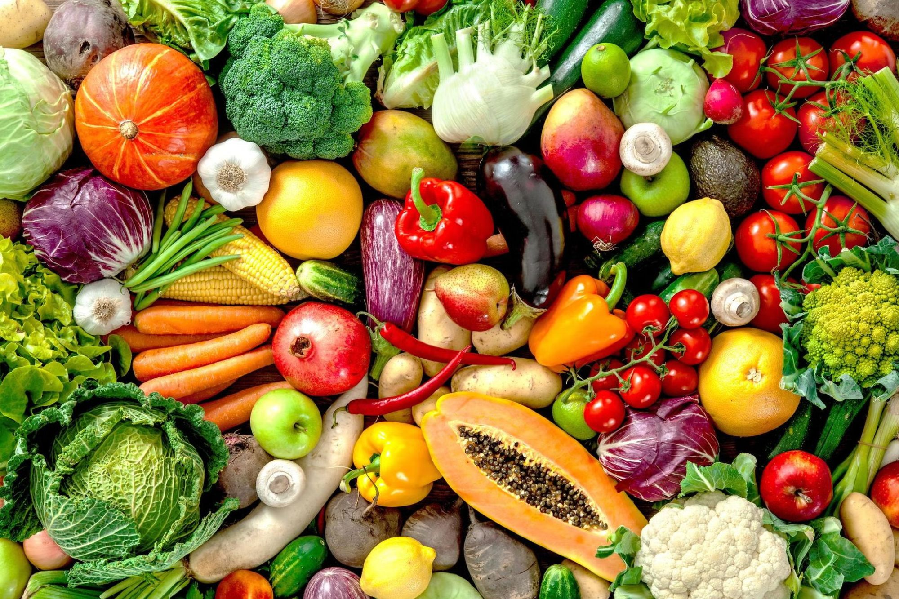
Goals: Use Case for BestAgro Business
Business Goal:
Establish a solid online presence and build an engaged community of followers.

Slide 15
Goals: Use Case for BestAgro Business
Make the Goals SMART
Within the next three months, I aim to create and grow an active and engaged community of 500 followers on our primary social media platform.

Slide 16
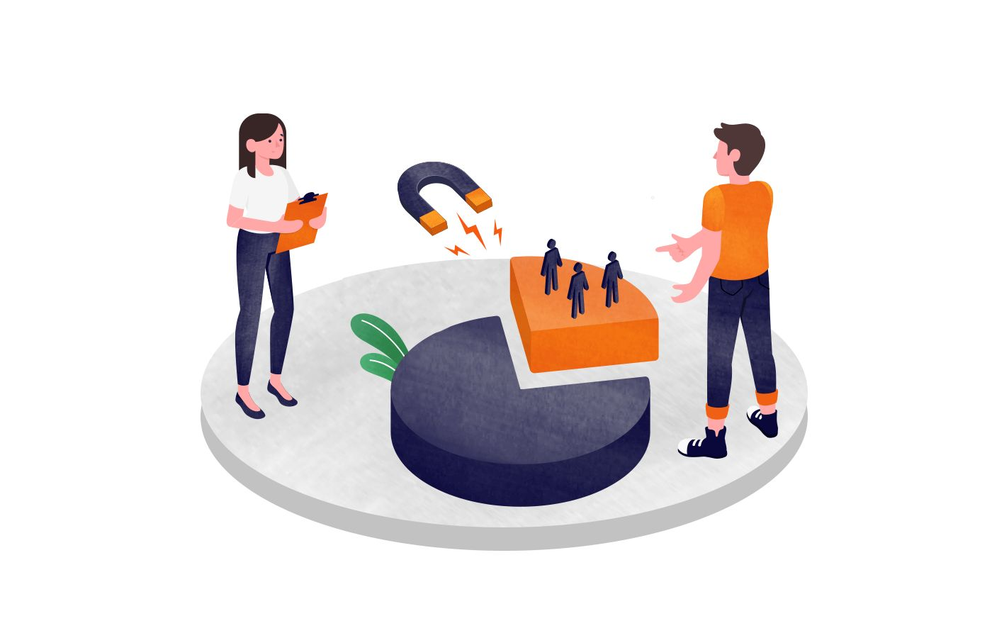
Understanding Target Audience:
Demographics (Statistical Information)
Age, gender, income level, education, and marital status
Psychographics (Behavioral Information)
Interests, hobbies, values, attitudes, and lifestyle choices

Slide 17
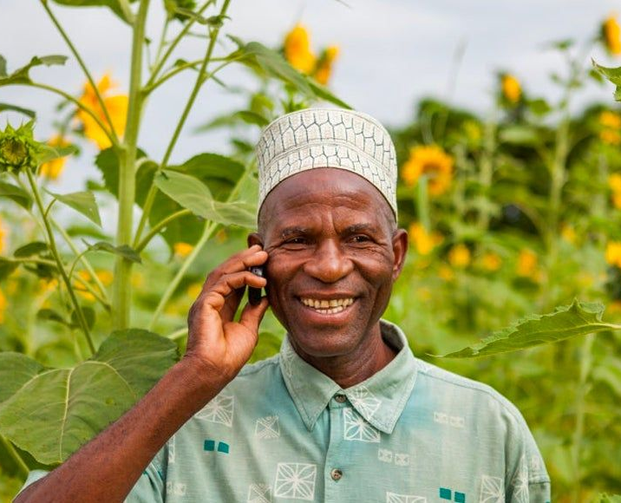
Audience: Use Case for BestAgro Business
Local Consumers
Restaurant and Cafe
Farmer Market
Super Markets

Slide 18
Audience: Demographics of Local Consumers
- Age: Broad range from young adults to seniors.
- Family Status: May include families with children, couples, or individuals.
- Income: Varied income levels, from low to high, depending on the local community.
- Location: Residents of the local community where the farm is located.

Slide 19
Audience: Demographics of Super Market
- Age: Super Market owners or managers can vary in age, but they are typically adults with business acumen.
- Income: Varies based on the size and success of the store.
- Location: Local grocery stores within the farm's distribution radius.

Slide 20
Audience: Psychographics of Local Consumers
Lifestyle: Local consumers seeking fresh vegetables may prioritize a healthy and sustainable lifestyle.
Values: Quality, freshness, and supporting local agriculture are likely important to them.
Behaviors: They may actively seek out locally grown produce, visit farmers' markets, and prefer seasonal and organic options.

Slide 21
Audience: Psychographics of Local Consumers
Lifestyle: Local consumers seeking fresh vegetables may prioritize a healthy and sustainable lifestyle.
Values: Quality, freshness, and supporting local agriculture are likely important to them.
Behaviors: They may actively seek out locally grown produce, visit farmers' markets, and prefer seasonal and organic options.

Slide 22
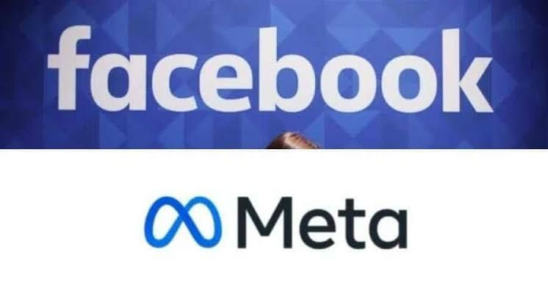



Select Your Platform
Facebook is the largest platform with a diverse user base across different age groups.
Instagram is popular among younger audiences and focuses on visual content.
Twitter is known for its real-time updates and appeals to those who prefer concise messaging.
LinkedIn is primarily used for professional networking and B2B marketing.
YouTube is a video-sharing platform with a wide range of content.

Slide 23
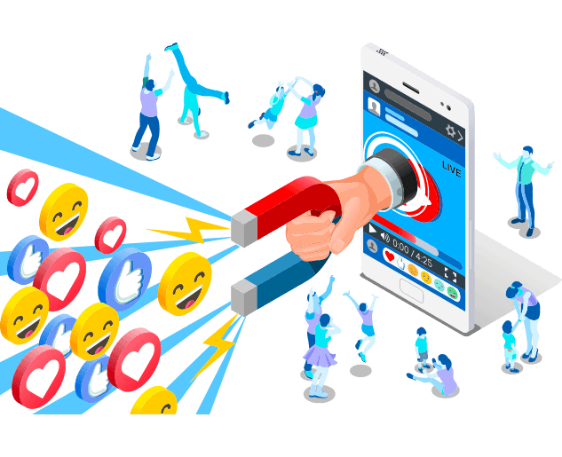
Creating Compelling Social Media Content
They need to be concise, compelling, and clear.
Effective headlines grab users' attention, while descriptions provide context and encourage engagement.
They should prompt users to take action or engage with the content further.

Slide 24
Creating Content: Use Case for BestAgro Business
"Fresh Organic Tomatoes: Picked with Care from Our Farm to Your Table 🍅"
"Celebrate the essence of freshness with our organic tomatoes! 🍅 Grown with meticulous care and a commitment to sustainable farming, these vibrant gems are handpicked from our farm and delivered straight to your table. Experience the unbeatable flavor and goodness of locally sourced, pesticide-free produce. Savor the taste of nature's perfection today!"

Slide 25
Creating Content: Use Case for BestAgro Business
Farm-to-Table Delights: Juicy Watermelons Available Now! 🍉
Quench your thirst for freshness with our farm-to-table watermelons! 🍉 Bursting with juiciness and sweetness, these delectable delights are now in season. Our commitment to quality ensures you get the very best from our fields to your plate. Dive into a slice of summer perfection and taste the essence of nature's bounty. Get your juicy watermelons today.

Slide 26
Creating Content: Use Case for BestAgro Business
From Our Farm to Your Plate: BestAgro's Finest Harvest 🌾
Experience the taste of farm-fresh excellence with BestAgro! 🌾 Our dedication to quality shines through in every harvest. From our fields straight to your plate, our finest produce awaits. Immerse yourself in the flavors of nature's bounty and savor the goodness of locally sourced, meticulously grown crops. Elevate your meals with the freshness that sets BestAgro apart.

Slide 27
Creating Content: Use Case for BestAgro Business
Examples of bad headlines and description
1. Tomatoes for sale.
We have tomatoes. Buy now.
2. Watermelons in stock.
Fresh watermelons available.
3. Our harvest.
We grow stuff.

Slide 28
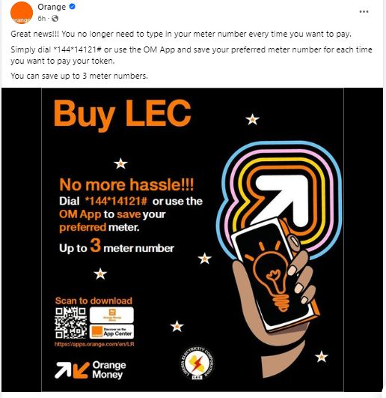
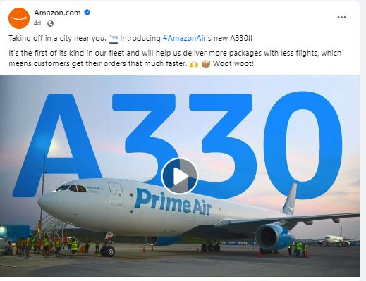
Creating Content: Incorporating Visuals

Slide 29
Publish and Engage
Share regularly and engaging with audience

Slide 30
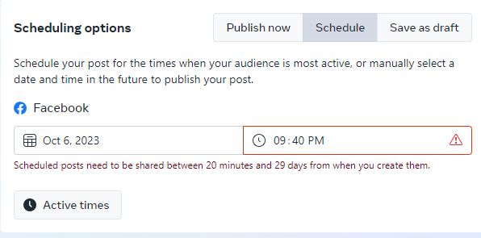
Publishing and Engage: Scheduling

Slide 31

Publishing and Engage
Determining Content Themes and Categories:
Establishing a Consistent Brand Voice and Tone

Slide 32
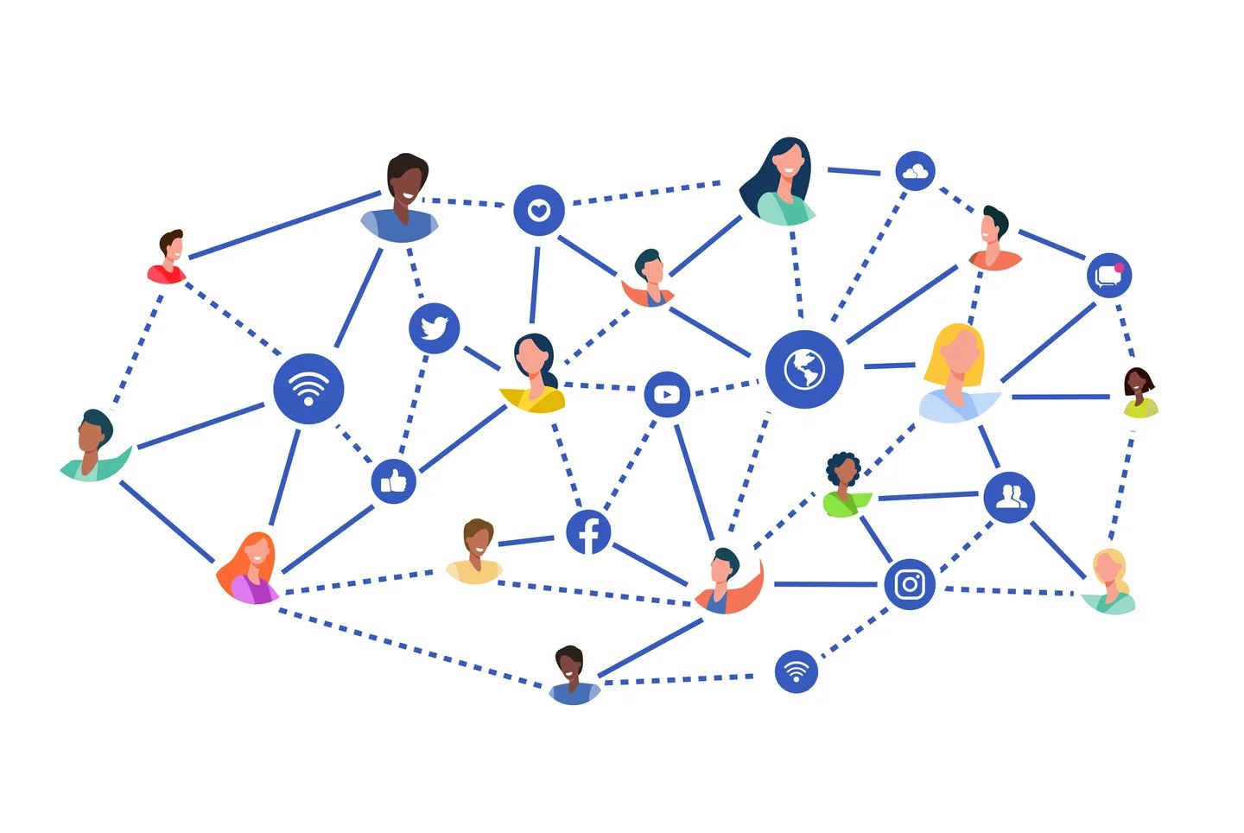
Engaging and Growing a Social Media Community
Building and nurturing relationships with Followers.
Responding to Comments, Messages, and Mentions
Encouraging User-Generated Content and Social Sharing

Slide 33

Understanding Paid Advertizing Options
These options include:
sponsored posts,
display ads,
video ads, and
influencer collaborations.

Slide 34
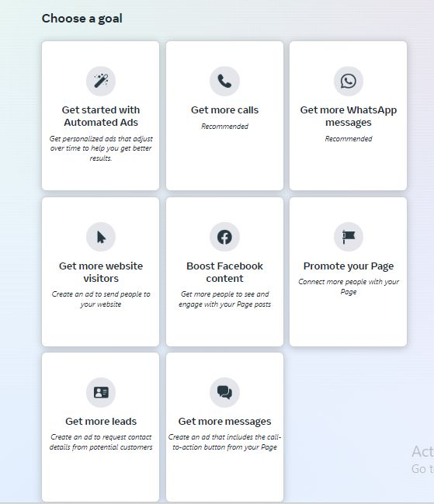
Paid Advertising Options on Social Media Platforms:

Slide 35
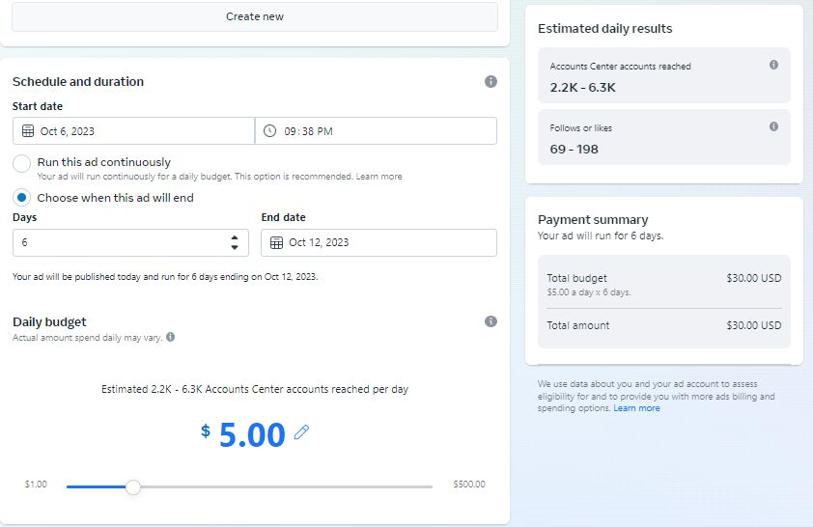
Engaging and Growing a Social Media Community

Slide 36
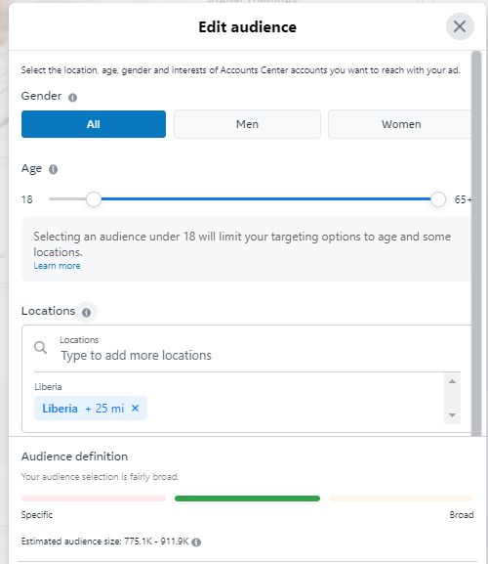
Setting up Targeted Ad Campaigns:

Slide 37
Analyze and Improve

Slide 38


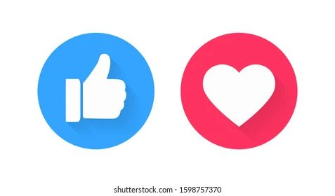
Measuring and Analyzing Social Media Metrics
Likes (or Reactions)
2. Comments
3. Shares

Slide 39



Measuring and Analyzing Social Media Metrics
4. Click-Through Rate (CTR)
5. Engagement Rate:
6. Impressions

Slide 40

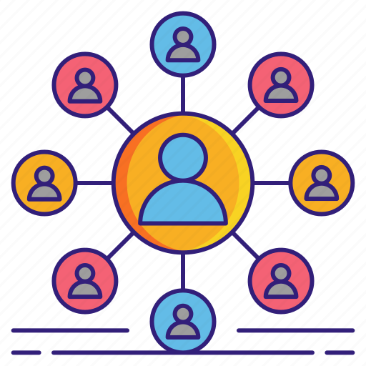

Measuring and Analyzing Social Media Metrics
7. Reach
8. Follower Growth
9. Engagement by Post Type

Slide 41
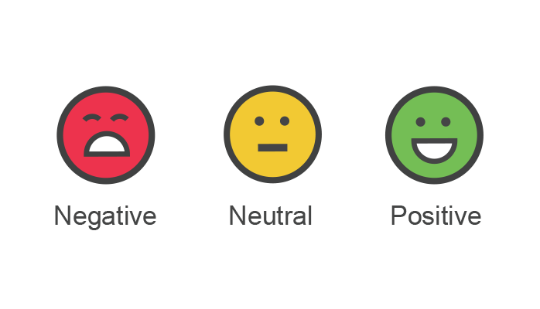


Measuring and Analyzing Social Media Metrics
10. Sentiment Analysis
11. Share Voice
12. Average Engagement Duration

Slide 42
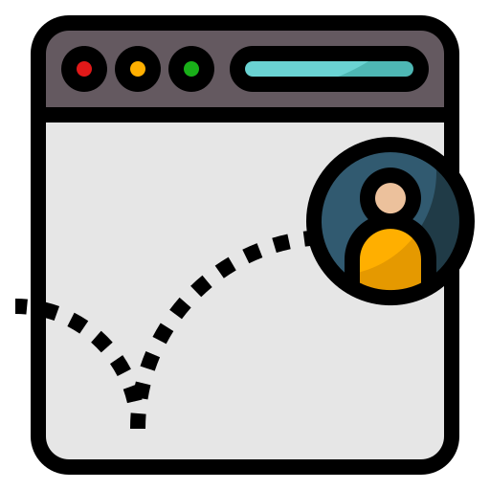
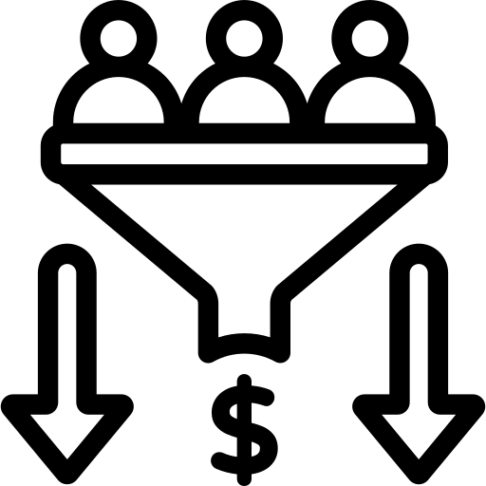

Measuring and Analyzing Social Media Metrics
13. Bounce Rate
14. Conversion Rate
15. Engagement Heat Map

Slide 43
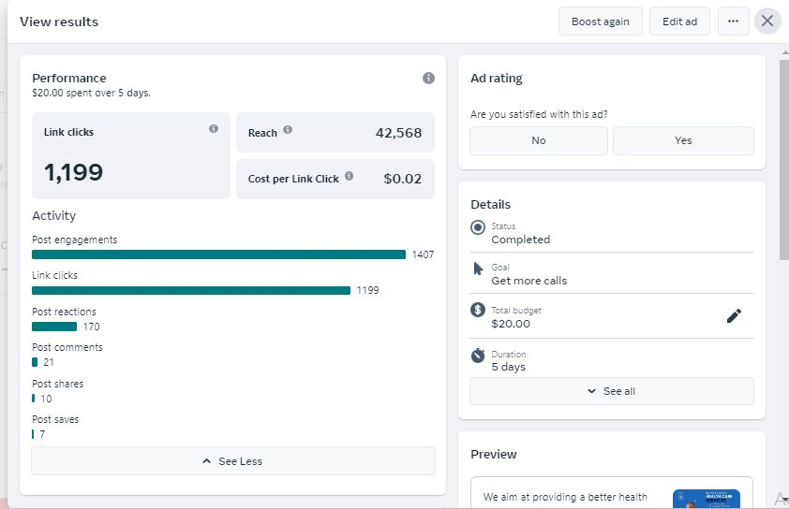
Measuring and Analyzing Social Media Metrics

Slide 44
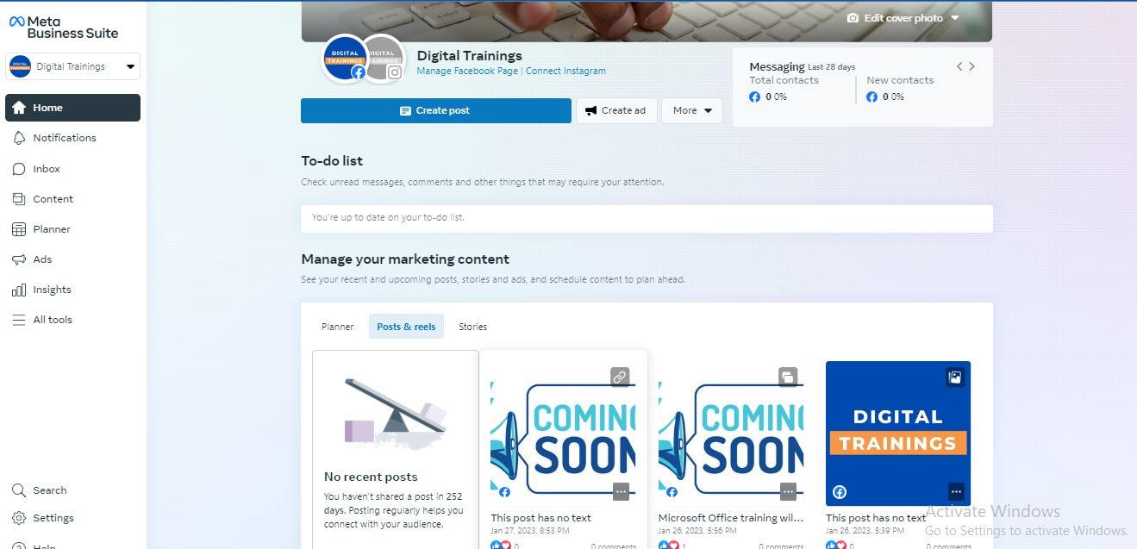
Social Media Management Tools

Slide 45
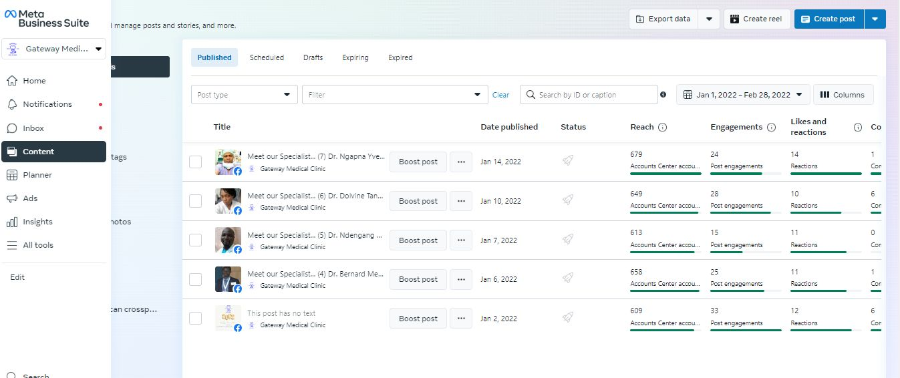
Social Media Management Tools

Slide 46
Question
and
Answer

