Slide 1
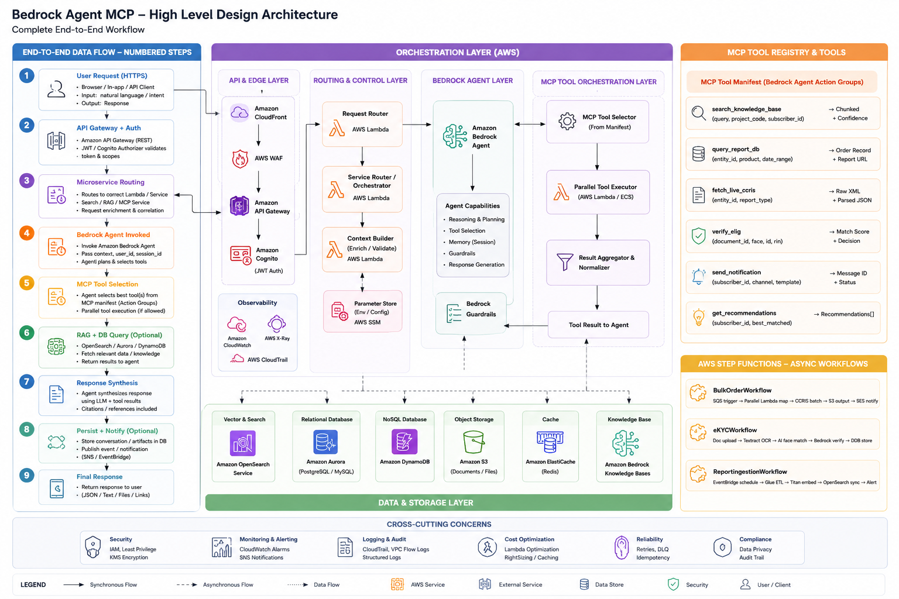
Bedrock Agent MCP — High-Level Design Architecture
End-to-End Workflow (Steps 1-9) · AWS Orchestration Layer · MCP Tool Registry · Data & Cross-Cutting Concerns
Amazon CloudFront · AWS Lambda · Amazon Bedrock Agent · MCP Protocol

