Slide 1

Company Bankruptcy Prediction Classification
By
AJAY KUMAR SADHU
Data Scientist Intern @ Learnbay.co

Slide 2
BANKRUPTCY??
Bankruptcy is a phenomenon of increasing interest in firms that stand to lose money because of unpaid debts.

Slide 3
Bankruptcy historical data of companies
This data having:
No_of_columns – 95 Nos
No_of_Rows – 6819 Nos
Shape of data=(6819 x 95)
The last column ‘Bankrupt’ which is output column having values (0 or 1)
0-Financially healthy
1-Financially unhealthy

Slide 4
Bankruptcy historical data of companies
No column is having null values
All columns are continuous and numerical except output column
‘Bankrupt’,’ _Liability-Assets_Flag’ which are numerical and categorical.

Slide 5
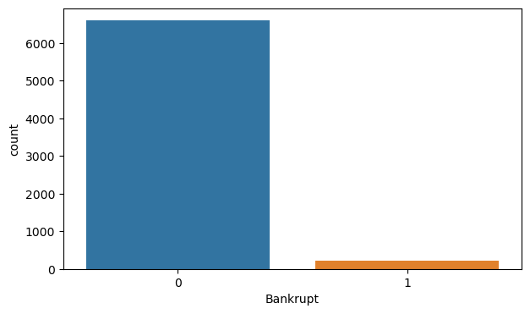
Total count of financially healthy and unhealthy companies of given data
Financially healthy (0)-6599(96.78 %)
Financially unhealthy(1)-220(3.22 %)

Slide 6
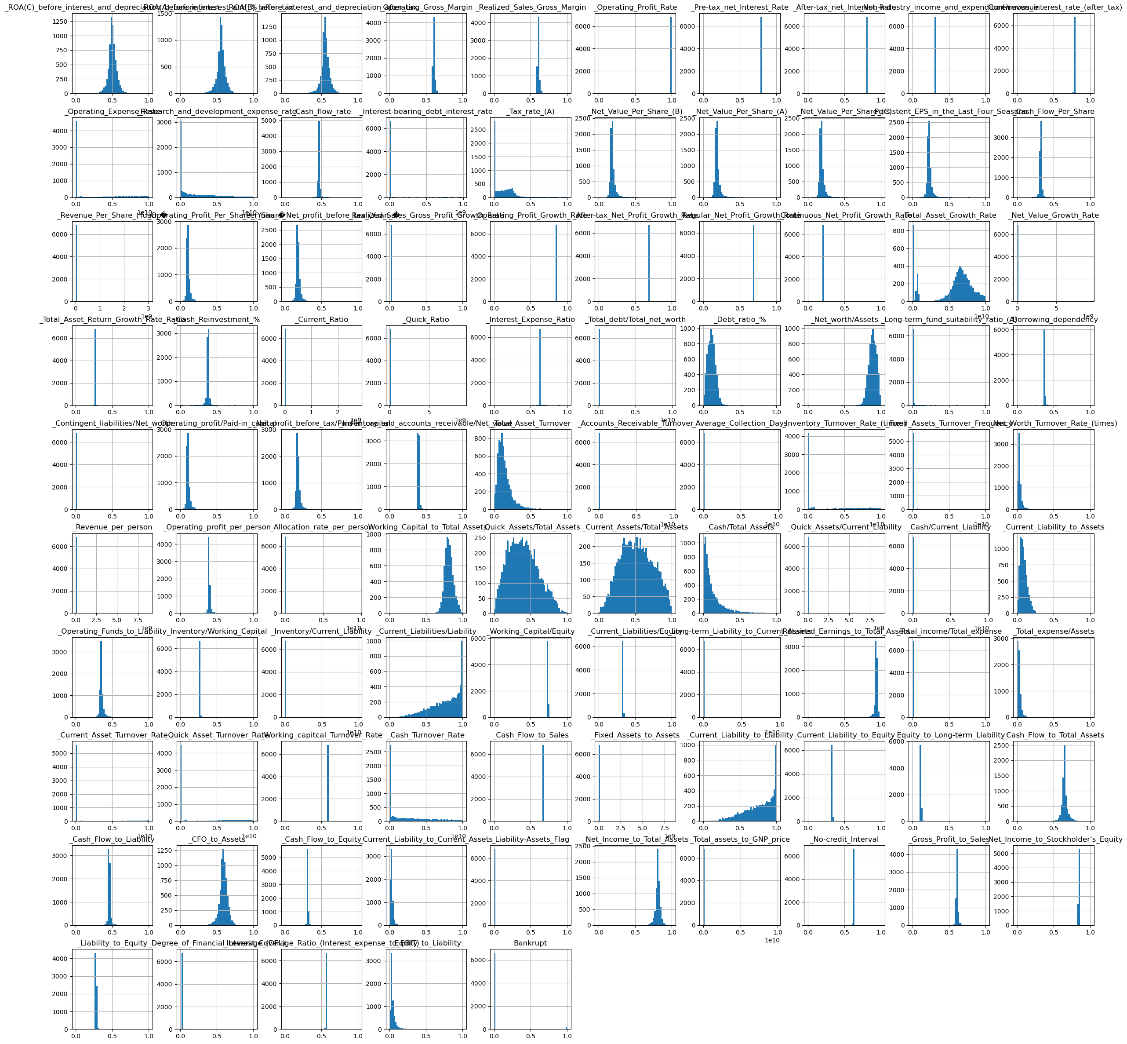
Distribution of each feature explained in the form of histogram.

Slide 7
Distribution of Features
Some features are distributed normally or approximately normally.
Some features are either left skewed or right skewed.
Skewed features has to be processed to be distributed normally before modelling for better performance of model.
Later in preprocessing I will continue on this.

Slide 8
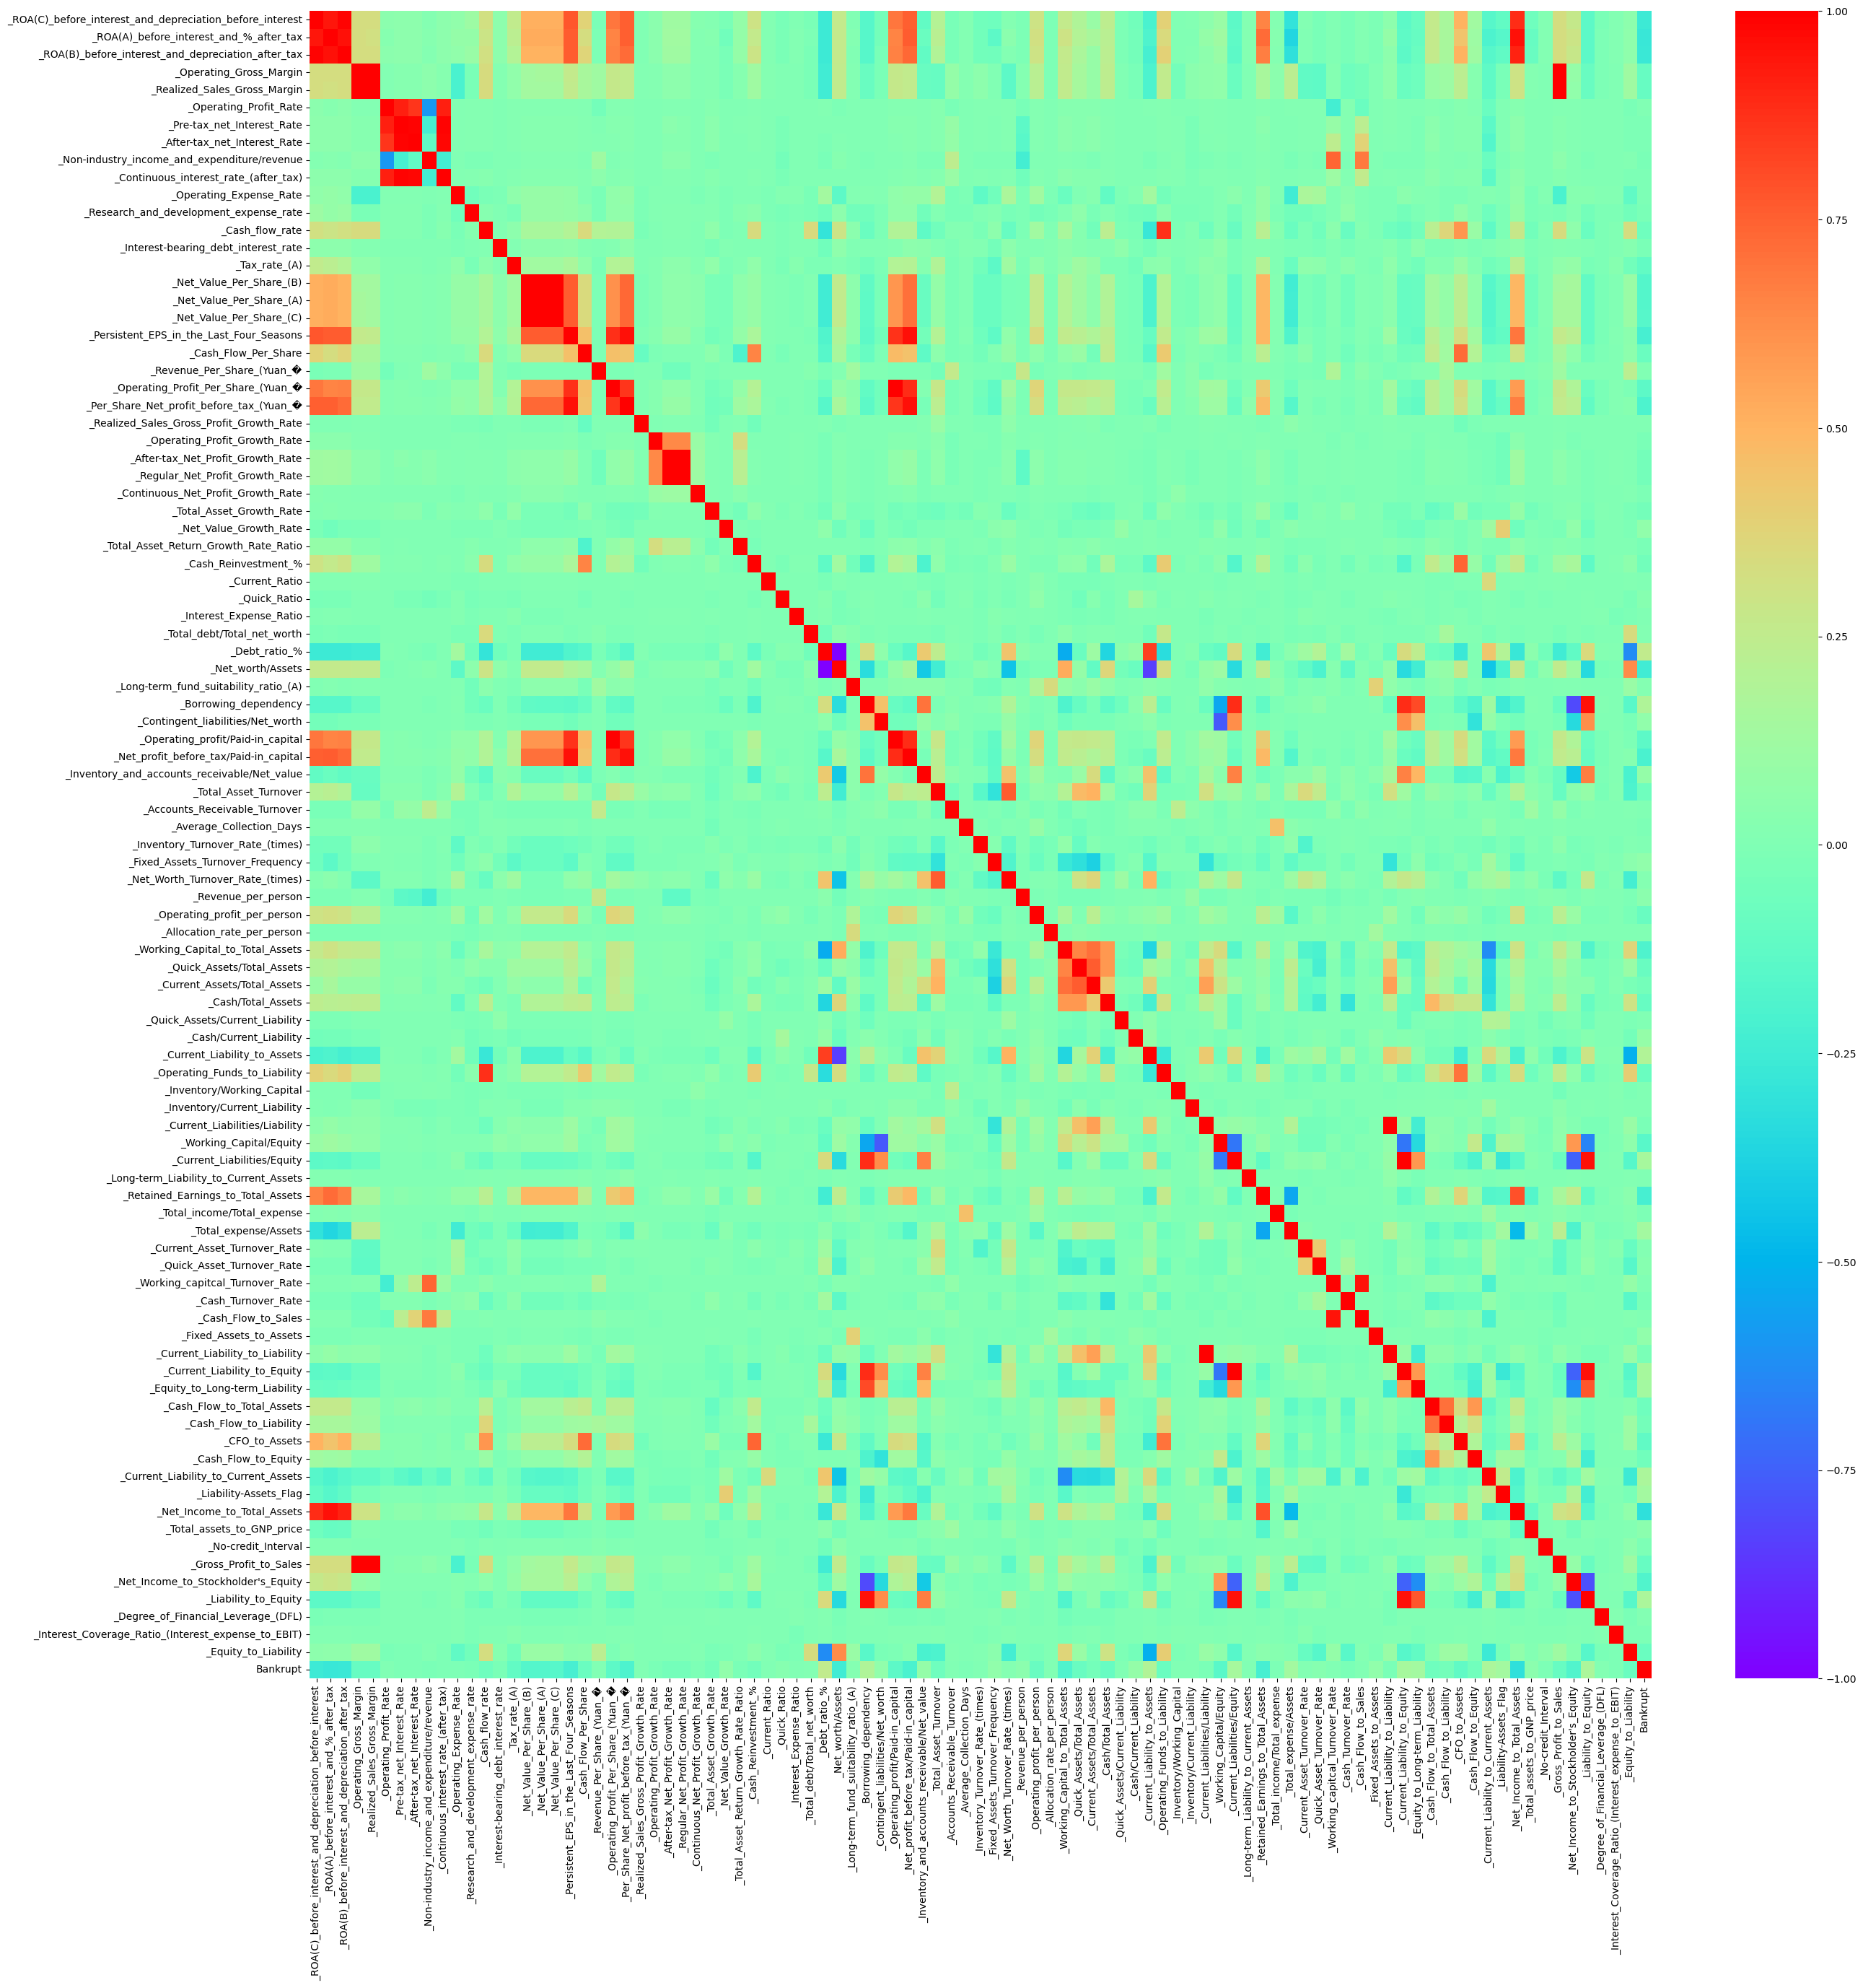
Correlation Matrix of features explained as Heat map

Slide 9
EDA based on some important features
_Net_Income_to_Total_Assets
_Total_expense/Assets
_Total_Asset_Growth_Rate
_Debt_ratio_%
_Total_Asset_Turnover
_Net_profit_before_tax/Paid-in_capital
_Working_Capital_to_Total_Assets
_CFO_to_Assets

Slide 10
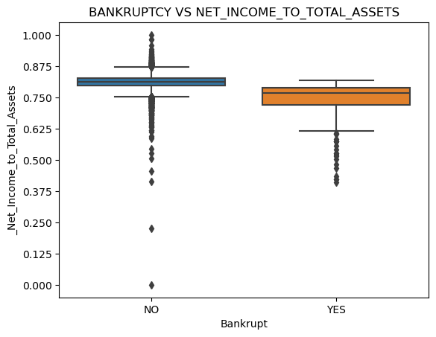
From this plot the more Net income to total asset more healthy is the company financially.

Slide 11
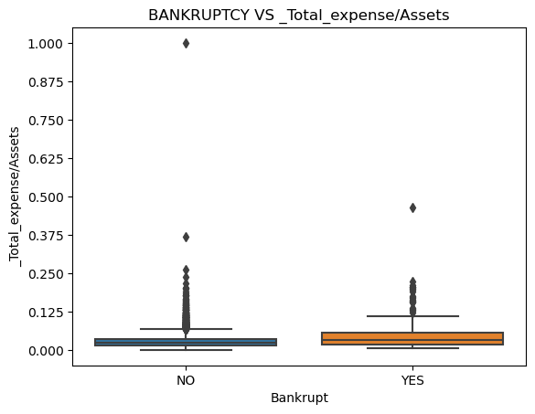
Financially unhealthy companies having this ratio a bit more compared to financially healthy companies.

Slide 12
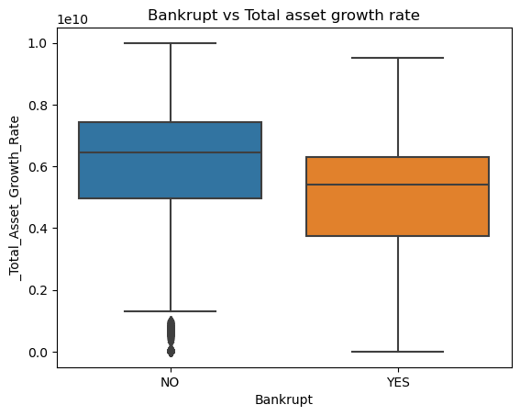
Total asset growth rate seems to be better indicator, which is high in financially healthy companies.

Slide 13
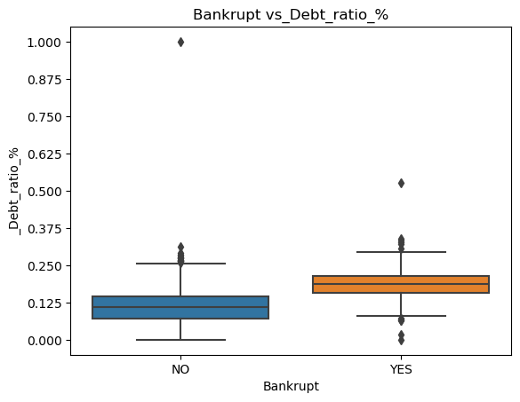
The lesser the Debt ratio percentage better is the companies financial health.

Slide 14
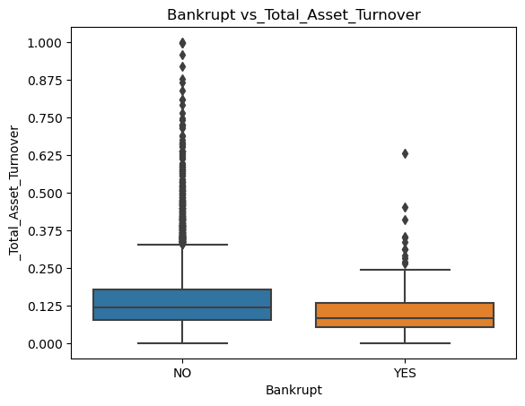
Total asset turnover is more is financially healthy companies and less in bankrupted companies.

Slide 15
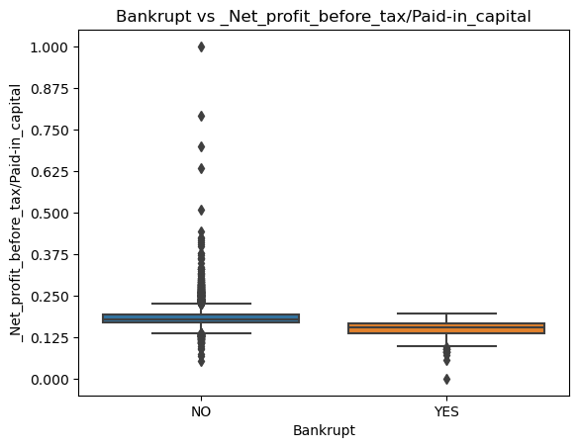
Net profit before tax to paid in capital is more in financially healthy companies and less in bankrupted companies.

Slide 16
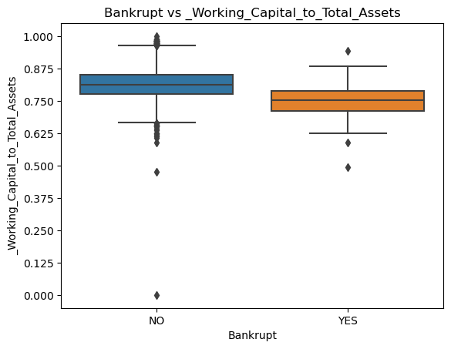
Working capital to total asset is more in financially healthy companies.

Slide 17
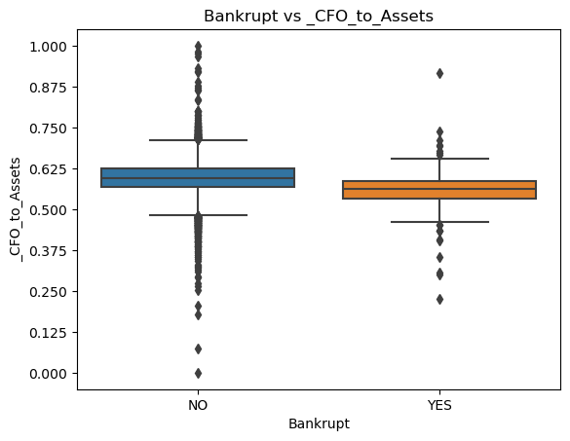
Cash flow from operations to assets is more in financially healthy companies compared to bankrupted companies.

Slide 18
PREPROCESSING
Separated input features and output label as x and y.
The data x contain no null values to impute.
THE data x contain no categorical columns to encode.
Given features are either left skewed or right skewed or both.
Handled this using a custom function by applying sqrt on a skewed feature.
Sqrt can handle only heavy tailed right skewed data.
As skewness persists after applying square root, I applied sklearn Power transformer on top of square root for further reduction of skewness.
Later Standard scalar from sklearn applied to standardize the data.

Slide 19
Model Building
First step as usual splitting the data as training set and testing set, setting stratified splitting based on the output y.
As count of unique values of y_trian has
0-Non Bankrupt-5279
1-Bankrupt-176
As we have to predict a companies status of bankruptcy, given data does not contain enough values to train a better model.

Slide 20
Model Building
Hence, I used one of oversampling technique SMOTE(Synthetic Minority Oversampling Technique)
Which will oversample minority class to required quantity by interpolating new instances using k-nearest neighbour and some distance metric.
Now the data is ready for modelling.

Slide 21
Model Building
List of models
K-Nearest neighbour classifier
Stochastic gradient descent classifier
Logistic regression
Support vector classifier
Random forest classifier
Decision tree classifier
Adaboost classifier
Gradient boosting classifier
Xgboost classifier
Voting classifier
Cross_val_predict () is a cross validation method used to validate the model based on the prediction for each and every instance given as input.

Slide 22
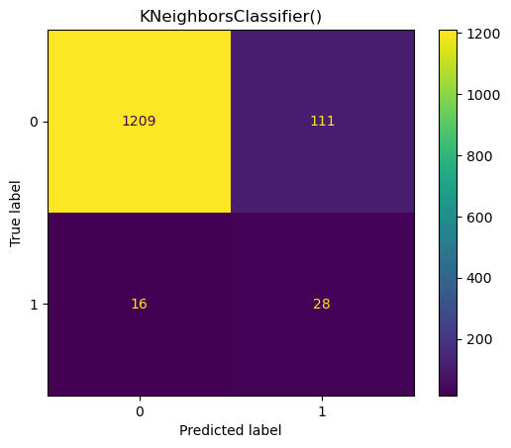
Model Building-K-nearest neighbours classifier
precision recall f1-score support
0 0.99 0.92 0.95 1320
1 0.20 0.64 0.31 44
accuracy 0.91 1364
macro avg 0.59 0.78 0.63 1364
weighted avg 0.96 0.91 0.93 1364
good recall and bad precision
F1 score is: 0.30601092896174864

Slide 23
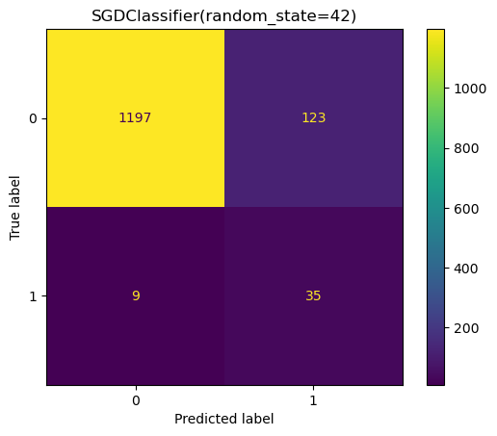
Model Building-Stochastic gradient descent
precision recall f1-score support
0 0.99 0.91 0.95 1320
1 0.22 0.80 0.35 44
accuracy 0.90 1364
macro avg 0.61 0.85 0.65 1364
weighted avg 0.97 0.90 0.93 1364
Very good recall bad precision
F1 score is:0.346534653465346

Slide 24

Model Building-Logistic regression
precision recall f1-score support
0 0.99 0.91 0.95 1320
1 0.20 0.70 0.32 44
accuracy 0.90 1364
macro avg 0.60 0.81 0.63 1364
weighted avg 0.96 0.90 0.93 1364
Very good recall bad precision
F1 score is: 0.3163265306122449

Slide 25
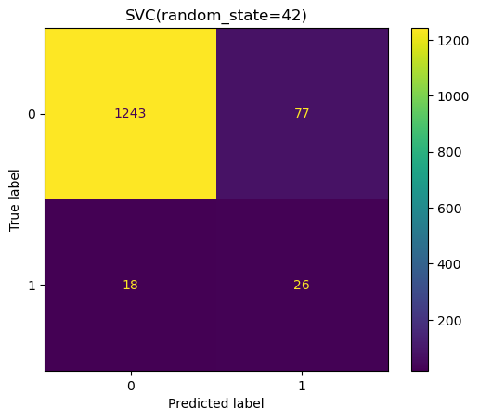
Model Building-Support vector classifier
precision recall f1-score support
0 0.99 0.94 0.96 1320
1 0.25 0.59 0.35 44
accuracy 0.93 1364
macro avg 0.62 0.77 0.66 1364
weighted avg 0.96 0.93 0.94 1364
average recall bad precision
F1 score is: 0.35374149659863946

Slide 26
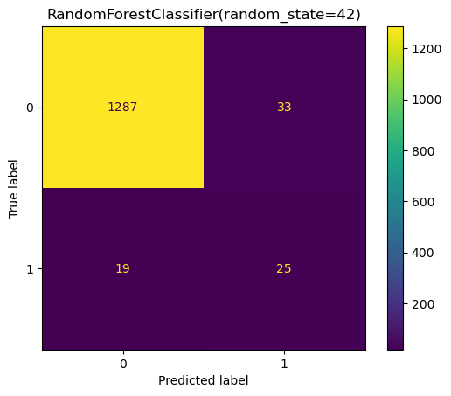
Model Building-Random forest classifier
precision recall f1-score support
0 0.99 0.97 0.98 1320 F1 score is: 0.49019607843137253
1 0.43 0.57 0.49 44
accuracy 0.96 1364
macro avg 0.71 0.77 0.74 1364
weighted avg 0.97 0.96 0.96 1364
average recall and good precision

Slide 27
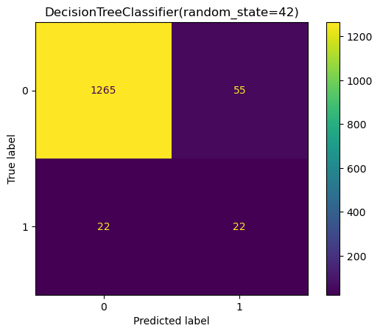
Model Building-Decision tree classifier
F1 score is: 0.36363636363636365
precision recall f1-score support
0 0.98 0.96 0.97 1320
1 0.29 0.50 0.36 44
accuracy 0.94 1364
macro avg 0.63 0.73 0.67 1364
weighted avg 0.96 0.94 0.95 1364
average recall and average precision

Slide 28

Model Building-Ada boost classifier
precision recall f1-score support
0 0.99 0.95 0.97 1320 F1 score is: 0.4148148148148148
1 0.31 0.64 0.41 44
accuracy 0.94 1364
macro avg 0.65 0.79 0.69 1364
weighted avg 0.97 0.94 0.95 1364
Good recall and average precision

Slide 29
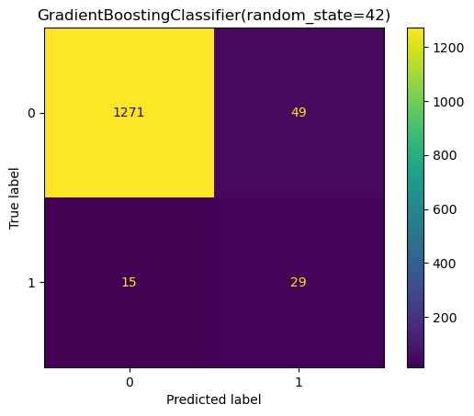
Model Building-Gradient boosting classifier
precision recall f1-score support F1 score is: 0.47540983606557374
0 0.99 0.96 0.98 1320
1 0.37 0.66 0.48 44
accuracy 0.95 1364
macro avg 0.68 0.81 0.73 1364
weighted avg 0.97 0.95 0.96 1364
Good recall and average precision

Slide 30
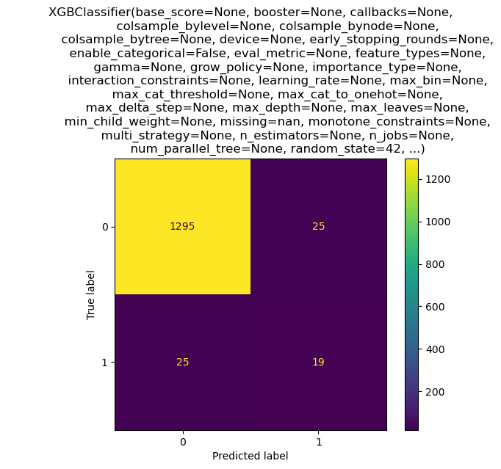
Model Building-XGboost classifier
precision recall f1-score support
F1 score is: 0.4318181818181818
0 0.98 0.98 0.98 1320
1 0.43 0.43 0.43 44
accuracy 0.96 1364
macro avg 0.71 0.71 0.71 1364
weighted avg 0.96 0.96 0.96 1364
Average recall and good precision

Slide 31
Model Building-Voting classifier
Voting classifier is ensemble classifier built on top of various classifier for enhancement of model metrics
Here I built Voting classifier on top of models having more f1 score and more diversified models(Logistic regression, Random forest,Gradient boosting,XG boost) by performing soft voting.
All that it needed for soft voting is all estimators in voting classifier should have predict_proba method, that all estimators will return class probabilities.

Slide 32
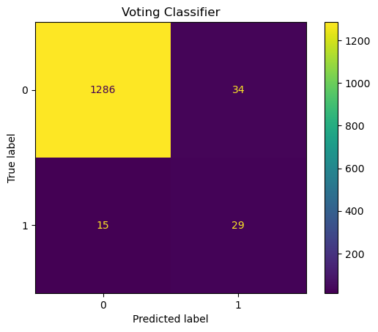
Model Building-Voting classifier
precision recall f1-score support
0 0.99 0.97 0.98 1320 F1-score: 0.5420560747663551
1 0.46 0.66 0.54 44
accuracy 0.96 1364
macro avg 0.72 0.82 0.76 1364
weighted avg 0.97 0.96 0.97 1364
Good recall and Good precision

Slide 33
Model building-comparision

Slide 34
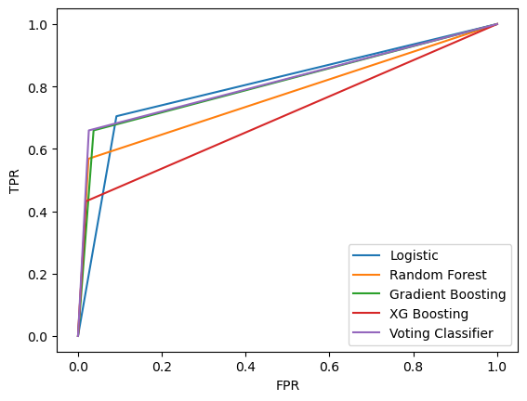
Model building-ROC AUC

Slide 35
Model building-ROC-AUC
Model: Logistic
ROC-AUC_SCORE: 0.8064393939393939
******************************
Model: Random Forest
ROC-AUC_SCORE: 0.7715909090909091
******************************
Model: Gradient Boosting
ROC-AUC_SCORE: 0.8109848484848485
******************************
Model: XG Boosting
ROC-AUC_SCORE: 0.706439393939394
******************************
Model: Voting Classifier
ROC-AUC_SCORE: 0.8166666666666668
******************************

Slide 36
Final Model
My final model is Voting classifier
Final F1-SCORE-0.542
Final ROC-AUC SCORE-81.67

Slide 37
THANK YOU

