Slide 1
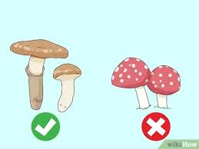
By AJAY KUMAR SADHU DATA SCIENCE INTERN LEARNBAY.CO
MACHINE LEARNING PROJECT TO CLASSIFY POISONOUS AND EDIBLE MUSHROOMS

Slide 2
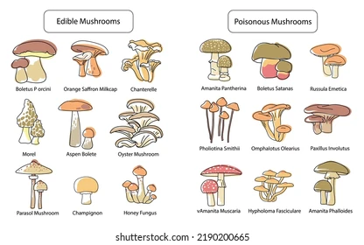

Slide 3
This data having:
No_of_columns – 21 Nos
No_of_Rows – 61070 Nos
Shape of data=(61070 x 21)
The column ‘Class’ which is output column having values (p or e)
P-Poisonous
e-Edible
The data is having redundant rows that repeating more than one time called the duplicate rows.
First getting rid of these duplicate rows as the first step of cleaning the data.
With this step the data shape has changed to (60923 x 21).

Slide 4
The data is having null values in some columns. Having null values more than 40% of total values, those columns are removed as next step
These columns are having null more than 40% of total values. Hence removing those columns is done as next step.
With this step the data shape has changed to (60923 x 15).
veil-type 94.785221
spore-print-color 89.616401
veil-color 87.832182
stem-root 84.592026
stem-surface 62.574069
gill-spacing 41.137173

Slide 5
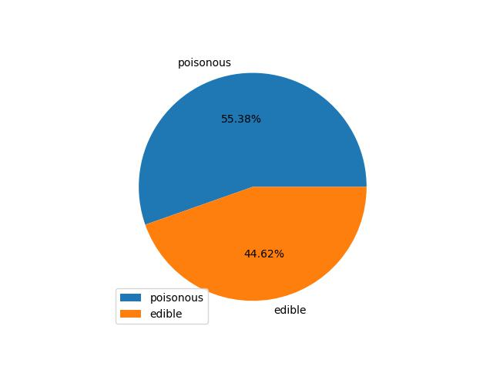
Total count of poisonous and edible mushrooms of given data
Poisonous(p)-33742(55.38 %)
Edible(e)-27181(44.62 %)

Slide 6
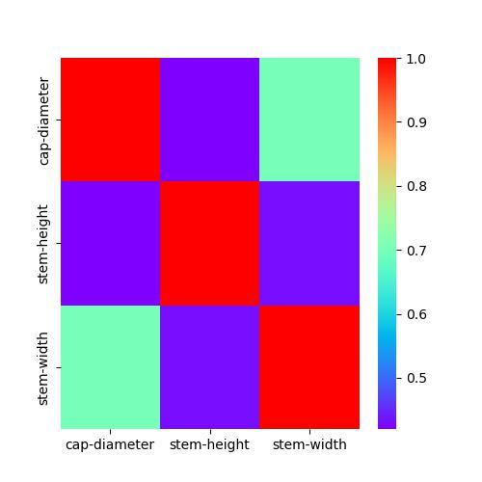
Stem height is less correlated with stem width and cap diameter.
Stem width and cap_diameter are moderately correlated.

Slide 7
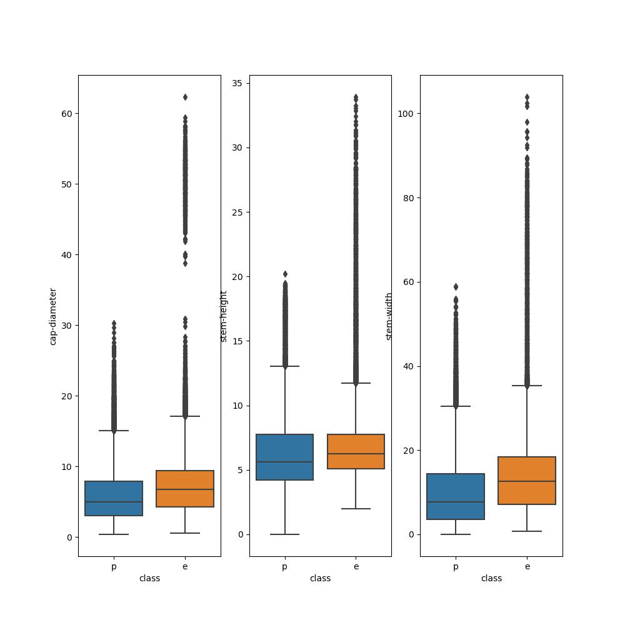
Features in the form of box plot
Cap_diameter and stem_width seems impact more the dependent variable.

Slide 8
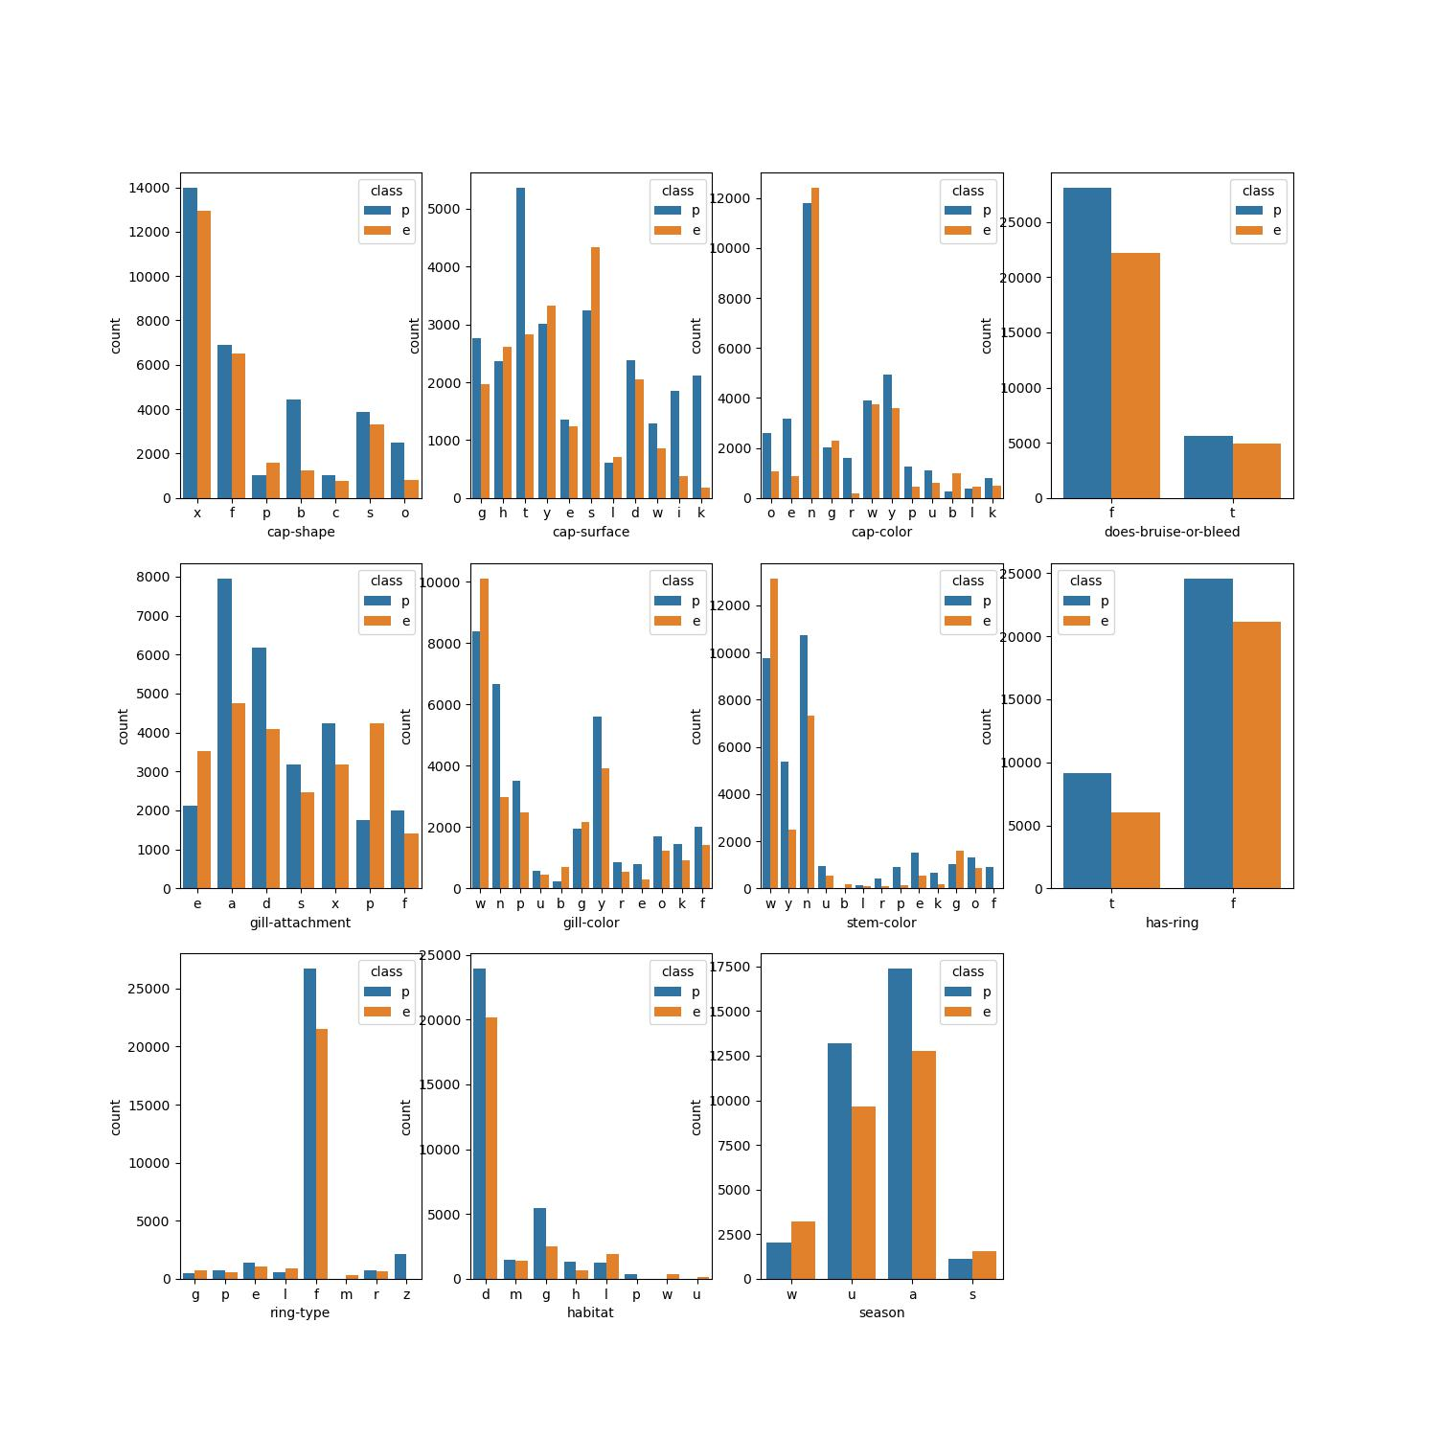
Categorical columns impact on dependent variable.

Slide 9
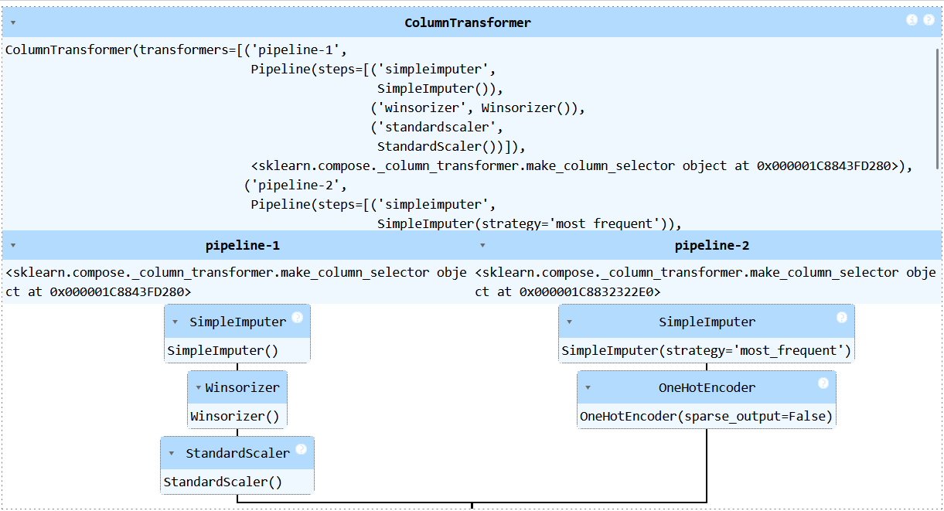
Preprocessing pipeline

Slide 10
Model Building
First step as usual splitting the data as training set and testing set, setting stratified splitting based on the output y.
Trained the following models on training data using cross_val_predict with cross validation=5
Logistic regression
SGD classifier
SVC
Decision tree classifier
Random forest classifier
K-nearest neighbours classifier

Slide 11
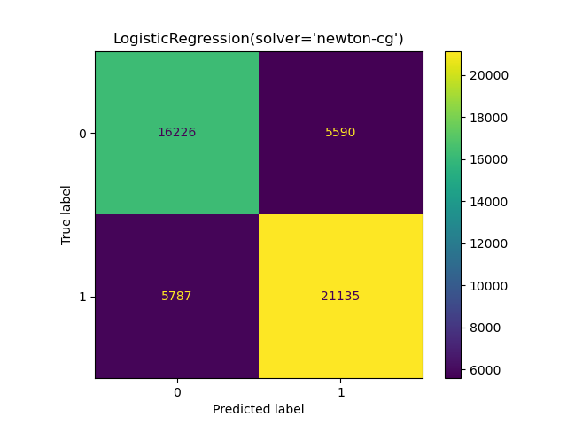
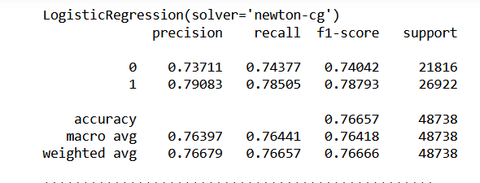
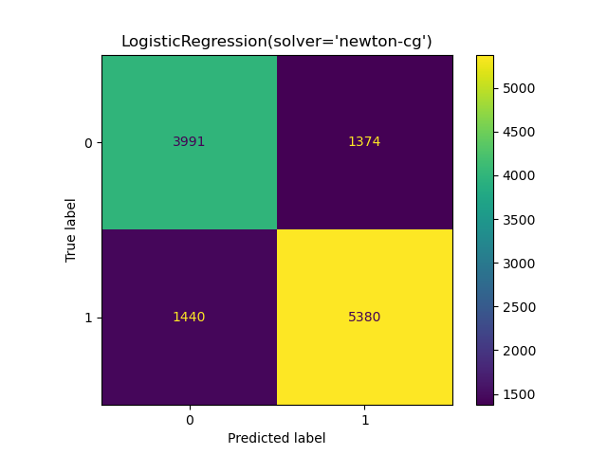
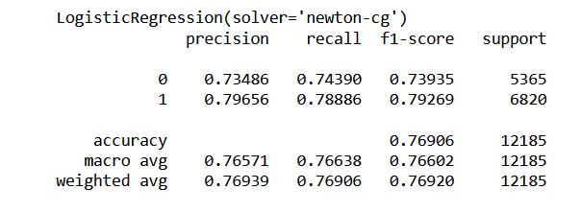
Logistic Regression

Slide 12

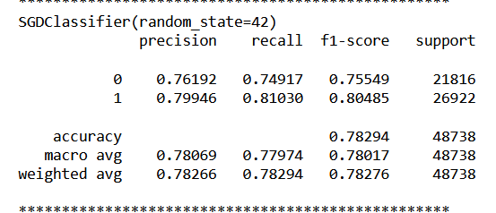
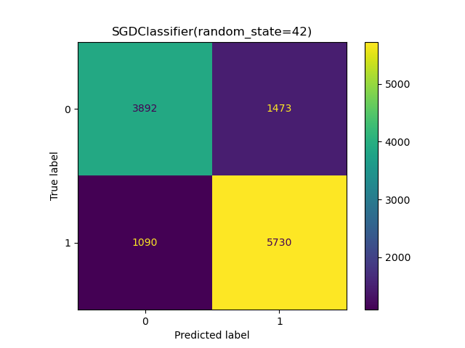
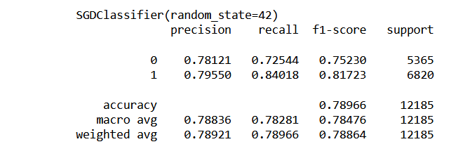
SGD classifier

Slide 13
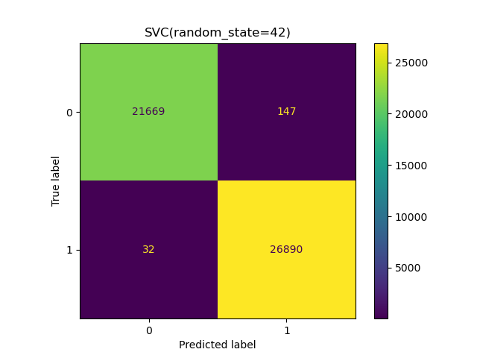
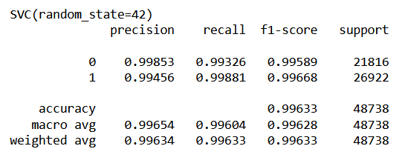
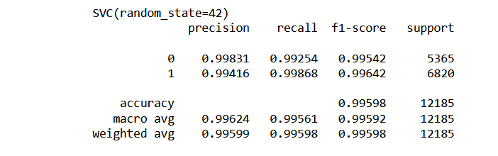

SVC

Slide 14

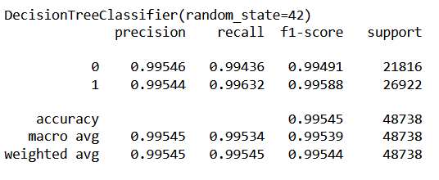

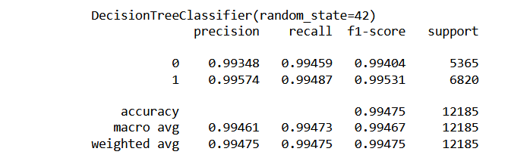
Decision tree classifier

Slide 15

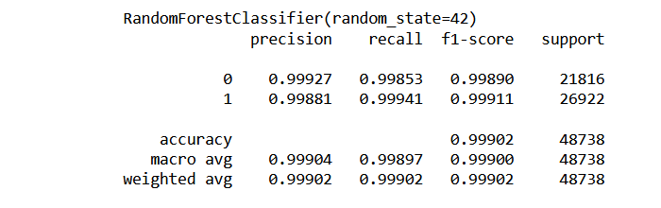

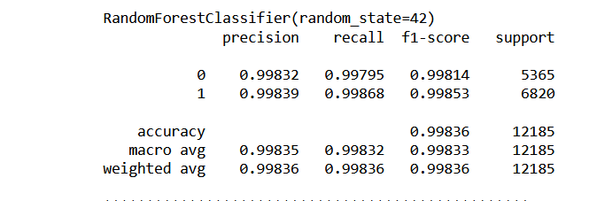
Random forest classifier

Slide 16

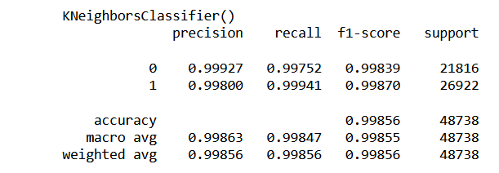

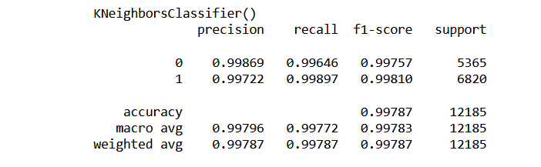
K-nearest neighbours classifier

Slide 17
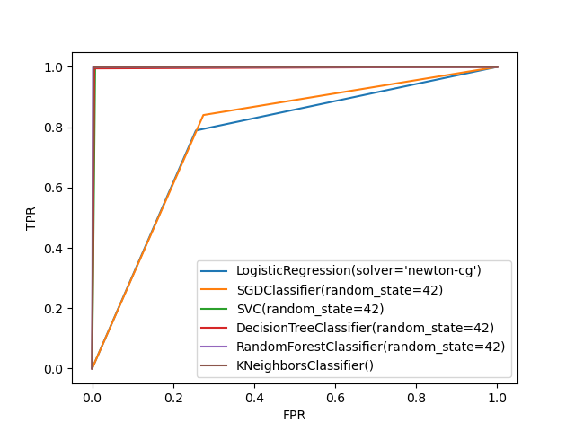
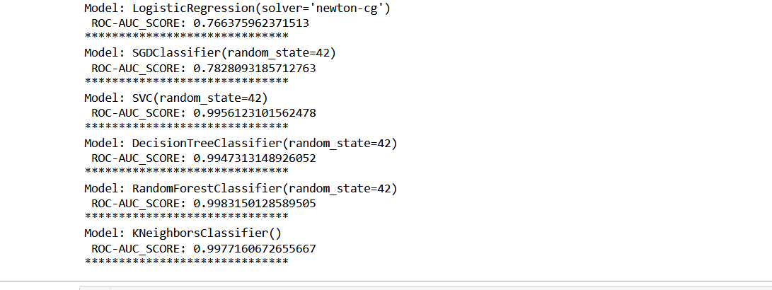
Model Comparison-ROC AUC

Slide 18
Final Model
My final model is Random forest classifier
Final F1-SCORE-99.8
Final ROC-AUC SCORE-99.83

Slide 19
THANK YOU

