Slide 1
Spring Inversion of Control
Ajay

Slide 2

Overview
Definition
Tight Coupling
Loose Coupling
Setter injection
Constructor injection
Wiring
Notes:
Definition - what is it?
Types - types of DI
Consequences - how does the use of DI change design
Patterns of use and anti-patterns
Architecture

Slide 3
Definition
Inversion of Control(IOC)
IoC is also known as dependency injection (DI).
IoC is all about Object dependencies.
IoC allows developers to write loosely coupled components.
Spring allows to decouple software layers by injecting a component’s dependencies at runtime rather than having them declared at compile time via importing and instantiating classes.
Provides centralized, automated configuration, managing and wiring of application Java objects.
Notes:
IOC
- control - over dependencies, coupling, configuration
- inversion - component gives up control to a framework and agrees to play by some rules
- another example: template methods
Hollywood principle
- “don’t call me, I’ll call you”
- framework calls component in well-defined ways (setters, template methods, interface)
Dependency injection
- specifically, IoC with respect to dependencies
- something outside a component handles:
1) configuration (properties)
2) wiring / dependencies (components)
- component-oriented
- removes coupling
- coupling of configuration and dependencies to the point of use
- coupling of component to concrete dependent components
- not a pattern, more of a design principle
- somewhat contrary to encapsulation
Configuration as dependency
- can be useful to think of configuration properties as a very light-weight dependency
- this merges the “configuration” and “wiring” aspects of DI together along a continuum

Slide 4
Definition
Java objects that are managed by the Spring IoC container are referred to as beans.
Container responsibilities:
  creating objects,
  configuring objects,
  calling initialization methods
  passing objects to registered callback objects
All together form the object lifecycle which is one of the most important features.

Slide 5
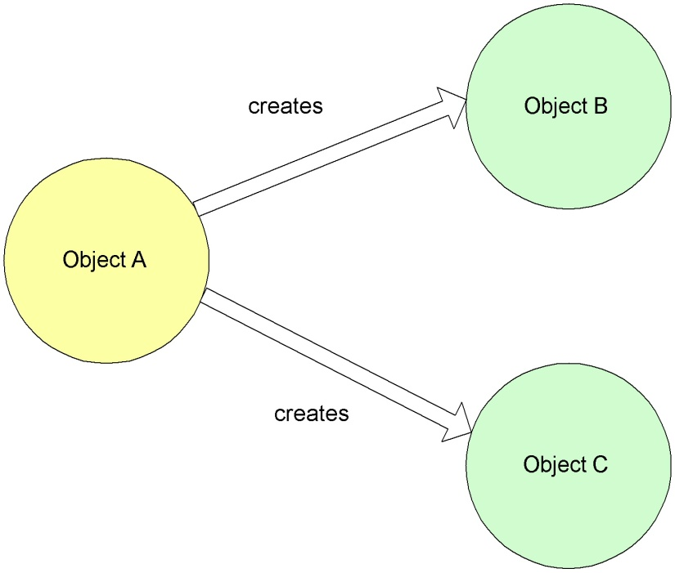
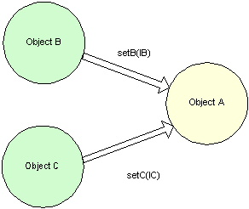
Definition
Non Inversion of Control approach
Inversion of Control approach

Slide 6
Tight Coupling & Loose Coupling
Tight coupling and loose coupling is the heart concept of Core Module.
Loosely coupling is always a good programming practice.
Loose Coupling is improved because you don't hard-code dependencies between layers and modules. Instead you configure them outside of the code. This makes it easy to swap in a new implementation of a service, or break off a module and reuse it elsewhere.
Testability is improved because your Objects don't know or care what environment they're in as long as someone injects their dependencies. Hence you can deploy Objects into a test environment and inject Mock Objects for their dependencies with ease.
Notes:
Pros
- Allows new components to be dynamically created and stitched into existing f/w later
Cons
- Every component that needs a dependency must have a reference to the service locator
- All components need to be registered with the service locator
- If bound by name
- Services can’t be type-checked
- Component has a dependency to the dependent component names - if many components share an instance but later you want to specify different instance for some, this becomes difficult
- If bound by type
- Can only bind one instance of a type i a container

Slide 7
Tight Coupling
class Traveler
{
Car c=new Car();
void startJourney()
{
c.move();
}
}
class Car
{
void move()
{
// logic...
}
}

Slide 8
Loose Coupling
class Traveler{
Vehicle v;
public void setV(Vehicle v){
this.v = v;
}
void startJourney(){
v.move();
}
}
class Car implements Vehicle{
public void move(){
// logic
}
}
class Bike implements Vehicle{
public void move(){
// logic
}
}
Interface Vehicle{
void move();
}

Slide 9
Setter injection
In setter injection, the class must contain a setter method to get dependencies other wise spring container doesn’t inject the dependencies to dependent object
Supporting dependency injection without having to modify the constructor of a legacy class.
Allowing expensive resources or services to be created as late as possible and only when needed.
Notes:
Pros:
- Makes explicit exactly what the dependencies for a component are
Cons:
- Requires an extra interface or standard set of interfaces for every component
- Lots of extra work and cruft in the code base

Slide 10
Setter injection
<bean id="exampleBean" class="examples.ExampleBean">
<!-- setter injection using the nested <ref/> element -->
<property name="beanOne"><ref bean="anotherExampleBean"/></property>
<!-- setter injection using the neater 'ref' attribute -->
<property name="beanTwo" ref="yetAnotherBean"/>
<property name="integerProperty" value="1"/>
</bean>
<bean id="anotherExampleBean" class="examples.AnotherBean"/>
<bean id="yetAnotherBean" class="examples.YetAnotherBean"/>

Slide 11
Constructor injection
Constructor Injection is the DI technique of passing an object's dependencies to its constructor.
Constructor-based DI is accomplished by the container invoking a constructor with a number of arguments, each representing a dependency.
Notes:
Pros:
- Makes explicit exactly what the dependencies for a component are
Cons:
- Requires an extra interface or standard set of interfaces for every component
- Lots of extra work and cruft in the code base

Slide 12
Constructor injection
<bean id="exampleBean" class="examples.ExampleBean">
<!-- constructor injection using the nested <ref/> element -->
<constructor-arg><ref bean="anotherExampleBean"/></constructor-arg>
<!-- constructor injection using the neater 'ref' attribute -->
<constructor-arg ref="yetAnotherBean"/>
<constructor-arg type="int" value="1"/>
</bean>
<bean id="anotherExampleBean" class="examples.AnotherBean"/>
<bean id="yetAnotherBean" class="examples.YetAnotherBean"/>

Slide 13
Wiring
Wiring is the process of injecting the dependencies of beans.
In spring there are two types are wiring.
  Explicit wiring
  Implicit wiring OR Autowiring
  Annotation based autowiring.
Notes:
Pros:
- Makes explicit exactly what the dependencies for a component are
Cons:
- Requires an extra interface or standard set of interfaces for every component
- Lots of extra work and cruft in the code base

Slide 14
Explicit Wiring
Programmer has to specify the bean dependencies explicitly then only spring container will inject those dependencies.
<beans>
<bean id="exampleBean" class="examples.ExampleBean">
<property name="beanOne" ref="firstBean"/>
<property name="beanTwo" ref="secondBean"/>
</bean>
</beans>
Notes:
Pros:
- Makes explicit exactly what the dependencies for a component are
Cons:
- Requires an extra interface or standard set of interfaces for every component
- Lots of extra work and cruft in the code base

Slide 15
Implicit Wiring/Autowiring
Spring container can detect the bean dependency automatically and inject those dependencies.
Below are the possible values of autowired attribute.
  no
  byName
  byType
  constructor
  autodetect
Notes:
Pros:
- Makes explicit exactly what the dependencies for a component are
Cons:
- Requires an extra interface or standard set of interfaces for every component
- Lots of extra work and cruft in the code base

Slide 16
Implicit Wiring/Autowiring
Mode | Description
no | No autowiring at all.
byName | Autowiring by property name. Will inspect the container and look for a bean named exactly the same as the property which needs to be autowired.
byType | Allows a property to be autowired if there is exactly one bean of the property type in the container.
constructor | The constructor mode injects the dependency by calling the constructor of the class
autodetect | Bean dependency will be resolved by constructor or byType.

Slide 17
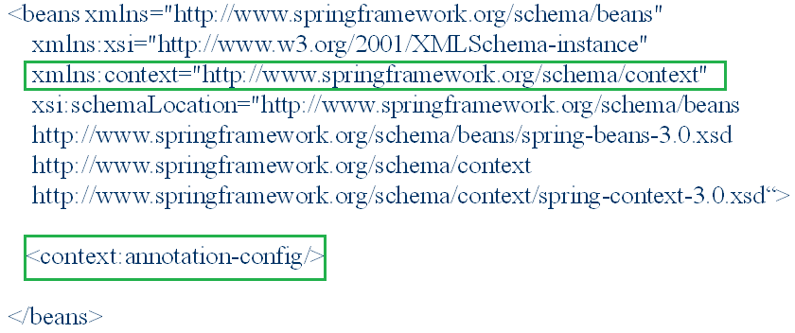
Annotation Based Autowiring
Enable context namespace in spring configuration file.
Add <context: annotation-config> in spring configuration file.
Use @Autowired annotation for the beans.
Notes:
Pros:
- Makes explicit exactly what the dependencies for a component are
Cons:
- Requires an extra interface or standard set of interfaces for every component
- Lots of extra work and cruft in the code base

Slide 18
Annotation Based Autowiring
@Autowired
public class ContactsDAO{
@Autowired
private SessionFactory sessionFactory;
public Contact getById(int id){
return (Contact) sessionFactory.getCurrentSession().get(Contact.class, id);
}
}
Notes:
Pros:
- Makes explicit exactly what the dependencies for a component are
Cons:
- Requires an extra interface or standard set of interfaces for every component
- Lots of extra work and cruft in the code base

Slide 19
Thank You

