Slide 1

Personal – Folie1
GRC Tool
Tool Design – Version 1.0

Slide 2
Personal – Folie1
Attribute based authentication (ABAC)
Detail Definition of ABAC : NIST Special Publication 800-162 (embadded in this document, see right)
Authentication over Active Directory (Cloud or on Premise)
XACML (extensible Access Control Markup Language). Concept is in detail described under xacml-3.0-core-spec-os-en.pdf

Slide 3
Personal – Folie1
Backend – Base requirement - Clean Architecture
Report generation / Print
Database
Error Management
Logging
Multilingual support
Authentication & authorization
Layer 1
Cross application Object (such as Organisation / Service Provider / Address, etc.)
Layer 2
Layer 4
Application specific business Functionality (See slide needed modules)
Layer 3
GUI
Interfaces*
To be independent from the infrastructure the repository pattern shall be used in combination with the latest entity framework
For business objects the proxy pattern should be used for object level authorization
For main business object functionality the strategy pattern should be used, due to the fact, that calculation can change depending on customer needs

Slide 4
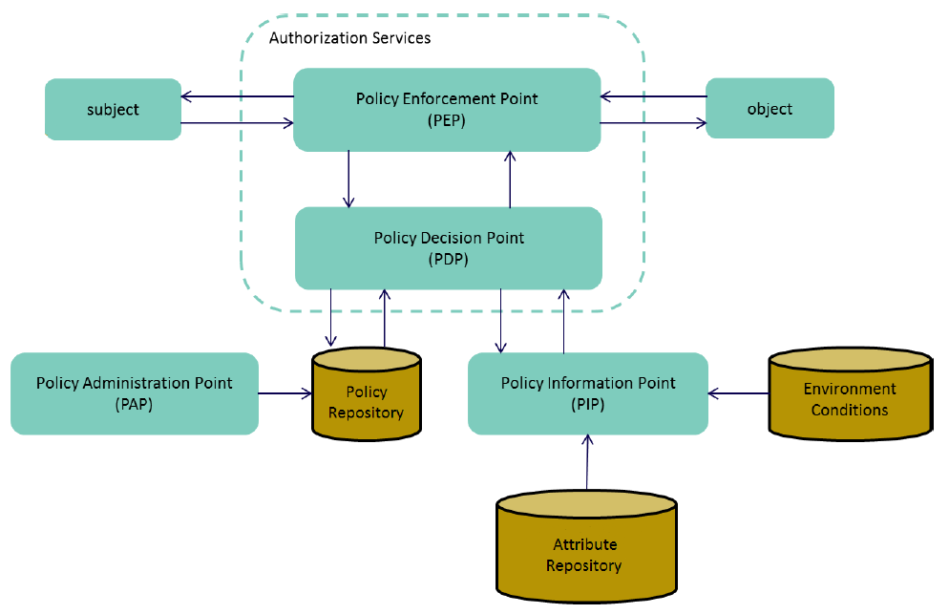
Personal – Folie1
Attribute based authentication (ABAC) - Main Concept
Module | Business Object
Policy administration point (PAP) | The system entity that creates a policy or policy set
Policy decision point (PDP) | The system entity that evaluates applicable policy and renders an authorization decision
Policy enforcement point (PEP) | The system entity that performs access control, by making decision requests and enforcing authorization decisions
Policy information point (PIP) | The system entity that acts as a source of attribute values
Context | The canonical representation of a decision request and an authorization decision
Context handler | The system entity that converts decision requests in the native request format to the XACML canonical form and converts authorization decisions in the XACML canonical form to the native response format
Target | The set of decision requests, identified by definitions for resource, subject and action
Effect | The intended consequence of a satisfied rule (either "Permit" or "Deny")
Policy | A set of rules, an identifier for the rule-combining algorithm and (optionally) a set of obligations. May be a component of a policy set
Policy set | A set of policies, other policy sets, a policy-combining algorithm and (optionally) a set of obligations. May be a component of another policy set
Rule | A target, an effect and a condition. A component of a policy
Resource | Data, service or system component
Predicate | A statement about attributes whose truth can be evaluated

Slide 5
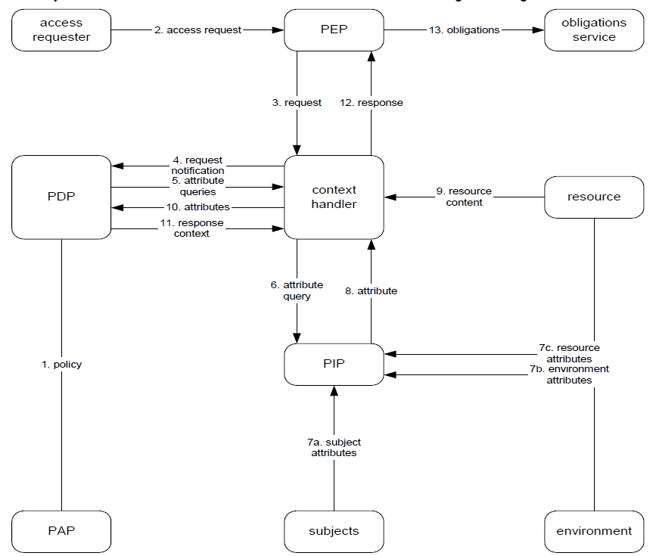
Personal – Folie1
Attribute based authentication (ABAC) – Information flows
Module | Business Object
Policy administration point (PAP) | The system entity that creates a policy or policy set
Policy decision point (PDP) | The system entity that evaluates applicable policy and renders an authorization decision
Policy enforcement point (PEP) | The system entity that performs access control, by making decision requests and enforcing authorization decisions
Policy information point (PIP) | The system entity that acts as a source of attribute values
Context | The canonical representation of a decision request and an authorization decision
Context handler | The system entity that converts decision requests in the native request format to the XACML canonical form and converts authorization decisions in the XACML canonical form to the native response format
Target | The set of decision requests, identified by definitions for resource, subject and action
Effect | The intended consequence of a satisfied rule (either "Permit" or "Deny")
Policy | A set of rules, an identifier for the rule-combining algorithm and (optionally) a set of obligations. May be a component of a policy set
Policy set | A set of policies, other policy sets, a policy-combining algorithm and (optionally) a set of obligations. May be a component of another policy set
Rule | A target, an effect and a condition. A component of a policy
Resource | Data, service or system component
Predicate | A statement about attributes whose truth can be evaluated

Slide 6
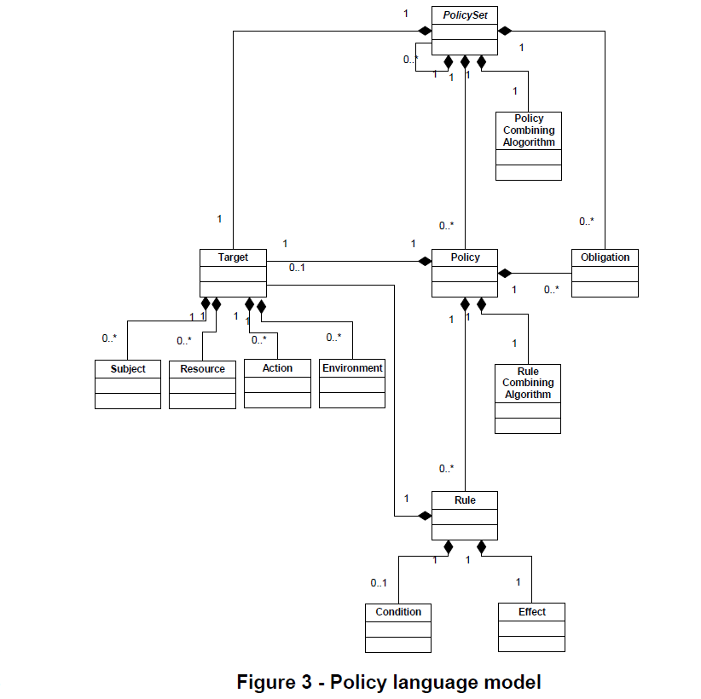
Personal – Folie1
Attribute based authentication (ABAC) – Model
Module | Business Object
Policy administration point (PAP) | The system entity that creates a policy or policy set
Policy decision point (PDP) | The system entity that evaluates applicable policy and renders an authorization decision
Policy enforcement point (PEP) | The system entity that performs access control, by making decision requests and enforcing authorization decisions
Policy information point (PIP) | The system entity that acts as a source of attribute values
Context | The canonical representation of a decision request and an authorization decision
Context handler | The system entity that converts decision requests in the native request format to the XACML canonical form and converts authorization decisions in the XACML canonical form to the native response format
Target | The set of decision requests, identified by definitions for resource, subject and action
Effect | The intended consequence of a satisfied rule (either "Permit" or "Deny")
Policy | A set of rules, an identifier for the rule-combining algorithm and (optionally) a set of obligations. May be a component of a policy set
Policy set | A set of policies, other policy sets, a policy-combining algorithm and (optionally) a set of obligations. May be a component of another policy set
Rule | A target, an effect and a condition. A component of a policy
Resource | Data, service or system component
Predicate | A statement about attributes whose truth can be evaluated

Slide 7
Personal – Folie1
Attribute based authentication (ABAC) – Attributes for granting access
Following attributes shall be used to grant access to a subject (user) in the first step
Business object related attributes
Environmental attributes
Client
Organization
Asset (Types: IT Asset, Process, Project, Organization)
Standard
Audit Program
Audit Template
Audit
Measure
Evidence
Risk Assessment
Risk
Risk Register
Report
Configuration parameters
Role
Country
Region
time
Objects must be assigned individually to standard users. For example: Employees answering questions within an audit for a legal entity, can be employed by different legal entities of the client/tenant.
Legal Entities shall have administrators who can change predefined set of parameters and create new users in the system
Board may have access to aggregated data on global level and region manager can have access on regional level for all data of legal entities
A Syntax shall be found for allowing users access to e.g. all Risk Assessments of a legal entity.

Slide 8
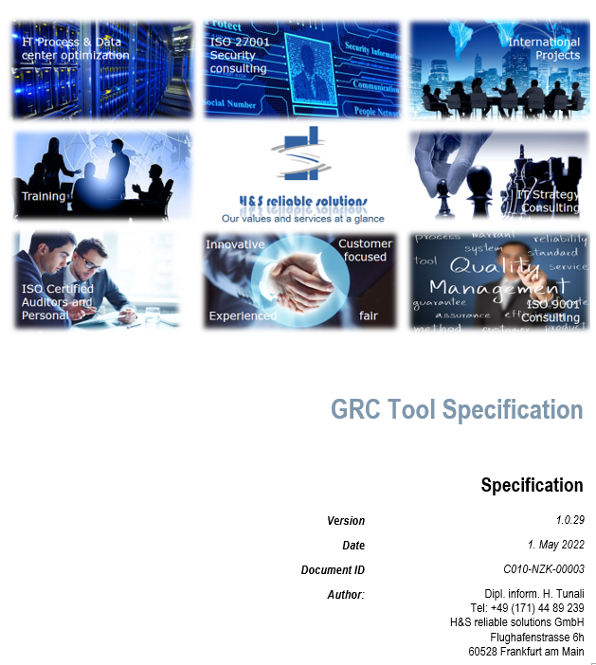
Personal – Folie1
Backend – Base requirement - Clean Architecture
Error Management
Logging
Multilingual support
Authentication & authorization
Detailed requirements for Error Management, Logging, Multilingual support are described within the specification document
Layer 1
Within the application there must be only one place where
Logging is done
Errors are managed
Multilingual support is provided for the GUI
Authentication und authorization is done
Each written object shall inherit from a Base class, where logging, error management and other needed functionality is written once
For each data type, used in the application, a class shall be created, which handles the null values, init the objects, makes data type checks etc. This shall avoid programming this kind of checks multiple times
Each Function shall have a try catch block to handle errors without program breaks
Tree search, rebuilding, Path-Finding, etc. algorithms shall be implemented once on layer 1. Especially to provide information if for example a legal entity inherits configuration from its parent entity, region or group

Slide 9
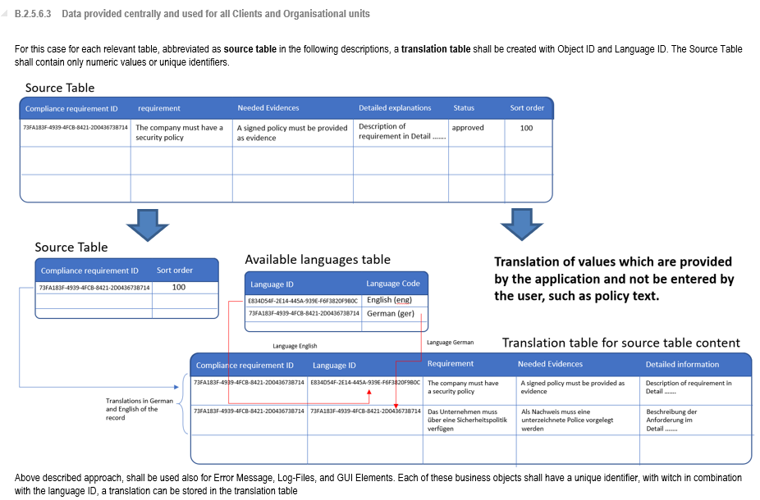
Personal – Folie1
Backend – Base requirement - Multi Lingual Support and Adding new Fields to application without program change
Error Management
Logging
Multilingual support
Authentication & authorization
Layer 1
Only user entered Information can be let not translated. Each Information such standards, Audit Questions, selection values must be translated

Slide 10
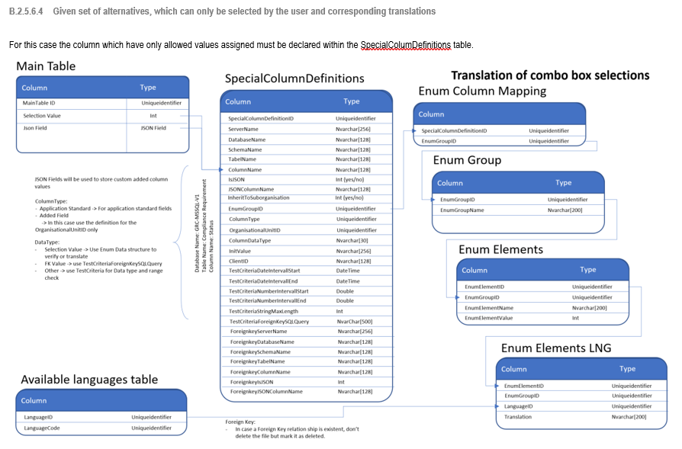
Personal – Folie1
Backend – Base requirement - Multi Lingual Support and Adding new Fields to application without program change
Error Management
Logging
Multilingual support
Authentication & authorization
Layer 1
Special column definition and corresponding enum Column Mapping tables should exist for each modules once
corresponding enums shall be defined as enum structures within the application on Layer 1 to 3, as needed

Slide 11
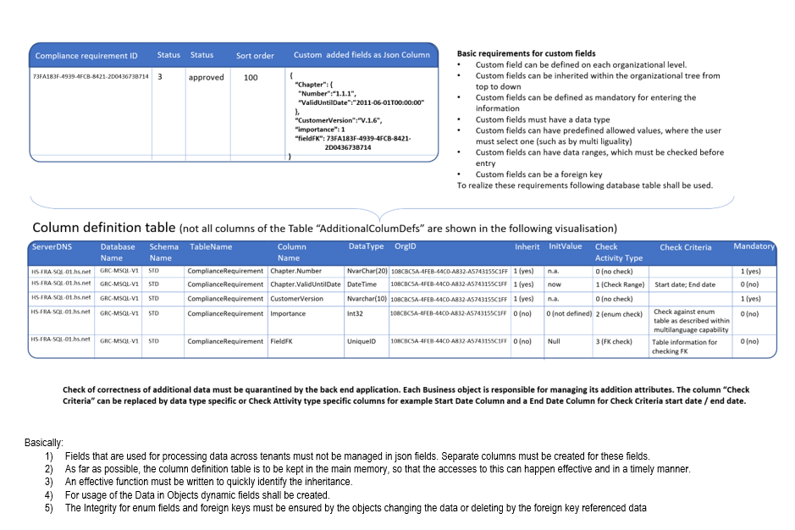
Personal – Folie1
Backend – Base requirement - Multi Lingual Support and Adding new Fields to application without program change
Error Management
Logging
Multilingual support
Authentication & authorization
Layer 1
Special column definition shall be used to check structure and integrity of json field content

Slide 12
Personal – Folie1
Backend – Base requirement - Layer 2
For Layer 2 following Cross application Objects shall be implemented:
Client / Tenant
Organizational Unit
Provider
User
Layer 2
Cross application Object (such as Organisation / Service Provider / Address, etc.)

Slide 13
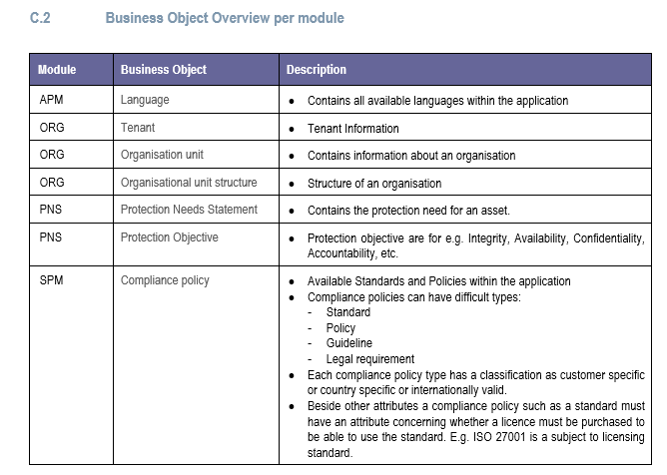
Personal – Folie1
Backend – Base requirement - Layer 3
In this layer the following structure shall be used to define modules and place the business objects within these modules
Layer 3
Application specific business Functionality (See slide needed modules)
Standards and Policy Management
Audit Management
Measure Management
The Assignment of the business objects to modules are defined within the specification document
Standard Registration and Provisioning
Audit Programm Management
Audit Questions Management
Self Compliance Check evaluation engine
Measure approval, review and closure management
Compliance Check Customer Policies against standards
Direct and transitive standard mapping
Audit Management
RACI – Model implementation module for measure management
Customer Policy Lifecycle Management
Policy publication and communication management
Audit Evidence Management
Audit Template Management
Measure Tracking and RACI Information management
Policy localization management
Workflow support for Policy approvals, reviews etc.
Risk Management
Risk Assessment Support for different Risk Assessment Methods (Qualitative and quantitative)
Risk relevant Asset Management
Reporting
Reporting
Organizational Structure and corresponding Responsibilities
Risk calculation engine (Qualitative and quantitative)
Risk Register Management on global, regional and local level
Reporting Info. Sec Status on global, regional and local level
Systems / System Compounds
Risk category and scenario Management
Business processes
Management and tracking of Risk mitigating measures
KPI definition & Mgmt.
Risk wording template management
Customizable Reports
A Discussion is also needed for Evidence Management. This functionality is needed by Standards and Policies, by Audits and also by Risk Assessments. Perhaps Evidence Management should be an own module
Module for use of compliance audit results to generate risks
Report generation scheduling engine

Slide 14
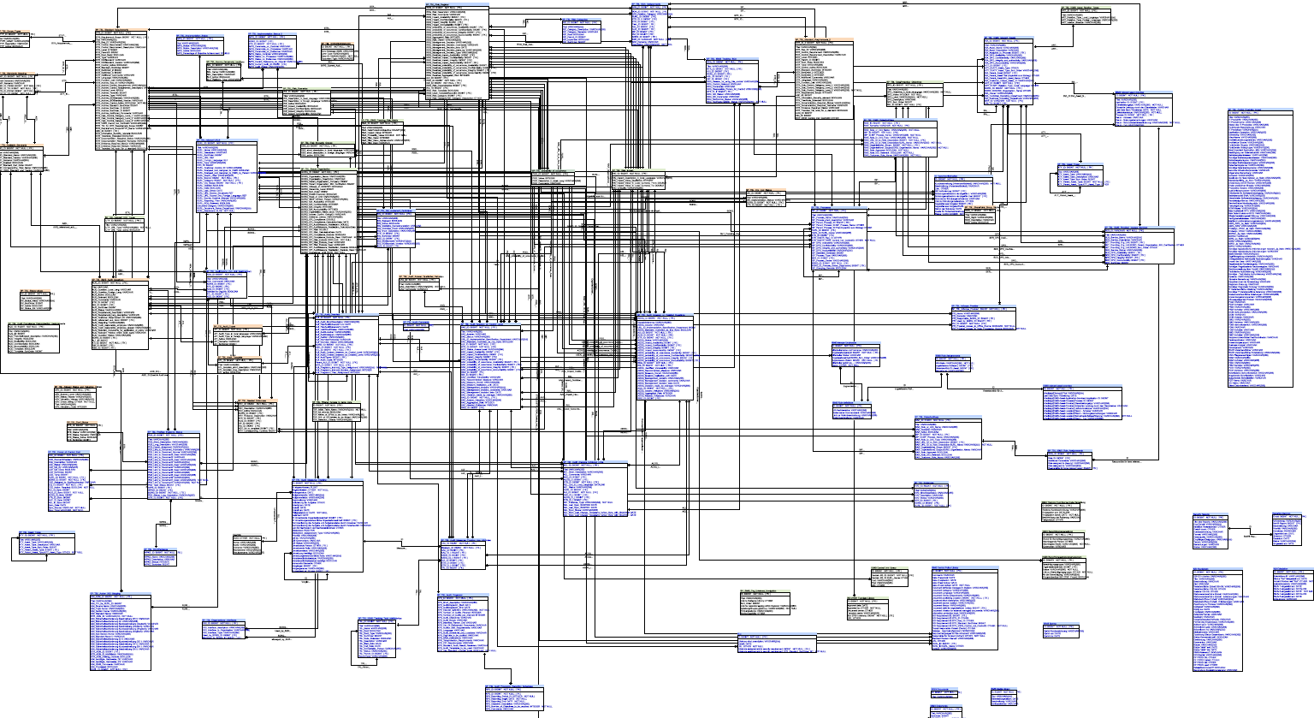
Personal – Folie1
Backend – Database - Table creation
Table Design for each module must be made in a Workshop with HT. The reason is, that based an experiences made with the current software, some structural changes must be made to data model.
The current data model will be provided as pdf.
Each table within the database must get a versioning table, so called temporary or history tables within MS SQL. We must be able to select a record constellation to a certain time for Getting Audit or Risk assessment information together for an audit in the past.
Database must be created so that UTF-8 Character set is used and the communication of Backend with Database must be encrypted
Some tables such as users, ABAC Tables, Audit Results, Risks and Risk Register must be stored in the database as a encrypted table.
A Password vault provided by Microsoft Production environment must be used to store technical user passwords! Password should be hard coded in the application or stored unencrypted somewhere on the file system

Slide 15
Personal – Folie1
Backend – Infrastructure - Layer
For Infrastructure following modules/Classes are needed
Database Access module: Access to MS SQL Database, which implements the interfaces within the Layers 1 to 3 to exchange data with the database
Module to read and write files on Filesystem
Reporting generation Module / Print
Data Import and Export
Physical File storage on SharePoint Server
GUI Interface

Slide 16
Personal – Folie1
Next Steps for Backend Development Team
Workshop for creating the needed Tables and corresponding create and init scripts for
Language
Configuration
Client / Tenant
Organizational Unit
Provider
User
Asset (Types: IT Asset, Process, Project, Organization)
Standard
Audit Program
Audit Template
Audit
Measure
Evidence

Slide 17
Personal – Folie1
Next Steps for Backend Development Team
Creating Layer 1 and Layer 2 Objects ( 2 Developers)
ABAC
Error Management
Logging
Multilingual support
Data validation
Root object for inheritance
Creating Layer 3 Objects ( 1 Developers)
For defined business objects
Language, Configuration, Client / Tenant, Organizational Unit, Provider
User, Asset (Types: IT Asset, Process, Project, Organization), Standard,
Audit Program, Audit Template, Audit, Measure, Evidence parallel to database creation. Sample data can be loaded manually in the corresponding repository. Interfaces must be defined for database connection.
Creating GUI

