Slide 1
CS 1010: Introduction to Programming with Python Lec 01: Introduction to Python
Dr. Madhavi Vaidya
Instructor
Department of Electrical Engineering & Computer Sciences
Finessefleet Foundation, Bangalore
Ms. Syeda Faaiza Afreen (EE2502102) TA Department of EECS Finessefleet Foundation, Bangalore

Slide 2
About Finessefleet Foundation
Finessefleet Foundation (founded: October 10, 2024) is a volunteer-driven, nonprofit organization based in Bangalore, India, dedicated to transforming education and empowering learners through high-quality educational initiatives. The foundation is committed to fostering academic excellence and promoting research and development across various domains, including AI, ML, NLP, Theory CS, and others.
As a volunteer-driven organization, this Foundation operates through the collective efforts of individuals who contribute their expertise and time towards societal betterment. It serves as a platform for those who aspire to make meaningful contributions to education and research, thereby advancing knowledge dissemination and fostering intellectual growth within the community.​

Slide 3

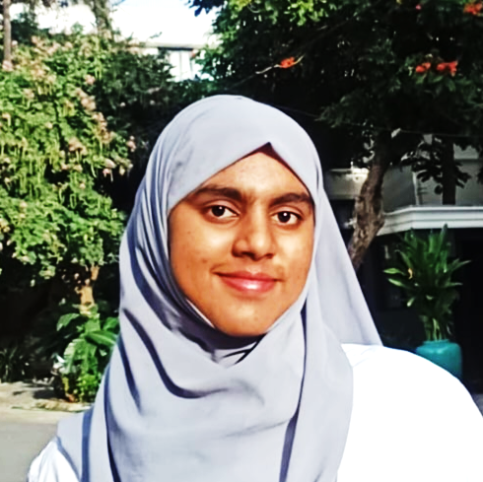
People
Dr. Madhavi Vaidya
Ms. Syeda Faaiza Afreen
Instructor Department of Electrical Engineering & Computer Sciences Finessefleet Foundation, Bengaluru
& Former Assoc. Professor, VESC, Mumbai Independent Researcher, Consultant
EE2502102 Teaching Assistant (TA) for CS 1010 Department of Electrical Engineering & Computer Sciences Finessefleet Foundation, Bengaluru

Slide 4
About This Course
This course, offered by the Finessefleet Foundation, is a part of its broader commitment to advancing public education and digital literacy as a matter of social responsibility. Designed to run over a span of fourteen weeks, the course introduces learners to the fundamentals of programming through the Python language—widely regarded for its simplicity, readability, and relevance across disciplines.
Structured to be accessible to learners from all academic and professional backgrounds, the course emphasizes not only the syntax and semantics of Python but also the development of computational thinking and structured problem-solving skills. Through a combination of conceptual discussions, illustrative examples, and practical coding exercises, participants will be guided towards acquiring both a theoretical and applied understanding of core programming constructs.
The course is offered entirely free of charge and is open to all, with no prerequisites other than a willingness to learn. All lectures will be conducted in an interactive format, live-streamed to allow real-time engagement, and subsequently made available as recorded sessions for flexible, self-paced learning.
By the end of this MOOC, learners are expected to develop a foundational competency in Python and gain the confidence to apply their skills to a range of real-world and academic contexts. This course reflects the Foundation’s belief in the transformative power of open education and its role in fostering inclusive, future-ready communities.

Slide 5
Today, we’ll cover
Need of Learning Programming
What’s Python?
Why Learn Python?
Historic Overview of Python
Features of Python
Setting up the Development Environment

Slide 6
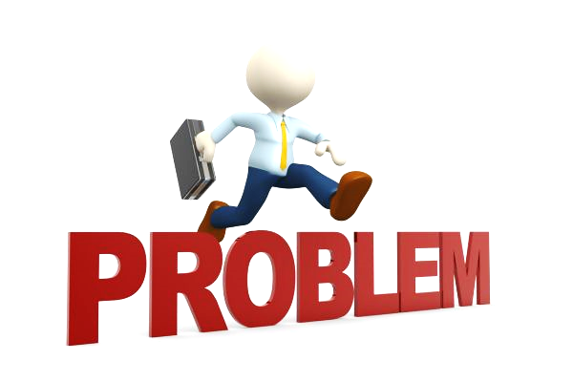
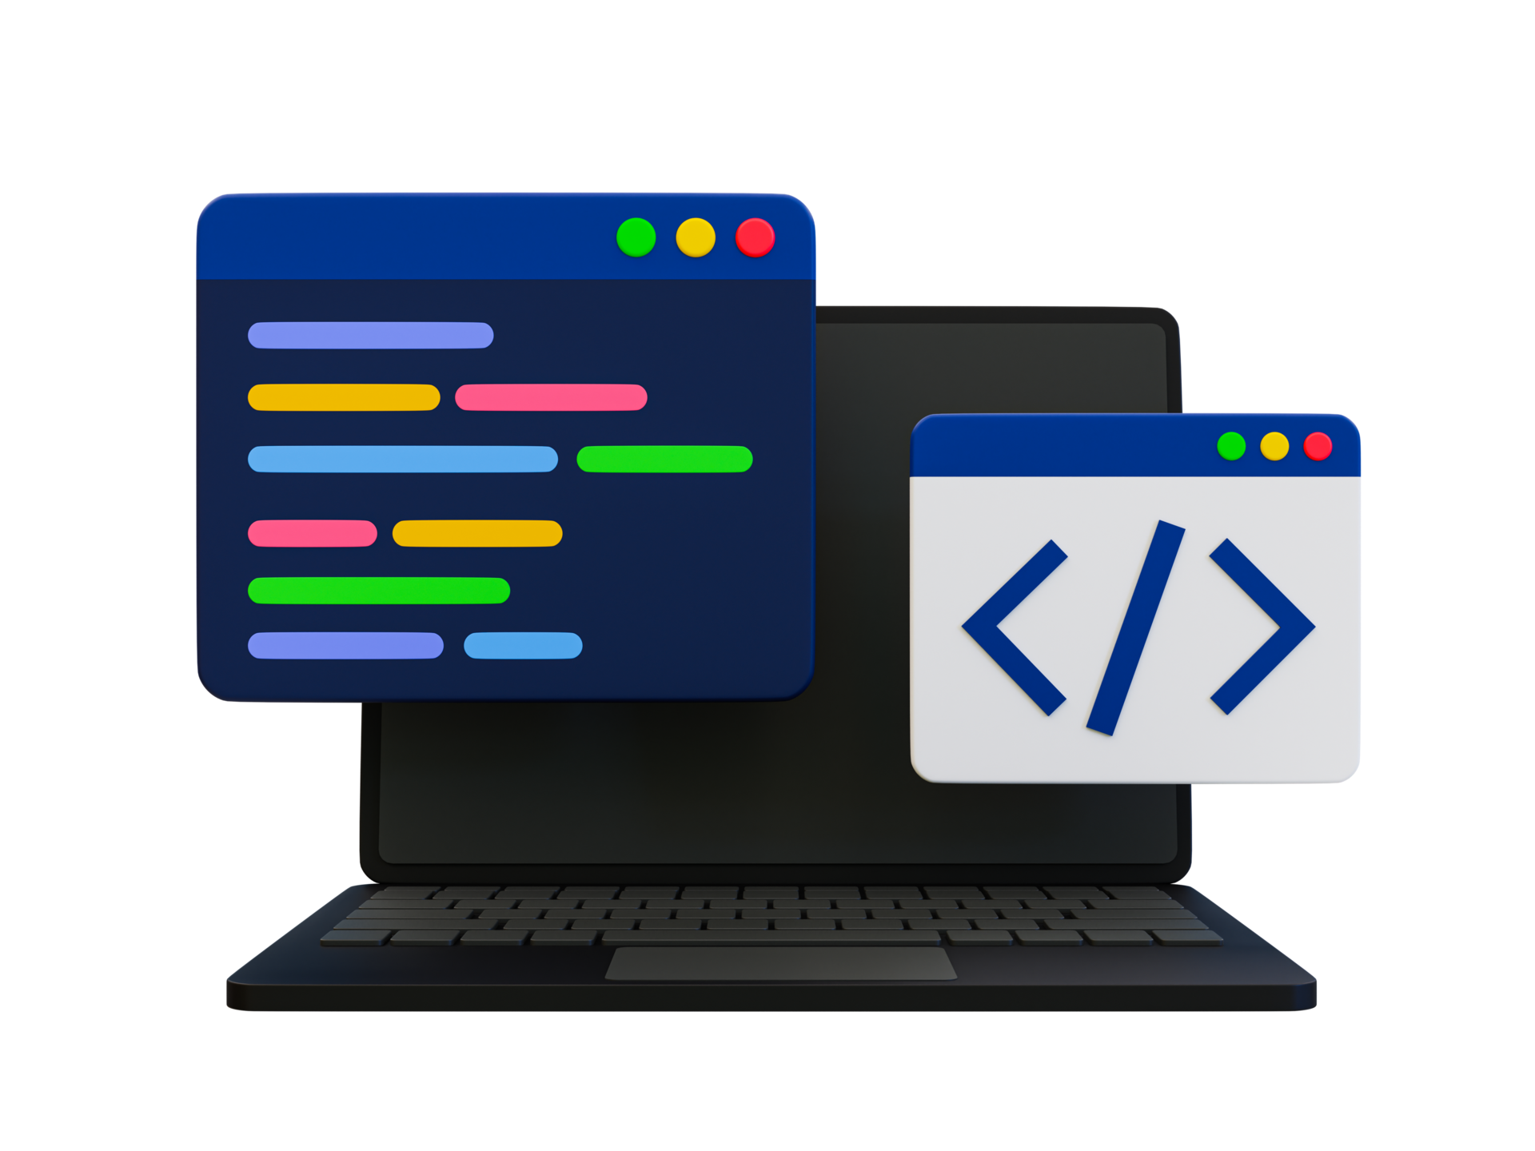
Why Do We Need a Programming Language?
The Problem?
Computers are powerful machines—but they do not understand human language.
They operate using binary code (0s and 1s)—called machine language.
Communicating directly in binary is impractical and error-prone.
What is a Programming Language?
A programming language is a formal way to instruct a computer to perform tasks.
It bridges the gap between human logic and machine-level execution.
Enables us to express solutions in a structured and understandable manner.

Slide 7

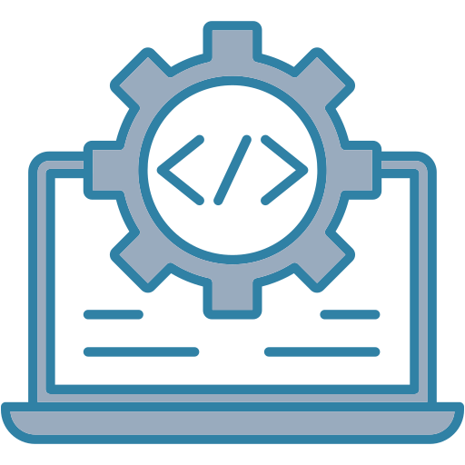

Why Do We Need It?
To Automate Repetitive Tasks Generating monthly salary slips for employees automatically.
To Solve Problems Efficiently Calculating tax, analyzing exam scores, finding optimal routes.
To Build Real-world Applications Websites, mobile apps, robotics, games, simulations, etc.
To Communicate with Machines Logically A programming language provides clear rules (syntax) to design logic.
To Ensure Precision and Reproducibility Computers follow exact steps without deviation, which is critical in domains like: banking, healthcare, scientific research.
How it works?
Writes Code (in Python)
Translates Code
Executes Task
Without programming languages, humans would not be able to fully harness the computational power of machines.

Slide 8
What’s Python?
Python is a high-level, interpreted, and general-purpose programming language.
Created by Guido van Rossum and first released in 1991.
Designed to emphasize code readability and simplicity.
Follows multiple programming paradigms – procedural, object-oriented, functional.

Slide 9
Why Python? – Key Features
Simple and Easy to Learn: English-like syntax.
Open Source and Free: Freely available and community-driven.
Interpreted Language: Executes code line-by-line.
Portable: Works across platforms (Windows, macOS, Linux).
Large Standard Library: Modules for everything from web to data science.
Dynamic Typing: No need to declare variable types.

Slide 10
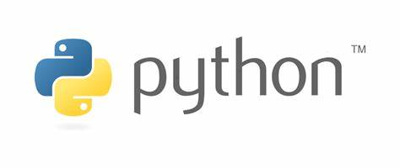
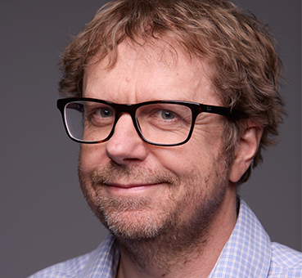
Historic Overview of Python
Python was conceived in the late 1980s by Guido van Rossum at the Centrum Wiskunde & Informatica (CWI) in the Netherlands. Its development began as a successor to the ABC language, aiming to address limitations in scripting and automation. Python was officially released as version 0.9.0 in 1991, introducing core features such as functions, modules, and exception handling. With time, Python evolved into a versatile, high-level language known for its clear syntax and wide applicability. Major milestones include Python 2.0 (2000), which introduced list comprehensions and garbage collection, and Python 3.0 (2008), a forward-looking release that improved consistency at the cost of backward compatibility. Today, Python stands among the most widely used programming languages across academia, industry, and government sectors.
Guido van Rossum Dutch Programmer

Slide 11
Python vs Other Languages
Feature | Python | C++ | Java
Syntax | Simple | Complex | Verbose
Compilation | Interpreted | Compiled | Compiled
Use Cases | Versatile | System Apps | Enterprise
Learning Curve | Easy | Steep | Moderate
List of Prominent Programming Languages
Python
Java
C
C++
JavaScript
C# (C-Sharp)
Go (Golang)
Swift, etc.

Slide 12
Applications of Python
Python is widely used in:
Web Development: Django, Flask
Data Science & ML: Pandas, NumPy, Scikit-Learn
Automation & Scripting: Cron jobs, bots
Desktop Applications: Tkinter, PyQt
Game Development: Pygame
Cybersecurity & Forensics: Scripting tools, automation
Scientific Computing: SciPy, SymPy

Slide 13
Installing Python
Step-by-step guide:
Visit https://www.python.org
Go to the “Downloads” section.
Choose the appropriate version for your operating system.
Run the installer and check "Add Python to PATH" before installation.
Finish the setup.

Slide 14
Demo 1: Installation of Python

Slide 15
Checking Installation
Open Terminal/Command Prompt.
Type: python –version
Expected Output: Python 3.x.x
To open the interactive shell: python
This opens the Python Interpreter (REPL).

Slide 16
Installing IDE
Recommended IDEs:
IDLE: Comes with Python installation.
VS Code: Lightweight, powerful editor with Python extensions.
PyCharm: Professional Python IDE (Community edition is free).
For this course, we shall take IDLE into consideration and proceed further with the same.

Slide 17
Demo 2: Installation of IDLE

Slide 18
Things to Know Before Getting Started with Python
Learn the difference between front-end and back-end.
Understand what you can do with Python.
Python is great for building the back-end of websites, data analysis, accessing API data, machine learning, and automating repetitive tasks.
Install Python on your machine.
Python 2 vs. Python 3 — Know the difference.
Understand where you can apply this knowledge in professional settings.
You can be a Python developer without knowing “everything” about Python.

Slide 19
Roles
Full Stack Developer
Data Scientist / Data Analyst (with added knowledge of Data Science)
Data Engineer
IoT Engineer
AI Engineer (with added knowledge of AI/ML), others.

Slide 20
Thank you.

