Slide 1
Partner-Ticketing at Telecom Scale
Engineering, Delivery, and a Reimagining with AI Agents
Ajay Antony · Lead Application Engineer
Capgemini Blue Harvest · Lead (AI) Application Engineer Panel
Ajay Antony · Capgemini Blue Harvest Panel · May 2026
1
Notes:
Greet the panel, thank Rajan. Quick framing: 30 minutes total - 12 minutes on the real project, 12 minutes on how I'd redesign it as an agentic system per the brief, then 5 minutes of reflections, then I'll open up for questions. Mention upfront that the project is solo-delivered work for a Belgian telecom and that everything I show is at architecture level, not customer or business-sensitive detail.

Slide 2
Agenda
The Project
Reimagined with AI Agents
Reflections
Project + outcomes
Why agents
Greatest achievement
My role
Reference architecture
Biggest mistake
Architecture
Framework, orchestration, tools
What I'd change
NFRs
Memory & RAG
Obstacles
Reliability & observability
Latency & scalability
Cost
Safety & responsible AI
Ajay Antony · Capgemini Blue Harvest Panel · May 2026
2
Notes:
Walk the panel through the structure. Make the point that the brief explicitly asked for a redesign-as-agentic if I hadn't built production agents - I'm taking that opportunity seriously, not just sprinkling buzzwords.

Slide 3
Project at a glance
Context
Outcomes
Belgian telecom; operations team files tickets with upstream fiber-installation partners + coordinates field-technician appointments
Solo-delivered end-to-end in under 2 months
In-scope of the delivery: ticket CRUD (create, edit, update, cancel) + appointment management (book, modify, cancel)
30+ user stories across backend, frontend, infra, observability, security
Pre-existing flow: email + spreadsheets, fragmented, slow
AI-driven automated ticket handling was on the roadmap for the next phase, not this delivery
Production live; written recognition from client and Infosys leadership
Ajay Antony · Capgemini Blue Harvest Panel · May 2026
3
Notes:
Lead with the unusual scope - this is the kind of platform a typical squad would scope for a quarter. Stress that 'solo' doesn't mean 'no review' - I had architects to lean on, but design, code, infra, and rollout were owned end-to-end. If asked, I can name the client (Telenet) but the slides keep things generic.

Slide 4
My role, stakeholders & scope
Role
Onsite Development SPOC; absorbed the Business Analyst role
Stakeholders
Telecom business owners, client architects, partner operations, Infosys delivery leadership, offshore pod on adjacent services
Scope owned
Requirements elicitation → architecture → backend → frontend → IaC → observability → security → release → support handover
What changed for me
Shifted from 'ticket-taker' to 'platform owner' mid-project
Ajay Antony · Capgemini Blue Harvest Panel · May 2026
4
Notes:
This is the slide where I explain how working onsite as an SPOC differs from working from a delivery centre - direct stakeholder access, faster decision cycles, but also no diffusion of responsibility. The Business Analyst absorption was the inflection point: when the assigned BA dropped off, I picked up requirements gathering rather than waiting for a replacement, which kept the project on schedule.

Slide 5
Architecture overview
Partner Browser
Route 53 / CloudFront
AWS WAF
Angular UI
3 × Quarkus Lambdas
Downstream Telecom
ECS Fargate (container)
one per downstream integration · A · B · C
Systems A · B · C (×3)
DynamoDB
DynamoDB CDC
OSIS · OpenSearch Ingestion Service
Index writes
OpenSearch
System of record
DynamoDB CDC streams
Faceted search
Observability: Dynatrace + Splunk
Auth: Okta (OIDC) — UI auth
Traces · Logs · Metrics · Correlation IDs
SSO · Scoped tokens · RBAC groups
Ajay Antony · Capgemini Blue Harvest Panel · May 2026
5
Notes:
The API surface is three Java/Quarkus Lambdas — each one owns a single REST endpoint that wraps a specific downstream telecom system. Splitting by downstream gave us independent failure isolation, independent scaling, and made cold-start budgets per-endpoint. Walk this top to bottom: Route 53 / CloudFront / WAF on the edge; the Angular UI is the only ECS container (ECS Fargate). Data tier is two stores — DynamoDB as system of record; OpenSearch for partner-side faceted search. The DynamoDB → OpenSearch sync is done via OSIS (Amazon OpenSearch Ingestion Service) consuming DynamoDB CDC streams — fully managed, no custom indexer code to operate. Cross-cutting: Dynatrace + Splunk for observability, Okta OIDC for UI auth.

Slide 6
Tech stack & key decisions
Quarkus over Spring Boot
OpenSearch + DynamoDB (split data tier)
Okta via OIDC
Why
Why
Why
Quarkus' fast cold-start and low memory footprint were tailored for AWS Lambda — Spring Boot would have struggled on cold starts; native-image option gave us further headroom
Heterogeneous access patterns — faceted search and single-key lookup are different jobs
Client-wide identity standard for partner SSO; mature OIDC support and group-based RBAC
Trade-off accepted
Trade-off accepted
Trade-off accepted
Smaller ecosystem; mitigated by mature extensions (RESTEasy Reactive, Hibernate Panache, SmallRye)
DynamoDB CDC streams piped into OSIS (managed OpenSearch Ingestion Service) — no custom indexer code to operate
Vendor lock-in to Okta; accepted as the org standard
Ajay Antony · Capgemini Blue Harvest Panel · May 2026
6
Notes:
This is where panels probe. Be ready to defend each trade-off. Quarkus-on-Lambda was the actual deployment for the three per-downstream APIs — the choice paid off in cold-start latency, where Spring Boot would have hurt us. The data-tier split is the most consequential decision; sync between DynamoDB and OpenSearch runs over DynamoDB CDC streams into OSIS (the managed OpenSearch Ingestion Service) — no custom indexer code, no Lambda concurrency tuning, no DLQ-handler maintenance, fully AWS-native. On identity, Okta was the org-wide IdP for partner SSO — group-based RBAC out of the box; the trade-off is vendor lock-in to Okta which the org had already accepted. I'm prepared to argue each decision and what I'd do differently with more time.

Slide 7
Non-functional requirements
Security
AWS WAF managed + custom rules; OIDC + scoped tokens; Okta groups for RBAC; secrets in AWS Secrets Manager; TLS in transit, KMS at rest; structured PII-aware logging
Observability
Distributed traces (Dynatrace), structured logs (Splunk), business metrics (custom), correlation IDs end-to-end
Reliability
Idempotent ticket-create; OSIS-managed retries and DLQ on CDC-stream failures; DynamoDB point-in-time recovery; circuit breakers on downstream API calls
Performance
Single-digit-second p95 on partner search; cached partner metadata in DynamoDB
Scalability
Lambda functions for the API (auto-scale by concurrent requests); ECS-Fargate task scaling for the Angular UI container
Ajay Antony · Capgemini Blue Harvest Panel · May 2026
7
Notes:
NFRs are where Lead-level scrutiny lives. I'd lean into observability - being able to debug from a single correlation ID across browser -> Angular UI on ECS -> three per-downstream Quarkus Lambdas -> DynamoDB -> CDC streams -> OSIS -> OpenSearch is what made solo on-call feasible. Using OSIS for the OpenSearch sync removed an entire operational surface — no custom indexer code, no Lambda concurrency tuning, no DLQ-handler maintenance. On durability: DynamoDB point-in-time recovery plus native multi-AZ replication cover the durability story without needing a separate relational tier. Backend scaling is Lambda-native (concurrency, per endpoint); the only ECS thing we scale is the UI container. Identity is Okta OIDC, with Okta groups mapped to RBAC.

Slide 8
Obstacles overcome
1
2
3
Obstacle
Obstacle
Obstacle
Solo scope on a typically-team-sized backlog
Heterogeneous data needs (faceted search + key-by-id lookup)
Late-discovered partner-side authentication constraint
Response
Response
Response
AI-assisted scaffolding (Claude Code) for boilerplate + tests; human focus on integration, design, and review
Split tier with DynamoDB CDC streams piped through OSIS into OpenSearch, instead of forcing one store
Re-negotiated scope; shipped a fallback flow first, full Okta integration in a follow-up release
Outcome
Outcome
Outcome
Kept velocity without compromising on review discipline
Search latency stayed sub-second; key lookups single-digit ms
Did not slip the live date; built credibility with the business
Ajay Antony · Capgemini Blue Harvest Panel · May 2026
8
Notes:
The auth obstacle is the one I'm most ready to talk about. The integration brief described an Okta flow that worked for direct employees but didn't account for federated partner identities. We caught it during integration testing, not design - that's a learning. I'll come back to it on the 'biggest mistake' slide. On the data-tier obstacle: the CDC-streams + OSIS pattern made the dual-store choice operationally cheap — no custom indexer to run, OSIS handles retries and DLQ, and the API never blocks on the search tier.

Slide 9
Reimagining the Platform as an Agentic System
The planned next phase — automating ticket handling with AI agents
Ajay Antony · Capgemini Blue Harvest Panel · May 2026
9
Notes:
Brief pause and reframe. This section describes what the planned next phase of the platform would look like - automating ticket handling with AI agents was on the roadmap from the start, not a hypothetical retrofit. I'm taking the same domain - partner-ticketing - and showing how the next-phase build would be architected, knowing what I know about agentic systems. The aim is not to AI-everything; it's to find the surfaces where agents add value over rules and ML.

Slide 10
Why agents fit this problem
Where rules and humans struggle today
Why agents are a fit
Free-text descriptions vary wildly between partners
Tasks are bounded, repeatable, judgement-heavy — the agent sweet spot
Triage requires domain knowledge spread across runbooks
Each step has a verifiable output (label, route, draft, summary)
Engineers spend cycles on classification + drafting, not real incidents
Domain knowledge is RAG-able (runbooks, past tickets, escalations)
Routing rules drift; quality depends on the on-call's experience
Human-in-the-loop on outbound preserves control where it matters
Ajay Antony · Capgemini Blue Harvest Panel · May 2026
10
Notes:
The point I want to land: agents are the right tool because the work is repetitive judgement on text. If it were deterministic routing, it'd be rules. If it were structured numeric prediction, it'd be a classifier. Triage-and-draft on partner-language descriptions is the agent sweet spot.

Slide 11
Reference architecture (agentic)
Issue detected → Ticket raised
Ingestion API
Memory
Short-term
thread
Supervisor (LangGraph)
Episodic
State machine · Checkpoints
per-partner
Long-term
Triage Agent
Router Agent
Enricher Agent
Drafter Agent
vector + Postgres
Tools: Knowledge RAG · Past Tickets
Tools: Entra ID · Queue Service
Tools: CRM · Network Inventory
Tools: Templates · Compliance
Observability + Eval Pipeline
Human-in-the-loop on outbound
OpenTelemetry · Replay · Golden-set regressions
Approval before any partner-facing communication is sent
Ajay Antony · Capgemini Blue Harvest Panel · May 2026
11
Notes:
Walk the panel through one ticket's path. Triage produces a structured envelope (category, urgency, entities). Router decides queue and assignee using Entra ID groups + workload signals. Enricher pulls customer context. Drafter produces a candidate response. Supervisor coordinates and checkpoints state. Human approves outbound.

Slide 12
Agentic framework choice
LangChain + LangGraph 1.x
CHOSEN
Microsoft Semantic Kernel
OpenAI Assistants / Bedrock Agents
Graph-based orchestration with deterministic tool-call control
Considered: native fit for Microsoft estate (Entra ID, Azure)
Considered: managed runtime
Built-in state checkpointing
Not chosen: less idiomatic outside .NET
Not chosen: tighter vendor coupling
Mature observability hooks
Smaller agent-orchestration patterns library
Weaker observability; less control over tool-call policy
Python ecosystem strongest for retrieval and eval
Java-side tools served via Spring AI / MCP shims; agent control plane in Python. Communication over Kafka and gRPC.
Ajay Antony · Capgemini Blue Harvest Panel · May 2026
12
Notes:
I want to be explicit that the chosen framework is the one I would push for, but I would not die on this hill. If the client estate is Azure-heavy and a .NET shop, Semantic Kernel is a defensible call.

Slide 13
Multi-agent orchestration & tool use
Orchestration pattern
Tool design
Supervisor + specialists (Triage / Router / Enricher / Drafter)
Strict JSON schema per tool input/output
LangGraph state machine; checkpoints in Postgres
Idempotency keys on side-effecting tools
Parallel where independent (CRM + inventory lookup)
Retry with backoff + circuit breaker
Sequential where dependent
Allow-listed per agent (least-privilege)
Explicit failure modes per node — never silent failure
Surfaced via MCP for reuse across agents
Ajay Antony · Capgemini Blue Harvest Panel · May 2026
13
Notes:
The two ideas I want them to take away: state-machine orchestration for traceability, and tool-call policy as a security primitive. An agent's 'permissions' are its tool list, full stop. That's how I'd design it from day one - not as a retrofit.

Slide 14
Memory & RAG
Embeddings + Retrieval
Memory layers
Freshness + safety
Domain-tuned embeddings over runbooks, past tickets, escalations
Short-term: rolling thread context
Indexer triggered by ticket-resolved events on Kafka
Hybrid retrieval: BM25 + dense; cross-encoder re-ranker
Episodic: per-partner profile (preferences, recent patterns)
Citations required on every generated answer
Chunking by semantic section, not fixed length
Long-term: org knowledge in vector store + structured facts in Postgres
Below confidence threshold: agent asks a clarifying question
Ajay Antony · Capgemini Blue Harvest Panel · May 2026
14
Notes:
Memory is where most production agent systems quietly fail - they conflate everything into one bucket. I'd separate by lifetime and by trust level. Per-partner episodic memory is also where data-isolation matters: nothing leaks across tenants.

Slide 15
Reliability, observability & monitoring
What I'd instrument
How I'd evaluate
OpenTelemetry spans (opt-in via PTAG_OTEL=1) alongside JSON-line trail
Golden-set regression tests on every model/prompt change
Structured prompt/response logs (PII-redacted) for replay
LLM-as-judge for subjective metrics, with human spot-checks
Token-spend metrics per tenant, agent, step
Canary deploys per agent
Refusal-rate, retry-rate, hallucination-flag rate
A/B with guardrails on safety metrics
Latency histograms per node
Dashboards in Dynatrace plus a custom AI-ops view
Ajay Antony · Capgemini Blue Harvest Panel · May 2026
15
Notes:
The reliability story for agents is fundamentally about being able to replay any interaction and explain why a decision was made. Without that, you cannot debug, you cannot improve, and you cannot defend the system in a regulated environment.

Slide 16
Latency & scalability
Latency budget
Scalability levers
p95 < 6s for end-to-end triage
Stateless agent workers on ECS / EKS
Provider-side streaming wired (Anthropic SSE, Ollama stream:true)
Queue-decoupled work via Kafka
Parallel tool calls where independent
Auto-scale on token-rate + tool-queue depth, not just CPU
Smaller models for simple steps (extraction, classification)
Per-partner token-bucket rate limits
Frontier models only when ambiguity warrants
Caching: prompt-template + retrieval results
Ajay Antony · Capgemini Blue Harvest Panel · May 2026
16
Notes:
For latency, the trick is recognising that 'the LLM is slow' is a budget you allocate, not a fact you accept. Most of the budget is recoverable through model routing and parallelism. For scalability, the new dimension is token-rate - CPU-only auto-scaling badly underprovisions for LLM workloads.

Slide 17
Cost optimization
Model routing
Prompt + retrieval hygiene
Guardrails + attribution
Small/cheap models for classification + extraction
Trimmed system prompts
Per-tenant token budgets with 70/90/100% alerts
Mid for summaries
Schema-first outputs
Cost dashboards by partner / agent / step
Frontier only for ambiguous escalations
Tight chunk sizes
Weekly cost review as a first-class operational metric
Function calling instead of free-text JSON
Re-rankers to keep fewer-but-better docs in context
Semantic cache for repeated questions
Ajay Antony · Capgemini Blue Harvest Panel · May 2026
17
Notes:
Cost optimisation is where engineering rigour pays directly. The single biggest lever is model routing - sending every request to the frontier model is a beginner's mistake. Tight prompt + retrieval design is second. Per-tenant budgets are how you survive rolling this out to many partners with different volumes.

Slide 18
Security, compliance & responsible AI
Data + access
Prompt-injection defence
Compliance + responsible AI
PII detection at ingest (email · BE phone · IBAN · IPv4); audit-only redaction
Untrusted partner content treated as data, not instructions
EU data residency
Tenant-scoped retrieval — no cross-partner leakage
Instruction filtering on inputs
GDPR retention + right-to-erasure (incl. embeddings)
Encrypted-at-rest vector store
Tool-call allow-listing per agent
Bias audits on routing decisions
Entra ID OIDC; fine-grained scopes per agent
Outbound communication always human-approved
Cited evidence on every recommendation
No broad service-account credentials
Refusal/escape hatches when confidence is low
Ajay Antony · Capgemini Blue Harvest Panel · May 2026
18
Notes:
This is the slide where Capgemini's financial-services bent and the EU regulatory environment matter most. I'd want to flag upfront that responsible AI in this context is not a marketing layer - it's the design constraint that shapes data flow, retrieval scope, and human-in-the-loop boundaries.

Slide 19
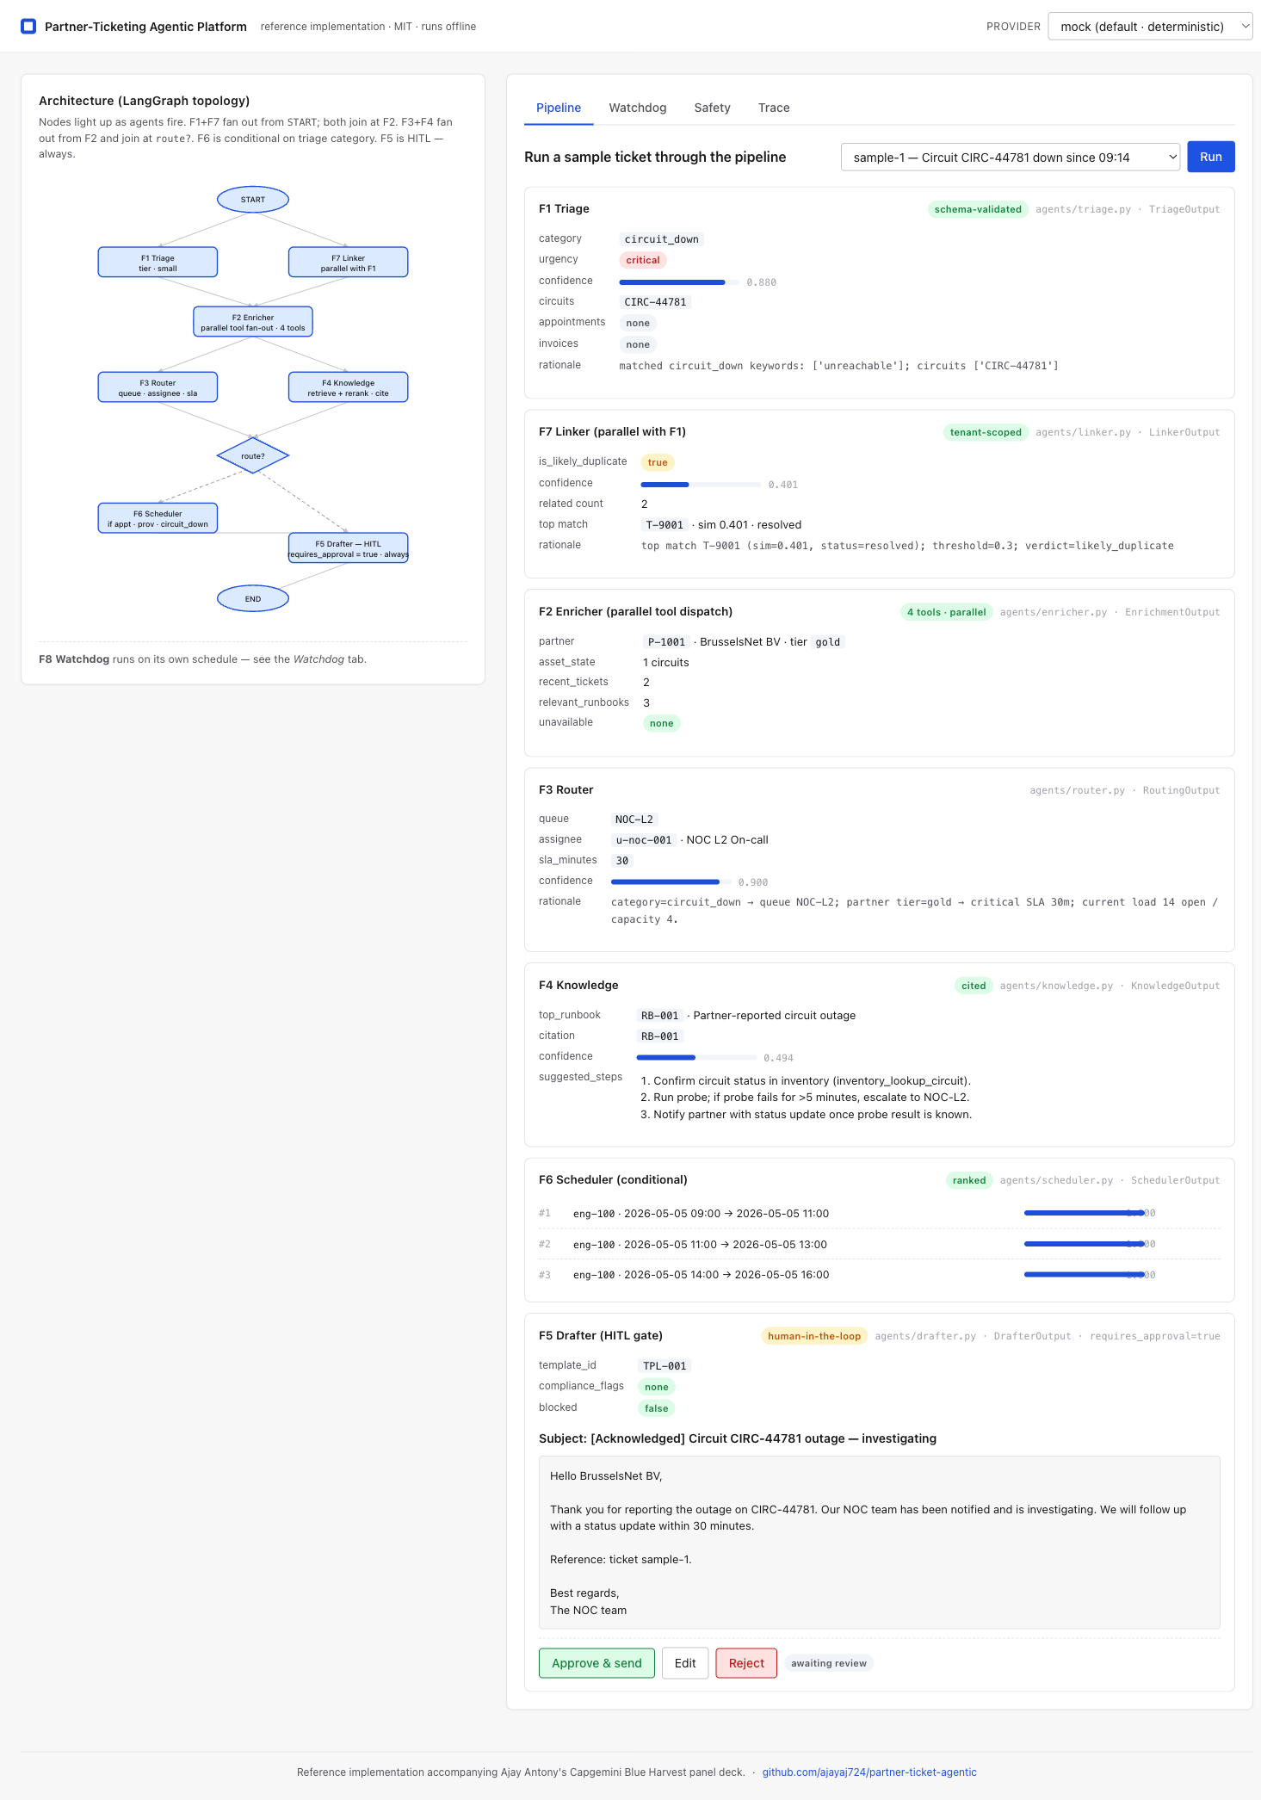
Demo at a glance
Web UI · LangGraph topology + HITL approval gate + Cost telemetry
Ajay Antony · Capgemini Blue Harvest Panel · May 2026

Slide 20
Greatest achievement
0 to Production
Scope: Platform that would normally be a squad's quarter
Constraint: Solo engineering, new business domain, two-month window
in under 2 months
solo
Result: Production live; written recognition from client and Infosys leadership
Ajay Antony · Capgemini Blue Harvest Panel · May 2026
19
Notes:
I want to land this as evidence, not a brag. The reason it matters for Capgemini is that the role I'm interviewing for needs someone who can walk into a client situation, absorb ambiguity, set architectural direction, and ship - not someone who needs a fully-staffed team and a year to deliver.

Slide 21
Biggest mistake & what I'd change with hindsight
The mistake
What I'd do differently
Took the partner authentication brief at face value during design
Two-day integration spike at sprint zero on every non-trivial dependency
Discovered the federation gap during integration, not design
Spike-the-risk-first as a non-negotiable habit
Use AI-assisted spec-to-test scaffolding earlier
Cost roughly a week of unblocking and a scope re-negotiation
Document the failure mode publicly so the team learns, not just me
Ajay Antony · Capgemini Blue Harvest Panel · May 2026
20
Notes:
I'm telling this story because architecture isn't done when the boxes are drawn - it's done when the seams are tested. The federation gap was visible if I had probed; I didn't, because the brief was confidently written. The lesson generalises: confident briefs from any source - clients, vendors, my own design notes - deserve a spike, not trust.

Slide 22
Thank you
Happy to dive deep on any architecture, agent design, or trade-off.
Ajay Antony · ajaybelgium724@gmail.com
Ajay Antony · Capgemini Blue Harvest Panel · May 2026
21
Notes:
Close warmly. Reiterate interest in the Blue Harvest brief - leading engineering teams to take real client systems agentic, in regulated industries, is exactly the work I want to do next. Open for questions; if asked something I don't have a strong answer to, I'll say so.

