Slide 1
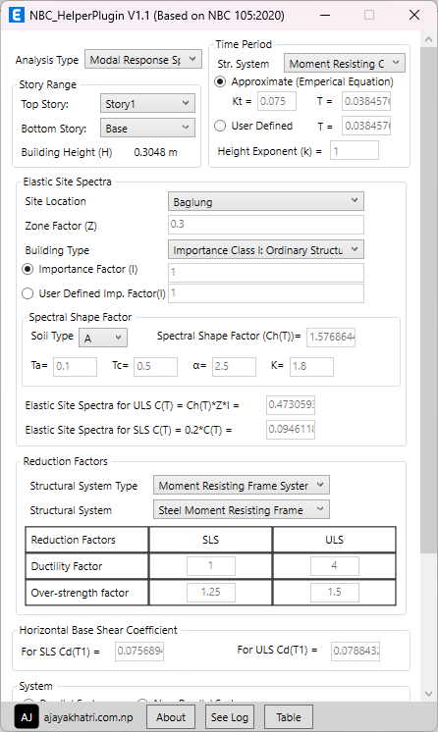





NBC_HelperPlugin
ETABS Plugin Based on NBC 105:2020
for Load Patterns and Combinations Definition
🔗 https://github.com/ajayakhatri/NBC_HelperPlugin
https://ajayakhatri.com
https://linkedin.com/in/ajayakhatri
me@ajayakhatri.com
https://github.com/ajayakhatri

Slide 2
NBC_HelperPlugin
ETABS Plugin Based on NBC 105:2020
for Load Patterns and Combinations Definition
https://github.com/ajayakhatri/NBC_HelperPlugin
https://ajayakhatri.com
https://linkedin.com/in/ajayakhatri
me@ajayakhatri.com
https://github.com/ajayakhatri

Slide 3
Select from various parameters
User-defined time period
User-defined Importance factor

Slide 4
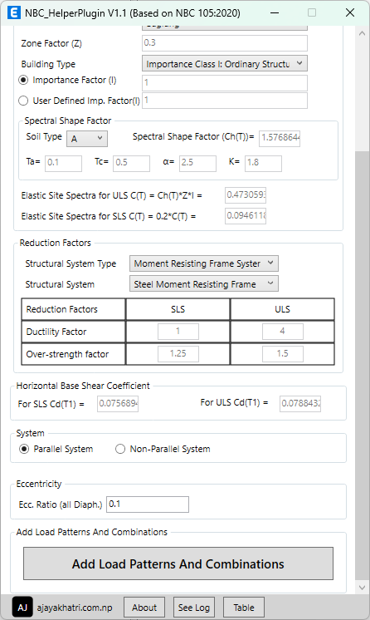
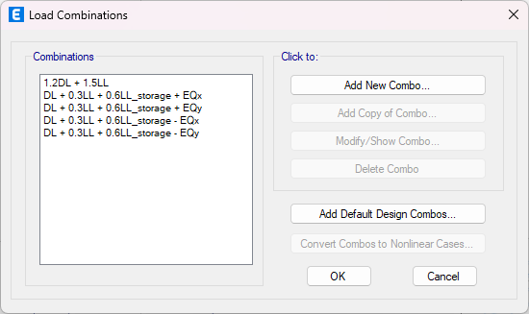
Select building system
Add Load Patterns & Combinations
See the Logs of the plugin

Slide 5
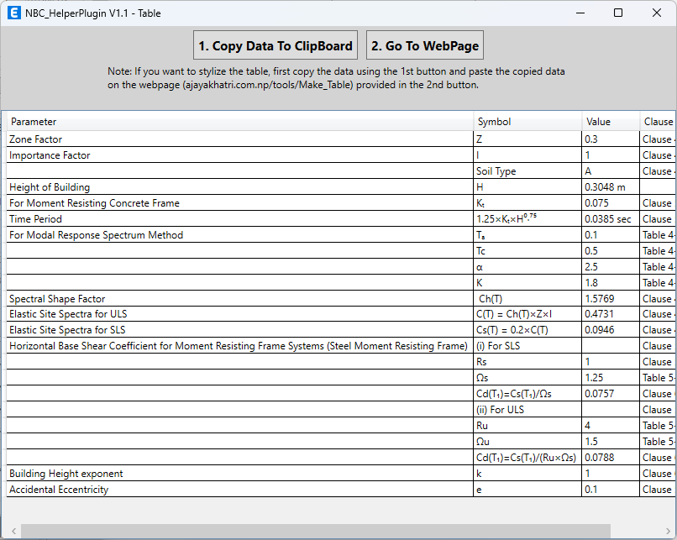
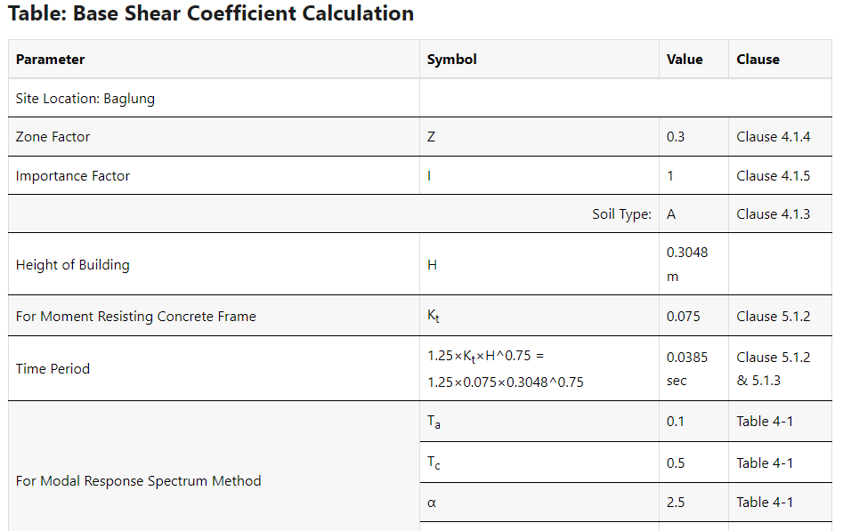
View calculation table
View and copy the table in proper format

