Slide 1

ABC Company -Data Science Assignment
By
Ajay Aakula
Eastern Illinois University

Slide 2
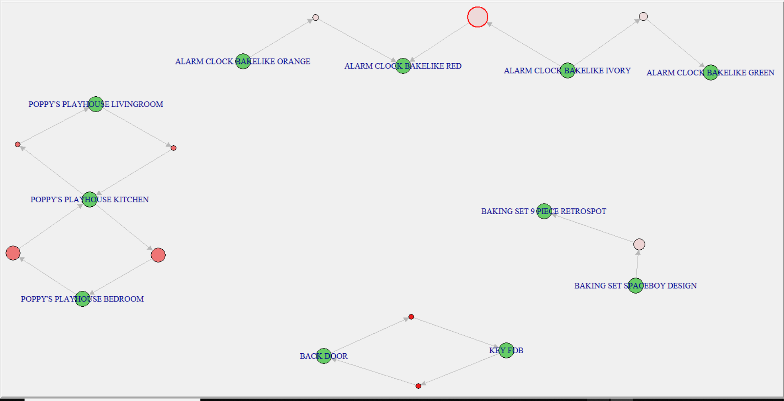
Market Basket Analysis
This Analysis helps to understand which are the products together business can offer to the customers out of all the products.
Mostly the similar family products need to display on the retail website to help customer buy the products.
The relation between the products should have some logical conclusion which trigger the customer to buy the products.

Slide 3
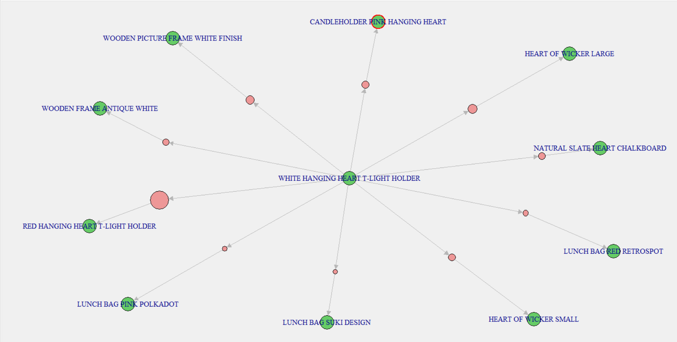
Market Basket Analysis
The image shows that which are the most closely related products, business can offer to the customer with WHITE HANGING HEART T-LIGHT HOLDER product as it’s is one of the most popular item from the item list.

Slide 4
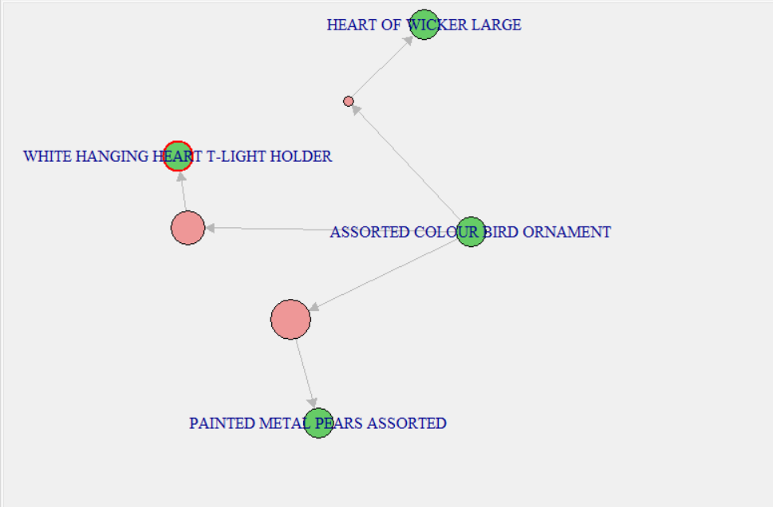
Market Basket Analysis
The image shows which are the most closely related products that business can offer to the customer with ASSORTED COLOUR BIRD ORNAMENT product as it’s is one of the most popular product.

Slide 5
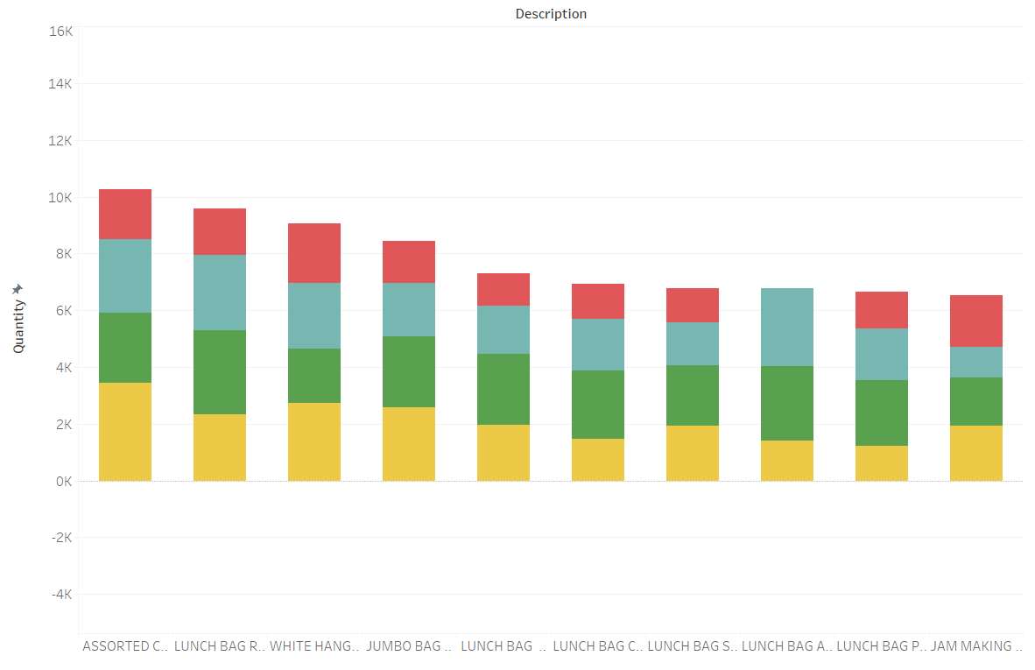

Top 10 Products Inventory Levels in next 12 weeks
According to the units sold in last 12 months , we are considering top 10 products as shown in the image.
ASSORTED COLOUR BIRD ORNAMENT product sold more in Q4 rather than reaming quarters, this implies that in every Q4 the market share of the product is high.
The image clearly explain that there is zero sale of LUNCH BAG APPLE DESIGN product in Q1 compare to other three quarters, so business need to be more cautious of this product in next Q1.

Slide 6
Top 10 Products Inventory Levels in next 12 weeks
All the top 10 products sold nearly equal in Q3 and vey low in Q1 compare to other quarters.
The image also explain how many units sold in each quarter in last four quarters, this gives clear picture of next quarter sale count of each product.
Overall in the next Q1 inventory levels should be maintain according to meet the demand and decrease the wastage.

Slide 7
Assumptions
Building Item Based Recommendation system in the assumption of users who have a similar interest in the past are most likely to have a similar interest in future.
Company data divide into 4 quarters as it’s contain data from Dec 2010 to Dec 2011.
Based on MBA analysis most frequently purchased products together are best combinations
to recommend other users
Most valued products are analyzed based on most sold products analysis instead of considering most income generated products.

Slide 8
Thank you

