Slide 1





Home About Us Trainers Classes Contact us
Push harder than yesterday
If you want a different tomorrow
GET START NOW
Notes:
Home page

Slide 2


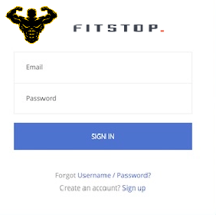
Free Wifi Friendly Trainers Flexible Timing
Notes:
Login page and management page

Slide 3

Welcome Admin
logout
Trainers
Members
Notes:
Admin page

Slide 4
Welcome Admin
logout
Trainers
Members
Trainers
Name | Age | Status | Slot | Contact
Add
Edit
Delete
Save
Notes:
Admin trainer page

Slide 5
Welcome Admin
logout
Trainers
Members
Members
Name | Contact Number | Date of Joining | Package | Expiry Date | Is Active | Schedule Time
Add
Edit
Delete
Save
Notes:
Admin Member page

Slide 6
Welcome Trainer
logout
Name | Contact Number | Date of Joining | Package | Expiry Date | Is Active | Schedule Time
Prev page
Next page
Notes:
Trainer page

Slide 7

Fit shop
Fit shop
Logout
Trainers
Members
Notes:
Admin

Slide 8
Fit shop
Fit shop
Trainers
Logout
Name | Age | Status | Slot | Contact
Add
Edit
Delete
Save
No . of Items
Per page
Prev page
Next page
Notes:
AdminTrainer page

Slide 9
Fit shop
Fit shop
Members
Logout
Name | Contact Number | Date of Joining | Package | Expiry Date | Is Active | Schedule Time
Add
Edit
Delete
Save
No . of Items
Per page
Prev page
Next page
Notes:
Admin Member page

Slide 10
Fit shop
Fit shop
Logout
Name | Contact Number | Date of Joining | Package | Expiry Date | Is Active | Schedule Time
No . of Items
Per page
Prev page
Next page
Notes:
Admin Member page

