Slide 1

CoinVision
Forecasting next day crypto close price
Ajay Anil Sree(107)
Guide:Prof.Natheera Beevi M

Slide 2
Introduction
Cryptocurrency Overview: Digital currency secured by cryptography,decentralized.
Importance of Price Prediction: Helps traders make informed decisions, reduces risk in volatile markets.
Motivation for Using ML/DL: Ability to handle complex patterns,improves prediction accuracy.
Cryptocurrencies Used: Bitcoin, Ethereum, Tron, Ripple, Tether

Slide 3
Related work
Existing Research:
"Forecasting Cryptocurrency Price Fluctuations with Deep Learning Models" – Explores LSTM for crypto predictions.
"Machine Learning Approaches for Cryptocurrency Market Price Prediction" – Compares ML models like SVM, RF, and KNN.
"A Survey on Cryptocurrency Price Prediction Using Time-Series Analysis" – Reviews techniques such as ARIMA and GARCH.
"Predicting Bitcoin Prices Using Sentiment Analysis and Machine Learning" – Combines sentiment analysis with ML for price forecasting.
Popular Algorithms: ARIMA, LSTM, SVM, Random Forests.
Techniques: Time-series analysis, sentiment analysis, feature engineering for price patterns.

Slide 4
Gap Identification
Limitations in Current Approaches:
Struggle with high volatility in crypto prices.
Complexity in capturing non-linear patterns.
Limited accuracy with traditional algorithms on diverse crypto datasets.
Research Gap:
Few studies explore a combination of KNN, SVM, MLP, and CNN specifically for crypto price prediction, aiming to improve accuracy by leveraging both traditional ML and deep learning approaches.

Slide 5
Problem Statement
Core Problem: Predicting cryptocurrency prices using machine learning and deep learning models to improve accuracy in highly volatile markets.
Target Cryptocurrencies: Bitcoin, Ethereum, Tron, Ripple, Tether.

Slide 6
Objective
· Build and Compare Models: Develop KNN, SVM, MLP, and CNN models for price prediction.
· Performance Evaluation: Assess and compare model accuracy on cryptocurrency price data.
· Identify Best Algorithm: Determine the most effective algorithm for predicting prices in volatile crypto markets.

Slide 7
Methodology
K-Nearest Neighbors (KNN)
Why Chosen: Known for its simplicity and high interpretability. Effective for data where relationships between instances are similar, as in some cryptocurrency trends.
Performance: Consistently low RMSE ,making it a reliable model for most cryptocurrencies in our study.
Support Vector Machine (SVM)
Why Chosen: SVM is known for its ability to handle high-dimensional data and non-linear relationships, which can be useful for complex cryptocurrency price movements.
Performance: SVM showed poor results, especially with negative R^2 scores on Bitcoin, Tron, and Tether, indicating a lack of fit.

Slide 8
Multi-Layer Perceptron (MLP)
Why Chosen: MLP is a deep learning model suited for time-series data with non-linear relationships. We used it to capture potential complex patterns in the crypto data.
Performance: MLP performed reasonably well for Ethereum and Ripple but had higher RMSE values for Bitcoin, indicating it may need further tuning for larger datasets.
Convolutional Neural Network (CNN)
Why Chosen: CNNs, though originally designed for image data, are effective in time-series data due to their ability to capture local dependencies and patterns.
Performance: CNN performed better than MLP for Bitcoin and Ethereum, but generally had slightly higher RMSE than KNN.

Slide 9
Dataset Description
Data Source: Kaggle
Features Used:
Independent Variables: Open, High, Low, Close, Volume, and Market Cap.
Dependent Variable: Next day’s closing price.
Preprocessing Steps
Data Normalization:
Used MinMaxScaler to scale features between 0 and 1, ensuring that each model performs optimally without being affected by differences in magnitude.
Train-Test Split:
Dataset was split into a 70:30 ratio, with 70% used for training and 30% for testing.
Feature Selection:
Key indicators (Open, High, Low, Close, Volume, Market Cap) were selected to capture daily price movements and trading volume, which are significant in predicting the next day’s closing price.

Slide 10
Why kNN?
Low RMSE Values Across Cryptocurrencies:
KNN consistently achieved the lowest RMSE values for each cryptocurrency, indicating its high accuracy in predicting prices. Lower RMSE values mean that the model's predictions are closer to the actual values, reducing the prediction error.
Consistency Across Different Cryptocurrencies:
KNN performed well not only on large cryptocurrencies like Bitcoin and Ethereum but also on smaller ones like Ripple, Tron, and Tether. This consistency makes it a robust choice across different datasets with varying price ranges and volatility levels.

Slide 11
Simplicity and Interpretability:
KNN is relatively simple to understand and interpret compared to deep learning models like CNN and MLP. Its distance-based approach aligns well with predicting daily price movements where similar past price behaviors can be useful indicators.
Suitability for Cryptocurrency Data:
The KNN algorithm performs well when similar data points share patterns, which is useful in cryptocurrency data where trends and patterns often recur. This makes KNN an effective choice for handling volatile price data.
Computational Efficiency:
KNN is computationally less intensive than CNN and MLP, making it a feasible choice if resources or time are limited, without compromising accuracy significantly.
Conclusion:
KNN is the best model due to its high accuracy, robust performance across currencies, simplicity, and efficiency.

Slide 12
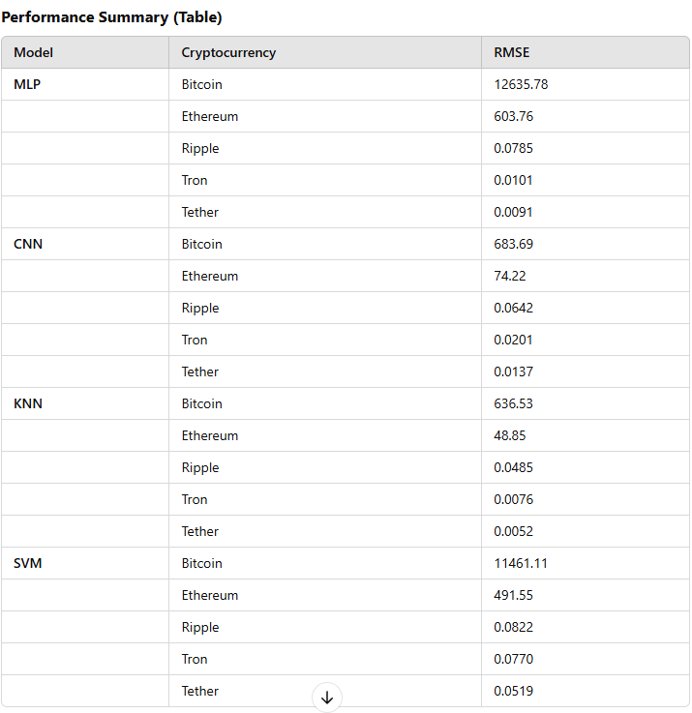
Results

Slide 13
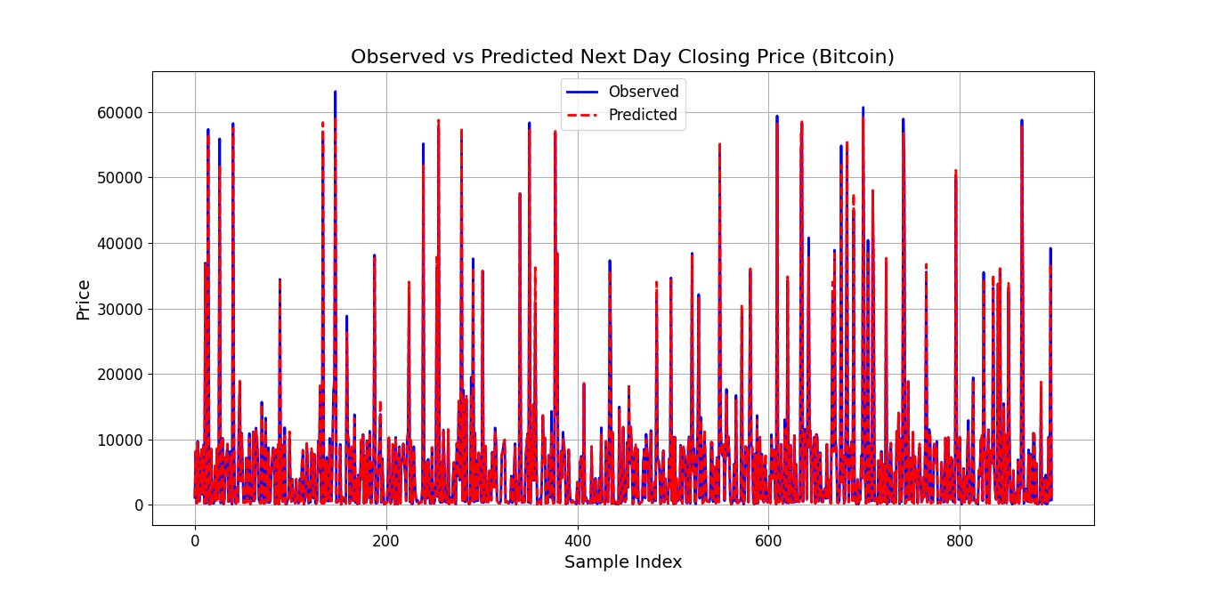

Slide 14
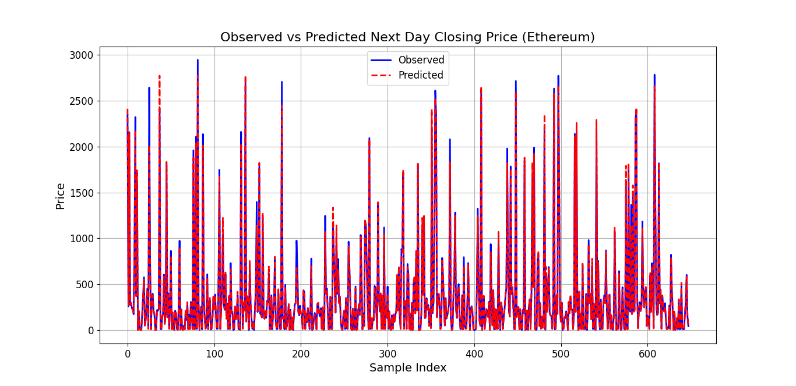

Slide 15
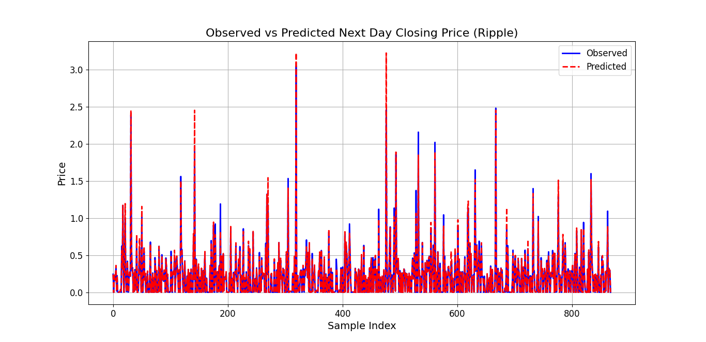

Slide 16
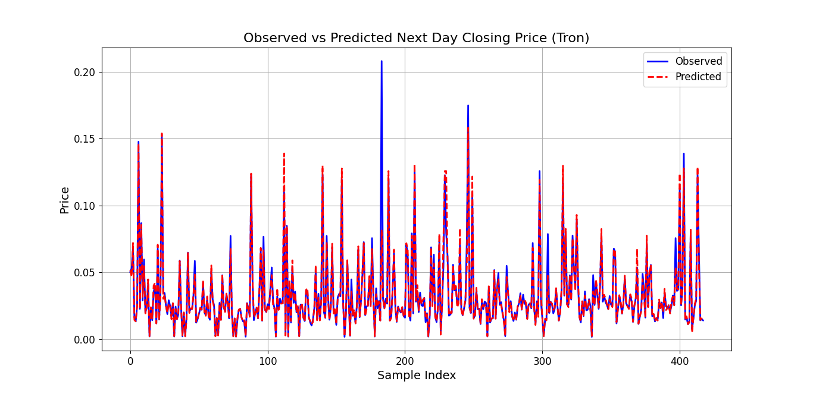

Slide 17
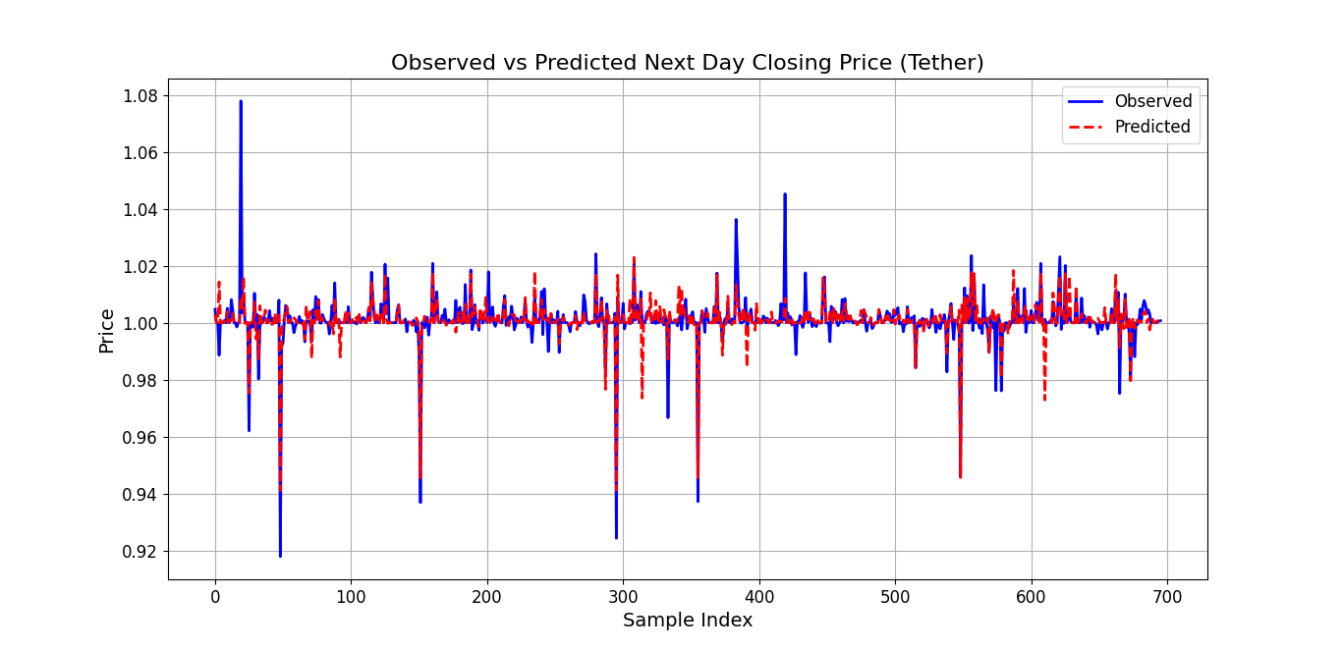

Slide 18
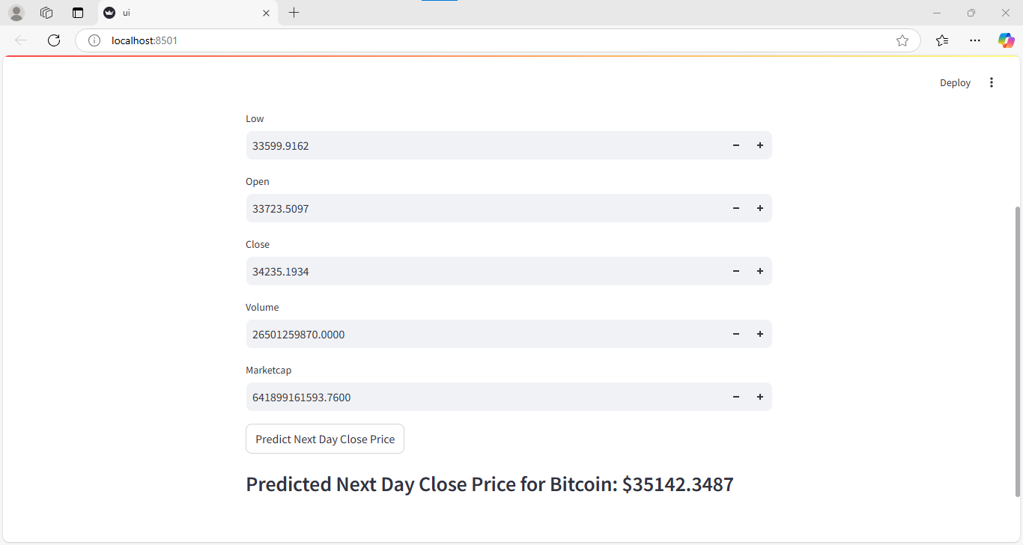

Slide 19
Future Enhancements
Larger Datasets:
Increase data variety and volume for improved model generalization and reduced overfitting.
Additional Variables:
Incorporate factors like market sentiment, global financial indicators, or news sentiment analysis to capture broader market influences on prices.
Ensemble Techniques:
Implement stacking or boosting methods to blend multiple models for enhanced accuracy and stability.

Slide 20
Thank You.

