Slide 1

EdgeDC360
Enterprise Edge Data-Center Operations Platform — Fog Computing + AWS
THE PROBLEM
Data-centre racks generate continuous multi-sensor telemetry.
Streaming every raw reading straight to the cloud is expensive, slow, and fragile.
A missed cooling failure or UPS depletion can mean cascading hardware failure and costly downtime.
EdgeDC360 pushes filtering, aggregation and anomaly detection to a Fog Gateway — so only what matters reaches AWS.
Ajay Anitha Ganesan · Fog and Edge Computing

Slide 2
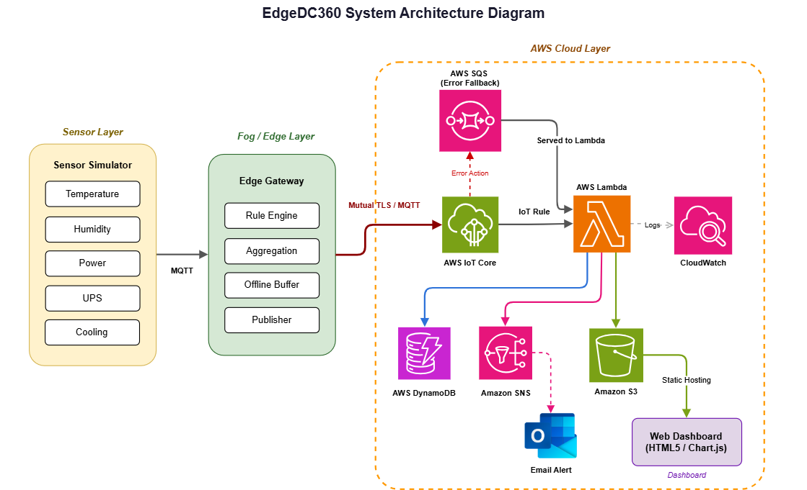
WHAT I BUILT
Three-Tier Fog → Cloud Architecture

Slide 3
LIVE DEMO
See It In Action
1
2
3
Live Ops Dashboard
Fog Bandwidth Savings
Failure Injection → Alert
Real-time temperature, humidity, power, UPS and cooling per rack, with a composite 0–100 health score.
Messages generated vs. messages actually uploaded, the visible payoff of edge-side aggregation.
Inject a critical reading (e.g. 88°C) and watch it bypass the batch window, hit DynamoDB/S3, and fire an SNS email in seconds.

Slide 4
HARDEST CHALLENGE
Anomalies Were Getting Silently Suppressed
PROBLEM
The duplicate/noise filter, designed to drop repeated routine readings, was also silently dropping repeated CRITICAL readings — hiding a real fault behind a debounce mechanism meant for noise, not emergencies.
SOLUTION
Added an explicit anomaly bypass: the rule engine now flags a reading as critical before the duplicate filter runs, and critical events skip the filter and the batch window entirely and dispatched immediately, every time.
Result: Full functional monitoring dashboard with zero-miss critical alerting end to end.

