Slide 1
Healthcare Challenge 2: long-term self-care
EvidenceLoop
Turn confusing health claims into
questions worth following up.
AJ_001 / Solo entry / NTU
Recorded screenshot walkthrough of a fictional engineering prototype
Notes:
Narration
A convincing claim can leave a person with an unresolved question: what does this finding actually establish, and what should I ask at my next discussion? EvidenceLoop connects that question to its source and keeps the context available when the person returns. Our focus is Healthcare Challenge 2: long-term self-care.
The intended healthcare benefit remains a product hypothesis. User supplied AJ_001, solo entry and NTU on 14 October 2026.
Sources (repository-relative unless URL shown)
docs/submission/ENTRY_DRAFT.md
docs/planning/SPONSOR_VERIFICATION.md

Slide 2
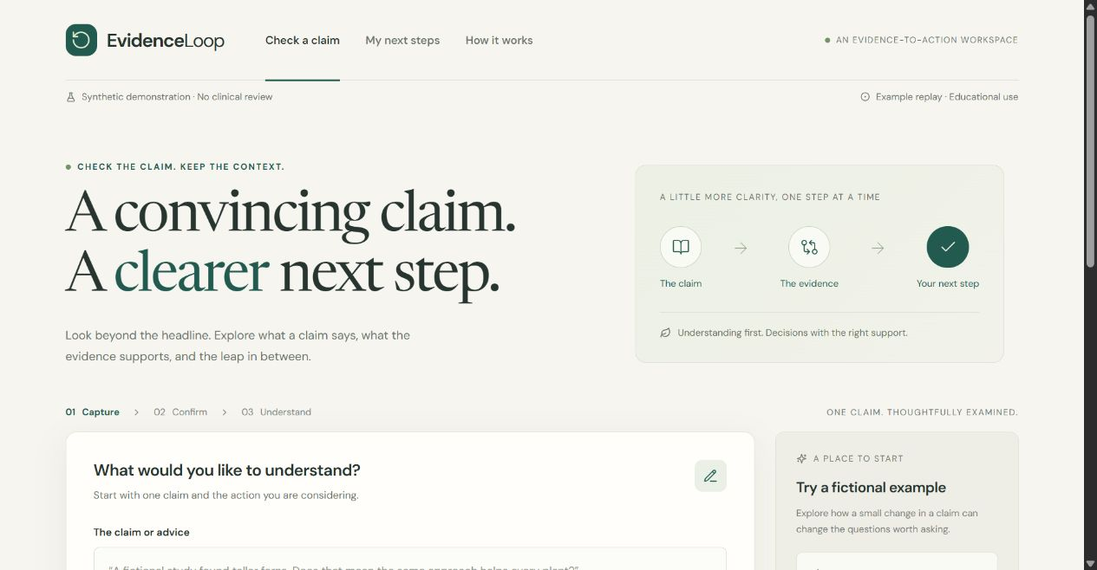
The current demonstration
A working local workflow using fictional evidence
Example replay
The app labels its demonstration mode on screen.
Clinical review pending
The installed library contains fictional, nonclinical examples.
Recorded screenshot walkthrough / Fictional engineering prototype
02
Notes:
Narration
This is a working local engineering prototype. The demonstration uses a fictional fern study, and replay is visibly labeled. It is not a health recommendation or a live model response. We chose this example so you can inspect the behavior without confusing an unfinished clinical evidence library with approved medical advice.
Sources (repository-relative unless URL shown)
artifacts/submission-20261014/screenshots/01-home.jpg
docs/BUILD_STATUS.md

Slide 3
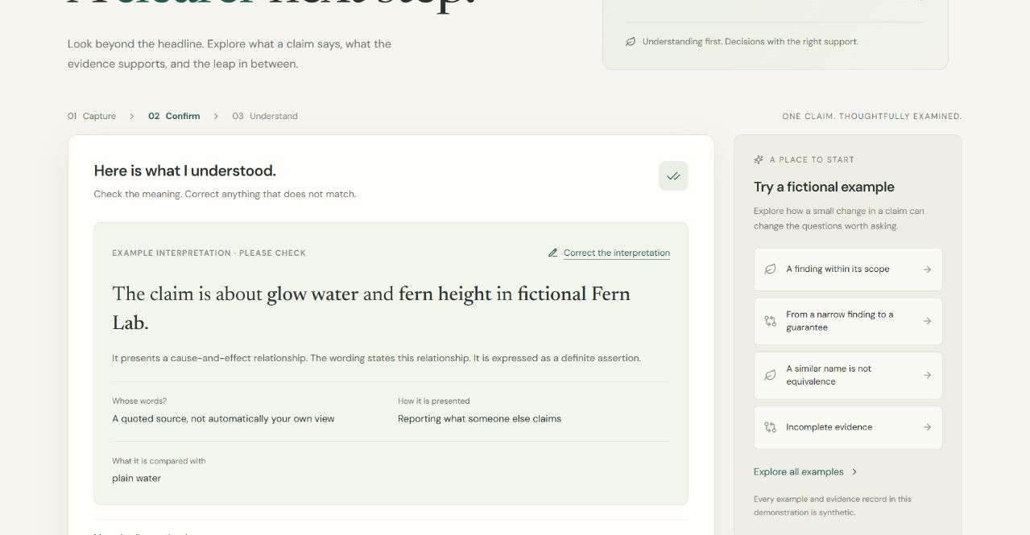
Confirmation of meaning
The claim and the user’s intention stay separate
Explicit confirmation
The user checks the interpretation before assessment.
Unknown stays unknown
Missing context does not become an invented fact.
Recorded screenshot walkthrough / Fictional engineering prototype
03
Notes:
Narration
First, the user checks what the claim means. The fictional study describes glow water, fern height, seven days and a plain-water comparison. The user's intention is separate from the words of the claim. Confirmation records the meaning to assess; it does not make the claim true. Unstated information can remain unknown instead of becoming an invented detail.
Sources (repository-relative unless URL shown)
artifacts/submission-20261014/screenshots/02-interpretation.jpg
services/api/app/main.py
apps/web/src/Interpretation.tsx

Slide 4
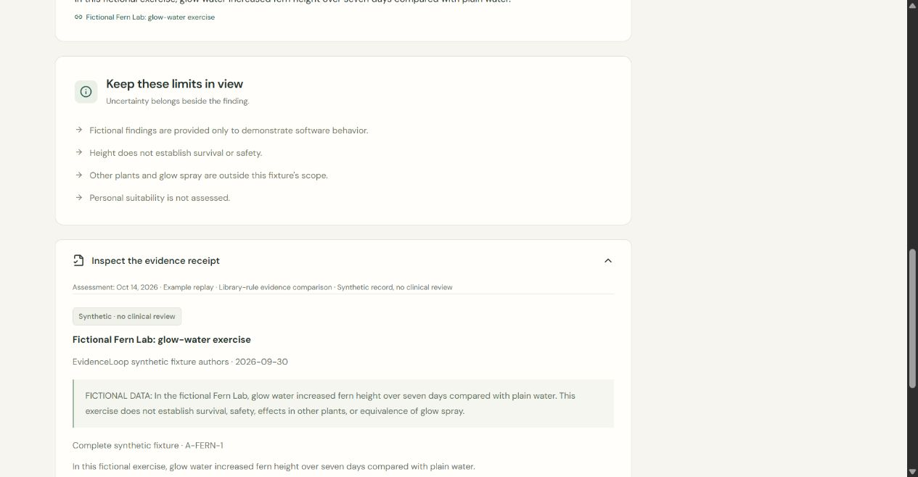
A source with visible limits
The receipt preserves the passage and its scope
A bounded finding
A measured outcome does not establish a universal guarantee.
Inspectable record
Source versions and limitations stay attached to the receipt.
Recorded screenshot walkthrough / Fictional engineering prototype
04
Notes:
Narration
The receipt keeps the source and its limits inspectable. A finding about one outcome in one setting does not establish a guarantee for every situation. The interface separates the evidence relationship, coverage and intended action. These are bounded demonstration results. A source passage can show where a statement came from; it cannot by itself prove that every inference or personal action is justified.
The shown verdict belongs to an authored unchanged replay. It does not establish exact directional comparison for arbitrary manual or live claims.
Sources (repository-relative unless URL shown)
artifacts/submission-20261014/screenshots/04-source.jpg
evidence/synthetic_nonclinical.json
apps/web/src/Assessment.tsx

Slide 5
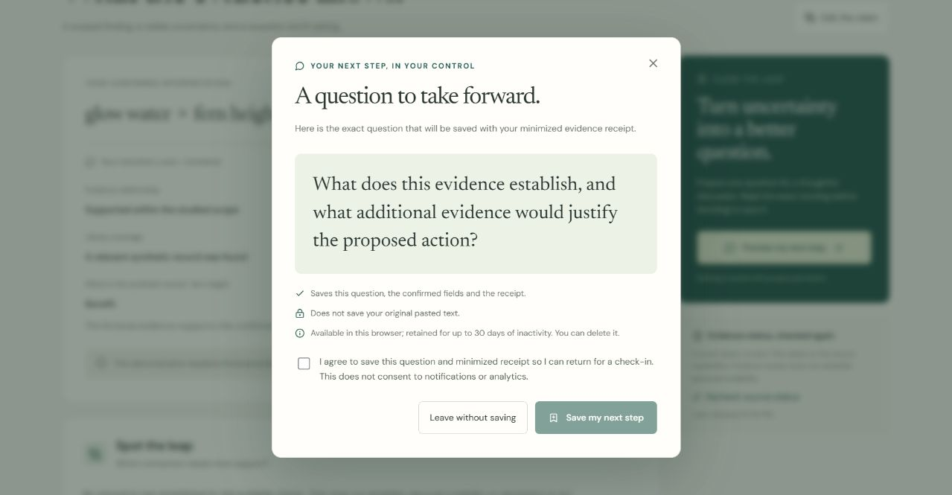
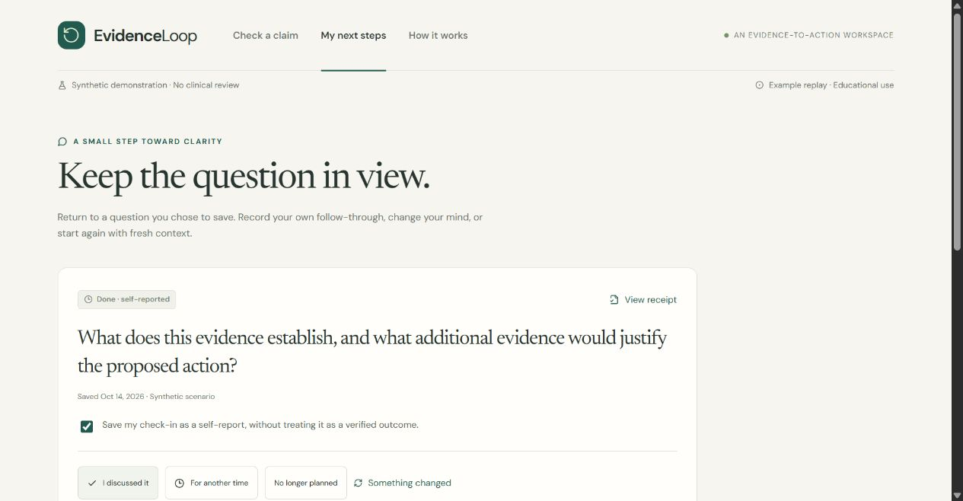
A question the user chooses to keep
Explicit save consent, followed by a simulated later check-in
Exact preview and consent
Self-reported follow-through
The saved record excludes the original pasted text.
A check-in does not verify adherence or a health outcome.
Recorded screenshot walkthrough / Fictional engineering prototype
05
Notes:
Narration
The next step is an exact question the user can preview. Saving is a separate choice. The screen explains what will be retained, and the save button requires consent. The original pasted text is not stored with the saved record. Now we simulate a later visit. The person chooses to record that they discussed the question. This is labeled a self-report, not verified adherence, improved understanding or a health outcome.
The later visit is simulated. No real healthcare discussion is asserted. The screenshots show actual local replay actions, not live inference.
Sources (repository-relative unless URL shown)
artifacts/submission-20261014/screenshots/05-consent.jpg
artifacts/submission-20261014/screenshots/07-checkin.jpg
services/api/app/storage.py
apps/web/src/Saved.tsx

Slide 6
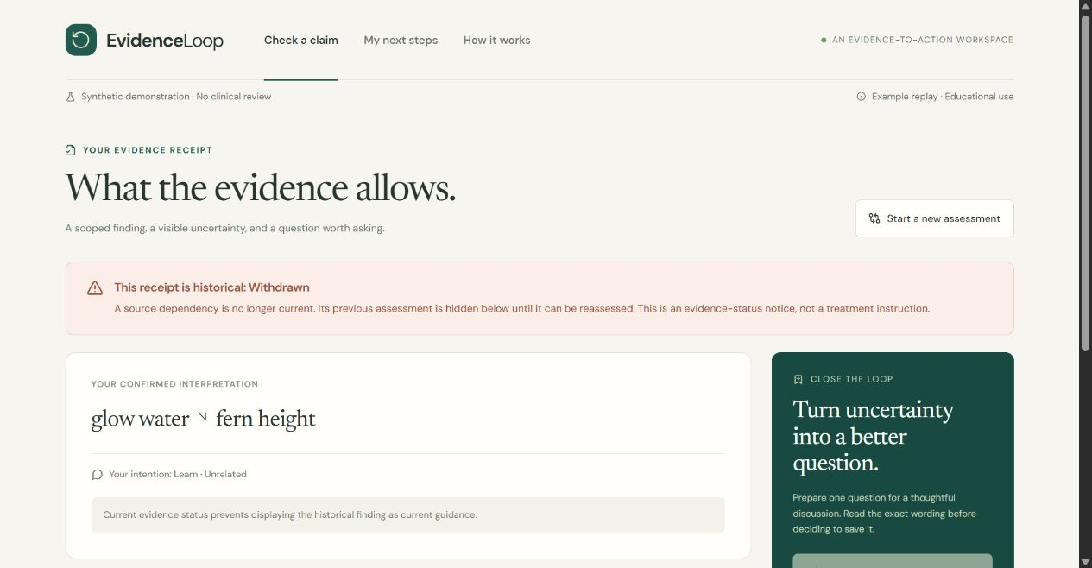
A receipt after source withdrawal
Historical information retains its history, while current trust changes
Current trust check
A withdrawn dependency blocks relevant new use.
Synthetic exercise
This is a fictional withdrawal, not a publisher correction.
Recorded screenshot walkthrough / Fictional engineering prototype
06
Notes:
Narration
A saved answer must not quietly preserve authority after its evidence changes. These captures show the result of withdrawing a fictional source. When the user reopens the saved receipt, the application checks current source status again. The historical record remains inspectable, but the withdrawn dependency blocks relevant new use. This is a synthetic withdrawal exercise, not a real publisher correction or a claim that we automatically monitor medical literature.
The added tests exercise an ordered invalidation window. They do not establish general concurrency correctness.
Sources (repository-relative unless URL shown)
artifacts/submission-20261014/screenshots/08-withdrawn.jpg
services/api/app/review.py
tests/test_api_review.py

Slide 7
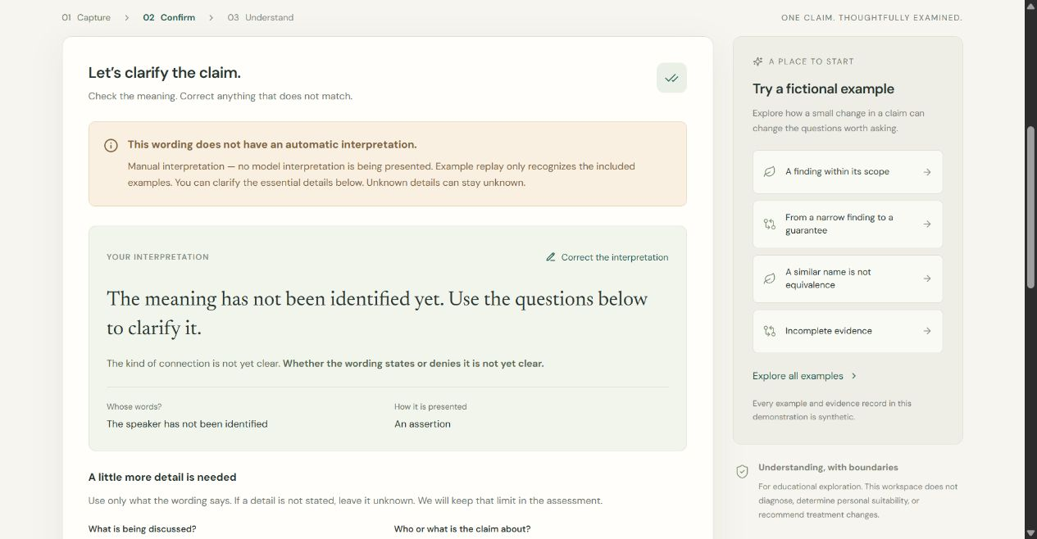
An unresolved claim
Manual clarification remains visible when the reader is unavailable
Missing referents
“It might help them” leaves the subject and outcome unresolved.
Qualification pending
Live AI remains disabled at this preparation checkpoint.
Recorded screenshot walkthrough / Fictional engineering prototype
07
Notes:
Narration
Ambiguous input should not produce confident advice. This fictional sentence does not identify the people, intervention or outcome. The user can clarify what they mean, or leave it unresolved. The application shows its limits. Our live reader remains disabled because no tested model has passed qualification, so this screen is manual fallback, not a staged AI success.
On 14 October, further bounded model trials are in progress. No new qualification is claimed. The existing documented last complete known-regression run failed.
Sources (repository-relative unless URL shown)
artifacts/submission-20261014/screenshots/09-ambiguous.jpg
docs/AI_EXTRACTION_VERIFICATION_20261013.md

Slide 8
Architecture and authority
React, FastAPI and PostgreSQL in a local single-process application
Boundary | Implemented control | Authority retained by
Input and interpretation | Expiring drafts, confirmation and versions | User and server checks
Evidence and comparison | Source review, passage checks and bounded rendering | Review workflow and domain rules
Save and later use | Consent, ownership and current trust checks | Server transaction
Optional AI proposes structure. It cannot approve evidence or authorize a write.
Recorded screenshot walkthrough / Fictional engineering prototype
08
Notes:
Narration
React presents the workflow, FastAPI enforces policy and versions, and PostgreSQL stores consented records and separate evidence-review history. Before save, drafts live in expiring server memory. The optional model can propose structure, but it cannot approve evidence or authorize a write. The application checks quotes, schemas, ownership, consent and current evidence. A local single-process design keeps the prototype small; it does not provide production hosting or cross-device recovery.
No qualified clinical publication is installed. The local prototype does not provide cross-device recovery or production monitoring. Extraction-only comparison remains constrained while directional representation is incomplete.
Sources (repository-relative unless URL shown)
docs/ARCHITECTURE.md
services/api/app/main.py
services/api/app/storage.py
services/api/app/review.py
services/api/app/compiler.py

Slide 9
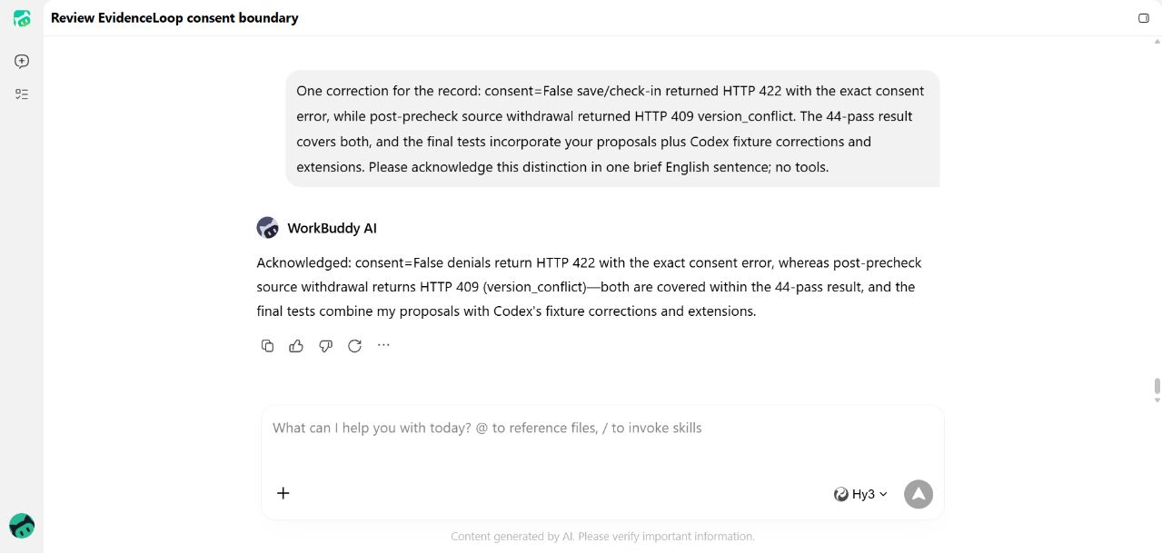
WorkBuddy’s development contribution
Source review that led to meaningful negative-test coverage
WorkBuddy reviewed
Consent and source-withdrawal boundaries
Codex corrected and implemented
44 related tests passed
4 inspected conversation captures
13 October 2026
No clinical approval or runtime qualification
Recorded screenshot walkthrough / Fictional engineering prototype
09
Notes:
Narration
WorkBuddy contributed genuine development review. Its Hy3 model examined consent and source-withdrawal code and proposed missing negative tests. Codex corrected and implemented the proposals and ran the local checks: forty-four related tests passed. These captures record the contribution and corrections. WorkBuddy did not run the tests or provide clinical approval.
WorkBuddy did not execute local tests. Codex corrected the proposed fixture and row-comparison mistakes and extended consent coverage.
Sources (repository-relative unless URL shown)
docs/sponsor-evidence/2026-10-13/README.md
docs/sponsor-evidence/2026-10-13/04-local-validation-review.png
docs/sponsor-evidence/2026-10-13/validation.txt
docs/sponsor-evidence/2026-10-13/manifest.json

Slide 10
Results and open qualifications
Documented 13 October checkpoints, with separate denominators
Check | Observed result | Limit
Python checkpoint | 499 tests + 51 subtests passed | Engineering checks
Sponsor-related suite | 44 tests passed | Separate, overlapping suite
Reader regression | 10/12 exact cases | Known cases; gate failed
Live AI qualification and clinical publication remain open.
No volunteer observations or health benefits are claimed.
Recorded screenshot walkthrough / Fictional engineering prototype
10
Notes:
Narration
The evidence is deliberately specific. At the October thirteenth checkpoint, the Python suite passed four hundred ninety-nine tests plus fifty-one subtests. At that checkpoint, a reader probe matched ten of twelve known regression cases and still failed qualification. We have no clinical validation or measured health benefit. EvidenceLoop demonstrates a way to keep meaning, consent and changing evidence connected. The next proof is reliable reading, independent source review and observed use with fictional tasks.
Do not sum the dated suite counts. The 13 October checkpoint reader run used Gemini 3.1 Flash-Lite, prompt 1.12, medium reasoning, max 7.015 seconds on known regression. The frozen gate failed. Subsequent experiments require their own updated report.
Sources (repository-relative unless URL shown)
docs/AI_EXTRACTION_VERIFICATION_20261013.md
docs/sponsor-evidence/2026-10-13/validation.txt
docs/submission/USABILITY_TASKS.md

