Slide 1

Original raster: aspect ratio and deliberate stretch
Notes:
XML-derived OpenDeck picture geometry probe. Original 800x400 coordinate-encoded raster created by project code. Full, square and wide copies isolate stretch from cropping. Marker rectangles show the local image frames.

Slide 2
Positive crops and signed source outsets
Asymmetric crop
Centered cover
Negative all edges
Left crop35
Top crop40
Right bottom crop
Notes:
XML-derived OpenDeck picture geometry probe. Six native Crop object cases. Source ratios were authored through picture dimensions and centered offsets, without XML edits. Negative ratios include transparent source outsets.

Slide 3
Asymmetric crop followed by local flips
No flip
Horizontal flip
Vertical flip
Both flips
Notes:
XML-derived OpenDeck picture geometry probe. Same asymmetric crop on four images. No-flip, horizontal, vertical and both local flip states distinguish source crop coordinates from displayed orientation.

Slide 4
Crop, flip and rotation order
Rotate30 no flip
Rotate30 horizontal
Rotate90 vertical
Rotate270 both
Notes:
XML-derived OpenDeck picture geometry probe. Native rotation controls use asymmetric crops and local flips. A geometric image mapping can predict pixel locations independently from import and export.

Slide 5
Contain and offset source windows
Contain in square
Negative left top
Mixed signed crop
Offset source window
Notes:
XML-derived OpenDeck picture geometry probe. Signed crop controls retain image-frame bounds, with negative source offsets representing empty space rather than discarded pixels. Contain uses a wider source window vertically.

Slide 6
Picture clipping to native preset geometry
Picture rectangle
Picture ellipse
Picture roundRect
Picture triangle
Notes:
XML-derived OpenDeck picture geometry probe. Native picture AutoShapeType controls attempt ellipse, rounded rectangle and triangle geometry. Unsupported authoring requests are recorded separately. No source bitmap is modified.

Slide 7
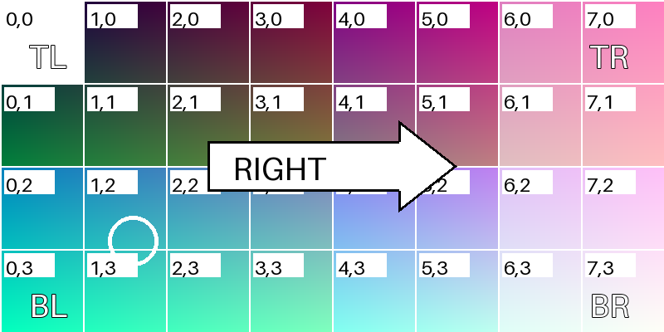
Alpha pixels, source outsets and flipped transparency
Notes:
XML-derived OpenDeck picture geometry probe. Second original PNG contains a fully transparent corner region and a half-alpha right strip. Marker backgrounds distinguish source transparency from cropped space; local flips move both color and alpha.

Slide 8
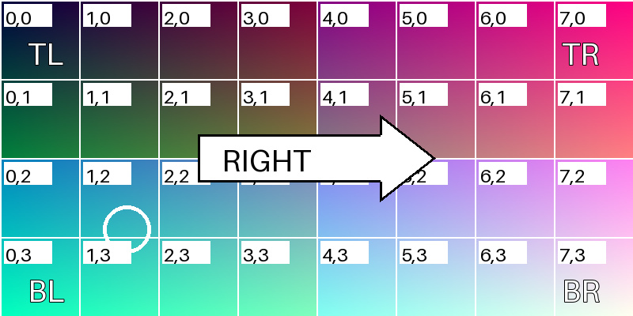
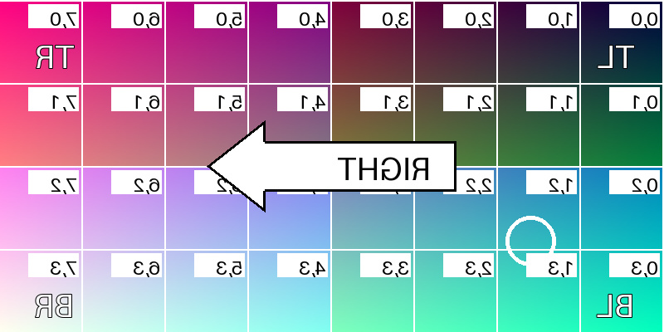
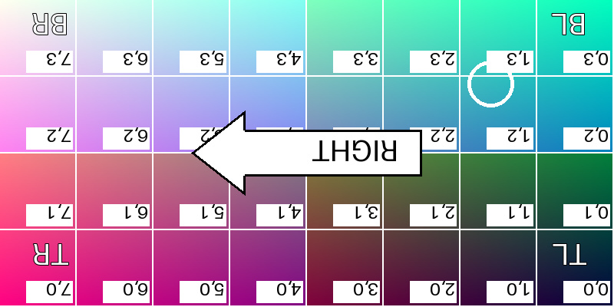
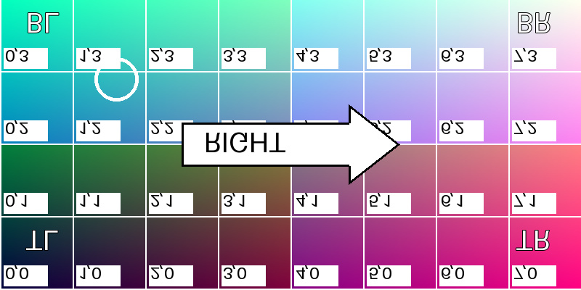
JPEG orientation metadata 1 to 4
EXIF orientation 1
EXIF orientation 2
EXIF orientation 3
EXIF orientation 4
Notes:
XML-derived OpenDeck picture geometry probe. Original project JPEG pixel payload is identical across files; EXIF orientation is the sole changed tag. Native AddPicture uses natural dimensions before resizing to the control cell. Insertion properties are recorded independently.

Slide 9
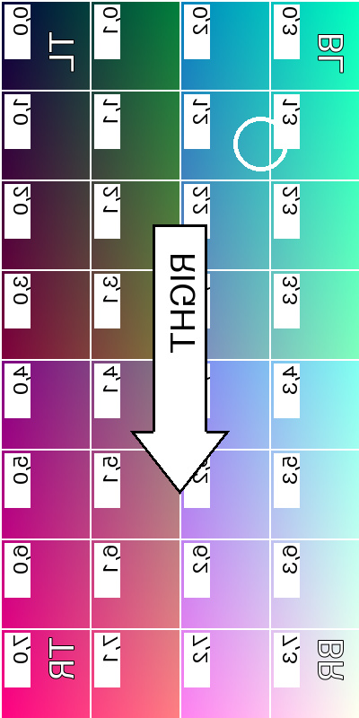
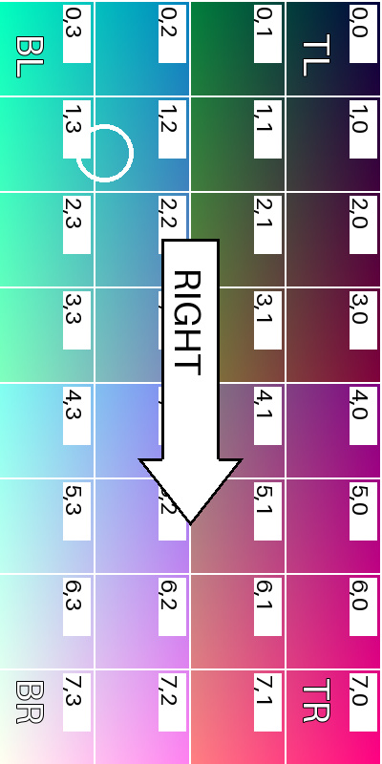
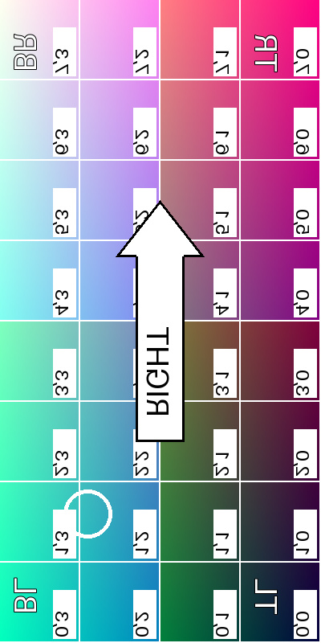
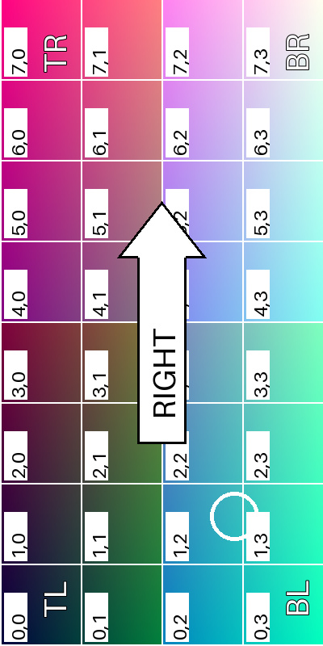
JPEG orientation metadata 5 to 8
EXIF orientation 5
EXIF orientation 6
EXIF orientation 7
EXIF orientation 8
Notes:
XML-derived OpenDeck picture geometry probe. Original project JPEG pixel payload is identical across files; EXIF orientation is the sole changed tag. Native AddPicture uses natural dimensions before resizing to the control cell. Insertion properties are recorded independently.

