Slide 1
Cryptocurrencies and Asset Allocation
Daniele Marazzina

Slide 2

Are banks investing in cryptocurrencies?
Or better…
Should banks invest in cryptocurrencies?
«Warren Buffett will continue to speak ill against cryptocurrencies, but what would you expect from a man who doesn’t even have an email account???»
«Spanish banking giant BBVA, made a considerate investment in the cryptocurrency trading platform Coinbase as it plans its next move involving the use of blockchain.»
«Bank of America has made several statements declaring that they’re investing the most in blockchain and crypto.»
Interest in the blockchain technology… or in cryptocurrencies???

Slide 3
We will use classical mathematical finance tools to study if investing in cryptocurrencies could make sense…
Are expected returns higher than (classical) financial assets ones?
Are cryptocurrencies riskier than (classical) financial assets?
What about diversification?

Slide 4
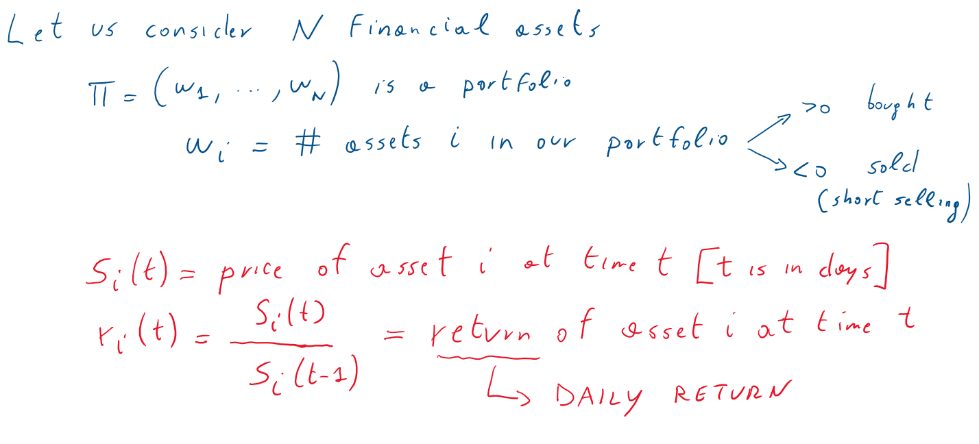
(Efficient) Portfolio Frontier

Slide 5
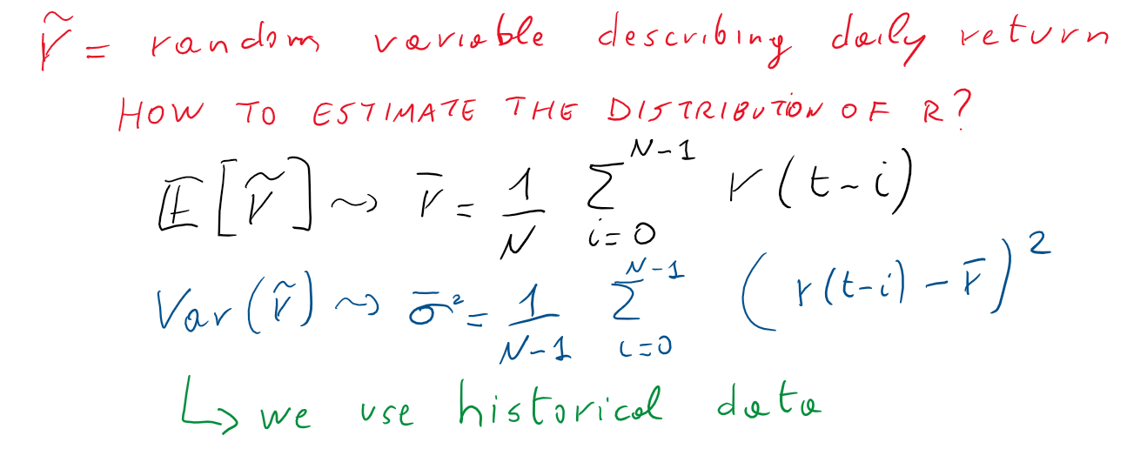

Slide 6
Mean-Variance Analysis
Mean-variance analysis is the process of weigthing risk, expressed as variance, against expected return.
Investors use mean-variance analysis to make decisions about which financial instruments to invest in, based on how much risk they are willing to take on in exchange for different levels of reward.
The efficient frontier is the set of optimal portfolios that offer the highest expected return for a defined level of risk or the lowest risk for a given level of expected return.
APPLIED TO A PORTFOLIO, NOT TO A SINGLE ASSET

Slide 7
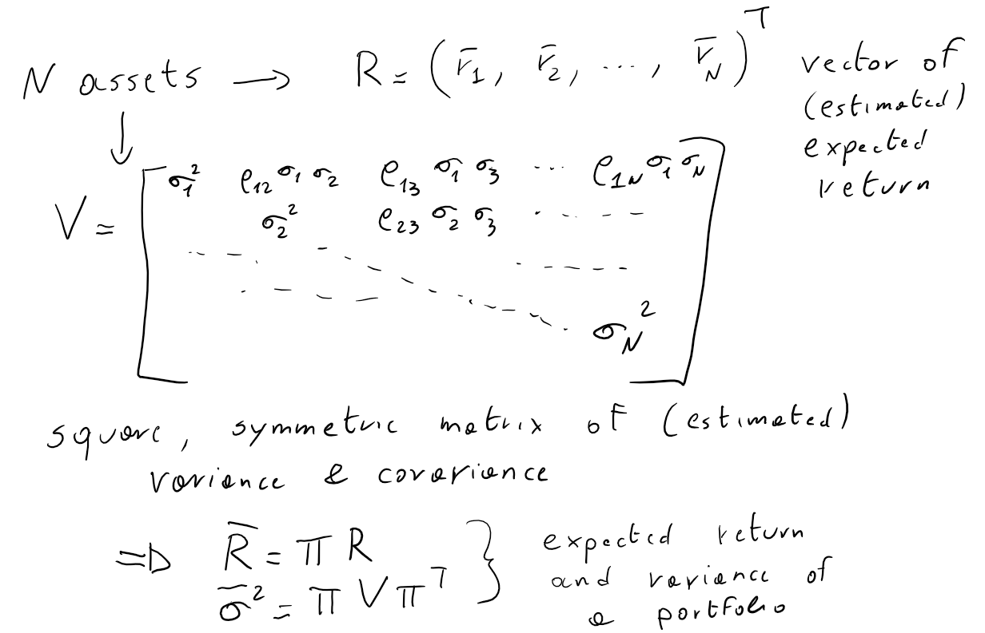

Slide 8
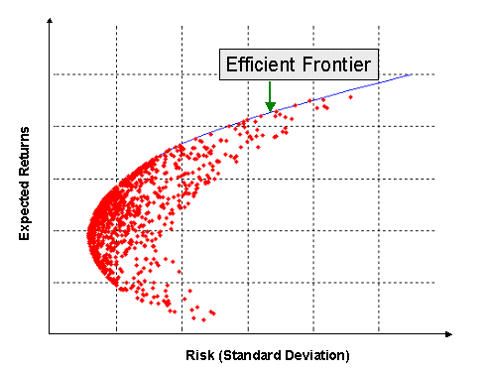

Slide 9
Consideriamo
Our Market for the first (toy) problem
Bitcoin
Ether
Amazon
Apple
Facebook
General Electric
General Motor
Daily datas (only working day) from September 2017 to February 2020
Notice that everything is in USD

Slide 10
ExpectedReturn =
1.0026 1.0017 1.0014 1.0012 1.0005 0.9993 1.0000
Variance = 0.24 0.36 0.03 0.03 0.04 0.06 0.03 (%)
Correlation=
1.0000 0.6975 0.0149 0.0188 0.0350 0.0160 -0.0093
0.6975 1.0000 0.0546 0.0614 0.0441 0.0403 0.0561
0.0149 0.0546 1.0000 0.5807 0.5623 0.2261 0.3016
0.0188 0.0614 0.5807 1.0000 0.4706 0.2844 0.3454
0.0350 0.0441 0.5623 0.4706 1.0000 0.2132 0.3292
0.0160 0.0403 0.2261 0.2844 0.2132 1.0000 0.2809
-0.0093 0.0561 0.3016 0.3454 0.3292 0.2809 1.0000

Slide 11
Expected Return = 1.01
Portfolio (% of wealth invested)
0.9573
-0.2611
2.8507
2.7995
-1.4778
-2.1661
-1.7026

Slide 12
Expected Return=1.001
Portfolio
0.1037
-0.0223
0.2308
0.3644
0.0439
0.0252
0.2543

Slide 13
Expected Return=1.0001
Portfolio
0.0184
0.0015
-0.0312
0.1209
0.1961
0.2444
0.4500

Slide 14
Daily Return… let us assume that the expected daily returns considered are risk-free, and invest 100 $.
After one year we receive
1.01 → 1227 $
1.001 → 128 $
1.0001 → 102.55 $
Take Away
The best reason to invest in cryptocurrency seems diversification!!!

