Slide 1
Contract Lens
A cited question answering assistant
for fintech contracts
LangChain and LangGraph with OpenAI, Pinecone and Streamlit
Demo presentation
October 24, 2026
Notes:
About 15 seconds. This is Contract Lens, a retrieval-augmented generation chatbot for fintech contracts. It searches supplied documents and links generated claims to source evidence. I will show the build, the architecture and several questions, including cases that require clarification or lack sufficient evidence.
Sources
C:\Users\Administrator\Documents\Codex\2026-10-20\at\outputs\Contract_Lens_Demo_Guide_With_Architecture.docx

Slide 2
Documents and setup
30
90
90
contract PDFs
physical PDF pages
stored chunks
Demo documents
Contract_1.pdf
Car financing agreement
Contract_2.pdf
Motorcycle financing agreement
Windows and Python 3.12.10 in a project virtual environment
Source: verified upload manifest. Original project target: 25 documents. Current indexed corpus: 30.
02
Notes:
About 20 seconds. The original target was 25 documents. The current verified namespace contains 30 PDFs, 90 pages and 90 chunks. For the demo I use a car financing agreement and a motorcycle financing agreement. The project runs on Windows inside a Python 3.12.10 virtual environment. Credentials remain in the server-side .env file.
Sources
C:/Users/Administrator/Documents/fintech-contract-rag/reports/upload_manifest.json
C:/Users/Administrator/Documents/fintech-contract-rag/data/contracts/Contract_1.pdf, physical PDF page 1
C:/Users/Administrator/Documents/fintech-contract-rag/data/contracts/Contract_2.pdf, physical PDF page 1
C:\Users\Administrator\Documents\Codex\2026-10-20\at\outputs\Contract_Lens_Demo_Guide_With_Architecture.docx

Slide 3
Document ingestion
PDF contracts
Extract page text
pypdf
Split into chunks
LangChain
Create embeddings
OpenAI
Store vectors
Pinecone
Chunking configuration
Embedding configuration
600-token limit
100-token target overlap
text-embedding-3-small
1,536 dimensions
Separate document and page boundaries preserve citation locations.
Each stored chunk includes a filename, PDF page and chunk ID.
Source: chunking manifest and upload manifest. This corpus fits one chunk per page.
03
Notes:
About 25 seconds. I extracted and checked PDF text, then applied recursive token-aware splitting. The maximum is 600 tokens with a target overlap of 100. Each contract and physical page is processed separately. In these short documents each page fits within the limit, so overlap is configured but not needed. OpenAI text-embedding-3-small produces 1,536-dimensional vectors. Pinecone stores the vectors with source metadata. Local records preserve the original text and hashes for later verification.
Sources
C:/Users/Administrator/Documents/fintech-contract-rag/reports/chunking_manifest.json
C:/Users/Administrator/Documents/fintech-contract-rag/reports/upload_manifest.json
C:/Users/Administrator/Documents/fintech-contract-rag/chunk_contracts.py

Slide 4
Question retrieval and routing
Question and
contract scope
Embed the
question
Pinecone
cosine search
Verify evidence
and route
Needs clarification
Ask a focused question
Insufficient evidence
No answer generation
Ready to answer
Generate cited claims
Named contracts receive separate filtered searches.
Default k = 5 per requested contract, or 5 globally.
Current LangGraph workflow. Full architecture diagram appears in the appendix.
04
Notes:
About 25 seconds. A question enters through Streamlit. The system resolves selected or named contracts, embeds the question with the same model and searches Pinecone. For named contracts, k applies to each contract, preventing another contract from consuming the entire global result budget. The workflow verifies returned text and metadata against local records. Routing then chooses clarification, insufficient evidence or readiness for generation. Document content remains untrusted evidence.
Sources
C:/Users/Administrator/Documents/fintech-contract-rag/answer_contracts.py
C:/Users/Administrator/Documents/fintech-contract-rag/test_retrieval.py
C:/Users/Administrator/Documents/fintech-contract-rag/contract_app_backend.py

Slide 5
Cited answer generation
Generate claims
gpt-4.1-mini
Validate exact
citation spans
Review claim
support
Display answer
with citations
Withhold rejected answer
Show a safe validation message
The model selects evidence IDs. The application copies the original quotations.
Only accepted claims reach the answer view. Automated support review remains fallible.
05
Notes:
About 25 seconds. The generator returns claims with application-controlled evidence-span IDs. It does not rewrite quotation text. Strict checks verify IDs and exact original source slices. A separate automated review assesses whether the cited spans support each claim. Citation failures or unsupported, uncertain or invalid review outcomes withhold the draft. Human review remains necessary. Runs save local JSON/text reports and append to the build log.
Sources
C:/Users/Administrator/Documents/fintech-contract-rag/answer_contracts.py
C:/Users/Administrator/Documents/fintech-contract-rag/contract_app_backend.py

Slide 6
Pinecone cosine search and ranking
Cosine search compares the direction of the question vector with document vectors.
Pos. | Contract | Page | Source rank | Cosine score | Share
1 | Contract_1.pdf | 1 | 1 | 0.4428 | 17.9%
2 | Contract_1.pdf | 3 | 2 | 0.4167 | 16.8%
3 | Contract_1.pdf | 2 | 3 | 0.4095 | 16.5%
4 | Contract_2.pdf | 3 | 1 | 0.4110 | 16.6%
5 | Contract_2.pdf | 2 | 2 | 0.4094 | 16.5%
6 | Contract_2.pdf | 1 | 3 | 0.3856 | 15.6%
Required amount evidence
Contract_1: context 1
Contract_2: context 6
Source rank is local
to each contract search.
Share = positive score / sum of positive scores in the run
Recorded v4 comparison run. Cosine similarity and derived shares do not measure factual confidence.
06
Notes:
About 25 seconds. Pinecone uses cosine similarity. A closer embedding-space match is a retrieval signal, not a factual confidence score. This is the recorded v4 comparison run, not a new v5 result. Six chunks returned: three per contract. The required amount for Contract_2 appears at source rank three and combined context position six. The app retains that evidence because each named contract receives its own query. Derived shares normalize positive scores for display and do not represent model attention. Combined context order is not a global score ranking.
Sources
C:\Users\Administrator\Documents\fintech-contract-rag\data\processed\answer_runs\20261024T054315735797Z-827735a5.json
C:/Users/Administrator/Documents/fintech-contract-rag/reports/upload_manifest.json
C:/Users/Administrator/Documents/fintech-contract-rag/contract_app_backend.py

Slide 7
Example question Financing period
QUESTION
What financing period is stated in Contract_1.pdf?
EXPECTED ANSWER
Up to 60 months, unless otherwise agreed
upon by the parties. [R1]
SOURCE EXCERPT
“CLAUSE TWO – TERM: The financing period shall be up to 60 months, unless otherwise agreed upon by the parties.”
Reference answer. [R1] Contract_1.pdf, physical PDF page 2. This is not a newly executed live test.
07
Notes:
About 20 seconds. This is a verified reference example. Ask what financing period Contract_1 states. A correct answer preserves both up to and unless otherwise agreed. The clause does not establish a specific final repayment date. R1 identifies reference evidence. A live app answer creates its own S labels. The excerpt uses the original wording with line breaks normalized for the slide.
Sources
C:/Users/Administrator/Documents/fintech-contract-rag/data/contracts/Contract_1.pdf, physical PDF page 2, Clause Two
C:\Users\Administrator\Documents\Codex\2026-10-20\at\outputs\question_bank.json

Slide 8
Example question Financed amounts
Which contract has the higher financed amount?
Contract_1.pdf
Contract_2.pdf
$82,437.00
$38,384.00
“FINANCED AMOUNT: $82,437.00.”
[S1] Contract_1.pdf, PDF page 1
“FINANCED AMOUNT: $38,384.00.”
[S6] Contract_2.pdf, PDF page 1
Contract_1.pdf has the higher financed amount. [S1] [S6]
Recorded v4 answer. Exact citation checks passed and automated support review passed.
08
Notes:
About 25 seconds. The full question requests both financed amounts and the higher contract. This slide shows the recorded v4 result: 82,437 dollars for Contract_1 and 38,384 dollars for Contract_2. Both values come from page one of their own documents, and both support the comparison. The labels S1 and S6 belong to that recorded run. This is historical evidence, not a newly generated v5 answer. The source quotations here include only the relevant amount lines, excluding unrelated identifiers.
Sources
C:\Users\Administrator\Documents\fintech-contract-rag\data\processed\answer_runs\20261024T054315735797Z-827735a5.json
C:/Users/Administrator/Documents/fintech-contract-rag/data/contracts/Contract_1.pdf, physical PDF page 1, financed amount
C:/Users/Administrator/Documents/fintech-contract-rag/data/contracts/Contract_2.pdf, physical PDF page 1, financed amount

Slide 9
Example question Termination grounds
Does the clause establish that breach is
the only possible reason for termination?
CITED PASSAGE
“CLAUSE SEVEN – TERMINATION: Breach of obligations will result in termination of the agreement and enforcement of the guarantees, regardless of notification.”
BOUNDED INTERPRETATION
The clause establishes a consequence of breach.
It does not establish exclusivity. [R1]
[R1] Contract_1.pdf, physical PDF page 2, Clause Seven. Recorded v3 answer passed support review.
09
Notes:
About 25 seconds. An early answer incorrectly added only to a breach-related termination claim. Authentic quotation alone did not establish the stronger claim. The bounded interpretation is that breach results in termination and enforcement regardless of notification. The cited clause does not establish exclusivity. This is not a finding about every possible legal ground. The recorded v3 answer to this question passed exact citation checks and automated support review. The separate controlled support test rejected an unsupported only claim. Human claim-support review remains necessary.
Sources
C:\Users\Administrator\Documents\fintech-contract-rag\data\processed\answer_runs\20261024T050410627554Z-57be041a.json
C:/Users/Administrator/Documents/fintech-contract-rag/data/contracts/Contract_1.pdf, physical PDF page 2, Clause Seven
C:\Users\Administrator\Documents\Codex\2026-10-20\at\outputs\question_bank.json

Slide 10
Ambiguous and unanswerable questions
AMBIGUOUS QUESTION
“What is the repayment deadline?”
Clarify the agreement and whether the user means a financing
term, final repayment date or installment due date.
UNAVAILABLE INFORMATION
“What is the borrower’s bank-account balance right now?”
Return insufficient evidence. Original financing does not
establish the current balance.
Recorded results: repayment deadline on v5, current bank balance on v4. Citation checks: not applicable.
10
Notes:
About 25 seconds. This slide uses two recorded cases. V5 asked for clarification on repayment deadline rather than choosing an agreement or turning a maximum duration into a date. V4 returned insufficient evidence for a current bank-account balance and did not invent a value. Neither non-answer needs factual answer citations. Missing retrieval evidence does not prove that a provision is absent from the full contract or corpus.
Sources
C:\Users\Administrator\Documents\fintech-contract-rag\data\processed\answer_runs\20261024T060322818410Z-1601ab64.json
C:\Users\Administrator\Documents\fintech-contract-rag\data\processed\answer_runs\20261024T055107062087Z-88ba3b0b.json

Slide 11
Twenty-question evaluation guide
Every case has an expected status and result.
Answerable cases include verified source evidence.
Expected outcome | Cases
Answerable | 16
Needs clarification | 2
Insufficient evidence | 2
Five comparisons
within the 16
answerable cases
Review evidence recall, evidence precision, citation checks and
claim support. Save human Pass / Fail notes and export results.
The reference bank is ready. The complete live benchmark and manual failure analysis remain pending.
11
Notes:
About 25 seconds. The guide contains 20 development cases: 16 answerable, two ambiguous and two unanswerable. Five cross-contract comparisons are a subset of the answerable cases. Expected answers never enter the model prompt. The app can score retrieval against gold evidence groups. Recall measures required fact groups covered and precision measures retrieved gold chunks among retrieved chunks. Repeated clause pages are alternative evidence for a fact, not independent confirmation. Ambiguous and unanswerable cases have no numerical retrieval recall or precision score. A final result still needs live execution and human review.
Sources
C:\Users\Administrator\Documents\Codex\2026-10-20\at\outputs\question_bank.json
C:/Users/Administrator/Documents/fintech-contract-rag/contract_app_backend.py

Slide 12
Live demonstration
http://127.0.0.1:8501/
1
Architecture
Open larger view, use 100% and pan
2
Q11 comparison
Inspect answer citations and retrieval ranks
3
Q17 clarification
Confirm that the app asks for missing context
4
Saved run inspector
Compare versions and record a human review
Current app: contract_cited_answer_v5_deadline_guarded. API questions may incur normal usage charges.
12
Notes:
About 25 seconds. Open the local app. Start in Architecture, choose the larger view and demonstrate zoom and pan. Then run Q11 and inspect the evidence for both contracts. Test Q17 for clarification. Use the saved run inspector if API latency would interrupt the demo, and label recorded results as historical. The app and its reference guide are working. The next project step is to run the final selected evaluation set and record manual failure analysis. The original 25-document submission selection remains unresolved because the current namespace holds 30 documents.
Sources
C:\Users\Administrator\Documents\Codex\2026-10-20\at\outputs\Contract_Lens_Demo_Guide_With_Architecture.docx
C:/Users/Administrator/Documents/fintech-contract-rag/STREAMLIT_APP.md

Slide 13
Appendix Tools and project files
TOOLS
WORKING FILES
Python 3.12.10
LangChain integration packages
LangGraph 1.2.17
pypdf and tiktoken
OpenAI and Pinecone SDKs
Streamlit 1.66.1
python-dotenv
data/contracts/
data/processed/
reports/
answer_contracts.py
app.py
architecture_viewer.py
question_bank.json
BUILD_LOG.md
Keys stay in the local server-side .env file.
Source: current project files and demo guide. LangSmith tracing and knowledge-graph retrieval remain future work.
13
Notes:
Reference slide. The project separates original PDFs, processed source text and chunks, and validation reports. answer_contracts.py holds the guarded workflow, app.py provides Streamlit, and architecture_viewer.py provides diagram controls. The question bank contains verified references. New answers save reports and append the build log. LangSmith is installed but not enabled in the app. A separate knowledge graph has not been implemented.
Sources
C:\Users\Administrator\Documents\Codex\2026-10-20\at\outputs\Contract_Lens_Demo_Guide_With_Architecture.docx
C:/Users/Administrator/Documents/fintech-contract-rag/STREAMLIT_APP.md
C:/Users/Administrator/Documents/fintech-contract-rag/BUILD_LOG.md

Slide 14
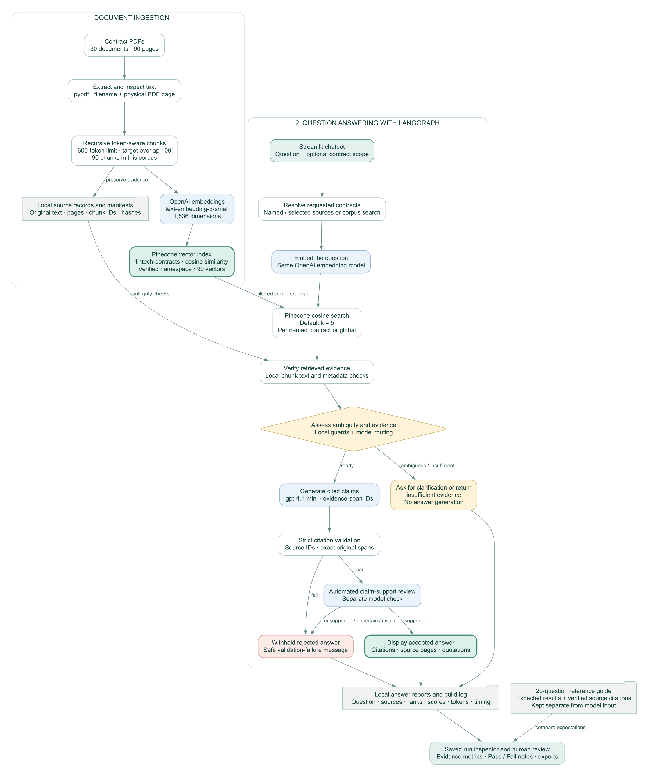
Appendix Complete architecture
Document ingestion
PDF text, chunks, embeddings
and the Pinecone index
Question answering
Cosine retrieval, routing,
citation validation and review
Local reports support
human evaluation.
Source: the current app architecture diagram. Use the Architecture tab for zoom, pan and SVG download.
14
Notes:
Reference slide. This is the complete supplied architecture without cropping or distortion. Main-deck diagrams use editable slide objects to explain individual flows at presentation scale. The app provides a larger view, actual size, Fit, zoom, pan, full screen and SVG download. Green identifies storage and user-facing results, blue identifies OpenAI stages, amber identifies routing and clarification, and red identifies withheld answers. Dashed arrows represent local verification and evaluation references. The reference bank stays outside model input.
Sources
C:\Users\Administrator\Documents\Codex\2026-10-20\at\outputs\architecture.svg
C:\Users\Administrator\Documents\Codex\2026-10-20\at\outputs\Contract_Lens_Demo_Guide_With_Architecture.docx

