Slide 1
GOOGLE CORE WEB VITALS

Slide 2
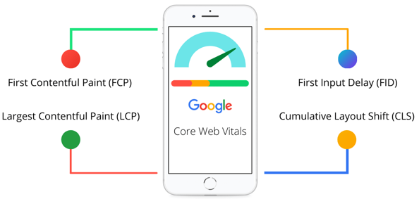
Google Web Vitals

Slide 3
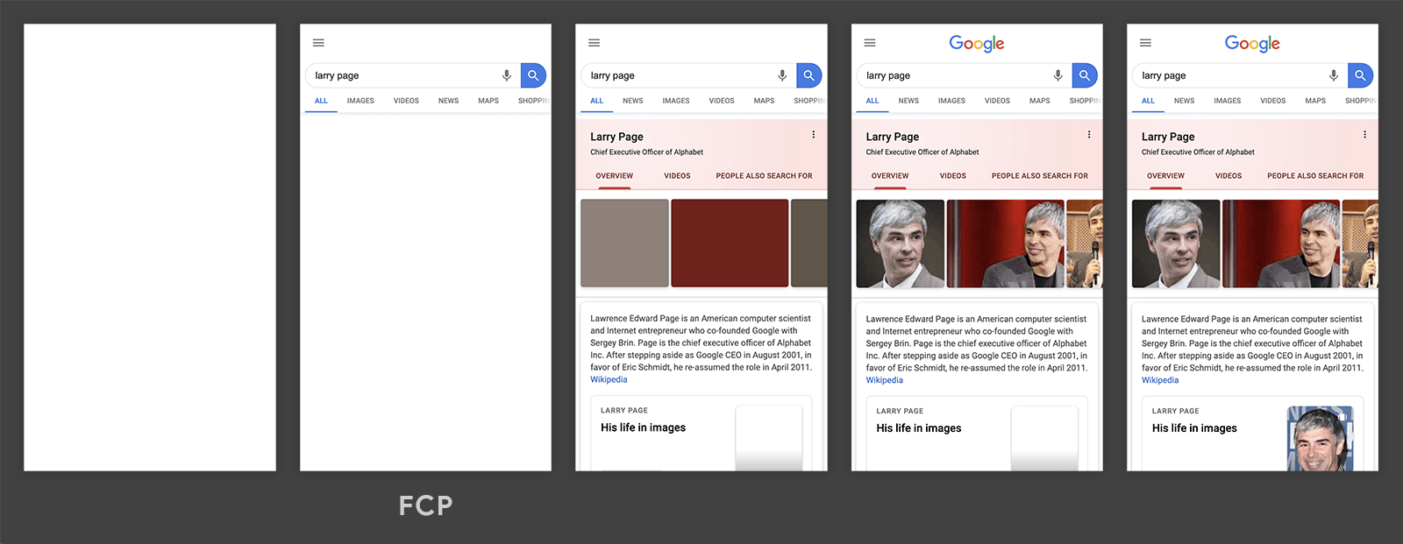
First Contentful Paint (FCP)
Metric measures the time from when the page starts loading to when any part of the page's content is rendered on the screen.
FCP happens in the second frame, as that's when the first text and image elements are rendered to the screen.

Slide 4
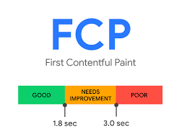
FCP Score

Slide 5
FCP Score
To provide a good user experience, sites should strive to have a First Contentful Paint of 1.8 seconds or less. To ensure you're hitting this target for most of your users, a good threshold to measure is the 75th percentile of page loads, segmented across mobile and desktop devices.

Slide 6
To improve First Contentful Paint (FCP) score
Enable website caching
Use a faster server
Eliminate render-blocking resources
Generate critical CSS and inline it
Preload critical resources
Reduce your DOM size
Use a fast ad serving solution
Serve images in next-gen formats
Do not lazy load images above the fold
Host your fonts locally
Avoid multiple page redirects

Slide 7
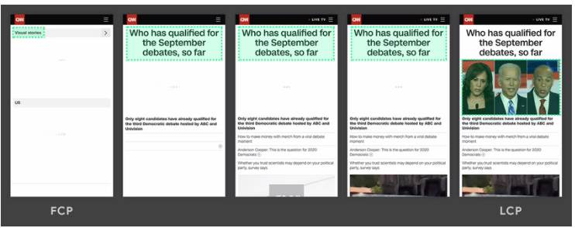
Largest Contentful Paint (LCP)
Metric reports the render time of the largest image or text block visible within the viewport
FCP happens in the fifth frame, as new content is added to the DOM and that changes what element is the largest

Slide 8
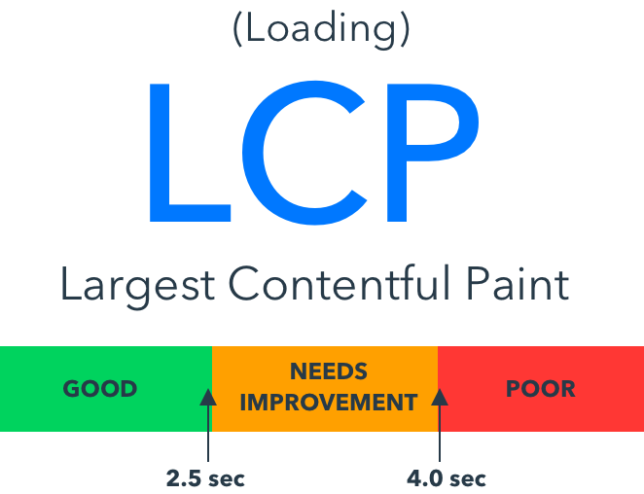
LCP Score

Slide 9
Largest Contentful Paint (LCP) score
To provide a good user experience, sites should strive to have Largest Contentful Paint of 2.5 seconds or less. To ensure you're hitting this target for most of your users, a good threshold to measure is the 75th percentile of page loads, segmented across mobile and desktop devices.

Slide 10
Elements are considered for LCP
<img> elements
<image> elements inside an <svg> element
<video> elements (the poster image is used)
An element with a background image loaded via the url() function (as opposed to a CSS gradient)
Block-level elements containing text nodes or other inline-level text elements children.

Slide 11
To improve LCP score
LCP is primarily affected by four factors:
Slow server response times
Render-blocking JavaScript and CSS
Resource load times
Client-side rendering

Slide 12
To improve LCP score
Optimizing the Critical Rendering Path
Optimize your CSS
Optimize your Images
Optimize web Fonts
Optimize your JavaScript

Slide 13
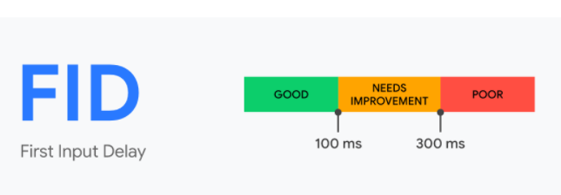
First Input Delay (FID)
FID measures the time from when a user first interacts with a page (i.e. when they click a link, tap on a button, or use a custom, JavaScript-powered control) to the time when the browser is actually able to begin processing event handlers in response to that interaction.

Slide 14
First Input Delay (FID) score
To provide a good user experience, sites should strive to have a First Input Delay of 100 milliseconds or less. To ensure you're hitting this target for most of your users, a good threshold to measure is the 75th percentile of page loads, segmented across mobile and desktop devices.

Slide 15
Why only consider the first input?
The first input delay will be the user's first impression of your site's responsiveness and first impressions are critical in shaping our overall impression of a site's quality and reliability.
The biggest interactivity issues we see on the web today occur during page load. Therefore, we believe initially focusing on improving site's first user interaction will have the greatest impact on improving the overall interactivity of the web.

Slide 16
To improve FID score
Reduce the impact of third-party code
Reduce JavaScript execution time
Minimize main thread work
Keep request counts low and transfer sizes small

Slide 17
Cumulative Layout Shift (CLS)
CLS is a measure of the largest burst of layout shift scores for every unexpected layout shift that occurs during the entire lifespan of a page.
A layout shift occurs any time a visible element changes its position from one rendered frame to the next
A burst of layout shifts, known as a session window, is when one or more individual layout shifts occur in rapid succession with less than 1-second in between each shift and a maximum of 5 seconds for the total window duration.
The largest burst is the session window with the maximum cumulative score of all layout shifts within that window.

Slide 18
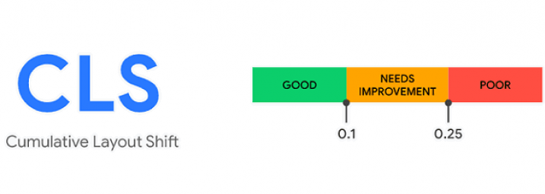
Cumulative Layout Shift (CLS) Score
To provide a good user experience, sites should strive to have a CLS score of 0.1 or less. To ensure you're hitting this target for most of your users, a good threshold to measure is the 75th percentile of page loads, segmented across mobile and desktop devices.

Slide 19
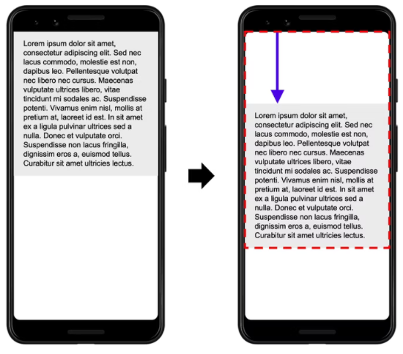
Cumulative Layout Shift (CLS) Score
To calculate the layout shift score, the browser looks at the viewport size and the movement of unstable elements in the viewport between two rendered frames.

Slide 20
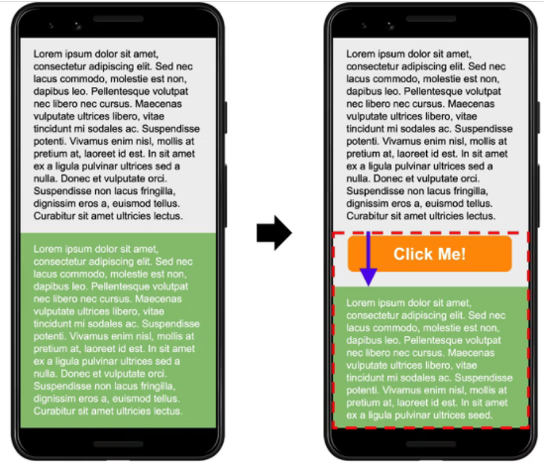
Cumulative Layout Shift (CLS) Score
Adding content to an existing element affects the layout shift score. The "Click Me!" button is appended to the bottom of the gray box with black text, which pushes the green box with white text down (and partially out of the viewport).

Slide 21
To improve CLS score
Always include size attributes on your images and video elements, or otherwise reserve the required space with something like CSS aspect ratio boxes.
Never insert content above existing content, except in response to a user interaction. This ensures any layout shifts that occur are expected.
Prefer transform animations to animations of properties that trigger layout changes. Animate transitions in a way that provides context and continuity from state to state.

