Slide 1
Architecture FOR building a recommendation engine for an e-commerce platform
BY AJAY BHATT

Slide 2
Table of Contents
1.What are recommendation engines?
2. How does a recommendation engine work?
Data collection
Data storage
Filtering the data
Content based filtering
Collaborative filtering Scoring
Scoring
Re-ranking
Recommender Pipeline

Slide 3
1. What are recommendation engines?
A recommendation engine filters the data using different algorithms and recommends the most relevant items to users. It first captures the past behavior of a customer and based on that, recommends products which the users might be likely to buy.

Slide 4


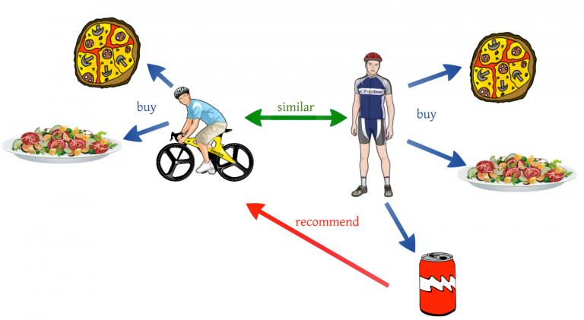
How does a recommendation engine work ?
We can recommend items to a user which are most popular among all the users
We can divide the users into multiple segments based on their preferences (user features) and recommend items to them based on the segment they belong to

Slide 5
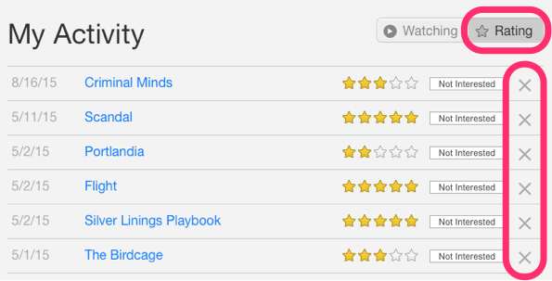
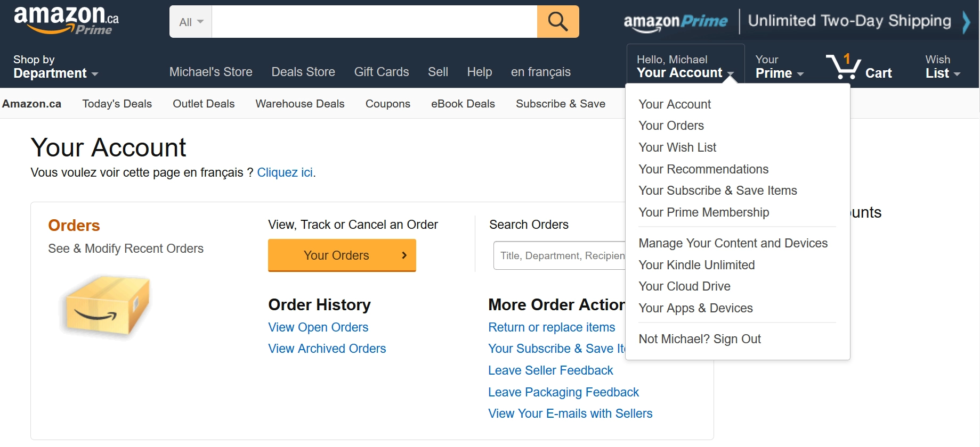
Data collection
This is the first and most crucial step for building a recommendation engine. The data can be collected by two means: explicitly and implicitly. Explicit data is information that is provided intentionally, i.e. input from the users such as movie ratings. Implicit data is information that is not provided intentionally but gathered from available data streams like search history, clicks, order history, etc.
In the above image, Netflix is collecting the data explicitly in the form of ratings given by user to different movies.
Here the order history of a user is recorded by Amazon which is an example of implicit mode of data collection.

Slide 6

Filtering the data
1. Content-Based Filtering
Content-based filtering involves recommending items based on the attributes of the items themselves. The system recommends items similar to what a user has liked in the past.
2. Collaborative Filtering
Collaborative filtering relies on the user-item interaction and relies on the concept that similar users like similar things eg Customers who bought this item also bought this.

Slide 7
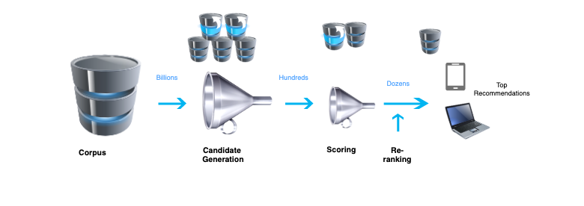
Scoring and re-ranking
Scoring
This constitutes the second stage where another model further ranks and scores the candidates usually on a scale of 10. For instance, in the case of Youtube, the ranking network accomplishes this task by assigning a score to each video according to the desired objective function using a rich set of features describing the video and user. The highest scoring videos are presented to the user, ranked by their score.
Re-ranking
In the third stage, the system takes into account additional constraints to ensure diversity, freshness, and fairness. For instance, the system removes the content which has been explicitly disliked by the user earlier and also takes into account any fresh item on the site.

Slide 8
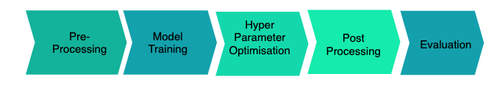
Recommender Pipeline

Slide 9
Preprocessing
It includes tasks like Handling Null Values ,Standardization ,Handling Categorical Variables ,One-Hot Encoding ,Multicollinearity ( as done in the source code of question)
Model Training
The process of training an ML model involves providing an ML algorithm (that is, the learning algorithm) with training data to learn from. The term ML model refers to the model artifact that is created by the training process.
Hyperparameter Optimization
Hyperparameter optimization in machine learning intends to find the hyperparameters of a given machine learning algorithm that deliver the best performance as measured on a validation set.

Slide 10
Evaluation
We have already covered this before but let’s talk in a bit more detail here. The best way to evaluate any recommender system is to test it out in the wild. Techniques like A/B testing is the best since one can get actual feedback from real users. However, if that’s not possible, then we have to resort to some offline evaluation.

Slide 11
Thank you

