Slide 1
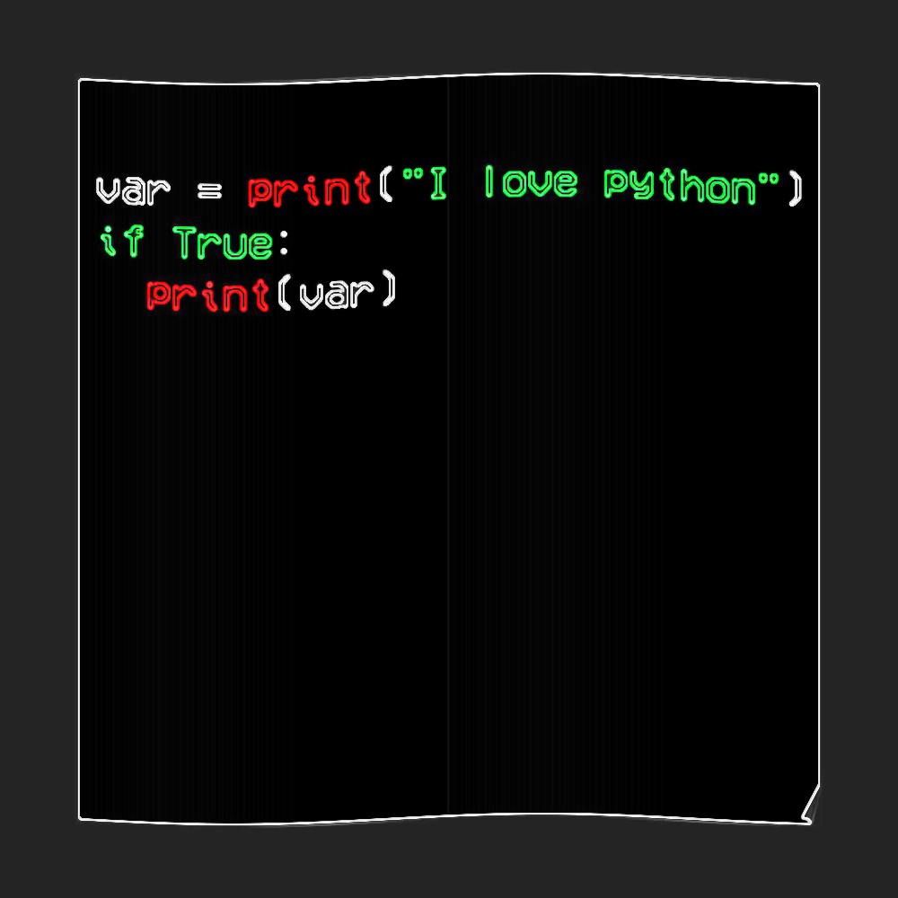


Slide 2
Do’s
And
Don’t do’s
Print
comments
Type
Data types
Taking Input values
variable

Slide 3
Execute Python Syntax
How to print a sentence ?
Print(“hello word”) //string
print(“123456”) // number
Print(“!@#$%^&*()”) //special character
creating a python file on the server, using the .py file extension, and running it in the Command Line
C:\Users\Your Name>python myfile.py

Slide 4
Contd..
Error:
Cmd> print(‘hi) //SyntaxError: EOL while scanning string literal
Cmd> print ‘hi’ // Missing parentheses in call to 'print'.
The proper way to quit python
>>>quit() //The proper way to say “good-bye” to Python is to enter quit()

Slide 5
Do’s and don’t do’s
CORRECT
WRONG
>>> x=5
>>>print(x) //output : 5
>>>z=x+2
>>>print(z) //output:7
>>>5+2 //output:7
>>>print(x+2) //output : 7
>>>z=x++2 //output:7
>>>print(x+++++++++++++2) //output:7
>>> x=5; //wrong
>>>print(“x”) //output:x
>>>print(z=x+2) //error:z is not identifying
>>> 2+1 //indentation error

Slide 6
Contd..
Python comments
>>>print(“hi”) //this is not comment in python
>>>#this is not executed
>>>print(“hi”) //output:hi
Multi Line Comments
#This is a comment #written in #more than just one line print("Hello, World!")
""" This is a comment written in more than just one line """ print("Hello, World!")

Slide 7
Python “TYPE”
Type operator
>>>x=5
>>>type(x) //class:int
>>>type(“hello techi”) //class:str
>>>type(“7”) //class:str
>>>type(8.9) //class:float
>>>type(“8.9”) //class:str

Slide 8
Variables Variables are containers for storing data values.
A variable name must start with a letter or the underscore character
A variable name cannot start with a number
A variable name can only contain alpha-numeric characters and underscores (A-z, 0-9, and _ )
Variable names are case-sensitive (age, Age and AGE are three different variables)
myvar = "John" my_var = "John" _my_var = "John" myVar = "John" MYVAR = "John" myvar2 = "John"
2myvar = "John" my-var = "John" my var = "John“c
Class=“abc”
#Legal variable names:
#Illegal variable names:

Slide 9
Data types
Int
>>>print(1) //integer
Float
>>>print(5.000) //float
Complex
>>>m=c+1j
>>>print(m)
String
>>>p=“lll”

Slide 10
Input
#include <stdio.h>
int main() { int x, y, z;
printf("Enter two numbers to add\n"); scanf("%d%d", &x, &y);
z = x + y;
printf("Sum of the numbers = %d\n", z);
return 0; }
#include <iostream>
int main() { int a, b, c; cout << "Enter two integers to add\n";
cin >> a >> b;
c = a + b; cout <<"Sumofthenumbers:" << c<<endl ; return 0;}
Class sum{
Public static void main(String[],args){
Int a,b,sum;
Scanner sc=new Scanner()
System.out.println(“enter a and b”);
a=sc.nextInt();
b=sc.nextInt();
Sum=a+b;
System.out.println(sum);
}}
c
C++
java
a=int(input(“enter a value”)
b=int(input(“enter b value”)
sum=a+b
Print(sum)
>>>Name=input(“enter name”)
>>>Print(name)
>>>num=int(input(“enter number”)
>>>print(num)

