Slide 1


Slide 2
C++
java
c

Slide 3
Unstructure program
This type of programming there is no reusability.
This is also called as unstructure program……...
Void add(){
-----
-----
-----
}
Void sub(){
-----
----
----
}
Void mul(){
----
----
}
Void add(){
---
Forton programming launguage

Slide 4
Structure program
ex: c language
This type of approach called structure program
Small programs called as sub program or function
It exist usability
Understanding program simple
Disadvantage:
A&b global variable , acess any function.
Also called as No security
Int a=10,b=20
Main(){
Add()
Sub()
Mul()
Add() }
Add()
{
Sum=a+b;
}
Sub()
{
Sum=a-b;
}
Mul()
{
Sum=a*b;
}

Slide 5
OBJECT ORIENTED PROGRAMMING
Private is also called access specifier
We can bind an object using private.
Private member can access only within class
Public can access any where.
Protected can access with in member function and friend function.
In 1970 oops came its name as c++.
Private a1,b1;
a1
b1
ADD()
SUB()
Disadvantage:
Platform dependent programs.
Platform means os.

Slide 6
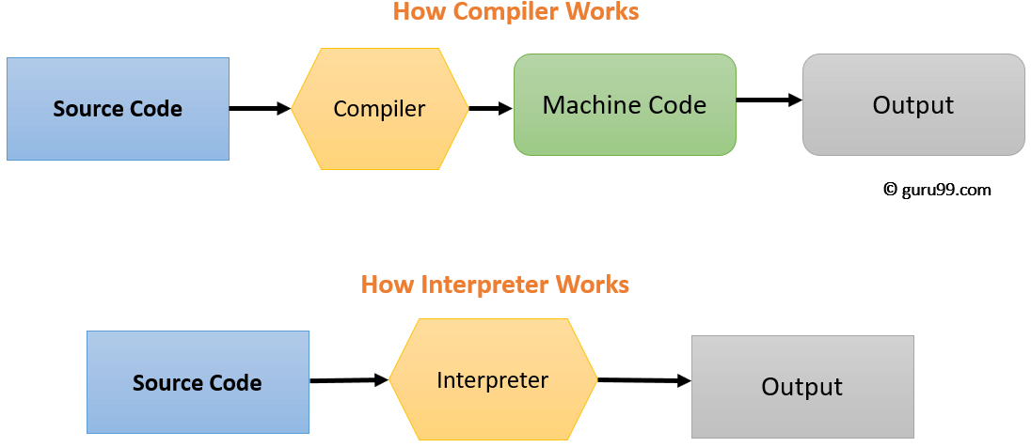
JAVA
Difference between compiler and interpreter
compiler | interpreter
high-level programming language into the machine code | high-level program statement, one by one, into the machine code
Compiled code runs faster | interpreted code runs slower.
Compiler displays all errors after compilation | Interpreter displays errors of each line one by one.
Java c c++ | Python

Slide 7
Overview of Java
Class file
Ram / jvm
Java program
(HLL)
Java compiler
Byte code
Class file
Byte
code
Class loader
Byte code verifier
Fun1(){
}
Func1(){
}
Func1(){
}
Func1(){
}
Class file
Interpreter
(byte-mll)

Slide 8
Object Orientation

Slide 9
Problem
solving
Oops
class
object
c
structure

Slide 10
Object orientation it is used to solve problem using programming language(c++,java)
In order to solve problem we can use different programming launguages
c
Complex problem
Structure program
Sub problem
Sub problem
Sub problem

Slide 11
Contd..
How they solve in object oriented ??

Slide 12
6 Pillars of Object Orientation or Features of Object Orientation
Class
Objects
Polymorphism
Encapsulation
Abstraction
Inheritance
Note: simula is the first object oriented programming language.

Slide 13
Object it is a real world entity
Type
Dog cat cow bus jeep car eagle pigeon sparrow
animal
vehicle
Birds
objects

Slide 14
Class it is a collection of objects
Class is a type
Class is a blueprint or template or prototype
class
Plan or blueprint or template
object
kitchen
Room
Civil engineer
(class)
hall

Slide 15
Contd..
Class does not exist in real world
Class does not occupy memory
Syntax:
Class “classname”
{
variable
method
nested class(){
}}

Slide 16
Object
DOG
Name bark
Age sleep
Class dog
{
String name;
String age;
Void bark(){
}
Void sleep(){
}
}
Name
Age
Bark
sleep
Variables
properties
properties
behavior
Methods
behavior

