Slide 1
.
Loops

Slide 2
Loops
For
nested
Examples
While
Examples
Break &control
Break and continue

Slide 3

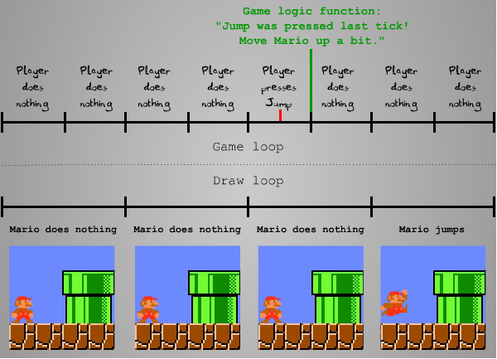
Loop

Slide 4
Range()
>>>x=6
>>>y=range(x)
>>>for z in x:
>>>print(z)
>>>for x in range(3,6):
>>>print(x)
>>>for x in range(3,20,2)
>>>print(x)

Slide 5
For loop
#include<stdio.h>
Void main()
{
Int I;
Print(“natural numbers”);
For(i=0;i<=10;i++)
{
Printf(“%d”,&i);
}
}
N=10
For x in range(1,n+1):
Print(x)
c
python

Slide 6
examples
>>>l=[“python”,”java”,”c”]
>>>for x in l:
>>>print(x)
>>>for z in “ajay”:
>>>print(z)

Slide 7
Nested for loop
A=[“python”,”c”,”java”]
B=[“easy”,”better”,”tough”]
For x in a:
For y in b:
Print(x,y)
Note : indentation is incorrect

Slide 8
Factorial number program
num = int(input("number"))
factorial = 1
if num < 0 :
print(" invalid input")
elif num == 0:
print(" factorial is 1")
else:
for i in range( 1 , num+1):
factorial = factorial * i
print(factorial)

Slide 9
Break and Continue statement
>>>for x in “techi”:
>>> if x==h:
>>> break
>>> print(x) //tec
Continue()
>>>for x in “techy”:
>>> if x==“c”:
>>> continue
>>> print(x) //tehi

Slide 10
While loop
>>>i=1
>>>while i<6:
>>>print(i)
>>>i+=1 //12345
Break()
>>>if i==3:
>>>break
>>>print(i) //12
Continue()
>>>if i==4:
>>>continue
>>>print(i)

