Slide 1
function
function

Slide 2
Function
definition
rules
function
arguments
parameter
function
keyword
default

Slide 3
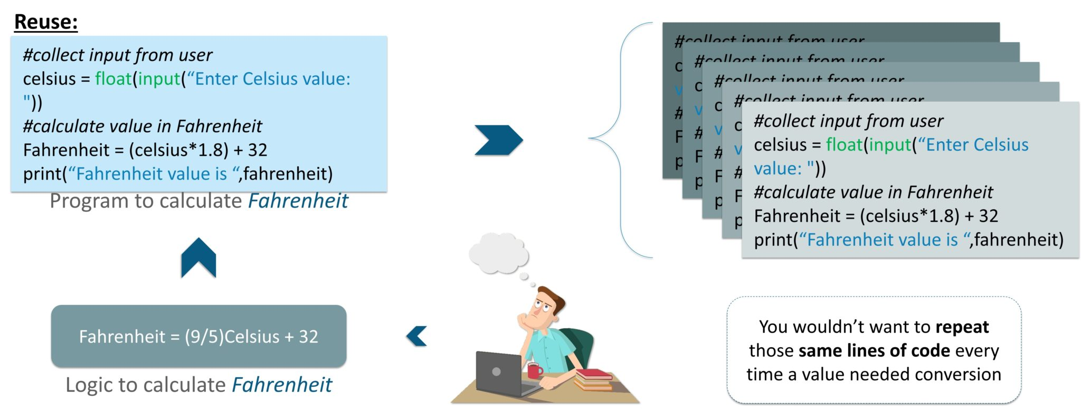
Function

Slide 4
Contd..
Function:
Reusable
Small program
Rules:
naming a function are the same as naming a variable.
It begins with either letter from A-Z, a-z in both upper & lower cases or an underscore(_).

Slide 5
Examples
In Python a function is defined using the def keyword:
>>>def func():
>>> print(“hello”)
>>> func()
Ex2:
>>>def my_func():
>>> x=10
>>> y=20
>>> c=x+y
>>> print(c)
>>> my_func()

Slide 6
Arguments Information can be passed into functions as arguments.
>>>def a(n):
>>>print(“the number is “,n)
>>>a(10)
>>>def a(m,n):
>>>print(“the first number is “,m)
>>>print(“the second number is”,n)
>>>a(10,20)

Slide 7
Arguments and parameter
>>>def func(fname):
>>>print(fname+”world”)
>>>func(“hello”)
>>>func(“techy”)
>>>func(“famous”)
>>>def func(fname,lname):
>>>print(fname+” “+lname)
>>>func(“hello”,”world”)

Slide 8
Pass by Reference or pass by value?
>>>def myFun(x):
>>>x[0] = 2
>>>lst = [10, 11, 12, 13, 14, 15]
>>>myFun(lst);
>>>print(lst)
>>>def myFun(x):
>>>x = [20, 30, 40]
>>>lst = [10, 11, 12, 13, 14, 15]
>>>myFun(lst);
>>>print(lst)

Slide 9
examples
>>>def myFun(x):
>>>x = 20
>>>x = 10
>>>myFun(x);
>>>print(x)
>>>def myFun(x, y=50):
>>> print("x: ", x)
>>> print("y: ", y)
>>>myFun(10)

Slide 10
Keyword Arguments
>>>def student(firstname, lastname):
>>> print(firstname, lastname)
>>>student(firstname =‘xyz', lastname =‘abc')
>>>student(lastname =‘abc', firstname =‘xyz')
>>>def my_function(child3, child2, child1): >>> print("The youngest child is " + child3) >>>my_function(child1 = “abc", child2 = “xyz", child3 = “123")

Slide 11
Arbitrary Arguments, *args
>>>def myFun(*argv):
>>>for arg in argv:
>>>print (arg)
>>>myFun('Hello', 'Welcome', 'to', ‘techy world')
>>>def my_function(*kids): >>> print("The youngest child is " + kids[2]) >>>my_function(“xyz", “abc", “123")

Slide 12
Passing a List as an Argument
>>>def my_function(food): >>>for x in food: >>> print(x) >>>fruits = ["apple", "banana", "cherry"] >>>my_function(fruits)

