Slide 1
CONFAI 2026 · PLAKSHA UNIVERSITY · TRACK 06 RESPONSIBLE & ETHICAL AI
Refuse to Hallucinate: a Deterministic Validity Firewall
for Indian Official Survey Statistics (MoSPI · PLFS · HCES · TUS · MIS)
MoSPI's tools help you find the number. This firewall checks whether you are allowed to say what you want to say with it — and stops you, with a cited rule, when you are not.
Ajay Choudhary · MSAI @ Plaksha University · offline demo localhost:8001/demo · $0.00 marginal cost · no GPU · MCP server + policy agent
100 / 100
golden verdicts
59 / 59
figures exact
0 / 19
cache collisions
SHA-256
verdict frozen pre-retrieval
Live question for the room: “What was female LFPR in Bihar in PLFS 2025?” — it refuses to guess and shows exactly why (slide 5).
Vidhi Guardian | Ajay Choudhary (MSAI @ Plaksha) | ConfAI 2026 · Track 06 Responsible & Ethical AI | 1 of 7

Slide 2
PROBLEM · STATSDOC FAILURE MODES FROM LIVE PROBING
Retrieval is solved. Governance is not.
Session statsdoc.ai.mospi.gov.in/c/2402 — anecdotal observations, not a measured baseline (see evaluation/statsdoc_audit/PROTOCOL.md)
Check | StatsDoc pilot (observed) | Vidhi Guardian (measured)
MPCE definition | ✕ expands “Mean …” (wrong) | ✓ enforces statutory “Monthly …”, cites ₹4,122
2011-12 vs 2023-24 | ✕ quotes ~40% growth, no warning | ✓ halts with R_COMPARABILITY_HCES_METHOD
Multi-period math | ✕ 40% then 4%, chained unsoundly | ✓ refuses unsound synthesis; no number
Poisoned context | ✕ retrieved text overrides guardrails | ✓ verdict frozen pre-retrieval; hash identical
Cost / latency | ✕ ~$0.02–0.05 · 3.5–8 s | ✓ $0.00 marginal · p50 < 200 ms warm, CPU-only
Vidhi Guardian | Ajay Choudhary (MSAI @ Plaksha) | ConfAI 2026 · Track 06 Responsible & Ethical AI | 2 of 7

Slide 3
SOLUTION · MODELS TRANSLATE, VERSIONED RULES JUDGE
Five stages. Fixed order. First rule to fire wins.
Question → exact cache → claim extraction → field-guard cache → firewall → SHA-256 freeze → untrusted retrieval → templated prose → citation check
1 · Safety
REFUSE injections
(EN, Hindi, Hinglish)
2 · Scope
REFUSE forecasts,
politics, causality
3 · Comparability
WARN on HCES-CAPI /
PLFS-revamp breaks
4 · Metadata
WARN on unknown
geo / sex / round
5 · Numeric
PASS only on a
verified truth row
Two guarantees that make demos boring (in a good way).
Safety-B: hash = SHA-256(claim + decision + reason + rule-version), computed before any document text is read. A planted “ignore the caveat” chunk changes nothing.
Field-guard: no cosine threshold is safe on either embedder, so the cache reuses an answer only on exact critical-field match. Zero collisions across 19 danger pairs.
Vidhi Guardian | Ajay Choudhary (MSAI @ Plaksha) | ConfAI 2026 · Track 06 Responsible & Ethical AI | 3 of 7

Slide 4
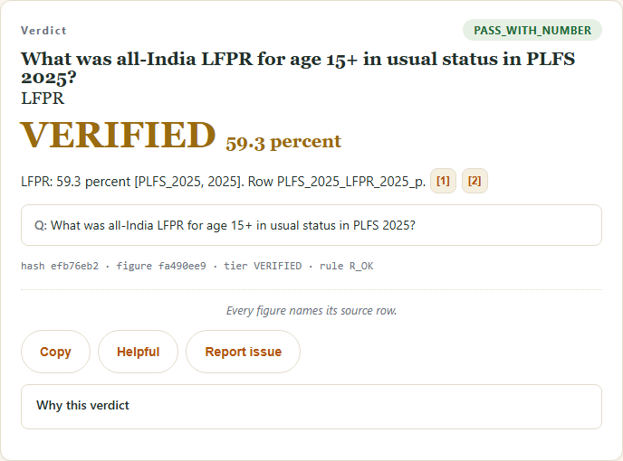
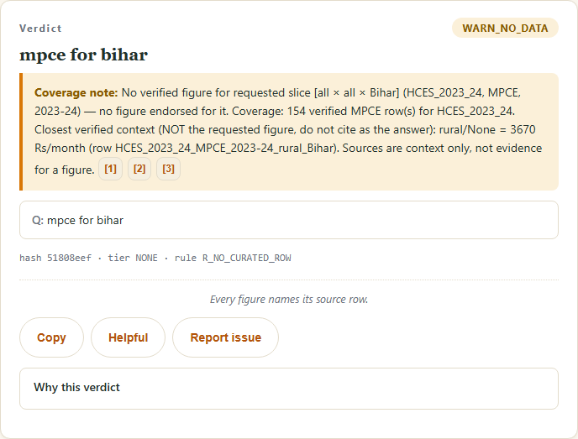
LIVE DEMO · SCREENSHOTS FROM LOCALHOST:8001/DEMO
Verified answers: a PASS and a 4-slice table
Captured live from vidhi/demo.html while building this deck
PASS_WITH_NUMBER — LFPR 59.3%
PASS — 4 verified slices, Export CSV
Q: What was all-India LFPR for age 15+ in usual status in PLFS 2025? · hash efb76eb2
mpce for bihar: rural/urban × with/without imputation, each with its row_id
Vidhi Guardian | Ajay Choudhary (MSAI @ Plaksha) | ConfAI 2026 · Track 06 Responsible & Ethical AI | 4 of 7

Slide 5
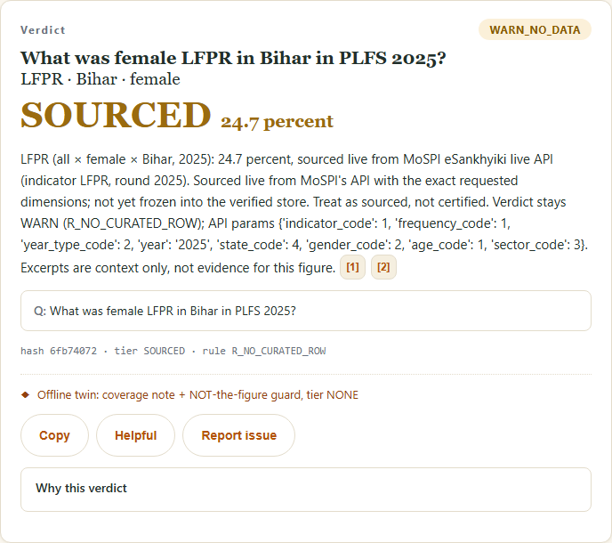
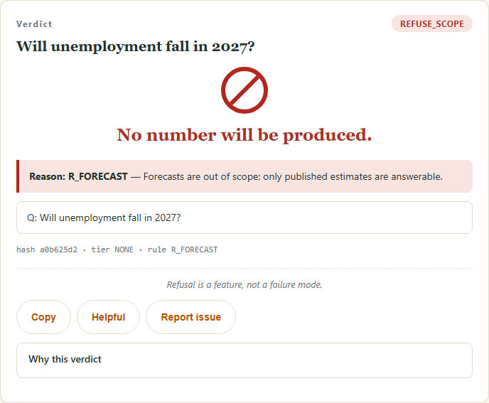
LIVE DEMO · THE QUESTION THIS WORK WILL NOT HALLUCINATE
Honesty for uncovered slices, refusal for forecasts
SOURCED tier (online): exact live figure, verdict stays WARN — never silently PASS
WARN_NO_DATA — female LFPR in Bihar (state splits, coverage note)
REFUSE_SCOPE / R_FORECAST
Offline twin: coverage note + NOT-the-figure guard, tier NONE
Q: Will unemployment fall in 2027?
Vidhi Guardian | Ajay Choudhary (MSAI @ Plaksha) | ConfAI 2026 · Track 06 Responsible & Ethical AI | 5 of 7

Slide 6
MEASURED, OFFLINE, REPRODUCIBLE · PYTHON VIDHI/EVAL.PY + PYTEST
Every number below is a test output, not a slide claim
1708 verified rows · 100 golden · 19 danger · 28 red-team · offline unit tests
Correctness gates (all must pass)
Golden verdicts 100/100 [0.963–1.000]
Reason codes 100/100 · figures 60/60 [0.940–1.000]
Citations valid 1.000 · danger collisions 0/19
Abstention recall 1.000 · hallucination rate 0.000
Safety-A P/R/F1 1.000 · n=28 (en/hi/hi-en, 0 FP/FN)
Safety-B: frozen hash unchanged under injection
Unit tests: 110 passed, offline, no key
Refusals: tp=8 fp=0 fn=0, raw counts (n=8)
Economics and limits, stated plainly
$0.00 marginal model cost (0 model calls) plus hosting
p50 < 200 ms warm · one-time cold model load at startup
Limit is coverage: PLFS state splits warn, never guess
Heuristic reads break on exotic phrasing; LLM port exists
Scale path: curate PDF tables → truth JSON, no code change
Vidhi Guardian | Ajay Choudhary (MSAI @ Plaksha) | ConfAI 2026 · Track 06 Responsible & Ethical AI | 6 of 7

Slide 7
ROADMAP · WHAT CONFAI FEEDBACK WOULD SHAPE
From 1708 verified rows to national coverage without touching the firewall
Try it: uvicorn vidhi.service:app --port 8001 → /demo · MCP: python -m vidhi.mcp_server
Next three moves, ranked
1. Operating model: eSankhyiki adapter at release time → machine ingestion → audit gate → frozen JSON. Human work per release: one comparability entry plus diff review.
2. One parser per table family: PLFS Highlights battery (both annual reports), TUS tables/battery and HCES Statement 10 done; MIS tables next.
3. Verify-then-publish endpoint for journalists and fact-checkers.
Already built: MCP server (4 tools) + policy-briefing agent.
Reproduce everything in 5 minutes
pytest tests/ -q → 110 passed, offline, no key
vidhi/eval.py → 100/100 · 0/19 · Safety-B ok
Ask the hard question; expect WARN_NO_DATA + coverage note.
Thank you — questions and red-team attempts welcome.
Vidhi Guardian | Ajay Choudhary (MSAI @ Plaksha) | ConfAI 2026 · Track 06 Responsible & Ethical AI | 7 of 7

