Slide 1
DevSecOps
“Integrating Security into the Development Lifecycle"

Slide 2
DevSecOps – Curriculum
Introduction to DevOps
What is DevSecOps
DevOps v/s DevSecOps
Secure Software Development Lifecycle (SSDLC)
Static Application Security Testing (SAST)
Software Composition Analysis (SCA)
Dynamic Application Security Testing (DAST)
Compliance as Code/Vulnerability Management
Infrastructure as Code and Security
Container/Cluster Security
Cloud Security
Best Practices
AI/MLOps/DevSecOps

Slide 3
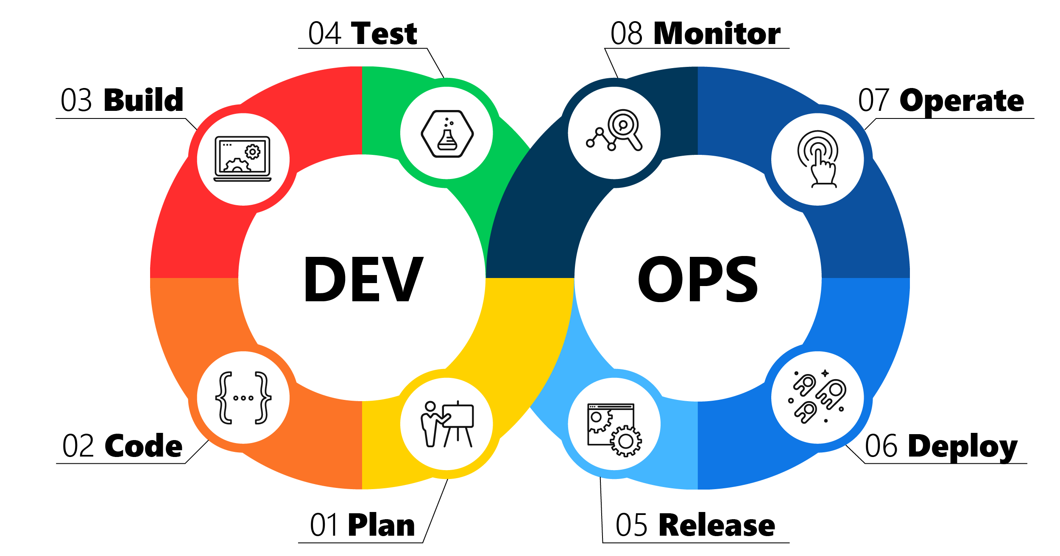
Introduction to DevOps
DevOps is methodology of automating Software Development / Deployment /Operations and increase software release cycle. This can involve:
Creating/maintaining CI/CD pipelines for development to leverage to release their code
Creating/maintaining environments/infrastructure so SDLC can develop/test etc.
Managing various tech stacks such as:
Version Control (Git, SVN)
CI/CD (Jenkins, Azure DevOps, GitHub, GitLab)
Infrastructure (Docker, VMs, Terraform)
Cloud (Azure, AWS, GCP)
Configuration Management (Ansible)

Slide 4





























DevSecOps Cycle

Slide 5

















Slide 6
Tools Github – to store source code (vulnerable code) Jenkins – to build this code SonarCloud – to perform SAST (Static Applicaiton) – Code Quality Snyk – SAST, SCA, Container, IaC scan NodeJS application Vuln – OWASP juice-shop vuln app, webgoat (UI scanning through Snyk), App repo (AWS pipeline) Bridgecrew – IaC scan tool Falco/Kube-bench – Kubernetes container scanning tool AppArmor – Linux Security Kernel Model for Cluster/Container AWS GuardDuty – Cloud Security (Threat Detection) AWS KMS – Cloud Security (Key Mgmt. Service)

Slide 7
What is DevSecOps?
A transformational shift which incorporates secure culture, practices, and tools to drive visibility, collaboration, and agility of security into each phase of the SDLC using DevOps pipeline
Governance
People
Process
Technology
Redesign the operational & compliance framework
Establish security ‘guardrails’ and monitor results
Establish shared metrics KPI/KRI to evaluate progress
Incorporate cybersecurity staff in DevOps teams
Break down silos between security and DevOps teams and instill cyber awareness
Have security teams brief dev and ops teams on current threats / exploits/breaches
Asset inventory and risk awareness
Orchestrate an integrated process flow and drive ‘in- line’ risk rationalized feedback
Integrated backlog and pipeline
Security telemetry and incident response
Automate secure application development
Automate recurring harden the development pipeline
Security tasks and Protect the toolchain and infrastructure(Cloud or On-Prem)

Slide 8
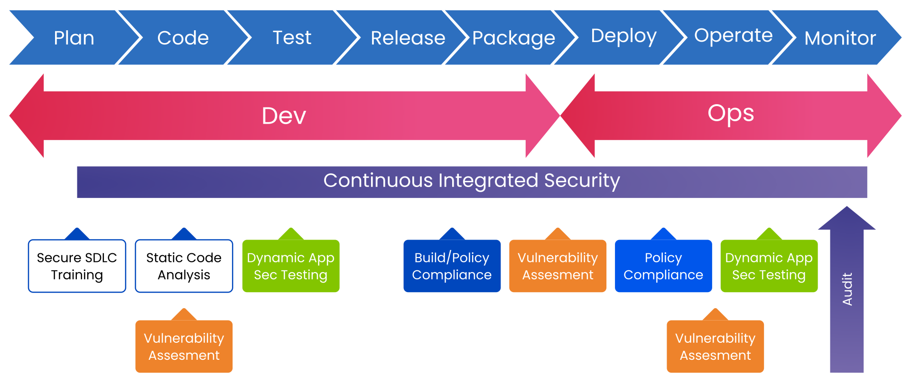
DevOps v/s DevSecOps
DevSecOps - Continuously adding security to the DevOps pipeline
“Shift Left” moving the security testing further ‘left’ as possible of the SDLC

Slide 9
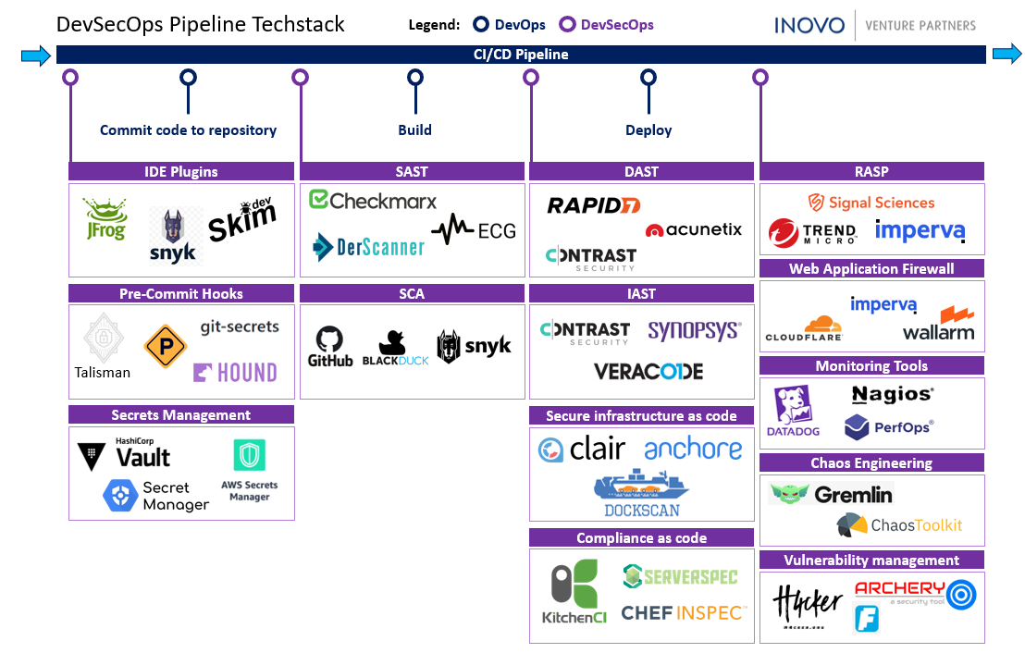
Notes:
Source: Medium.com (https://medium.com/inside-inovo/devsecops-explained-venture-capital-perspective-cb5593c85b4e)

Slide 10
Secure Software Development Lifecycle (SDLC)
Five Phases of Software Development Lifecycle (SDLC)
Requirements gathering
Design of new features based on the requirements
Development of new capabilities (writing code to meet requirements)
Testing and verification of new capabilities—confirming that they do indeed meet the requirements
Deployment of the new project
“Secure SDLC means adding security testing at each software development stage, from design, to development, to deployment and maintenance of the software”

Slide 11
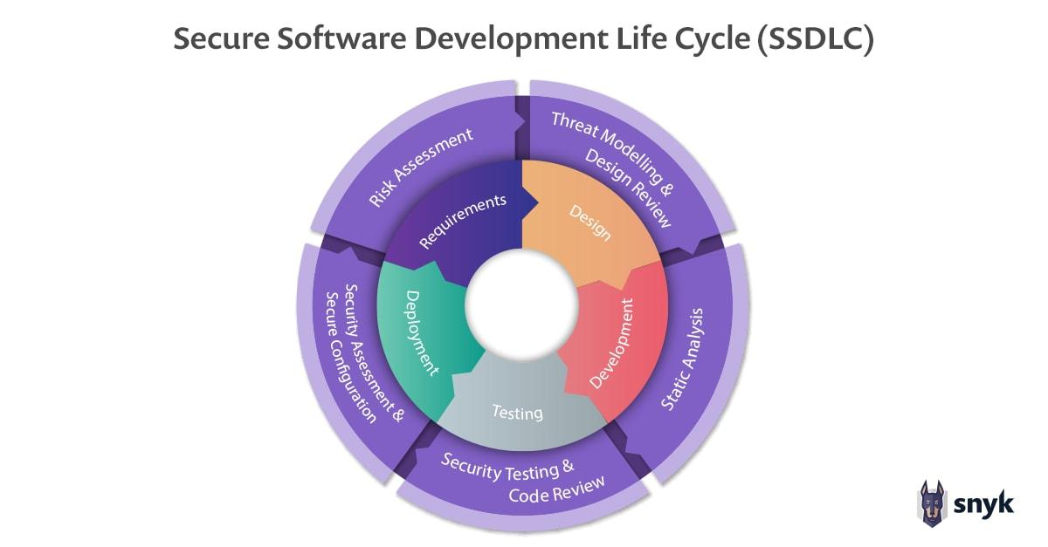
Secure Software Development Lifecycle (SDLC)

Slide 12
Secure Software Development Lifecycle (SDLC)
Both SSDLC and DevSecOps focus on empowering developers to have more ownership of their application, ensuring they are doing more than just writing and testing their code to meet functional specifications.
Secure SDLC is focused on how the application is designed and built.
DevSecOps seeks to shift ownership of the production environment for each application away from traditional IT teams and into the hands of the developers. This lets developers focus on automating build, test, and release processes as much as possible.

Slide 13
Open Worldwide Application Security Project (OWASP)
A01:2021-Broken Access Control
A02:2021-Cryptographic Failures
A03:2021-Injection
A04:2021-Insecure Design
A05:2021-Security Misconfiguration
A06:2021-Vulnerable and Outdated Components
A07:2021-Identification and Authentication Failures
A08:2021-Software and Data Integrity Failures
A09:2021-Security Logging and Monitoring
A10:2021-Server-Side Request Forgery

Slide 14
Building Secure Code
Code reviews(Peer review) - Code reviews are methodical assessments of code designed to identify bugs, increase code quality, and help developers learn the source code.
Four approaches : Pair Programming Over-the-shoulder review Tool assisted review (e.g Amazon CodeGuru) Email pass-around
Threat modelling - Threat modeling works by identifying the types of threat agents that cause harm to an application or computer system. Objectives – identify security requirements, pinpoint security threats and potentials vulnerabilities, quantify threat and vulnerability criticality, and prioritize remediation methods.
https://www.synopsys.com/glossary/what-is-threat-modeling.html#:~:text=Threat%20modeling%20is%20a%20structured,An%20abstraction%20of%20the%20system

Slide 15
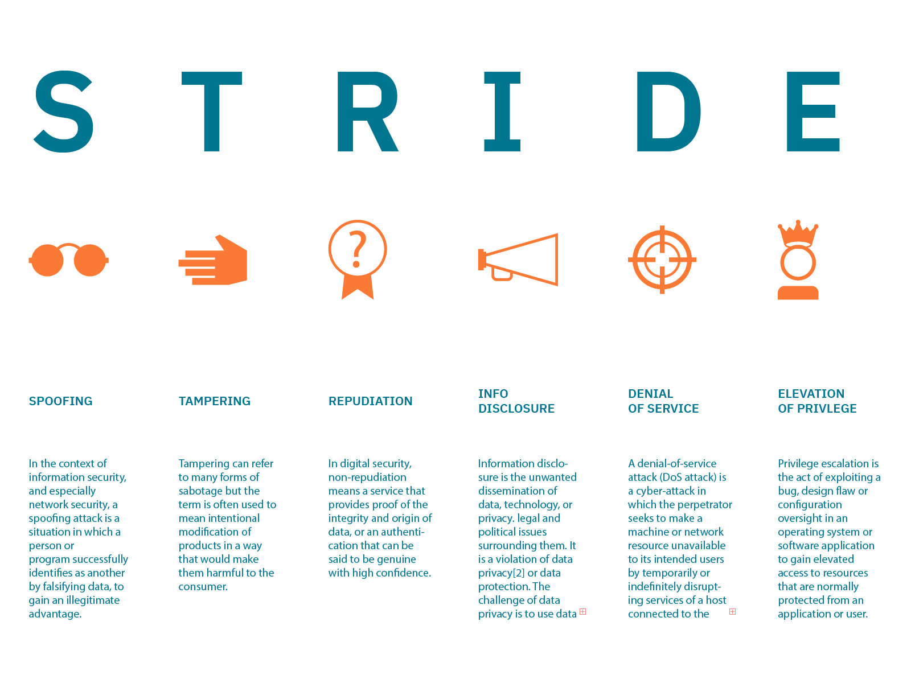
Threat Modelling

Slide 16
Static Application Security Testing (SAST)
SAST is a scanning technique specifically designed to detect vulnerabilities which focuses on source code, bytecode, or assembly code.
Integration can be done using CI pipeline through tools API, as a plugin in CI Pipeline and while coding within an IDE.
By monitoring your code, SAST tools provide protection against potential security risks that could include areas such as storing passwords in plain text or transmitting data via unencrypted connections.
How SAST works?
Parsing the source code, building an abstract syntax tree, and applying various analysis techniques to detect issues is part of the process of scrutinizing a program's structure and syntax for potential coding mistakes, security vulnerabilities, and performance bottlenecks.

Slide 17
SAST Findings
SAST tools detect a range of security incidents and vulnerabilities in source code, including:
Analysis Type | Description
Dataflow issues | Tracks data flow through application to identify insecure source such as file, the network or user input is cleansed before consumption.
Semantic errors | Examine syntax, identifiers and resolving types and context from code e.g. SQL injections through *.executeQuery()
Misconfigured settings (Configuration Analysis) | Checks application’s configuration files, Ensures configuration is aligned with security policies, such as default error page for web application
Control flow Analysis | Check order of the program operations to detect dangerous sequences such as race conditions, secure cookie transmission failure, non-initiated variables, or misconfigurations of utilities.
Structural flaws | Examines language-specific structures for inconsistencies and identifies weakness in class design, declaration and use of variables and functions Issues related to weak cryptographic and hard-coded credentials

Slide 18
Software Composition Analysis (SCA)
Software composition analysis (SCA) is an automated process that identifies the open source software and third-party dependencies, libraries in a codebase. This analysis is performed to evaluate security, license compliance, and code quality.
Ex: package.json “dependencies”: {
“node-emoji”: “1.0.0” }
Depends upon “lodash”: “1.0.0”
Depends upon “methods”: “1.0.0”
It checks vulnerable dependencies for an up to date versions or vulnerable to any CVEs.
Some of the leaders the market in SCA tools BlackDuck (Synopsys), Snyk, Veracode

Slide 19
Software Composition Analysis (SCA)
Risks can be organized into 5 categories
OSS Version Control: risks of changes introduced by new versions
Security: risks of vulnerabilities in components - Common Vulnerabilities & Exposures (or CVEs)
License: risks of Intellectual property (IP) legal requirements
Development: risks of compatibility between existing codebase and open-source software
Support: risk of poor documentation and Obsolete software components
National Vulnerability Database (NVD) is the U.S. government repository of standards based vulnerability management data represented using the Security Content Automation Protocol (SCAP). This data enables automation of vulnerability management, security measurement, and compliance.
The NVD includes databases of security checklist references, security-related software flaws, misconfigurations, product names, and impact metrics.

Slide 20
CVE, CWE, CVSS and CISA
The Common Vulnerabilities and Exposures (CVE) system provides a reference method for publicly known information-security vulnerabilities and exposures. Maintained by MITRE (US non-profit)
The Common Vulnerability Scoring System (CVSS) is a free and open industry standard for assessing the severity of computer system security vulnerabilities.
The Common Weakness Enumeration (CWE) is a category system for hardware and software weaknesses and vulnerabilities. Operated and maintained by MITRE (US non-profit) with help from US-CERT
The Cybersecurity and Infrastructure Security Agency (CISA) is a federal agency of the US responsible for cybersecurity and infrastructure protection across all levels of government. Similarly, UK govt. have NCSC.
They maintain information such as:
Known exploited vulnerabilities catalogue
Alerts

Slide 21
Dynamic Application Security Testing (DAST)
Dynamic Application Security Testing (DAST) is the process of analyzing a web application through the front-end to find vulnerabilities through simulated attacks.
the
DAST solutions can detect and help protect against web application vulnerabilities, such as the OWASP Top 10. Common flaws include SQL injection, cross site scripting (XSS), external XML entities (XXE), and cross-site request forgery (CSRF). DAST can simulate these attacks and see if the application is vulnerable. attacks and see if the application is vulnerable.
OWASP ZAP (short for Zed Attack Proxy) is an open-source web application security scanner.

Slide 22
Dynamic Application Security Testing (DAST)
OWASP ZAP (short for Zed Attack Proxy) is an open-source web application security scanner.
Hands-on Lab: DAST OWASP ZAP with AWS CodeBuild
Go to Actions of GitHub repo
Create a simple workflow and add OWASP ZAP snippet
Commit changes and check build

Slide 23
Compliance as Code
Compliance as code tools will turn your compliance rules and policy requirements into automated tests.
To make it possible developers need to translate human-readable rules received from non-tech people into code, and compliance-as-a-code tools should do the rest.
There are two main types of compliance; corporate and regulatory
Follow CIS benchmarks and compliance related to industries(banking, insurance, payments) also if the application created is compliant to respective countries industry standards (eg. NYDFS, PCI, GDPR)

Slide 24
Infrastructure as Code and Security
Infrastructure as Code (IaC) is the managing and provisioning of infrastructure through code instead of through manual processes.
IaC uses DevOps methodology and versioning with a descriptive model to define and deploy infrastructure, such as networks, virtual machines, load balancers, and connection topologies. Just as the same source code always generates the same binary, an IaC model generates the same environment every time it deploys.

Slide 25
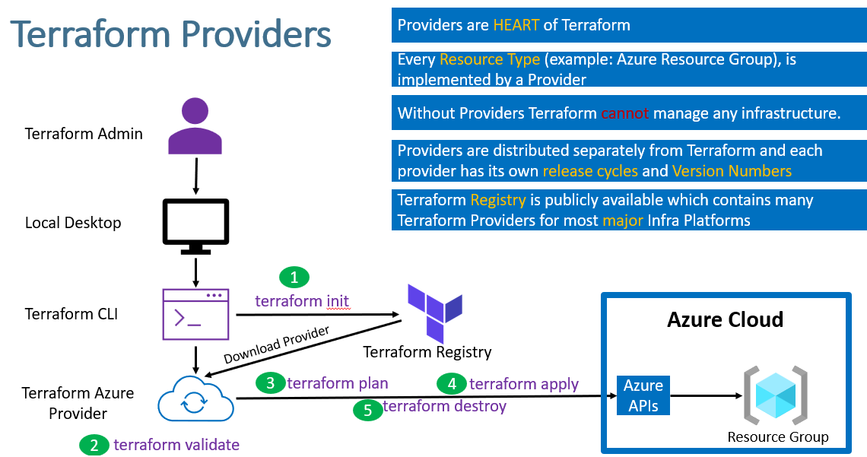
Infrastructure as Code (Terraform)

Slide 26
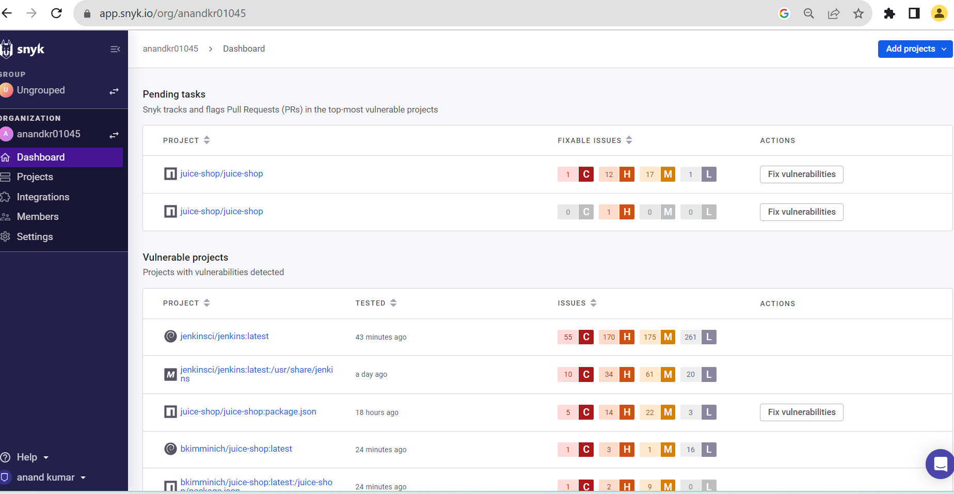
Infrastructure as Code and Security
Terraform is leader in IaC market as it’s support with Cloud (AWS, Azure, GCP) as well as on-prem infrastructure provisioning.

Slide 27
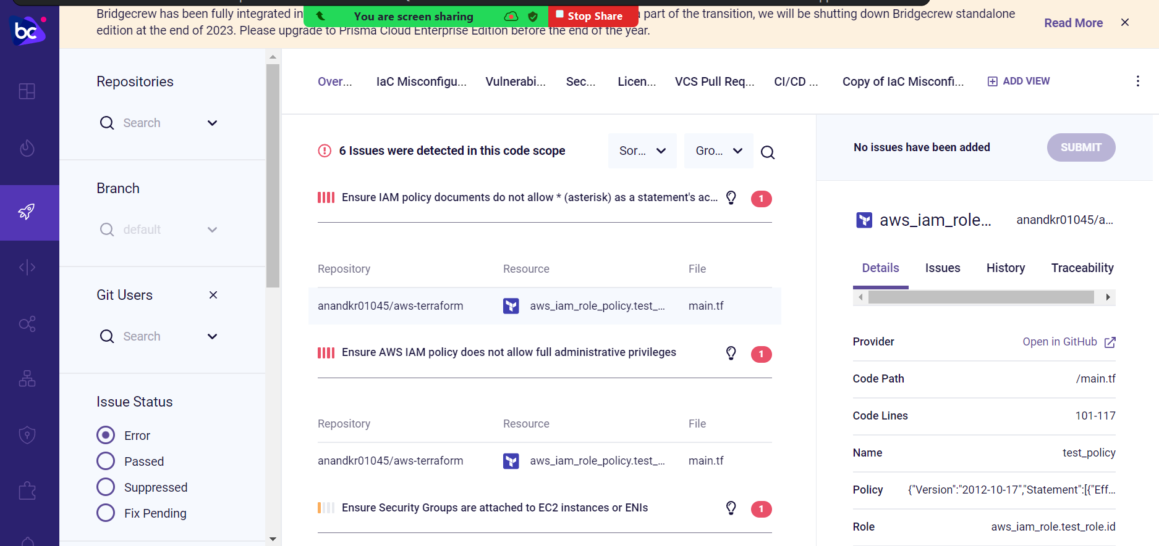

Slide 28
Vulnerability Management
Vulnerability management is the process of continuously identifying, evaluating, treating, and reporting vulnerabilities.
Vulnerability Management Software Capabilities
Detect, identify, and report
Establish software bill of materials(BOM)
Reporting, audit, and compliance
Risk prioritization for remediation
Remediation guidance
Control points and centralized management
Integration and automation

Slide 29
Vulnerability Management
Goal of vulnerability management is to reduce the organization's overall risk exposure by mitigating as many vulnerabilities as possible.
Defect Dojo is an open source vulnerability management tool that streamlines the testing process by offering templating, report generation, metrics, and baseline self-service tools

Slide 30
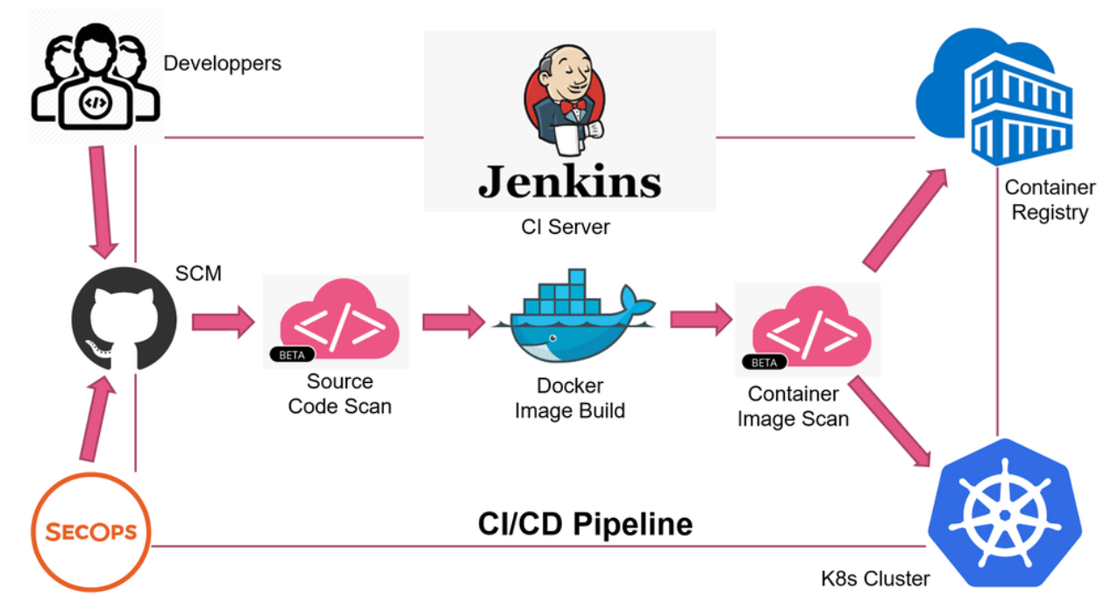
Container Security
Container security is the process of implementing security tools and processes to provide strong information security for any container-based system or workload — including the container image, the running container, and all the steps required to create that image and get it running somewhere.

Slide 31
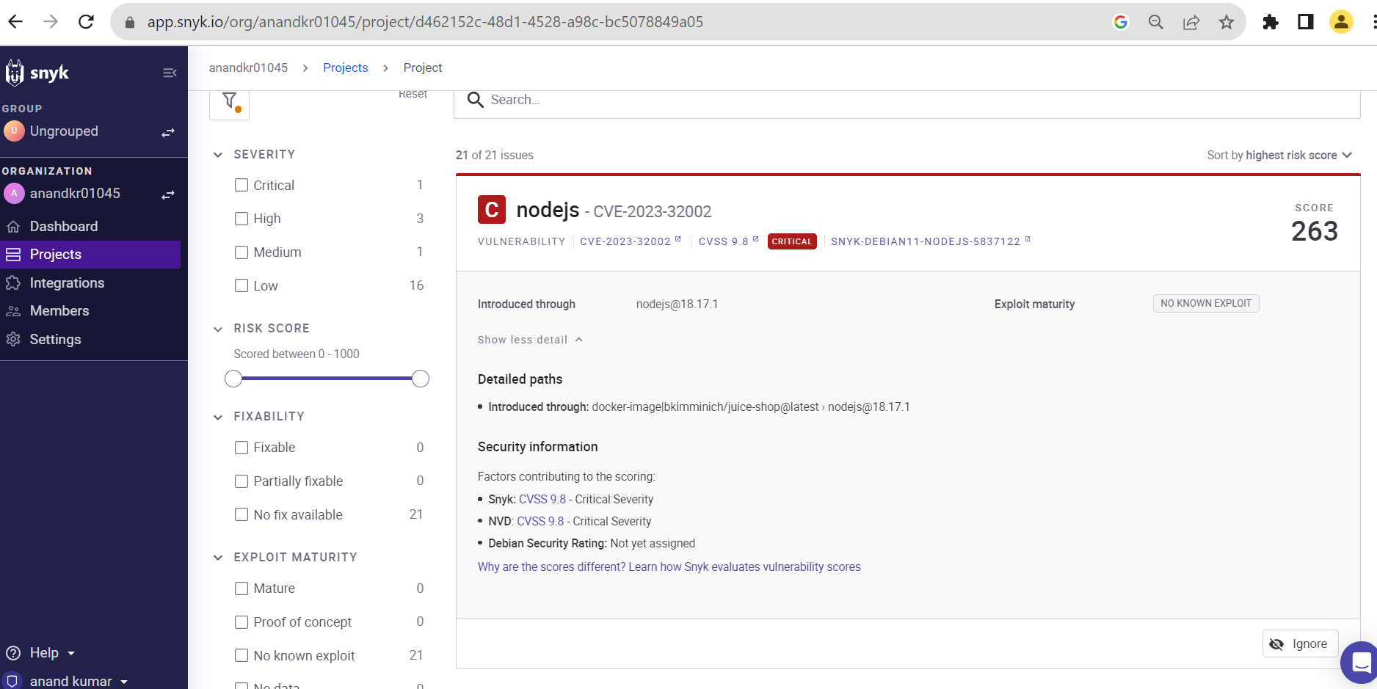
Container Security
Container image security using Snyk

Slide 32
Container Security – Hands-On with Snyk
Container security using Snyk
Resources:
Vulnerable Dockerfile - https://github.com/SamP10/VulnerableDockerfile/
docker pull vulnerables/cve-2017-7494
snyk container test

Slide 33
Container Security
Best Practices for container security
Secure your code and its dependencies
Start with a minimal base image from a trusted source
Manage all the layers between your base image and your code
Use access management Set Volumes and File System Permissions to Read-Only: docker run -read-only alpine sh -c 'echo "running as read only" > /tmp'
Securing container infrastructure
Prevent Direct Access to Core Container Files If you keep the logs outside, it prevents users from accessing the container files directly
Reduce Resources Available to Containers By default, Docker containers are given full access to all the underlying CPU and RAM resources available on the host, instead use set quotas
Tighten Security with Container Registries Implement RBAC (Role Based Access Control) so that only authorized users are able to access and download images from the registry.

Slide 34
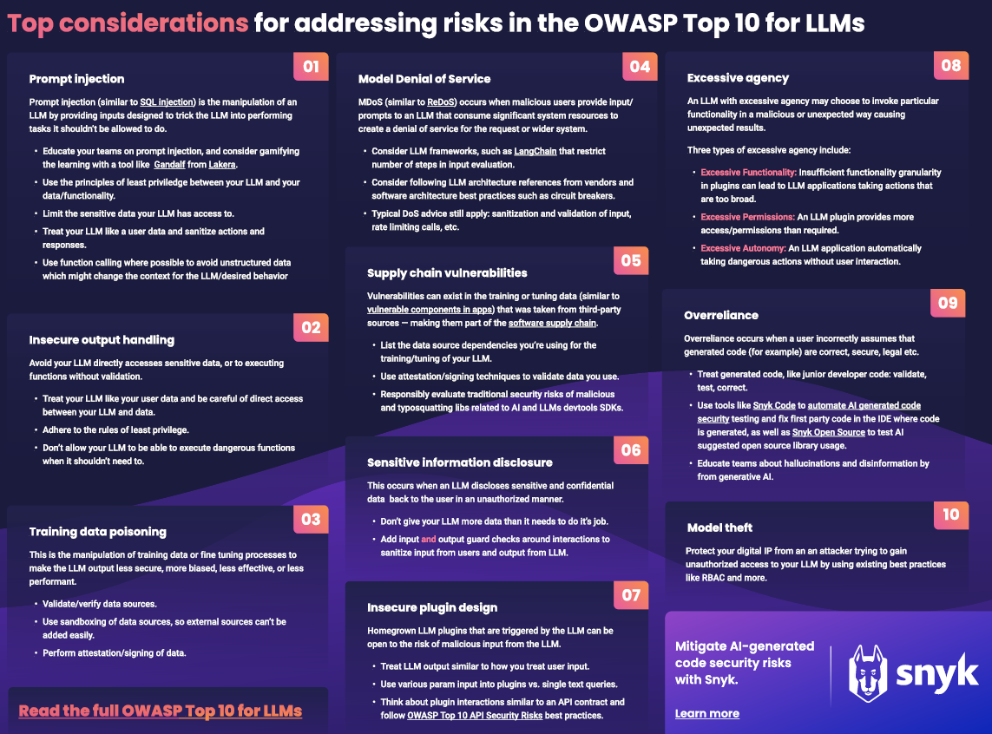
Future Technologies – AI and DevSecOps

Slide 35
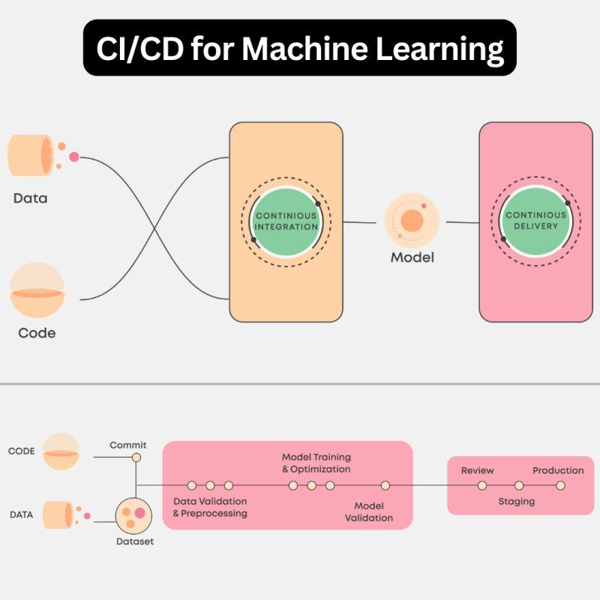
Future Technologies – AI and DevSecOps

Slide 36
Best Practice for DevSecOps
Use Threat Modeling Tools to identify key security areas in development and deployment infrastructure
Do not expose sensitive information (credentials, IP, DB connections details) in plain text In repository. You can use git-secrets or vault to store sensitive information.
Use service account to interact tool APIs
Use RBAC and Least privileges(PAM)
Zero-Trust Concept and MFA (Multi-Factor authentication)
Continuous Integration/ Continuous Deployment/ Continuous Testing/ Continuous Monitoring/ Continuous Security

Slide 37
Thanks!

