Slide 1

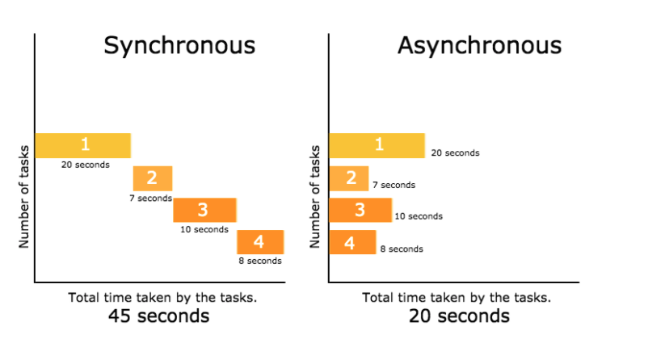
Synchronous
VS
Asynchronous
Simple Difference

Slide 2
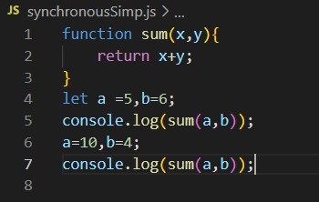

Synchronous:-
Every statement of code gets executed one by one
This will block user request until operation completes
Browser will be unresponsive
Lets see on vscode:-
Simple code

Slide 3

Not to worry about code now
I will show long time taking synchronous example on my pc just to show how irritating it is.
It will be a code that generates user given no. of prime numbers
click
Ok but,
What’s the problem in synchronous code

Slide 4
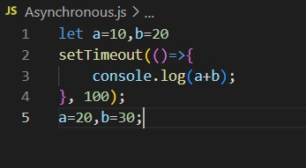

Asynchronous:-
Functions running in parallel with other functions are called asynchronous
Asynchronous code doesn’t block the user
Browser is responsive
Allows multiple things to happen at same time
Lets see on vscode:-
setTimeout is best example of asynchronous functions
Same last complex example with asynchronous to be shown.

Slide 5


Need of Asynchronous Script
While loading heavy data from server we need our
Our website to be responsive while loading Is done
In its Background.

Slide 6
Here the terms come:
Callbacks
Promises
Await / Async
While loading file there might be the content which you cannot use before it is fully loaded.

Slide 7
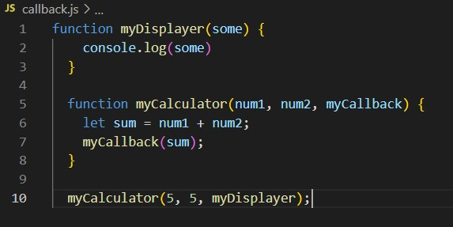

Callbacks:-
A callback is a function passed as an argument to another function
This technique allows a function to call another function
A callback function can run after another function has finished

Slide 8
This is What Nested
callback looks like
function doStep1(init, callback) {
const result = init + 1;
callback(result);
}
function doStep2(init, callback) {
const result = init + 2;
callback(result);
}
function doStep3(init, callback) {
const result = init + 3;
callback(result);
}
function doOperation() {
doStep1(0, result1 => {
doStep2(result1, result2 => {
doStep3(result2, result3 => {
console.log(`result:${result3}`;
});
});
});
}
doOperation();
Then, What's the Problem in Callbacks
Hard to understand
And debug code😢

Slide 9
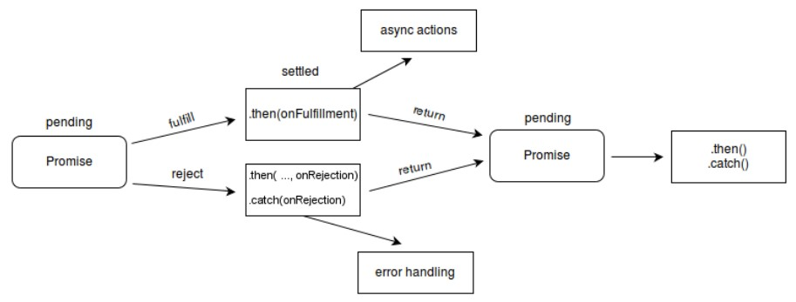
Promises:-
Promises is a way through which we can deal with asynchronous operations in JavaScript.
A promise in JavaScript is similar to a promises we do in real life.
when we define a promise, either it will be resolved when the time comes, or it will get rejected.
A promise has three state:
    Pending - It is initial state
    Fulfilled - It indicates promised operation was successful
    Rejected - It indicates that promised operation was unsuccessful

Slide 10

Lets see code:
const mypromise= new Promise(function(resolve,reject){
setTimeout(function (){
let error=false;
if(error){
console.log("your problem has been resolved");
resolve();
}
else{
console.log("There is some error");
reject();
}
},2000)
})
mypromise.then(function(){
console.log("In resolve function");
}).catch(function(){
console.log("In reject function");
})

Slide 11
Another
Example:-
<!DOCTYPE html>
<html lang="en">
<head>
<meta charset="UTF-8">
<meta http-equiv ="X-UA-Compatible" content="IE=edge">
<meta name="viewport" content="width=device-width, initial-scale=1.0">
<title>Document</title>
</head>
<body>
<h1>Student list</h1>
<ul id="students"></ul>
<script>
console.log("This is tutorial 37");
const students = [
{ name: "harry", subject: "JavaScript" },
{ name: "Rohan", subject: "Machine Learning" }
]
function enrollStudent(student) {
return new Promise(function (resolve, reject) {
setTimeout(function () {
students.push(student);
console.log("Student has been enrolled");
const error = false;
if (!error) {
resolve();
}
else {
reject();
}
}, 1000);
})
}
function getStudents() {
setTimeout(function () {
let str = "";
students.forEach(function (student) {
str += `<li> ${student.name}</li>`
});
document.getElementById('students').innerHTML = str;
console.log("Students have been fetched");
}, 5000);
}
let newStudent = { name: "Sunny", subject: "Python" }
enrollStudent(newStudent).then(getStudents).catch(function () {
console.log("Some error occured");
});
</script>
</body>
</html>

Slide 12
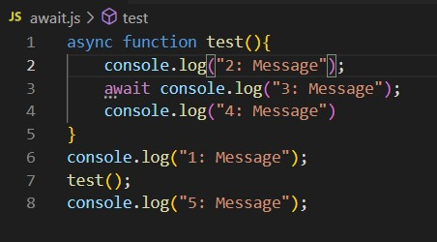
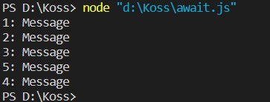
Async/await:-
Async/await functions, which is a new addition with ES2017, that help us even more in allowing us to write completely synchronous-looking code while performing asynchronous tasks behind the scenes.
We use the async keyword with a function to represent that the function is asynchronous.
The async function always returns a promise.
Benefits:-
  The biggest advantage of using async and await is, it is very simple and the asynchronous method looks very similar to a normal synchronous methods
  Also it is quite easy to debug
Lets see code:

