Slide 1
GOOGLE ADS
Campaign Performance
& Sales Analytics
2,600
campaign records
Python final project presentation
6.97
overall ROAS
Ajay Divakar K
Data Analytics Project | Google Colab
Notes:
Source: User-provided Google Ads project notebook and CSV dataset. Cover slide.

Slide 2
Project purpose and objectives
02
Business question
01
Measure campaign scale
How effectively did advertising spend generate attention, conversions and sales?
Impressions, clicks, leads and conversions
02
Evaluate efficiency
CTR, CPC, CPL, CPA and ROAS
03
Compare performance
Devices, keywords and daily sales
04
Translate results
Business insights and practical recommendations
Google Ads Campaign Performance & Sales Analytics
Notes:
Source: User-provided Google Ads project notebook and CSV dataset.

Slide 3
Dataset overview
03
One campaign in Hyderabad during November 2024
2,600
13
7
0
rows
original columns
columns with missing values
duplicate rows
Core fields
Ad ID • Campaign • Impressions • Clicks • Cost • Leads • Conversions • Sale Amount • Date • Device • Keyword
Initial issues: missing values, currency stored as text, inconsistent spelling and capitalization, and dates stored as text.
Google Ads Campaign Performance & Sales Analytics
Notes:
Source: User-provided Google Ads project notebook and CSV dataset.

Slide 4
Analysis workflow
04
01
02
03
04
05
06
Load and inspect
›
Clean categories
›
Convert data types
›
Handle missing values
›
Create KPIs
›
Analyze and visualize
The workflow preserves all 2,600 records while converting the raw file into an analysis-ready dataset.
Google Ads Campaign Performance & Sales Analytics
Notes:
Source: User-provided Google Ads project notebook and CSV dataset.

Slide 5
Data cleaning decisions
05
Campaign and location
Corrected spelling variants and standardized labels
Device and keyword
Standardized capitalization and corrected keyword spelling
Cost and sales
Removed currency symbols and converted values to numeric
Advertisement date
Converted day-month-year text into datetime values
Missing numerical data
Filled values with each column's median
Conversion rate
Recalculated as conversions divided by clicks
Google Ads Campaign Performance & Sales Analytics
Notes:
Source: User-provided Google Ads project notebook and CSV dataset.

Slide 6
Marketing KPIs
06
CTR
Clicks ÷ Impressions × 100
Ad engagement
CPC
Cost ÷ Clicks
Cost of one click
CPL
Cost ÷ Leads
Cost of one lead
CPA
Cost ÷ Conversions
Cost of one conversion
ROAS
Sales ÷ Cost
Sales per advertising dollar
Feature engineering converted raw campaign activity into comparable measures of reach, cost and return.
Google Ads Campaign Performance & Sales Analytics
Notes:
Source: User-provided Google Ads project notebook and CSV dataset.

Slide 7
Campaign performance summary
07
11.76M
361,293
16,985
$559K
Impressions
Clicks
Conversions
Ad cost
$3.90M
3.07%
6.97
Sales
Overall CTR
Overall ROAS
Each $1 of advertising spend generated approximately $6.97 in sales.
Google Ads Campaign Performance & Sales Analytics
Notes:
Source: User-provided Google Ads project notebook and CSV dataset.

Slide 8
Device performance was closely matched
08
Desktop
Highest total sales
$1.332M
ROAS
Desktop 6.99
Tablet 6.99
Mobile 6.92
Average sale values differed by less than $4 across devices.
Google Ads Campaign Performance & Sales Analytics
Notes:
Source: User-provided Google Ads project notebook and CSV dataset. Device totals from the completed notebook.

Slide 9
Keyword ROAS ranged from 6.83 to 7.09
09
Top keyword
Data analytics course
ROAS 7.09
Difference between the highest and lowest keyword ROAS: 0.26
Google Ads Campaign Performance & Sales Analytics
Notes:
Source: User-provided Google Ads project notebook and CSV dataset. Keyword labels were cleaned before aggregation.

Slide 10
Daily sales fluctuated across November
10
$174,719
Highest sales
14 November
$101,935
Lowest sales
17 November
No consistent upward or downward trend
Google Ads Campaign Performance & Sales Analytics
Notes:
Source: User-provided Google Ads project notebook and CSV dataset. Daily totals calculated after data cleaning and median imputation.

Slide 11
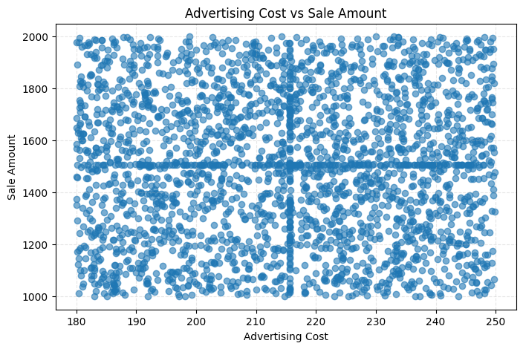
Higher volume did not predict better outcomes
11
Cost vs sales
0.01
correlation
Clicks vs conversions
0.01
correlation
Both relationships were almost flat. Higher spending or more clicks did not consistently produce higher results in this dataset.
Google Ads Campaign Performance & Sales Analytics
Notes:
Source: User-provided Google Ads project notebook and CSV dataset. Scatter plot image supplied by the user and generated from the completed analysis.

Slide 12
Conclusions and recommendations
12
What the analysis shows
Recommended next steps
• The campaign produced a strong overall ROAS of 6.97.
• Device performance was broadly similar after accounting for record counts.
• Keyword returns differed only slightly.
• Cost and click volume alone did not explain sales or conversions.
• Monitor ROAS, CPA and conversion rate together.
• Test keyword and audience combinations instead of increasing spend broadly.
• Extend the analysis across more months, campaigns and locations.
• Validate results with experiments before making causal claims.
Campaign decisions should combine return, acquisition cost and conversion quality.
Google Ads Campaign Performance & Sales Analytics
Notes:
Source: User-provided Google Ads project notebook and CSV dataset. Limitations: one campaign, one location, one month, and imputed missing values.

