Slide 1
Floor-plan detection
Fine-tuned SegFormer-B0
Walls · Doors · Windows · Rooms
Normalized geometry for a 2D-to-3D pipeline
Notes:
Assessment implementation. Model source: https://huggingface.co/nvidia/segformer-b0-finetuned-ade-512-512 . Dataset: https://github.com/CubiCasa/CubiCasa5k . All results in this deck are loaded from actual run artifacts.

Slide 2
Model and output
SegFormer-B0: 3.72 million trainable parameters
Pretrained hierarchical vision transformer and compact segmentation decoder
Five semantic masks converted into polygons and opening spans
JSON stores normalized geometry; physical scale is supplied separately
Notes:
SegFormer paper: https://arxiv.org/abs/2105.15203 . Official checkpoint model card: https://huggingface.co/nvidia/segformer-b0-finetuned-ade-512-512 . The five-class output head is newly initialized, and all encoder and decoder parameters are fine-tuned.

Slide 3
Dataset and preprocessing
4179 train / 400 validation / 400 test plans
Input / annotation | Preprocessing
F1_scaled.png + SVG polygons | 512 × 512 letterbox; preserve aspect ratio
Rooms, walls, doors, windows | Five classes including background
Outdoor regions and railings | Excluded from the architectural targets
Official floor-level splits | Exact duplicates removed; test > validation > train
CubiCasa5K: CC BY-NC 4.0; attribution and sharing restrictions apply
Notes:
CubiCasa5K: https://zenodo.org/records/2613548 . License: https://github.com/CubiCasa/CubiCasa5k/blob/master/LICENSE . Split counts and class mapping are measured from results/dataset_audit.json. The model uses aligned raster images and SVG polygons. SVG viewport size is not used to rescale already aligned pixel coordinates.

Slide 4
Fine-tuning settings
Parameter | Run setting
Optimization | AdamW · learning rate 6e−5 · weight decay 0.01
Batch and schedule | Batch 16 · 5% warmup · polynomial decay
Objective | Weighted cross-entropy + foreground soft Dice
Run duration | 30 epochs · 7,857 optimizer steps
Checkpoint selection | Best validation foreground mIoU; patience 6
Notes:
Training configuration and exact results: artifacts/segformer/training_config.json, history.json, class_weights.json, and finetuning_evidence.json. Training augmentation uses 90-degree rotations, horizontal flips, brightness and contrast. CUDA mixed precision and gradient clipping are enabled.

Slide 5
Evidence of learning
Encoder weights updated
Maximum observed change
1.45e-2
Best validation mIoU
70.0%
Notes:
Measured source: artifacts/segformer/history.json, before_finetuning_val.json, finetuning_evidence.json. The initial model uses the pretrained backbone with an untrained five-class head; this is not a direct comparison to the original ADE20K label space.

Slide 6
Results on unseen floor plans
400 held-out plans · foreground mIoU 69.8%
Pixel accuracy
94.7%
Schema-valid JSON
100.0%
Notes:
Measured source: results/test/metrics.json. IoU is aggregated from the confusion matrix over valid, non-padding pixels. Foreground mIoU excludes background. Test plans were excluded from training and checkpoint selection.

Slide 7
Detection and room-count metrics
Element | Precision | Recall | F1
room | 51.0% | 31.4% | 38.9%
door | 47.5% | 44.3% | 45.8%
window | 64.1% | 54.0% | 58.6%
Room-count MAE: 4.715 rooms per plan
Connected regions can merge adjoining instances; wall-instance scores are diagnostic
Notes:
Measured source: results/test/metrics.json. Instances are matched one-to-one using mask IoU ≥ 0.5; source SVG polygons are ground-truth instances, connected predicted regions are predicted instances. Pixel class accuracy alone cannot establish instance quality.

Slide 8
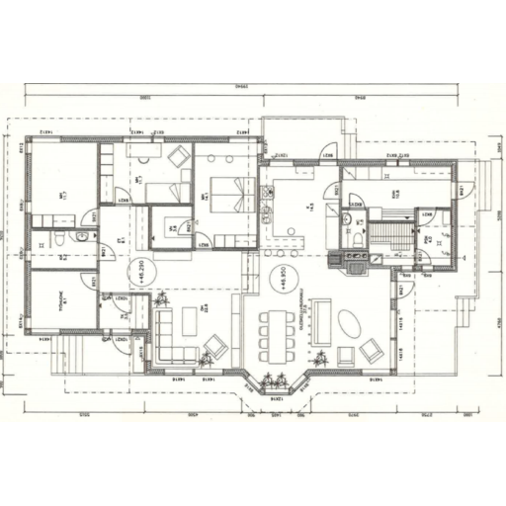
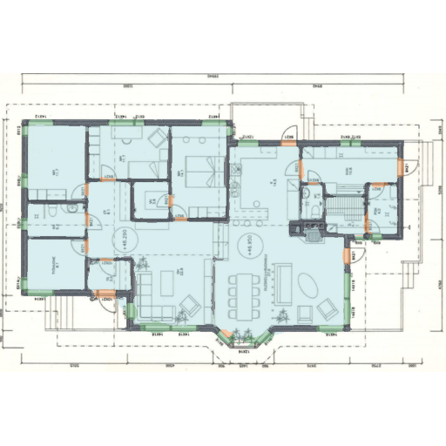
Example prediction
Floor-plan image
Predicted architectural regions
Room: blue · Wall: slate · Door: orange · Window: green
Notes:
The first exported test example in manifest order, not selected for quality. Source: CubiCasa5K, DOI 10.5281/zenodo.2613548, CC BY-NC 4.0. Exact sample ID and attribution are in results/test/samples/sample_01/source.json.

Slide 9
JSON handoff to 3D
Normalized coordinates with source image dimensions
Room and wall polygons, interior holes, and bounding boxes
Door/window spans and per-region probability estimates
External physical scale and heights required before extrusion
Notes:
Contract: docs/JSON_FORMAT.md and src/floorplan/prediction.schema.json. Per-instance confidence is average winning class probability and is not calibrated. Opening spans come from major-axis rectangles. No physical heights or dimensions are inferred.

Slide 10
Challenges and next steps
Small openings lose detail when plans are resized
Connected regions can merge rooms and neighboring symbols
21 duplicate images excluded before training and evaluation
Topology repair and physical calibration remain downstream work
Notes:
Limitations follow from the implemented semantic segmentation and postprocessing approach. Results are those measured in the exported artifact files. No claim of commercial suitability is made; dataset and model licenses apply.

Slide 11
Reproducible submission
Training, inference, and evaluation scripts with a reusable Colab notebook
Fine-tuned weights with recorded optimizer steps and encoder changes
Held-out metrics, sample images, overlays, and normalized JSON
README, dataset/license notes, and local verification records
Notes:
Source code, README, Colab notebook, checkpoints, training logs, dataset audit, held-out evaluation, sample images with JSON, and this editable PowerPoint are saved locally. GitHub publication remains deferred until the user requests it following review.

