Slide 1
Subject Code:21EEO304T Subject Name: Energy Efficient Practices
Course Offered To: B.Tech 6th Semester Students
Dr. Amit Kumar
Assistant Professor
Mechanical Engineering Department

Slide 2
Unit-5 Industrial Sector
Energy efficiency in industrial sector
Main challenges to improve energy efficiency in industry
Energy Efficient Technologies
Industrial Automation
Industrial Sensors

Slide 3
Energy efficiency in industrial sector
Energy efficiency in the industrial sector is a critical aspect of sustainable development, as industries are among the largest consumers of energy globally. Improving energy efficiency not only reduces operational costs but also minimizes environmental impact.
Importance of Energy Efficiency in Industry
High Energy Consumption: Industries account for a significant portion of global energy use, especially in energy-intensive sectors like manufacturing, cement, steel, and chemicals.
Cost Savings: Efficient energy use reduces production costs, enhancing profitability and competitiveness. (through better equipment, optimized processes, waste heat recovery, variable speed drives, LED lighting, or smarter controls)
Environmental Benefits: Lower energy consumption leads to reduced greenhouse gas emissions, contributing to climate change mitigation.

Slide 4
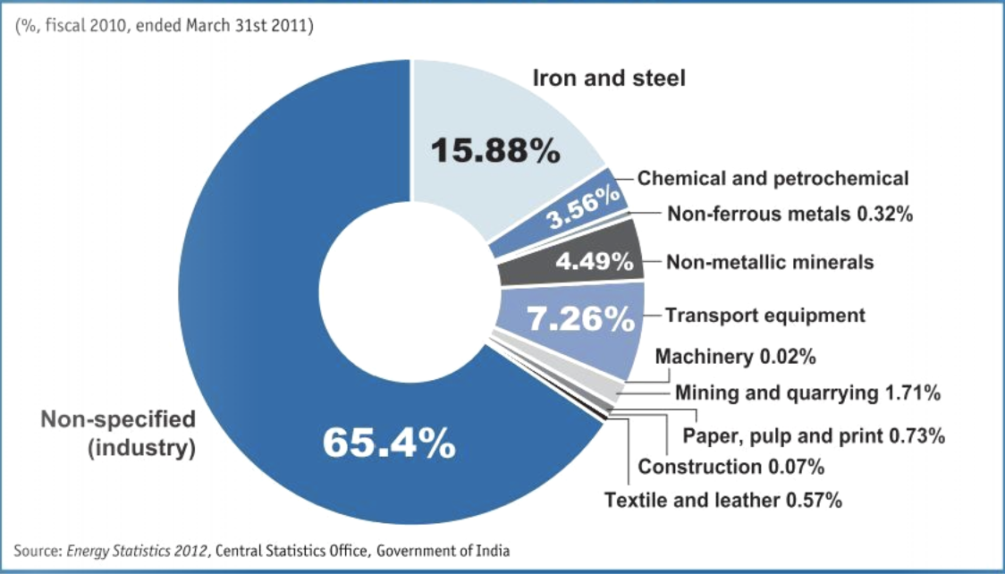
High Energy Consumption

Slide 5
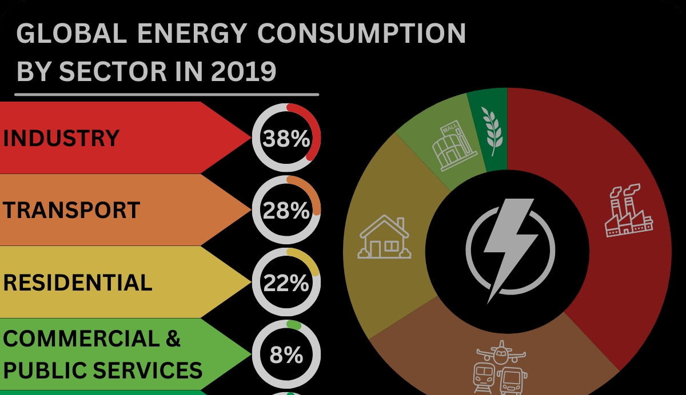
High Energy Consumption

Slide 6
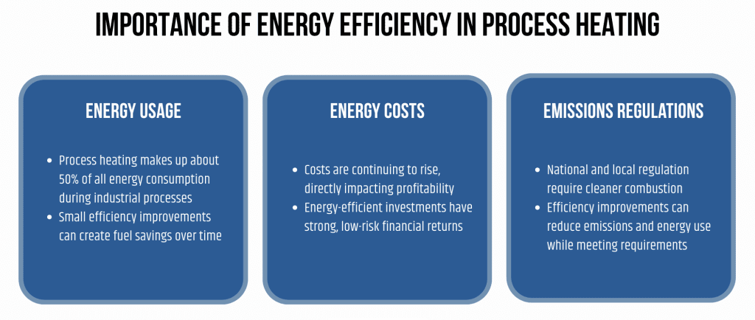

Slide 7
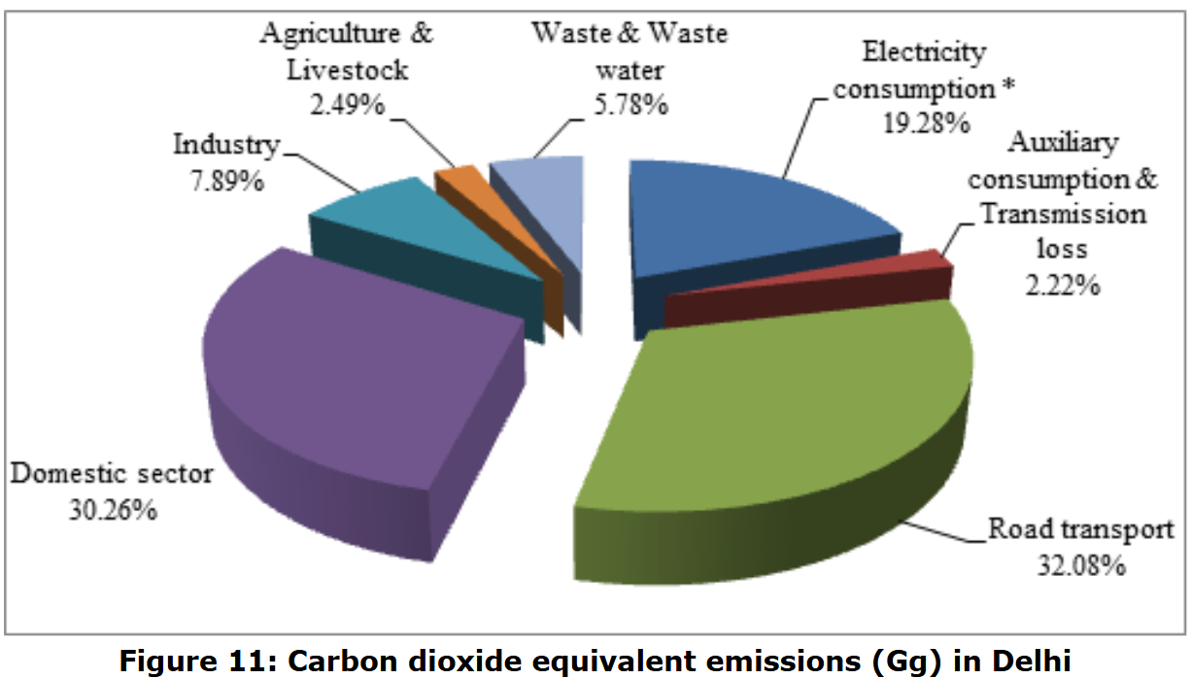

Slide 8
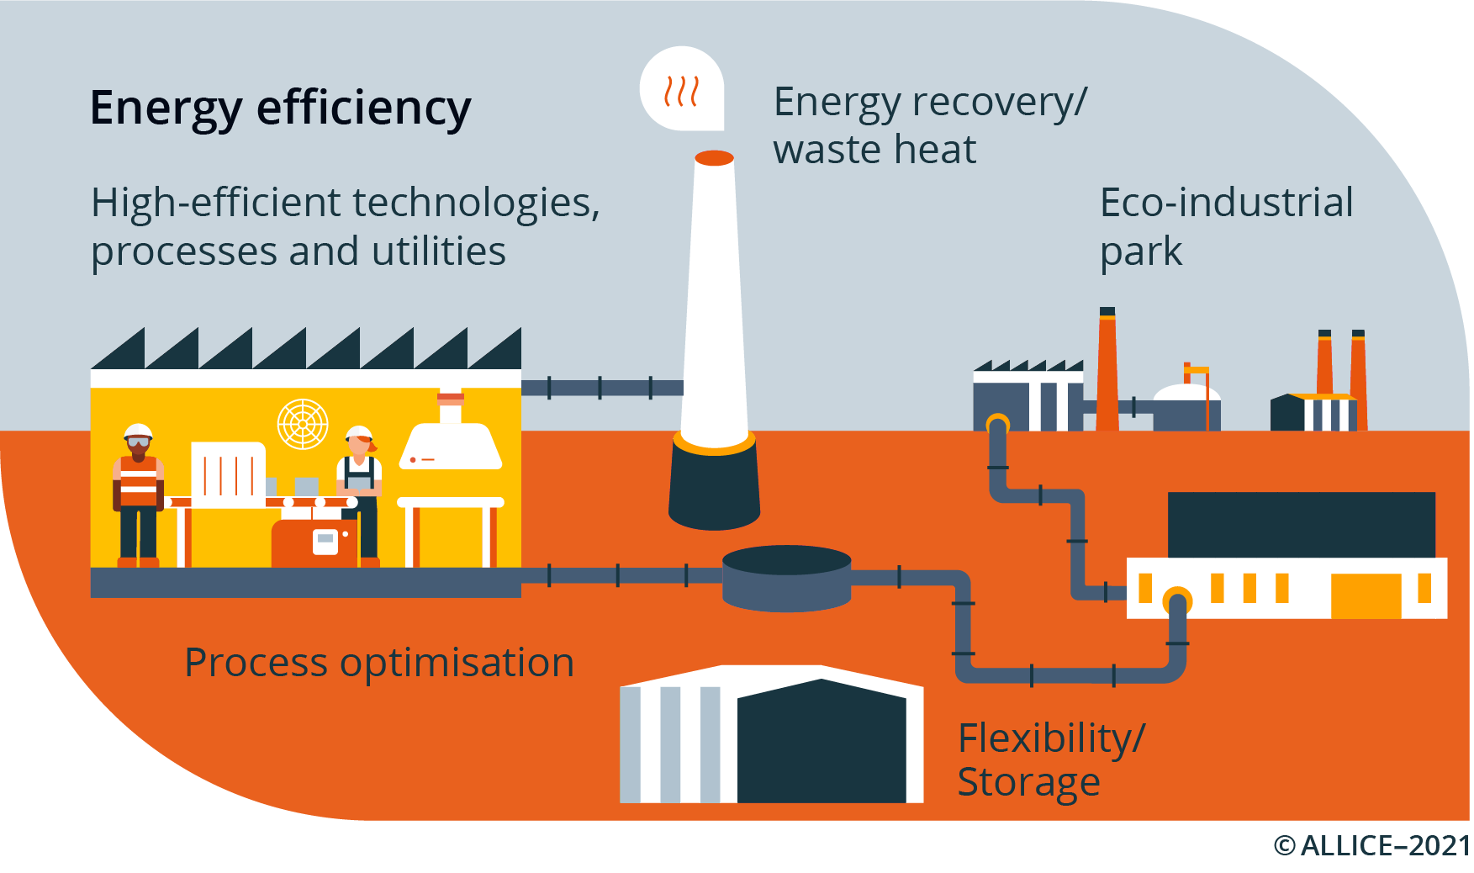
Key Strategies for Energy Efficiency
(a) Energy Audits: Energy audits are systematic assessments of energy consumption within an organization, facility, or industrial process. They help identify inefficiencies, potential savings, and areas for improvement. By conducting regular energy audits, industries can optimize their energy use, reduce costs, and improve sustainability.

Slide 9
How an Energy Audit Typically Works (Simplified Steps)
Collect historical data — Review past electricity/gas bills, production records, and equipment logs to establish a baseline (e.g., kWh per ton of product).
On-site walkthrough and measurements — Inspect equipment, measure actual consumption (using power meters, thermal cameras, etc.), check for leaks, and evaluate operating practices.
Identify inefficiencies — Look at major energy users like motors, lighting, compressed air systems, HVAC, boilers, furnaces, and processes.
Propose measures — Categorize recommendations as low-cost/no-cost (e.g., behavioral changes, maintenance) or capital investments (e.g., new equipment), with estimated savings, investment cost, and payback period.
Report and implement — Prioritize actions with short payback (often <2–3 years) and track results after implementation.

Slide 10
(b) Process Optimization: Process optimization refers to the practice of analyzing, refining, and upgrading industrial operations to achieve maximum efficiency with minimal resource consumption. It helps industries eliminate inefficiencies and improve production processes while lowering energy costs.
Ex-
1. Using Variable Frequency Drives (VFDs) to optimize motor performance and reduce power use.
2. Capturing and reusing waste heat from industrial processes improves energy efficiency including air preheater, superheater etc.

Slide 11
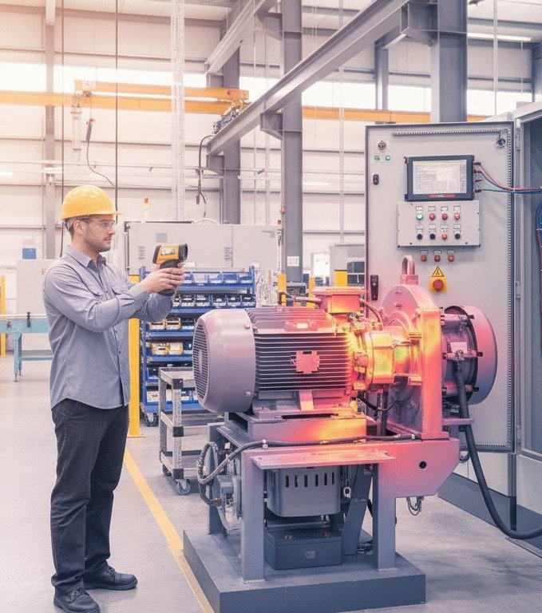
How Process Optimization Works (Typical Approach)
Map and measure — Document current processes (value stream mapping), install sub-meters/sensors for real-time data on energy, cycle times, yields, and bottlenecks.
Analyze — Identify waste using tools like root cause analysis, Pareto charts, or simulation software.
Redesign — Apply techniques: lean (eliminate non-value steps), Six Sigma (reduce variation), automation (e.g., VFDs, AI controls), heat recovery, or scheduling improvements.
Implement and monitor — Pilot changes, track KPIs (e.g., OEE, specific energy use), and iterate.

Slide 12
(c) Upgrading Equipment: Upgrading industrial equipment is a key strategy in improving energy efficiency. By replacing outdated machinery with high-efficiency alternatives, industries can significantly reduce energy consumption, operational costs, and environmental impact.
Ex-
1) Retrofitting fluorescent lamps with LEDs in warehouses can reduce electricity costs by 50%.
(2) Energy-efficient welding machines reduce electricity demand.
(3) HVAC systems with VFDs improve energy efficiency by 20-50%.

Slide 13
Practical Example: A Forging/Wheel Manufacturing Plant in Jamshedpur
Many local units rely on motors (for presses, fans, pumps, conveyors), lighting, compressed air, cooling systems, and induction/heat treatment furnaces. Upgrading key items yields quick, measurable gains.
Before upgrade (typical baseline):
50–100+ old IE1/IE2 motors (7.5–75 kW) running pumps, fans, compressors, and presses → efficiency ~80–88%.
Conventional fluorescent/high-pressure sodium lighting.
Fixed-speed compressors and old chillers/HVAC.
Older resistance/coal-fired furnaces or basic induction setups.
Annual energy bill: ₹50–200 lakh+ (depending on scale); motors/compressors often 50–70% of total consumption.

Slide 14
(d) Waste Heat Recovery: Waste heat recovery is a crucial energy-efficient strategy in industries that helps capture excess heat generated during industrial processes and reuse it, minimizing energy waste and lowering operational costs.
Waste heat refers to unused thermal energy released during various industrial operations, such as combustion, chemical reactions, and material processing. Waste heat recovery involves harnessing this excess heat and repurposing it for other applications, reducing overall energy demand.
Ex- Shell-and-tube heat exchangers in chemical plants improve thermal efficiency.
Turbo chargers uses the exhaust gas from the IC engine to drive the compressor for drawing in fresh air. And in turn improves the efficiency by 20-40%.

Slide 15
(e) Automation and Control Systems: Automation and control systems play a vital role in improving energy efficiency across industries, commercial spaces, and smart grids. These systems monitor, regulate, and optimize energy consumption using real-time data, reducing waste and ensuring smooth operations.
Key Components of Automation and Control Systems
Sensors: Detect temperature, pressure, occupancy, and power consumption.
Controllers (PLCs, Microcontrollers): Process data and issue commands for optimization.
Actuators: Execute commands by adjusting motors, HVAC systems, and lighting.
SCADA (Supervisory Control and Data Acquisition): Provides real-time monitoring and control.

Slide 16
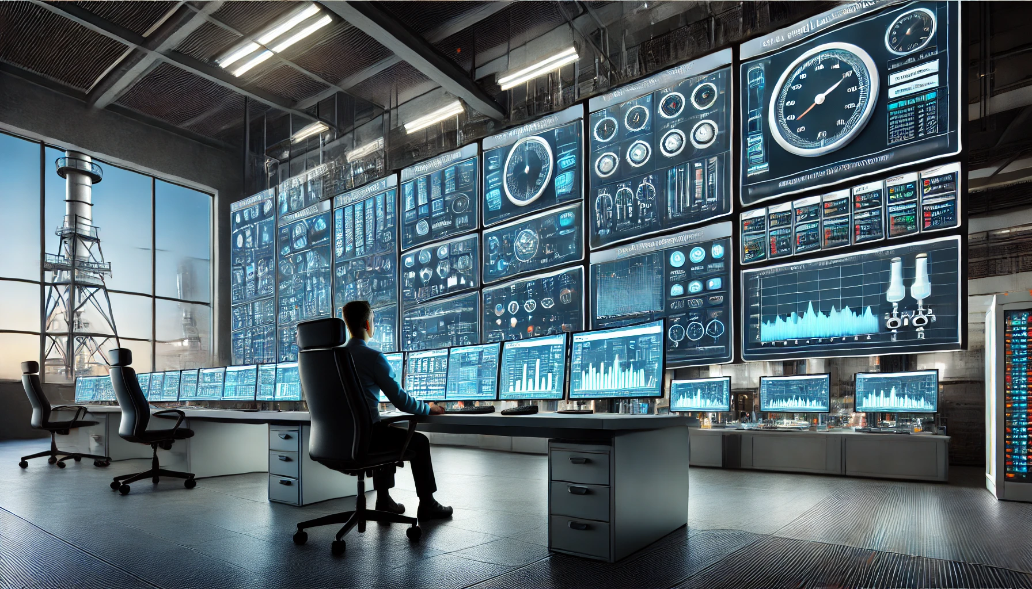
Automation upgrades and results (typical in Indian MSME/large plants):
VFDs + PLC Control on Variable Loads
Install VFDs on fans, pumps, compressors; integrate with PLC for automatic speed adjustment based on pressure/flow demand.
Example: Compressor runs at 50–70% speed during low air demand → 20–50% savings (cube law savings). → Annual: ₹5–15 lakh saved per large system; payback 1–2 years.
2. SCADA/EMS for Plant-Wide Monitoring Centralized dashboard tracks kWh by machine/line, alerts on anomalies (e.g., high furnace temp), schedules shutdowns, and optimizes load shedding.
Example: Auto-shut idle presses during breaks; predictive alerts for motor faults. → 10–25% overall reduction; enables data-driven decisions.
3. Building/Process Management Systems (BMS/EMS) For office areas, lighting/HVAC auto-adjust based on occupancy/time/weather.
In production: Integrate with furnace controls for optimal heating cycles. → Lighting/HVAC savings 30–60%; process tweaks add 5–15%.

Slide 17
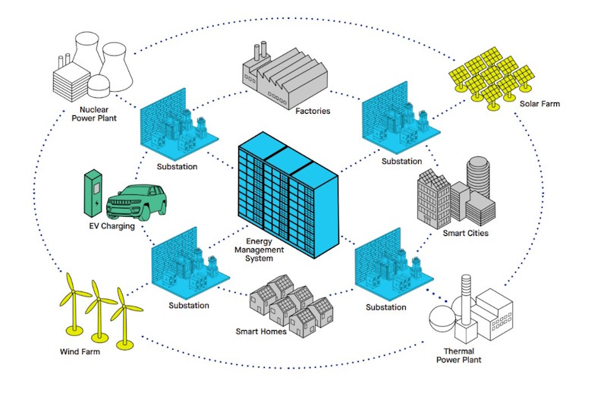
4. Broader Integration (Smart Grid/ Demand Response) Participate in utility programs (e.g., JUSCO/Tata Power demand response) via automated load curtailment during peaks. → Avoid penalties; earn incentives.

Slide 18
Main challenges to improve energy efficiency in industry
Improving energy efficiency in the industrial sector is essential but comes with several challenges.
Here are the main obstacles:
1. High Initial Investment Costs
Challenge: High initial investment costs pose a major challenge for businesses, especially small and medium-sized enterprises (SMEs), when adopting energy-efficient technologies. These upgrades—like advanced machinery, automation systems, or renewable energy solutions—typically require a substantial upfront financial commitment.
Impact: While these investments often lead to lower operational costs and energy savings over time, SMEs may find it difficult to allocate the necessary funds. Limited access to financing, cash flow constraints, or uncertainty about the return on investment can make businesses hesitant to take the leap, even if the long-term benefits outweigh the costs.

Slide 19
2. Lack of Awareness and Expertise
Challenge: Lack of awareness and expertise presents a significant barrier to adopting energy-efficient technologies across industries. Many businesses, especially small and medium-sized enterprises (SMEs), may not be fully informed about the latest advancements in energy efficiency or the long-term benefits they offer. This knowledge gap can stem from
limited access to educational resources,
insufficient training programs, or a
lack of emphasis on sustainability within certain sectors.
Impact: Without proper awareness, industries may continue using outdated systems that consume excess energy, leading to higher operational costs and environmental consequences. Businesses that fail to upgrade may also miss out on government incentives, tax benefits, or competitive advantages that energy-efficient practices can provide.

Slide 20
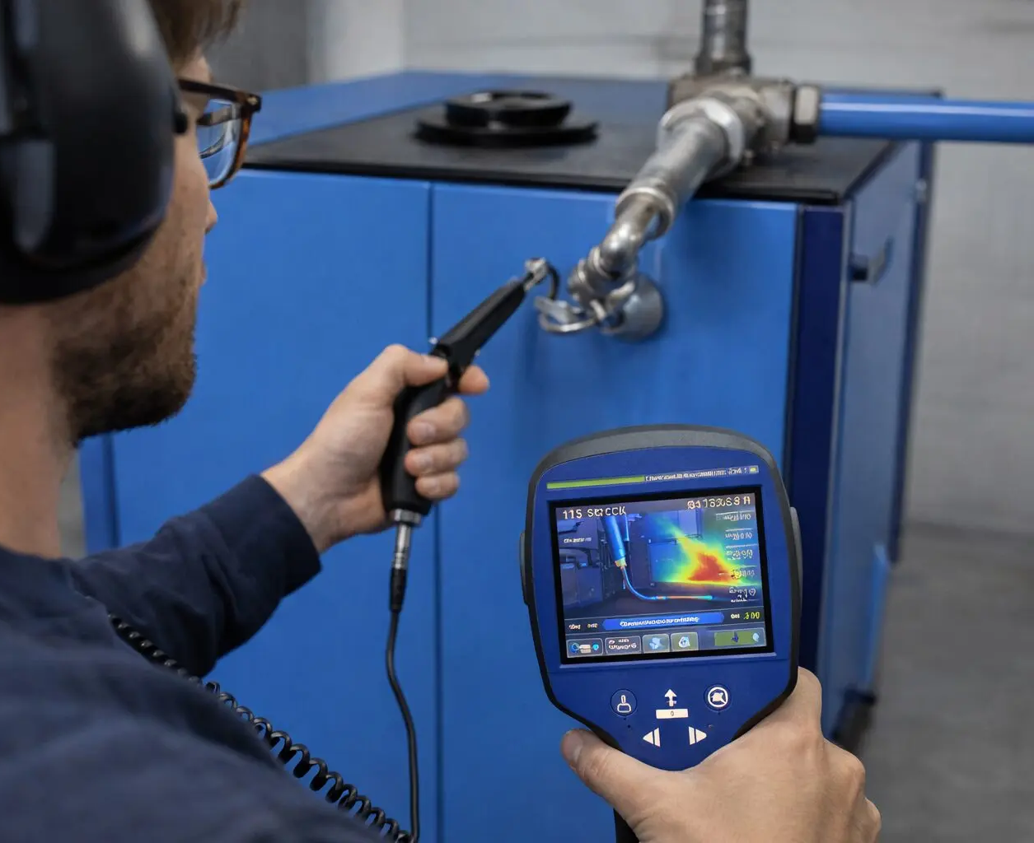
Example: Compressed Air Systems in Manufacturing SMEs (Very Common in India and Globally)
20–40% of the compressed air is lost through leaks.
The compressor runs unnecessarily during lunch breaks or night shifts.
Old fixed-speed compressors waste huge amounts of electricity compared to modern variable-speed drives (VSD).
Example: Lighting and Motors in Indian SMEs
Switching to LED lighting with sensors can cut lighting energy by 50–70%.
Replacing old motors with energy-efficient IE3/IE4 class motors + variable frequency drives can save 10–30% on motor electricity.
3. Resistance to Change
Challenge: Resistance to change is a major obstacle in the adoption of energy-efficient technologies across industries. Many businesses hesitate to upgrade due to fears that new systems might disrupt existing workflows, reduce productivity during the transition, or fail to deliver the promised return on investment.

Slide 21
Impact: This reluctance slows down the shift to more sustainable practices, leaving industries stuck with outdated, energy-intensive technologies. Even when long-term cost savings and efficiency improvements are clear, uncertainty can prevent companies from making necessary changes.
4. Limited Access to Financing
Challenge: Access to financing is a major roadblock for industries looking to invest in energy-efficient technologies. Even when businesses recognize the benefits and are willing to make upgrades, they may struggle to secure loans or incentives due to strict eligibility criteria, complex application processes, or limited availability of financial programs tailored for sustainability efforts.
Impact: Without adequate funding, industries may delay or abandon plans for energy-efficient upgrades, preventing them from improving operational efficiency and reducing costs in the long run. This challenge is particularly significant for small and medium-sized enterprises (SMEs), which often lack the financial flexibility to absorb high upfront costs without external support.
However, most struggled because:
Their plant and machinery were already pledged as collateral for working capital or expansion loans.
Banks were hesitant to lend without additional security.
The application process for subsidies or low-interest loans was lengthy and bureaucratic.

Slide 22
5. Technological Barriers
Challenge: Technological barriers can significantly hinder the adoption of energy-efficient solutions in certain industries. Some sectors rely on highly specialized equipment or processes that may not yet have viable energy-efficient alternatives.
For example, heavy industries such as steel production, cement manufacturing, and chemical processing often depend on high-temperature operations that require substantial energy input, with limited scope for immediate efficiency improvements.
Impact:
Slow Adoption – Industries with complex requirements may struggle to transition to energy-saving technologies.
Limited Innovation – Certain processes may not yet have energy-efficient substitutes due to technological constraints.
High Costs for Alternatives – The development and implementation of custom energy-efficient solutions can be expensive.
Environmental Concerns – Continued reliance on traditional, energy-intensive technologies can increase carbon emissions.

Slide 23
Technological Barriers Example
Real-World Example: Cement Manufacturing — One of the best examples worldwide and in India. Making Portland cement involves heating limestone and clay in a huge rotary kiln to about 1450°C to produce clinker. This high-temperature process releases CO₂ not only from burning fuel but also from the chemical reaction in limestone itself (process emissions).
Even the most modern cement plants in India (using best available technology) can only improve energy efficiency by a small margin (around 0.04% per year through incremental upgrades like better insulation, efficient fans, or waste heat recovery). There is no simple "plug-and-play" efficient replacement for the kiln that maintains the same output and quality at much lower energy use.
True low-carbon alternatives (like using hydrogen, electric kilns, or completely new binders such as magnesium oxide cement) are still in pilot or early demonstration stages and are not yet viable at commercial scale for most Indian cement plants.

Slide 24
6. Policy and Regulatory Gaps
Challenge: Policy and Regulatory Gaps can be a significant hurdle for industries seeking to implement energy-efficient solutions. When government policies, incentives, or regulations are unclear, inconsistent, or insufficient, businesses may struggle to justify the investment in sustainable practices.
Impact:
Lack of Incentives – Without tax benefits, subsidies, or financial support, industries may find energy-efficient upgrades too costly.
Unclear Regulations – Companies may hesitate to act if legal requirements are vague or frequently change.
Slow Adoption – Industries may delay energy efficiency projects due to uncertainty about compliance or future regulations.

Slide 25
7. Energy Data and Monitoring Issues
Challenge: Energy Data and Monitoring Issues can create significant obstacles for industries aiming to improve energy efficiency. Many businesses lack advanced monitoring systems, real-time data analytics, or the necessary expertise to track their energy consumption effectively.
Impact:
Hidden Inefficiencies – Without proper tracking, businesses may unknowingly waste energy in outdated processes.
Inaccurate Decision-Making – Lack of precise data prevents industries from identifying and prioritizing efficiency improvements.
Higher Operational Costs – Undetected energy wastage leads to unnecessary expenses over time.

Slide 26
Example from clusters like Ludhiana (forging), Tirupur (textile), or Morbi (ceramic): A small forging unit tracks only the total electricity bill. They have no idea that their old motors and pumps are inefficient or that lighting consumes far more than necessary. When energy prices rise, they simply complain about high costs instead of targeting the real culprits. Because they lack data, they cannot justify investments in efficient motors or LED lighting with sensors — even though these often pay back in 1–2 years.

Slide 27
8. Integration with Renewable Energy
Renewable energy sources like solar, wind, and hydro can significantly boost efficiency and sustainability, but incorporating them requires additional infrastructure—such as energy storage solutions, smart grids, and specialized equipment. Expertise is also crucial for designing, installing, and maintaining these systems, which may not be readily available in every industry.
Impact:
For industries unfamiliar with renewable energy, these requirements can act as a barrier to adoption. Businesses may struggle with the high upfront costs, the complexity of system integration, and the need for specialized knowledge. This can slow down the transition to cleaner energy, despite the long-term financial and environmental benefits.
To overcome these barriers, industries can:
Leverage government incentives and subsidies for energy efficiency projects.
Invest in training programs to build awareness and expertise.
Collaborate with energy service companies (ESCOs) for financing and implementation.
Adopt digital tools for energy monitoring and management.

Slide 28
Example
A typical medium-sized textile dyeing or garment unit in Tirupur or Ludhiana wants to install a 100–200 kW rooftop solar system. However, they face multiple integration hurdles:
Limited rooftop space & unsuitable structures: Many factories have tin-shed roofs that need frequent replacement. Installing heavy solar panels risks structural damage or requires costly reinforcement.
Intermittency & no storage: The factory runs 2–3 shifts (including night). Solar generates power only during the day, so without expensive battery storage, they can use only 30–50% of the generated solar energy. The rest is wasted or requires complex net-metering arrangements.
Power quality & process needs: Textile or pharma units need stable, high-quality power for sensitive machines (e.g., extrusion, injection moulding, or dyeing). Sudden drops or fluctuations from solar can disrupt production or damage equipment.
Lack of expertise: The owner or plant manager has no experience in designing hybrid systems (solar + grid). They don’t know how to size inverters, integrate with existing electrical panels, or maintain the system. Hiring external experts adds cost and risk.

Slide 29
Energy Efficient Technologies
Energy-efficient technologies are innovations designed to perform tasks using less energy while maintaining or improving performance. These technologies help industries, businesses, and households optimize energy use.
Some of the major energy efficient technologies are
1. Maximum Demand Controller
2. Soft starters
3. Energy efficient transformer
4. Electronic ballast
5. Variable Frequency Drives (VFDs) or Variable Speed Drives (VSDs)

Slide 30
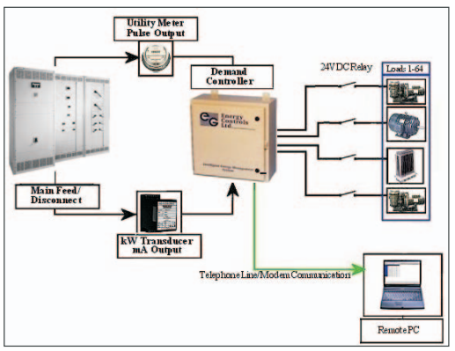
Maximum Demand Controller
A Maximum Demand Controller (MDC) is an electrical power management device designed to monitor and control the maximum demand for electricity in industrial, commercial, and residential settings. Its primary function is to prevent demand from exceeding a predetermined level, thereby avoiding peak demand charges and optimizing energy use.
Working
The MDC continuously tracks electrical power consumption in real time. It records power utilization data for analysis and reporting.
When power usage approaches the specified demand limit, the MDC automatically sheds or shuts off non-essential loads.
It prioritizes critical loads while temporarily disconnecting less important ones.
The MDC provides alerts when power consumption nears the maximum demand threshold.
Operators can take preventive actions to avoid unnecessary power surges.
Benefits
Maximum Demand Controller
Cost Savings: Prevents penalties by optimizing power usage and reducing peak demand charges.
Energy Efficiency: Reduces wastage by scheduling operations during off-peak hours.

Slide 31
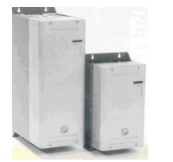
Soft starters
Soft starters are devices used to control the voltage and current supplied to motors during startup, ensuring a smooth acceleration rather than an abrupt application of full voltage. This helps reduce mechanical stress, electrical surges, and energy consumption.
Working
Soft starters use Silicon Controlled Rectifiers (SCRs) arranged in pairs for each phase.
These SCRs gradually increase the voltage supplied to the motor by controlling the firing angle of the AC waveform.
Initially, only a fraction of the total voltage is applied, reducing the inrush current.
As the motor begins to rotate, the control system decreases the firing angle, allowing more voltage to pass through.
This progressive increase ensures a steady acceleration while preventing sudden torque shocks.
By controlling the voltage, soft starters limit the startup current, typically reducing it to 2-3 times the motor’s rated current instead of the usual 6-8 times seen in direct-on-line (DOL) starters.
This prevents excessive torque and stress on motor components.
Soft starters
Benefits
Reduced Mechanical Wear – Prevents abrupt torque spikes that cause stress on gears, couplings, and bearings.
Lower Power Consumption – Limits peak current draw, leading to energy savings.

Slide 32
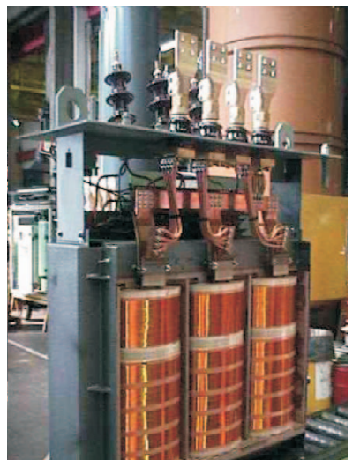
Energy Efficient transformer
An energy-efficient transformer operates on the same fundamental principles as a conventional transformer but is designed to minimize energy losses and improve efficiency.
Working
Like all transformers, it relies on Faraday’s Law of Electromagnetic Induction to transfer electrical energy between primary and secondary windings without direct electrical connection.
Instead of standard iron cores, energy-efficient transformers use amorphous metal cores or high-permeability silicon steel to reduce hysteresis losses (energy lost due to repeated magnetization and demagnetization).
The windings are made from low-resistance copper or aluminum to reduce I²R losses (heat generated due to electrical resistance). Some designs use foil or continuously transposed conductors (CTC) to improve efficiency.
Energy-efficient transformers integrate smart sensors and load management systems to optimize power distribution and reduce unnecessary energy consumption.
Benefits
Lower Energy Losses – Reduces power wastage, leading to cost savings.
Improved Lifespan – Less heat generation means longer operational life.
Environmental Benefits – Lower carbon footprint due to reduced energy consumption.
1600 kVA amorphous core transformer

Slide 33
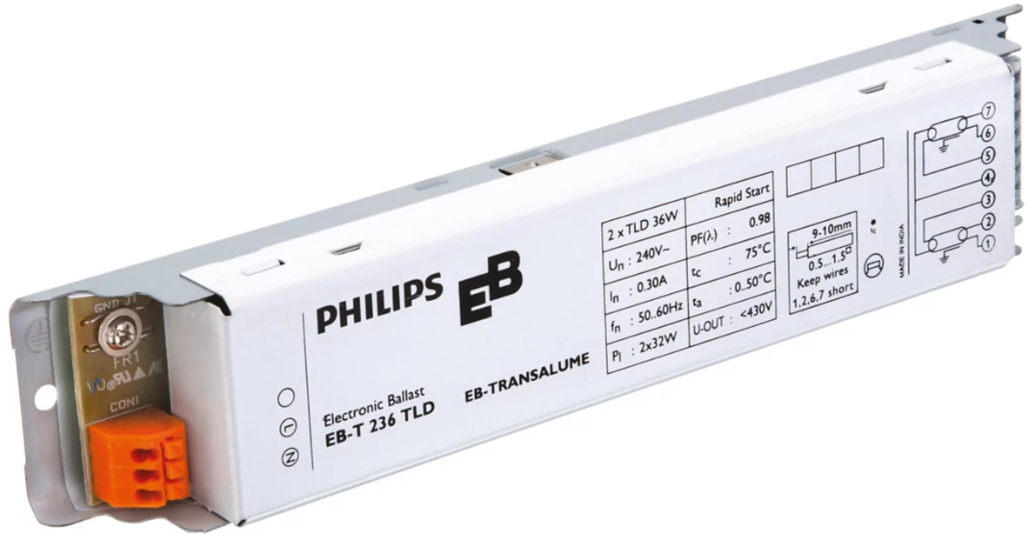
Electronic Ballast
Electronic ballasts use semiconductor components to convert AC power into a high-frequency AC signal, typically ranging from 20 kHz to 60 kHz, rather than the traditional 50 Hz or 60 Hz power supply. This high-frequency operation reduces flickering, enhances brightness, and extends the life of the lamp.
Working
The ballast first converts the incoming AC power into DC power using a bridge rectifier and capacitor.
A DC-to-AC inverter inside the ballast generates high-frequency AC.
Before igniting the lamp (for fluorescent lamps), the ballast sends a small current to preheat the lamp electrodes.
The ballast applies a high voltage pulse across the lamp to ignite the gas inside.
Once the lamp is lit, the ballast maintains a steady current flow to ensure efficient operation.
Benefits
Energy Efficiency: Uses less power than magnetic ballasts.
Flicker-Free Operation: Produces a constant and stable light output.
Compact & Lightweight: Smaller in size compared to magnetic ballasts.
Electronic Ballast

Slide 34
5. Variable Frequency Drives (VFDs) or Variable Speed Drives (VSDs) — Adjust motor speed to match actual load requirements (especially for pumps, fans, and compressors), achieving energy savings of 20–50% or more compared to constant-speed operation.
Working
A VFD works in three main stages. It converts fixed-frequency AC power into variable-frequency AC power:
Rectifier (Converter) Stage The incoming fixed AC supply (typically 50/60 Hz, 3-phase) is converted into DC using a diode bridge rectifier. This changes alternating current into pulsating direct current.
DC Bus (Filter/Link) Stage The pulsating DC is smoothed and stored using large capacitors. This creates a stable DC voltage (the "DC link") that acts as a reservoir for the next stage.
Inverter Stage The inverter (usually made of IGBTs — Insulated Gate Bipolar Transistors) converts the DC back into AC, but now with variable frequency and variable voltage.
Basic Relationship: Motor speed is directly proportional to the supply frequency.
Speed (RPM) ≈ (120 × Frequency) / Number of Poles
By lowering the frequency (and proportionally the voltage), the motor runs slower. By increasing it, the motor runs faster.
Benefits
Major Energy Savings: 20–50%+ (up to 60–90% in fans/pumps) because power ∝ speed³ (Affinity law)
Soft Start: Reduces high starting current and mechanical stress.
Longer Equipment Life: Less wear on motor, bearings, and driven parts.

Slide 35
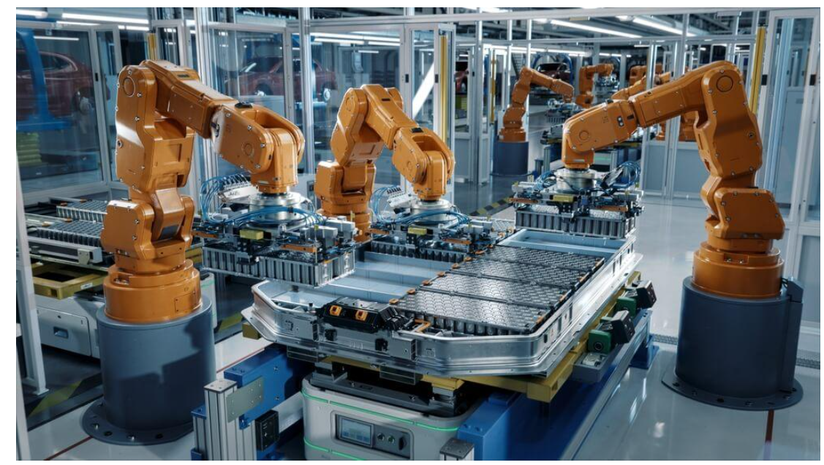
Industrial Automation
Industrial automation refers to the use of control systems, robotics, and computer technology to enhance manufacturing processes, reduce human intervention, and improve efficiency, productivity, and safety. Automation plays a crucial role in modern industries by minimizing errors, optimizing production rates, and lowering operational costs.
Industrial automation relies on several hardware and software components, including:

Slide 36
1. Sensors and Actuators
Think of sensors and actuators as the nervous system and the muscles of a machine. They work together to help a system "sense" its environment and then "do" something about it
Sensors: The "Inputs"
Sensors act like human senses (sight, touch, hearing). They detect a physical property and turn it into an electrical signal that a computer or controller can understand.
What they do: They observe and measure.
Common Examples:
Thermometer: Senses heat (like in a smart thermostat).
Lidar/Radar: Senses distance (used in self-driving cars).
Microphone: Senses sound waves.
PIR Sensor: Senses motion (used in security lights).
Actuators: The "Outputs"
Actuators are the muscles. They take an electrical signal (usually from a controller) and convert it into physical movement or action.
What they do: They exert force and create change.
Common Examples:
Electric Motor: Rotates wheels or fans.
Solenoid Valve: Opens or closes a pipe to let water flow.
LED: Converts electricity into light.
Hydraulic Piston: Lifts heavy loads on construction equipment.

Slide 37
2. Programmable Logic Controllers (PLCs)
If sensors and actuators are the "senses" and "muscles," a Programmable Logic Controller (PLC) is the brain that connects them.
Think of a PLC as a rugged, industrial computer specifically built to live on a factory floor rather than an office desk.
Why use a PLC instead of a regular PC?
Standard computers are fragile. PLCs are "hardened" to survive:
Extreme Temperatures: They work in hot mills or cold storage.
Electrical Noise: They aren't affected by the massive magnetic fields of nearby motors.
Vibration & Dust: They are built with no moving parts (like fans) that could fail.
How the PLC "Thinks" (The Scan Cycle)
A PLC doesn't just run a program once; it runs in a lightning-fast, continuous loop called a Scan Cycle:
Input Scan: It checks the status of all connected sensors (Is the button pressed? Is the tank full?).
Logic Execution: It runs the user-written program (e.g., "If the tank is full AND the button is pressed, then...").
Output Scan: It sends signals to the actuators (Turn on the motor! Open the valve!).
Housekeeping: It checks its own health and communication, then starts over.

Slide 38
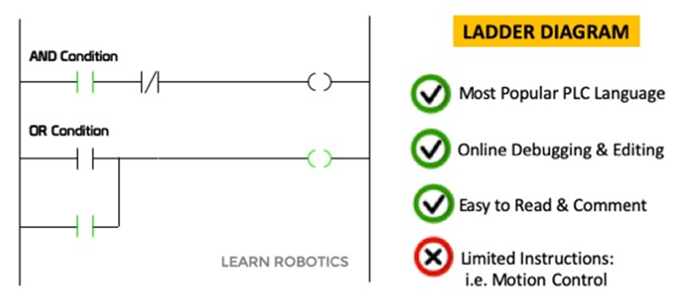
The "Language" of PLCs
The most common way to program a PLC is Ladder Logic. It looks like an electrical circuit diagram with two vertical rails and horizontal "rungs."
This was designed so that electricians who were used to wiring physical relays could easily switch to programming software.
Real-World Example: An Automatic Car Wash
Sensor Input: A proximity sensor detects a car has pulled in.
PLC Logic: The PLC sees the "Car Present" signal and waits 2 seconds.
Actuator Output: The PLC sends power to the motor (actuator) to start the overhead brushes.
Programmable Logic Controllers (PLCs)
PLCs are robust industrial computers that control machinery and processes.
They receive inputs from sensors and execute pre-programmed logic to produce desired outputs.

Slide 39
3. Supervisory Control and Data Acquisition (SCADA) Systems
If sensors/actuators are the limbs and PLCs are the local brains, then SCADA is the control tower (the CEO’s office) for an entire facility.
SCADA doesn't replace PLCs; it sits on top of them to give human operators a high-level view of everything happening at once.
1. The "Eyes" (Monitoring)
A SCADA system collects data from dozens or hundreds of PLCs and displays it on a Graphical User Interface (GUI).
Visuals: Instead of looking at code, an operator sees a digital map of the factory with moving parts, tanks filling up, and temperatures changing in real-time.
Alarms: If a sensor detects a pipe is about to burst, SCADA flashes a red warning and sounds an alarm to alert the human operator immediately.
2. The "Voice" (Control)
SCADA allows humans to talk back to the machines from a central location.
Remote Action: An operator sitting in a control room can click a button on a screen to stop a motor in a different building.
Setpoints: The operator can type "75 degrees" into the SCADA dashboard, and the SCADA system tells the PLCs to adjust the heaters accordingly.

Slide 40
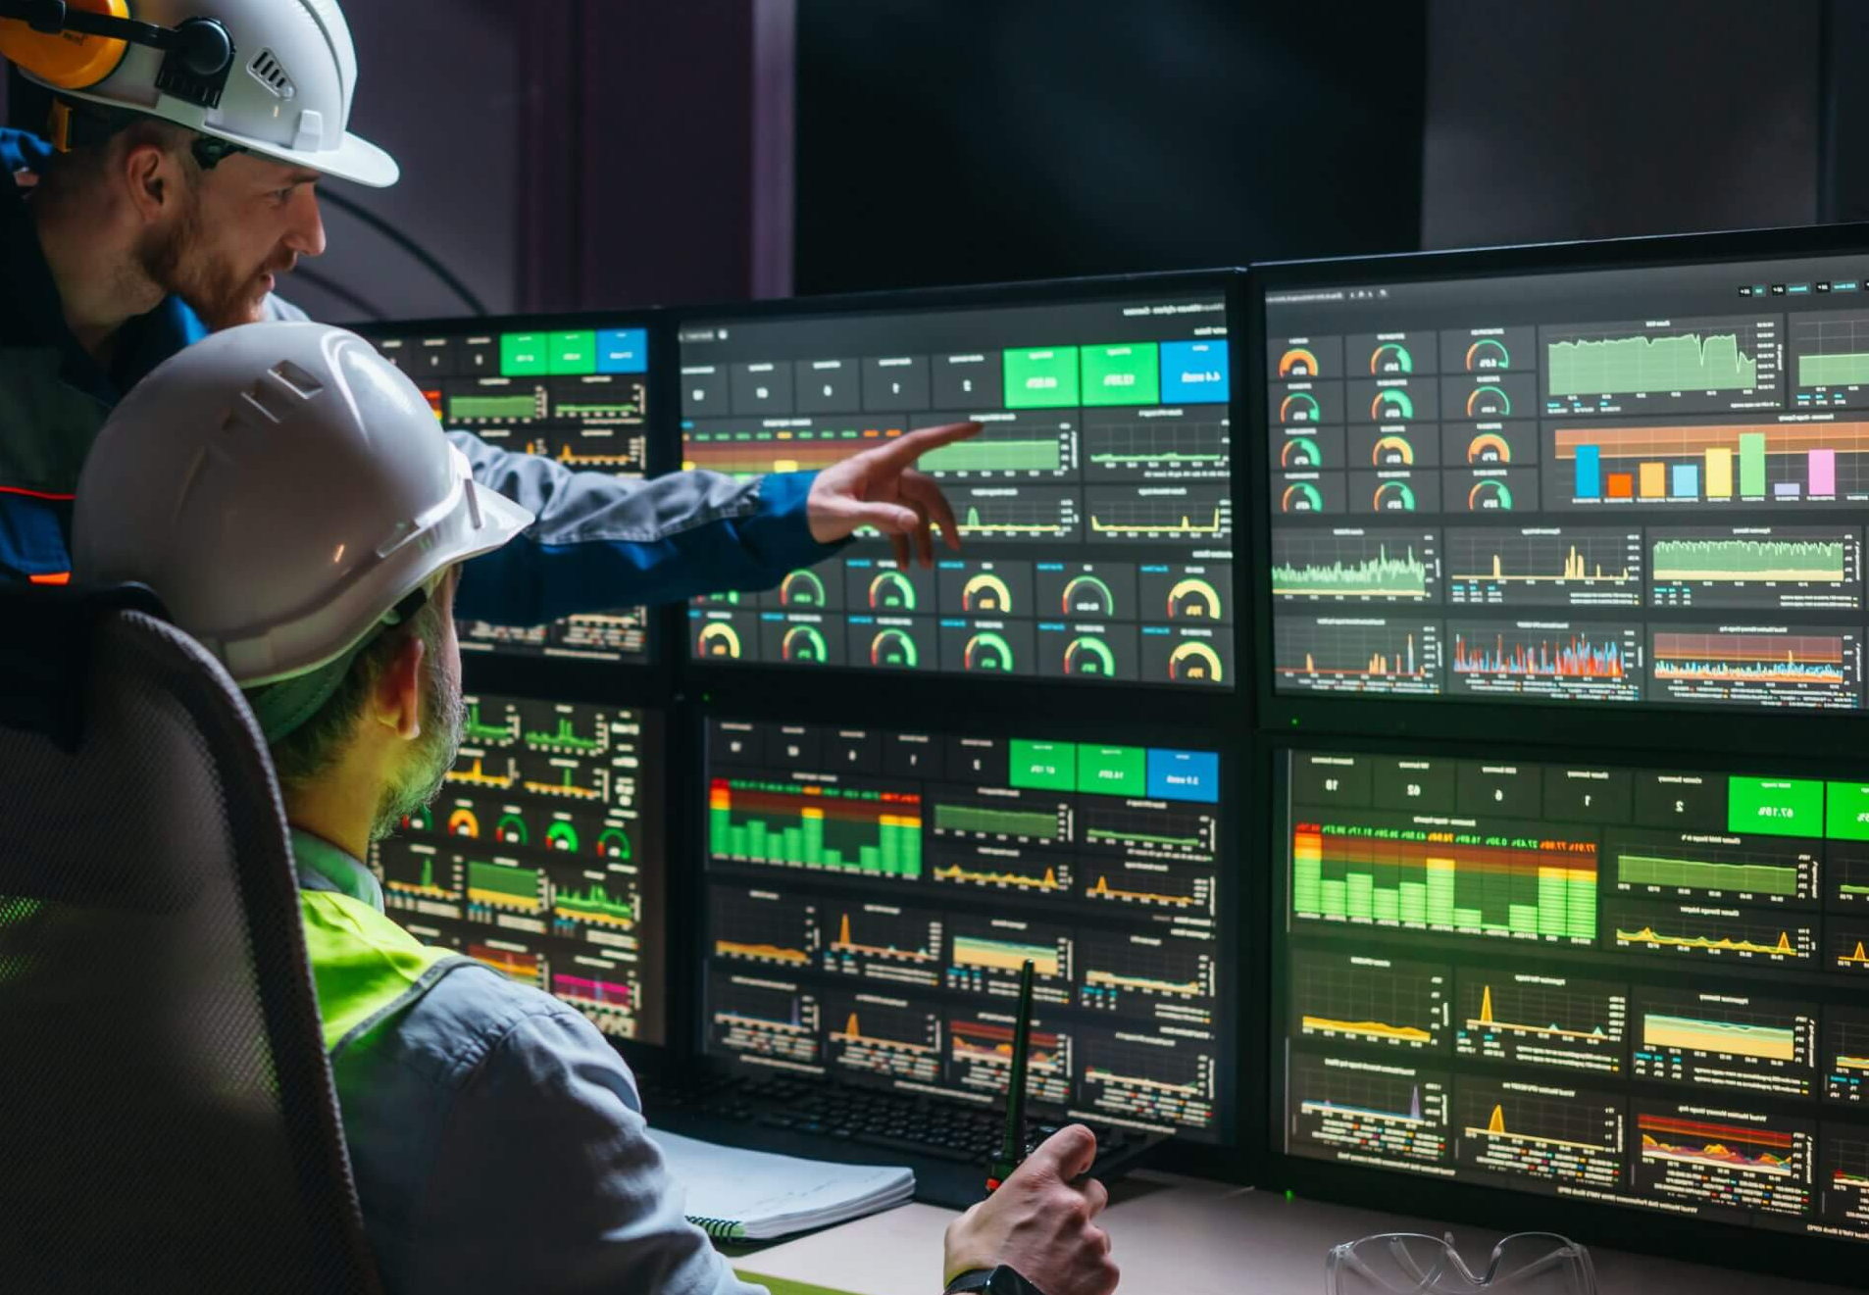
3. The "Memory" (Data Acquisition)
This is the "DA" in SCADA. It acts like a black box flight recorder for a factory.
Historian: It records every sensor reading and operator action into a database.
Analytics: Managers can look at last week’s data to see why a machine slowed down at 2:00 PM every day, helping them fix hidden problems.
Real-World Example: A City Water Treatment Plant
PLCs: Small computers at various pump stations control individual valves.
SCADA: A central office with giant screens showing the water levels of every tank in the city. If a tank in the north side of town drops too low, the SCADA system alerts the engineer, who can remotely trigger a pump to refill it.
Supervisory Control and Data Acquisition (SCADA) Systems
SCADA systems provide real-time monitoring and control of industrial processes.
They integrate PLC systems, user interfaces, and data analytics for better process management.

Slide 41
4. Industrial Robots
If sensors/actuators are the limbs, PLCs are the local brain, and SCADA is the control tower, then Industrial Robots are the specialized workers on the floor.
They are the ultimate "all-in-one" systems that combine sensors, actuators, and complex programming to perform physical labor with extreme speed and precision.
1. What Makes an Industrial Robot?
Unlike a simple machine that does one thing, an industrial robot is reprogrammable and multipurpose. It usually consists of:
The Controller: The "brain" (often a specialized PLC) that coordinates movements.
The Manipulator: The mechanical arm that moves.
End-of-Arm Tooling (EOAT): The "hand" of the robot, which can be changed (e.g., a gripper, a welding torch, or a vacuum suction cup).
2. The Three "D"s of Robotics
Industries typically deploy robots to handle tasks that fall into these three categories:
Dull: Repetitive tasks like picking up a box and moving it six inches, 10,000 times a day.
Dirty: Tasks in messy environments, like spray painting car bodies or handling chemicals.
Dangerous: Tasks like spot welding (sparks), heavy lifting, or working in extreme heat.

Slide 42
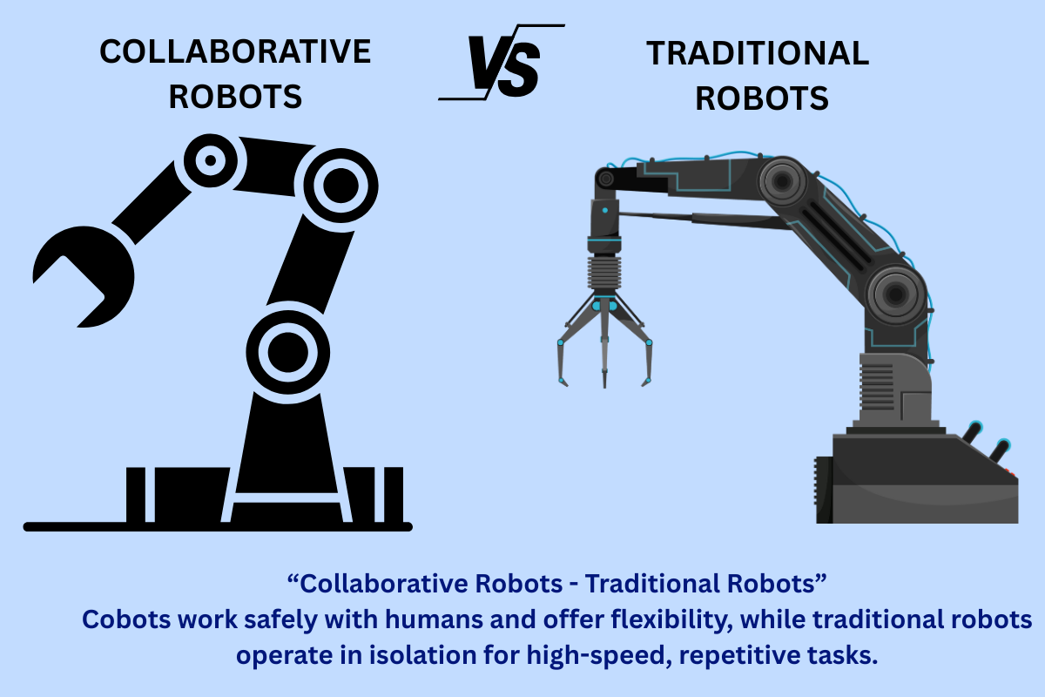
3. Key Advantages
Precision & Repeatability: A human might miss a weld by a millimeter after eight hours; a robot hits the exact same spot within 0.02mm every single time.
High Throughput: Robots don't need breaks, sleep, or lighting to see, allowing factories to run "lights-out" (24/7 operations).
Adaptability: If a factory stops making sedans and starts making SUVs, the robots don't need to be replaced—they just need new code and perhaps a different gripper.
4. Modern Trend: "Cobots"
The newest generation of industrial robots is the Collaborative Robot (Cobot).
Traditional Robots: High-speed, heavy, and dangerous. They must stay behind safety cages.
Cobots: Equipped with advanced force sensors. If they touch a human, they stop instantly. They are designed to work side-by-side with people without a cage.
Industrial Robots
Robots automate repetitive tasks like assembly, welding, material handling, and packaging.
They improve accuracy and productivity while minimizing the need for human labor.

Slide 43
5. Human-Machine Interfaces (HMI)
If SCADA is the control tower for the whole factory, the Human-Machine Interface (HMI) is the dashboard on an individual machine.
It is the physical screen (usually a touchscreen) that allows a human operator to "talk" to a PLC without needing to understand complex computer code.
1. The Digital "Dashboard"
An HMI replaces physical buttons, switches, and dials with a digital display.
Visual Controls: Instead of 20 physical buttons, an operator sees a screen with "Start," "Stop," and "Reset" icons.
Live Feedback: It shows real-time data like "Current Temperature: 180°F" or "Parts Produced: 450."
System Status: It uses color-coding—Green for running, Yellow for standby, and Red for an error.
2. Why Use an HMI?
Before HMIs, machines had massive control panels with hundreds of wires. HMIs changed the game by offering:
Flexibility: If you want to add a new function to a machine, you just update the software on the HMI instead of drilling holes and wiring new physical buttons.
Detailed Diagnostics: When a machine breaks, the HMI can display a specific error message (e.g., "Emergency Stop Pressed on Conveyor 3") instead of just a generic warning light.
Historical Trends: Operators can view a small graph of the last hour’s performance right at the machine.

Slide 44
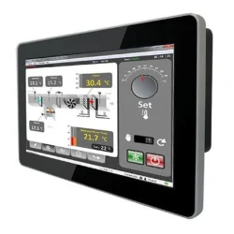
3. HMI vs. SCADA: What’s the difference?
They look similar, but their scope is different:
HMI: Local. It controls one machine or a small part of a line. It is located right next to the hardware.
SCADA: Global. It monitors the entire factory or multiple sites. It is usually located in a central office.
4. Real-World Example: A High-Speed Bottling Line
The Operator's View: A technician walks up to a filling machine and looks at the HMI screen.
Input: They tap the screen to change the "Bottle Size" from 500ml to 1L.
Communication: The HMI sends this command to the PLC.
Execution: The PLC adjusts the actuators (valves) to stay open longer.
Feedback: The HMI screen updates to show "Target: 1000ml" so the operator knows the change worked.
Human-Machine Interfaces (HMI)
HMIs provide operators with a graphical interface to interact with industrial systems.
They enable real-time data visualization and process control.

Slide 45
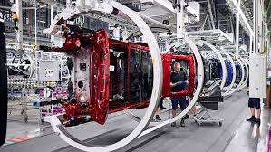
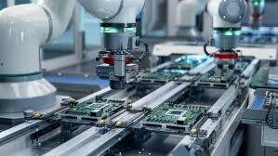
Types of Industrial Automation
Industrial automation is classified into different levels:
1. Fixed Automation (Hard Automation)
Used for mass production with highly repetitive processes.
Best suited for large-volume manufacturing (e.g., automotive assembly lines).
Example: In a car manufacturing plant, a fixed automation line might use dedicated robotic arms, transfer lines, and conveyors to repeatedly perform the same welding or assembly steps on thousands of identical car bodies.
2. Programmable Automation
Allows modification of process parameters using software programming.
Ideal for batch production with varying product specifications.
Example: In programmable robotic assembly cells in electronics manufacturing, where robots can be reprogrammed to assemble different smartphone models or circuit boards by changing the control software.

Slide 46
3. Flexible Automation
Enables rapid product changes without significant system modifications.
Commonly used in custom manufacturing or industries with dynamic product demands.
Example : Flexible Manufacturing System (FMS) in the Automotive Industry Modern car factories (e.g., Tesla, BMW, or Toyota plants) use flexible automation to assemble different car models or variants (sedan, SUV, electric/gasoline versions) on the same production line. Robots with quick tool changers and smart vision systems automatically switch between welding different body styles, installing various interiors, or painting different colors with almost zero downtime. The system is controlled by software that schedules and routes parts dynamically.
4. Integrated Automation
Combines AI, IoT, and advanced robotics for complete industrial automation.
Allows autonomous decision-making and process optimization.
Example : Smart Factory / Lights-Out Manufacturing (e.g., FANUC’s robot factory in Japan or modern Tesla Gigafactories)
In these facilities:
IoT sensors collect data from every machine and robot.
AI analyzes the data in real-time to predict maintenance needs, adjust production speed, optimize robot paths, and handle quality control automatically.
Advanced collaborative robots and AGVs (Automated Guided Vehicles) work together with minimal human supervision.
The system can autonomously switch between product variants, reroute production if a machine fails, and self-optimize for energy efficiency or output.

Slide 47
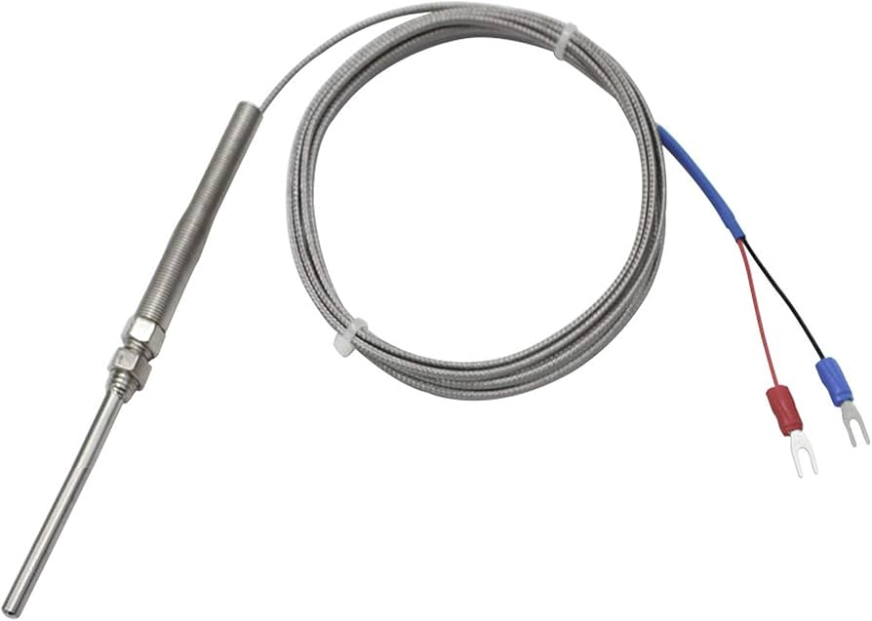
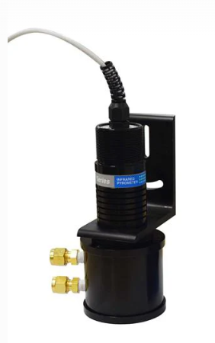
Industrial Sensors
Industrial sensors are essential components of modern automation and control systems. They enable machines and systems to monitor, measure, and respond to changes in environmental and operational conditions. Sensors help in detecting physical, chemical, and electrical properties, ensuring efficient and precise industrial processes.
Types of Industrial Sensors
Industrial sensors are classified based on the type of measurement they perform. Some of the most commonly used sensors include:
1. Temperature Sensors
Measure temperature variations in industrial processes.
Types:
Thermocouples: Used for high-temperature applications.
RTDs (Resistance Temperature Detectors): Provide accurate temperature readings.
Infrared Sensors: Non-contact temperature measurement.
Thermocouples
Best for: Precise temperature control in chemical processes, food & beverage, pharmaceuticals, and HVAC.
Best for: Glass manufacturing, metal forging, food processing (baking), and monitoring rotating machinery.

Slide 48
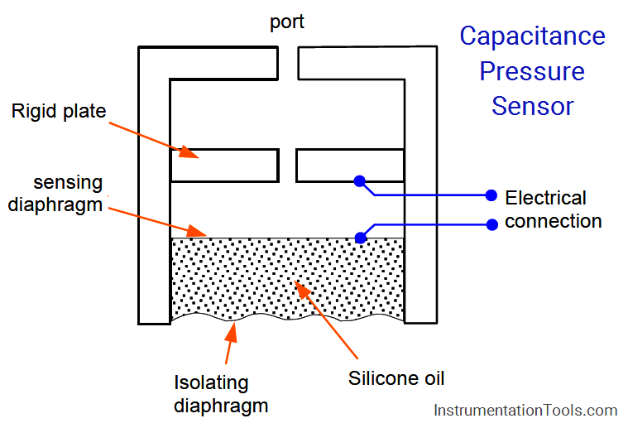
2. Pressure Sensors
Detect pressure levels in fluids and gases.
Types:
Strain Gauge Pressure Sensors: A thin metal diaphragm deforms under pressure. Strain gauges (small resistors) bonded to the diaphragm change electrical resistance when stretched or compressed. This change is measured using a Wheatstone bridge circuit.
Capacitive Pressure Sensors: Pressure changes the distance or area between two capacitor plates (one is a flexible diaphragm). This alters the capacitance, which is converted into an electrical signal.
Piezoelectric Pressure Sensors: Certain crystals (like quartz) generate an electric charge when mechanical stress (pressure) is applied to them.
Differential Pressure Sensors: Measure the difference between two pressure points (high side and low side). Often used with orifice plates or pitot tubes for flow measurement.
Strain Gauge Pressure Sensors

Slide 49
3. Proximity Sensors (Detect objects without physical contact)
Types:
Inductive Proximity Sensors: Used for metallic object detection.
Working : Generate an electromagnetic field. When a metallic object enters the field, it induces eddy currents that change the oscillation amplitude, triggering the sensor.
Capacitive Proximity Sensors: Detect non-metallic objects (plastic, liquids).
Work: Detect changes in capacitance between the sensor and the target object. Any material (conductive or non-conductive) that enters the electrostatic field changes the capacitance.
Ultrasonic Sensors: Measure distance using sound waves.
Work: Emit high-frequency sound waves (ultrasound) and measure the time it takes for the echo to return (Time of Flight).
Optical Sensors: Use light beams to detect objects.
Work: Use a light beam (usually infrared or red LED laser). Types include Through-beam, Retro-reflective, and Diffuse-reflective.

Slide 50
4. Flow Sensors
Measure the flow rate of liquids and gases.
Types:
Turbine Flow Meters: Detect fluid movement using rotating blades.
Electromagnetic Flow Sensors: Use magnetic fields to measure flow in conductive fluids.
Ultrasonic Flow Meters: Use sound waves to detect fluid movement.
Mass Flow Sensors: Measure flow rate based on mass transfer.
5. Motion Sensors
Detect movement in industrial settings.
Types:
Infrared Motion Sensors: Identify heat signatures.
Ultrasonic Motion Sensors: Detect movement using sound waves.
Laser Motion Sensors: High-precision detection for security and automation.

Slide 51
6. Gas Sensors
Measure gas concentration and detect leaks.
Types:
Electrochemical Gas Sensors: Detect oxygen, CO, and toxic gases.
Work: Gas reacts chemically with an electrolyte inside the sensor, producing an electrical current proportional to the gas concentration.
Catalytic Bead Sensors: Used for detecting combustible gases.
Work: A catalytic bead heats up and burns combustible gas on its surface. The temperature rise changes the resistance of a wire inside the bead.
Infrared Gas Sensors: Monitor gas emissions in industries.
Work: Gases absorb specific wavelengths of infrared light. The sensor measures how much IR light is absorbed to determine gas concentration (NDIR – Non-Dispersive Infrared).
Semiconductor Gas Sensors: Detect volatile organic compounds (VOCs)
Work: Gas interacts with a heated metal oxide surface (e.g., SnO₂), changing its electrical resistance

Slide 52
Applications of Industrial Sensors
Industrial sensors find applications across multiple sectors:
Manufacturing
Quality Control: Optical sensors inspect defects in production lines.
Process Monitoring: Temperature sensors regulate furnace temperatures.
Automotive Industry
Pressure Sensors: Monitor fuel and tire pressure.
Proximity Sensors: Used in vehicle collision avoidance systems.
Chemical & Petrochemical Industry
Gas Sensors: Detect toxic gases and prevent leakage.
Flow Sensors: Monitor liquid flow rates in chemical plants.
Pharmaceutical Industry
Humidity Sensors: Ensure controlled moisture levels for drug storage.
Optical Sensors: Used for precision filling in medicine packaging.

Slide 53
5. Aerospace Industry
Vibration Sensors: Monitor aircraft engine conditions.
Temperature Sensors: Regulate heat levels in spacecraft.
6. Food Processing Industry
Level Sensors: Maintain ingredient levels in storage tanks.
Flow Sensors: Monitor fluid transfer in food production.

Slide 54
Thank You

