Slide 1
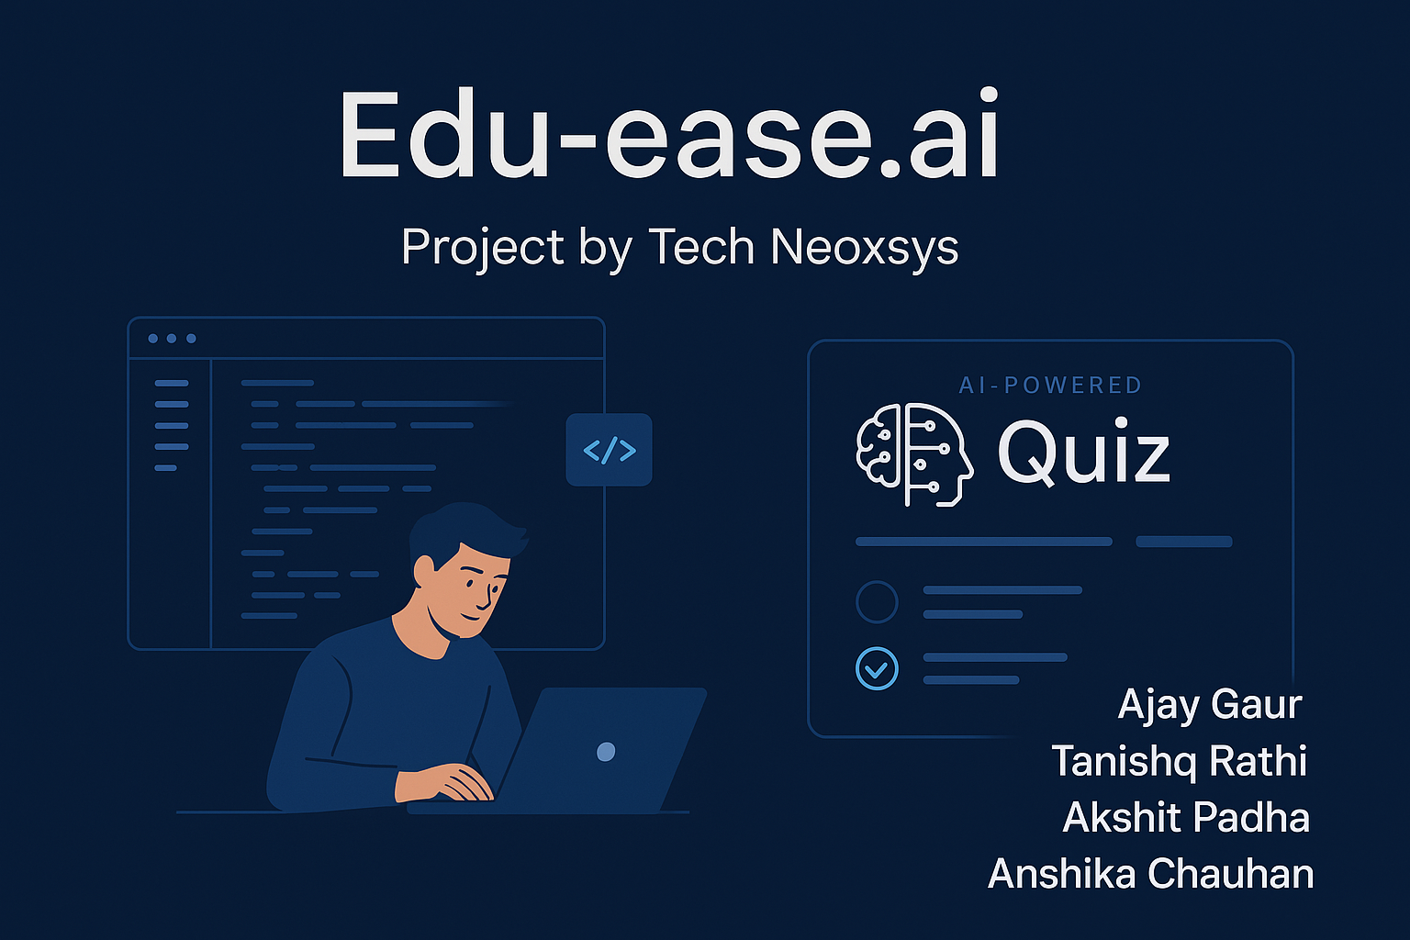
Nisha Saini

Slide 2

Welcome to Edu-ease.ai : Revolutionizing Education with AI
Edu-ease.ai is a one-stop, AI-driven educational platform. We offer comprehensive features for learners and educators. Our goal is to revolutionize the way we learn and innovate, making education accessible and engaging for everyone.

Slide 3
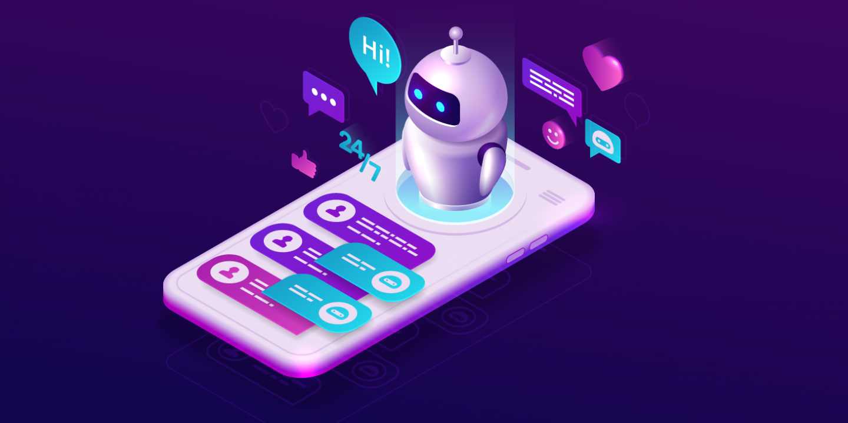
Unleash Your Creativity with AI Playground
Effortless Website Building
Rapid Prototyping
Build websites effortlessly with proper file structures. Our platform offers tailored no-code tools for creative development.
Supports rapid prototyping and professional results. Perfect for bringing your ideas to life quickly and efficiently.

Slide 4
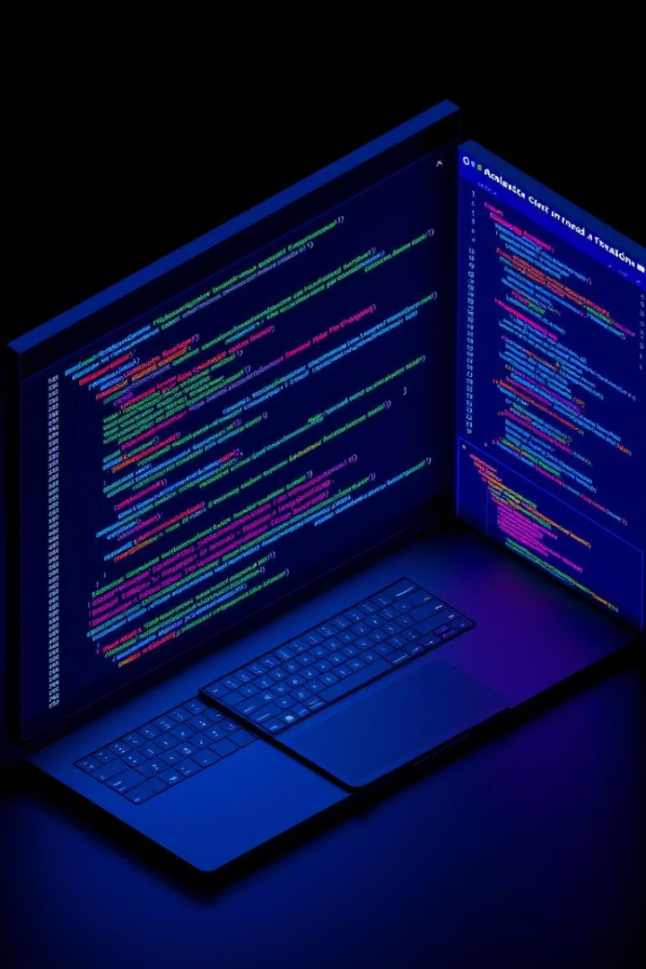



Master DSA with CodeNeoxys
Interactive Challenges
Adaptive Learning
Adaptive problem-solving environment tailors to your skill level, enhancing learning.
Solve Data Structures & Algorithms (DSA) questions in an interactive environment.
Real-Time Feedback
Learn coding with real-time feedback and challenges, designed to boost proficiency.

Slide 5




Elevate Code Quality with AI Code Reviewer
Quality Analysis
Improved Standards
Optimization Tips
Automated code quality analysis and rating provided. Improves coding standards and troubleshooting. Provides suggestions for optimizing performance and readability.

Slide 6



Discover Hackathons Near You with Hackathon Arena
Find Events
Discover hackathons
Register Easily
Register online
Connect & Collaborate
Join Communities

Slide 7




Transform Documents into Dynamic Quizzes
Upload Docs
1
AI Extracts
Upload Study materials.
2
AI pulls concepts.
Personalize Learning
4
Generate Quizzes
3
Improve retention.
Create custom quiz.

Slide 8




Create Stunning Visuals and Content with AI Generator
Generate Graphics
AI-powered tools.
Generate Content
Generate Copy quickly.
Edit and Refine
Customize results.

Slide 9

Unlock Your Potential with Edu-ease.ai
Centralized Tools
AI Innovation
Seamless learning.
Powered by AI.
Unlock Potential
Easy and efficient.

