Slide 1
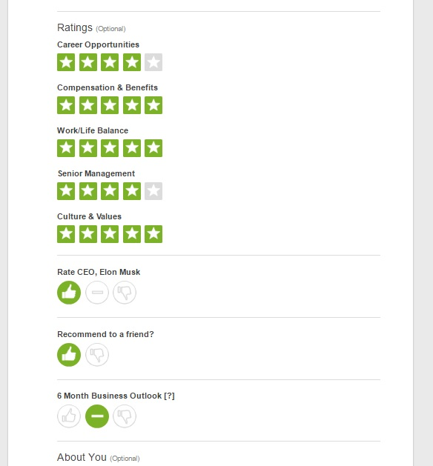
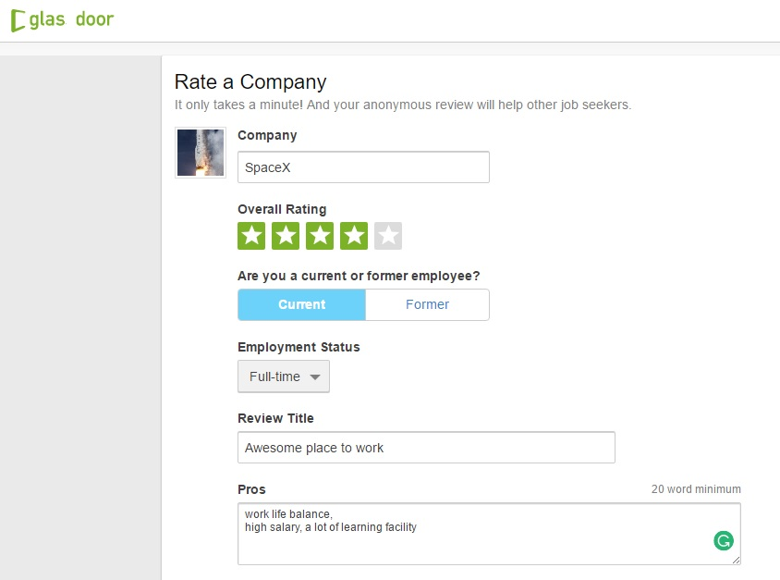
Rating
Textual Review
Ranking
Slide is intentionally placed here, Don’t ignore me

Slide 2
String based sentimental analysis predictor using lda
Ajaighosh.R
Contact-ajayghoshrr@gmail.com

Slide 3
keywords
Recommendation System
Sentimental Analysis or Opinion Mining
Fraud Review/APP Detection
Latent Dirchlet Allocation[LDA]
Collaborative Filtering
Genetic or Heuristic Algorithm
Feature Extraction
String Based Sentimental Analysis Predictor using LDA

Slide 4
Recommendation system
It is an information filtering technique, which provides users with information, which he/she may be interested in.
Types of Data Acquisitions
Explicit Data- Customer Ratings, Feedback, Physiography, Demography, Ephemeral Needs etc
Implicit Data- Purchase History, Browse or Click History etc
Product Information- Product Attributes, Product Description, Product Hierarchy etc
Techniques for Data Processing
Collaborative Filtering (Item, content, User Based), Matrix Factorisation, Sentimental Analysis, LDA, Pattern Matching, Feature Extraction etc

Slide 5

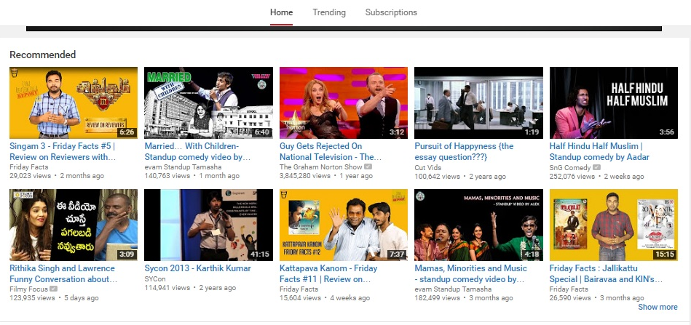

Recommendation real-time Example
Rec_FB
Rec_Youtube
Rec_Amazon

Slide 6
Sentimental Analysis
Sentimental analysis sometimes known as Opinion mining or Emotion AI
Refers to the use of natural language processing, text analysis, computational linguistics, and biometrics to systematically identify, extract, quantify, and study affective states and subjective information
Sentiment analysis is widely applied to voice of the customer materials such as reviews and survey responses, online and social media, and healthcare etc
Sentimental Dictionary

Slide 7
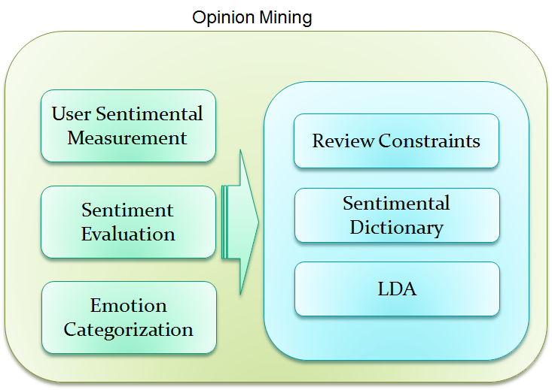
ARCHITECTURE

Slide 8
Fraud review/app detection
Fraud reviews can be eliminated by Allocating limited review to the user
Fraud APP can be detected by the Review evidences, Product features, Product Hierarchy etc
Unique MAC, IMEI address Allocation

Slide 9
Latent dirchlet allocation(lda)
LDA is a sub topic of Natural Language Processing
It is a generative statistical model that allows sets of observations to be explained by unobserved groups that explain why some parts of the data are similar
Bayesian probability statistical Model used to categorize similar information
Emotions or Opinions are categorized using LDA

Slide 10
Collaborative filtering
Collaborative Filtering method finds a subset of users who have similar tastes and preferences to the target user and use this subset for offering recommendations.
Approaches- Item based, Content based, User based, Hybrid based Filtering
Used to Filter information based on similarity by evidences from Leading sessions

Slide 11
Genetic or Heuristic Algorithm
Used to find the best probability of constraints given to the system
Genuine reviews can be identified through this Algorithm
Taking evidences from Leading Sessions, Physiography, Demography etc

Slide 12
Feature extraction
It is one of the feature of Machine learning
It starts from an initial set of measured data and builds derived values (features) intended to be informative and non-redundant, facilitating the subsequent learning and generalization steps, and in some cases leading to better human interpretations
Feature extraction is related to dimensionality reduction
If the algorithm or data is redundant or too large it returns features or prioritised data

Slide 13
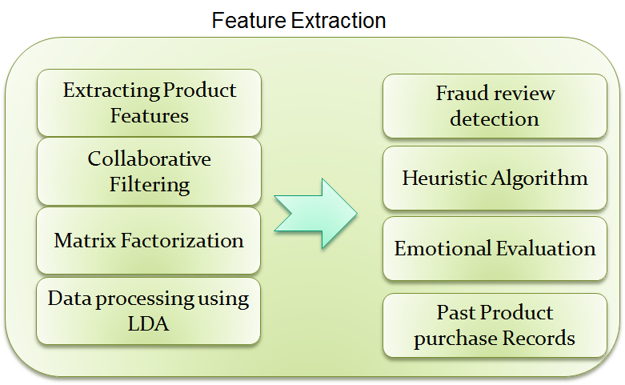
Architecture

Slide 14
String Based Sentimental Analysis Predictor using LDA
To improve the recommendation experience, Textual review evidences efficiently processed by Sentimental Analysis and Fraud review/APP detection
Process Rating, Ranking, Review based evidences
Categorize emotions based on similarity in opinions of User
Apply Collaborative Filtering, Sentimental Analysis, LDA, Genetic Algorithm, Feature Extraction, Pattern matching etc to the evidences
Detect the Fraud reviews/APP by final recommendation evidences, and MAC/IMEI authentication

Slide 15
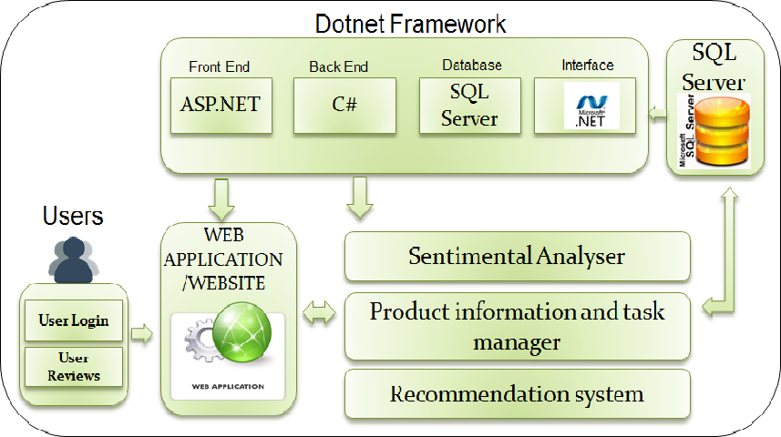
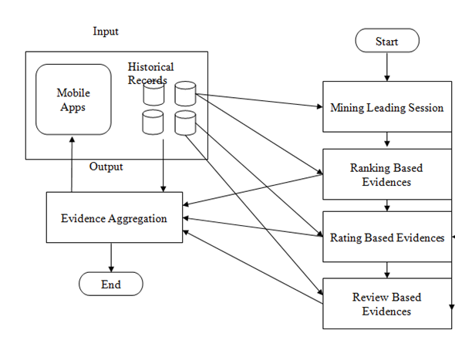
ARCHITECTURE

Slide 16
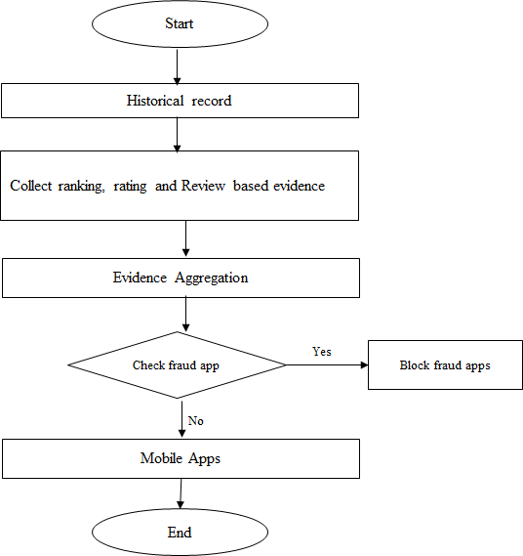
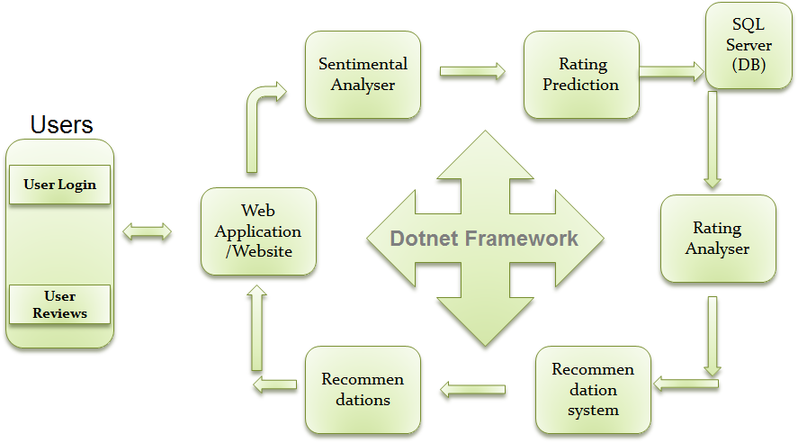
Workflow diagram

Slide 17
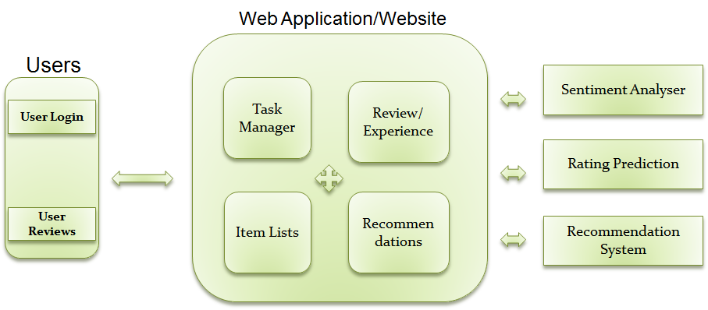
Dataflow diagram

Slide 18
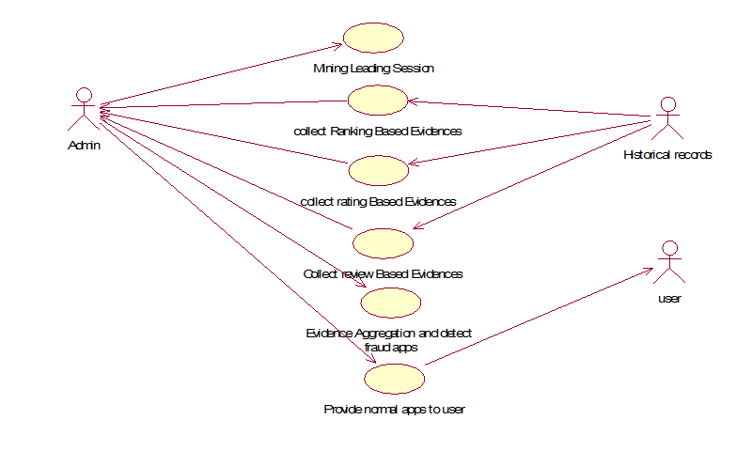
Dataflow diagram(2)

Slide 19

???????

Slide 20
THANKS
For more details……………………………………
Contact- ajayghoshrr@gmail.com

