Slide 1
Modelling and Control of a Quadcopter
Andreas Thöni | Samuel Peer

Slide 2
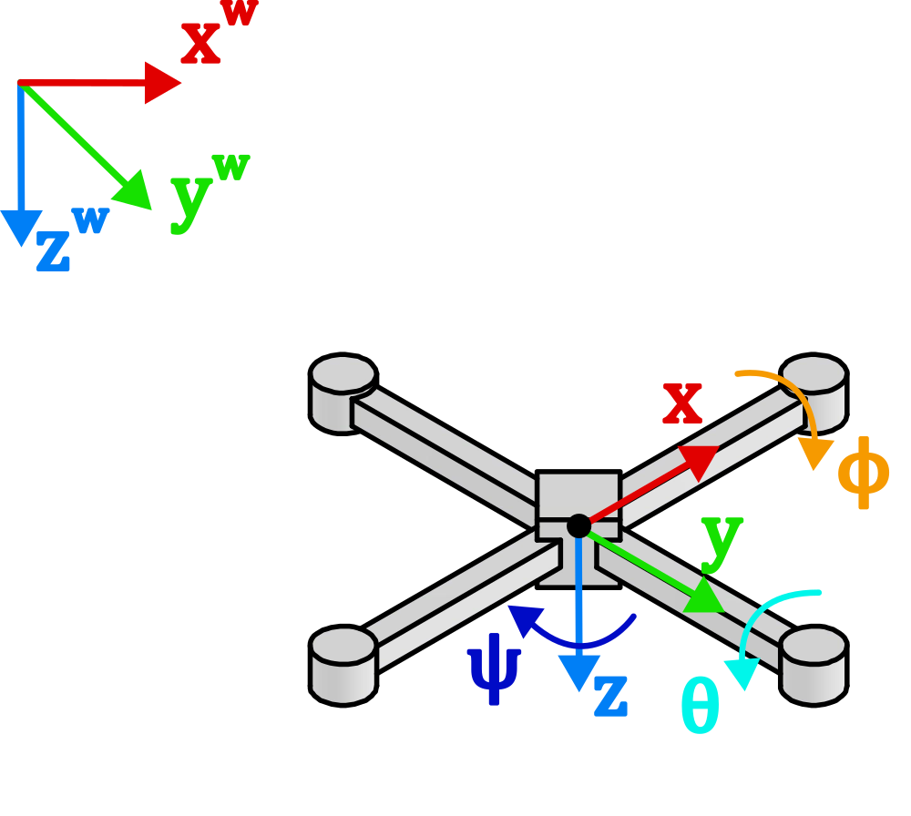


Orientations & Coordinate Transformations
$${\overset{⃑}{x}}^{(d)}={\underline{R}}_{w}^{d}\left(φ,θ,ψ\right) {\overset{⃑}{x}}^{(w)}$$
$${\overset{⃑}{x}}^{(d)}=\underline{R_{x}}\left(φ\right)\underline{ R_{y}}\left(θ\right)\underline{ R_{z}}\left(ψ\right) {\overset{⃑}{x}}^{(w)}$$
Notes:
State variables for velocity are in body frame, state variables for position are in global frame.

Slide 3
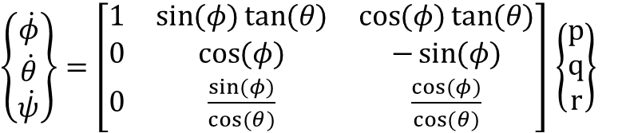
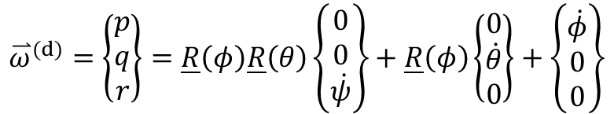
Rotational Kinematics
$${\overset{⃑}{ω}}^{(d)}=\left\{\begin{matrix}p \\ q \\ r\end{matrix}\right\}=\underline{R}\left(φ\right)\underline{R}\left(θ\right)\left\{\begin{matrix}0 \\ 0 \\ \dot{ψ}\end{matrix}\right\}+\underline{R}\left(φ\right)\left\{\begin{matrix}0 \\ \dot{θ} \\ 0\end{matrix}\right\}+\left\{\begin{matrix}\dot{φ} \\ 0 \\ 0\end{matrix}\right\}$$
$\left\{\begin{matrix}\dot{φ} \\ \dot{θ} \\ \dot{ψ}\end{matrix}\right\}=\left[\begin{matrix}1 & \sin{(φ)}\tan{(θ)} & \cos{(φ)}\tan{(θ)} \\ 0 & \cos{(φ)} & −\sin{(φ)} \\ 0 & \frac{\sin{(φ)}}{\cos{(θ)}} & \frac{\cos{(φ)}}{\cos{(θ)}}\end{matrix}\right]$ $\left\{\begin{matrix}p \\ q \\ r\end{matrix}\right\}$
Notes:
Angular rates defined in body frame, euler angles defined in intermediate coordinate frames.

Slide 4
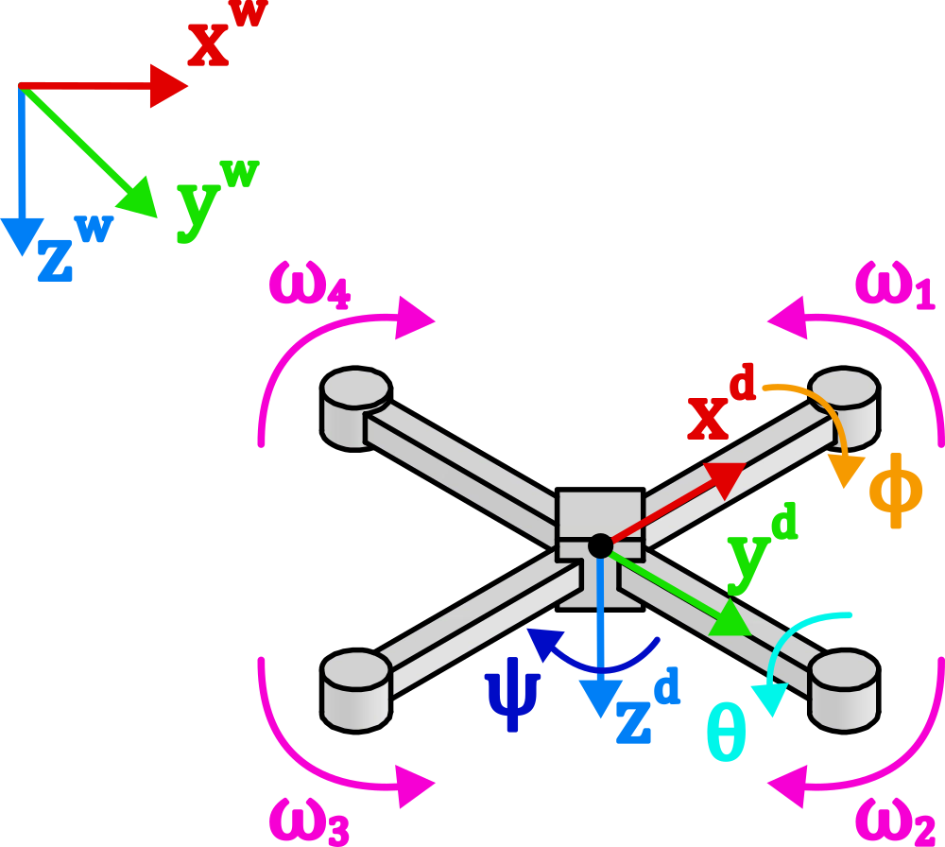

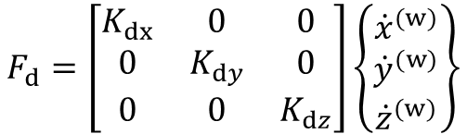
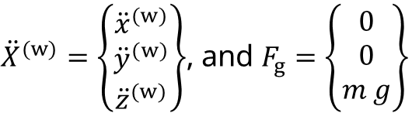


Translational Dynamics
$${m \ddot{X}}^{(w)}=F_{g}−F_{T}^{\left(w\right)}−F_{d}$$
$$F_{i}=b {ω_{i}}^{2}$$
${\ddot{X}}^{(w)}=\left\{\begin{matrix}{\ddot{x}}^{(w)} \\ {\ddot{y}}^{(w)} \\ {\ddot{z}}^{(w)}\end{matrix}\right\}$, and $F_{g}=\left\{\begin{matrix}0 \\ 0 \\ m g\end{matrix}\right\}$
$$F_{d}=\left[\begin{matrix}K_{dx} & 0 & 0 \\ 0 & K_{dy} & 0 \\ 0 & 0 & K_{dz}\end{matrix}\right]\left\{\begin{matrix}{\dot{x}}^{(w)} \\ {\dot{y}}^{(w)} \\ {\dot{z}}^{(w)}\end{matrix}\right\}$$
$$F_{T}^{(w)}={\underline{R}}_{d}^{w}\sum_{i=1}^{4}{F_{i}}$$
Notes:
Linear EOM are defined in global reference frame. Acc of quadrotor is equal to sum of force of gravity, thrust force of motors and linear friction force leading to drag. The thrust vector in the body frame is transformed into the global frame using the rotation matrix from two slides before.

Slide 5
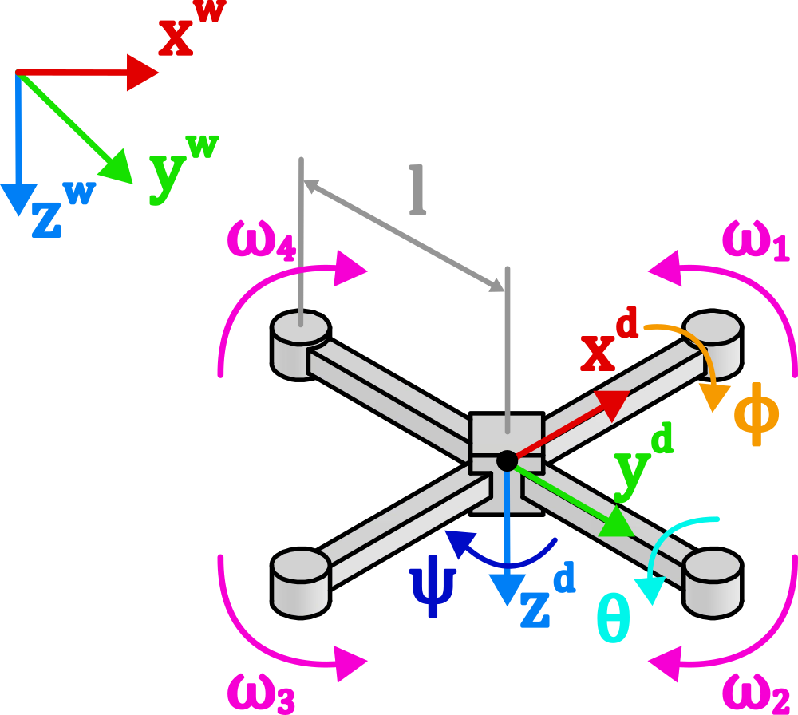






Rotational Dynamics
$$F_{i}=b {ω_{i}}^{2}$$
$${\underline{I} \dot{\overset{⃑}{ω}}}^{(d)}=−{\overset{⃑}{ω}}^{\left(d\right)}×\left( {\underline{I} \overset{⃑}{ω}}^{\left(d\right)}\right)−τ_{gyr}+τ_{ctr}$$
$$τ_{x}=l b \left(ω_{4}^{2}−ω_{2}^{2}\right)$$
$$τ_{y}=l b \left(ω_{1}^{2}−ω_{3}^{2}\right)$$
$$τ_{z}=d \left(ω_{1}^{2}−ω_{2}^{2}+ω_{3}^{2}−ω_{4}^{2}\right)$$
$$Ω= ω_{1}−ω_{2}+ω_{3}−ω_{4}$$
Notes:
Translational dynamics in world frame, rotational dynamics in body frame. Rotational physics are translated to world via matrix on slide rotational kinematics

Slide 6




Rotational Dynamics
$$F_{i}=b {ω_{i}}^{2}$$
$${\underline{I} \dot{\overset{⃑}{ω}}}^{(d)}=−{\overset{⃑}{ω}}^{\left(d\right)}×\left( {\underline{I} \overset{⃑}{ω}}^{\left(d\right)}\right)−τ_{gyr}+τ_{ctr}$$
$$\dot{p}=\frac{1}{I_{xx}} \left(\left(I_{yy}−I_{zz}\right) q r −J_{r} q Ω+ τ_{x}\right)$$
$$\dot{q}=\frac{1}{I_{yy}} \left(\left(I_{zz}−I_{xx}\right) p r+J_{r} p Ω+ τ_{y}\right)$$
$$\dot{r}=\frac{1}{I_{zz}} \left(\left(I_{xx}−I_{yy}\right) p q+τ_{z}\right)$$

Slide 7
Simulink Implementation

