Slide 1


Android Introduction

Slide 2

What is Android?
Android is an operating system based on the Linux kernel.
Android is developed in the Android Open Source Project (AOSP).
This project is lead by Google.

Slide 3
Versions of Android
Table 1. Android versions
Code name | Version | API level
Oreo | 8.0 | 26
Nougat | 7.0 – 7.1.1 | 24 -25
Marshmallow | 6.0 | 23
Lollipop | 5.1 | 22
Lollipop | 5.0 | 21
KitKat | 4.4 - 4.4.4 | 19
Jelly Bean | 4.1.x - 4.3.x | 16 - 18
Ice Cream Sandwich | 4.0.1 - 4.0.4 | 14 - 15
Honeycomb | 3.2.x | 13
Honeycomb | 3.0 - 3.1 | 11 - 12
Gingerbread | 2.3 - 2.3.7 | 9-10
Froyo | 2.2.x | 8
Eclair | 2.1 | 7
Eclair | 2.0 - 2.0.1 | 5 -6
Donut | 1.6 | 4
Cupcake | 1.5 | 3
(no code name) | 1.1 | 2
(no code name) | 1.0 | 1

Slide 4
An Android application (app) is a single installable unit which can be started and used independently. An Android application consists of configuration files, Java source and resource files.
An activity is the visual representation of an Android application. An Android application can have several activities.
Activities use views and fragments to create their user interface and to interact with the user.

Slide 5
manifest file
The components, settings and metadata of an Android application are described in the AndroidManifest.xml file
The manifest is read by the Android system during installation of the application
This file is important to define access rights and external libraries, like Google Maps API.

Slide 6
Testing
Using a real Android device for testing
To use a normal Android device, connect your device to your development machine (via USB).
On your Android device turn on USB Debugging. Select Settings ▸ Development Options, then enable the USB-Debugging option.
Using the Android emulator and Android Virtual Device
The Android tooling contains an Android device emulator. This emulator can be used to run an Android Virtual Device (AVD)
Virtual devices give you the possibility to test your application for selected Android versions and a specific configurations

Slide 7
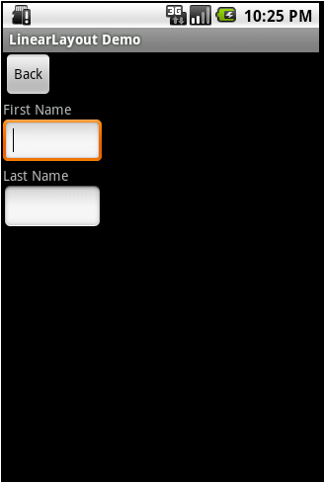
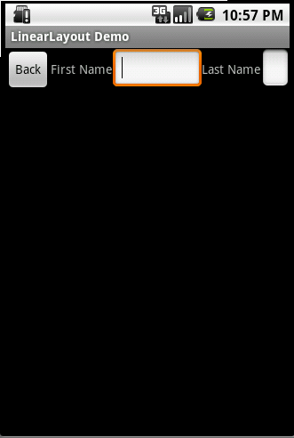
Different Layouts
Linear Layout

Slide 8
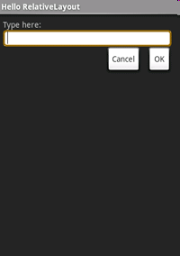
Relative Layout

Slide 9
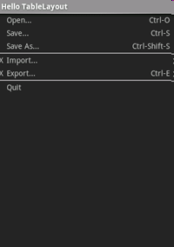
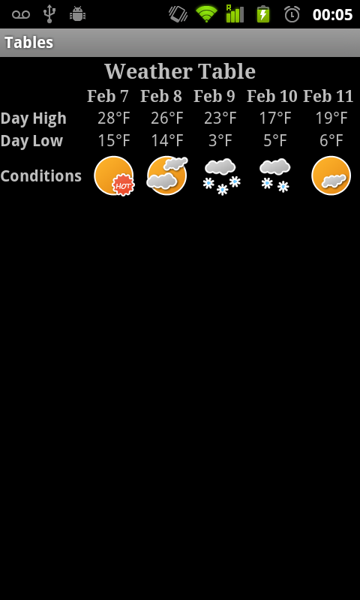
Table Layout

Slide 10
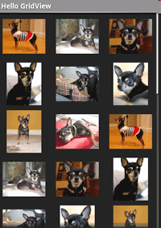
Grid View

Slide 11
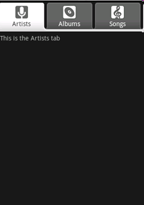
Tab Layout

Slide 12
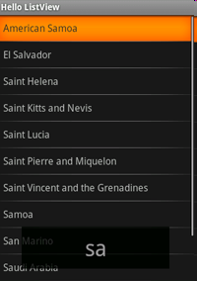
List View

Slide 13
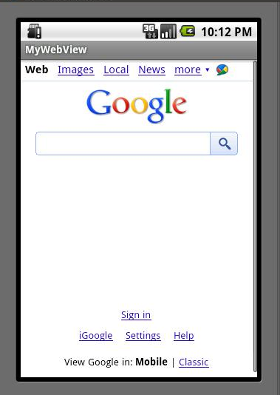
Web View

Slide 14
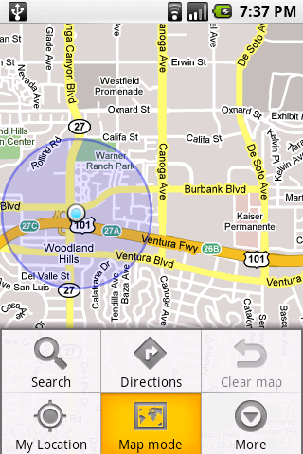
Map View
One of the most exciting features of android is that it can directly integrate Google maps in an app with Google map library that comes with the API, map activities like zooming, finding, tagging etc. can be easily accomplished and with GPS many location based services can be created.

Slide 15
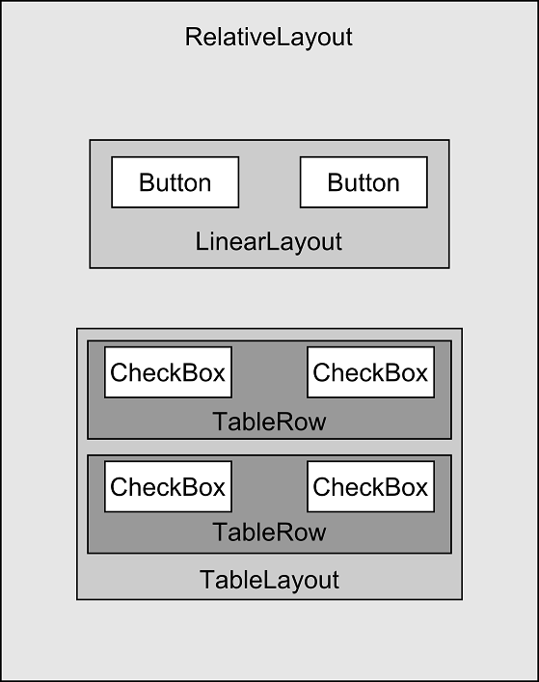
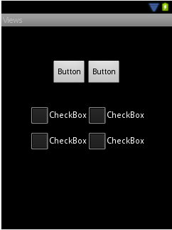
Example of GUI

Slide 16
The Android Developer Website
http://developer.android.com/index.html
This should be your homepage for this semester for AT lab!

