Slide 1

Market Analysis
Team mates: Ajay Mishra,Shipon Nath,Michel Ngoye, Ilona Inchenko

Slide 2
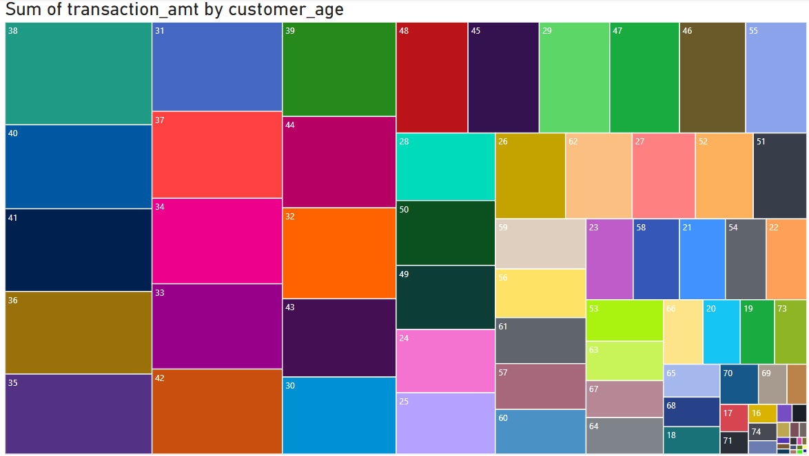
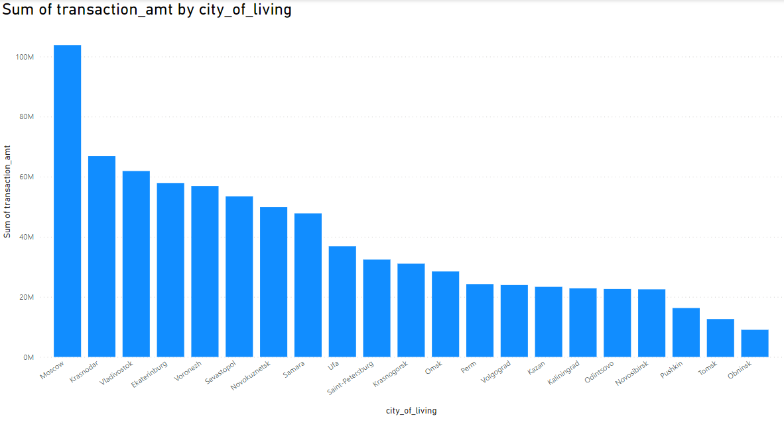
About data-
Investigated about data
Used isna(). sum() returns the number of missing values in each column
Identified missing values
Cleaned the data by removing null values
Checked the data and prepared for an analysis

Slide 3
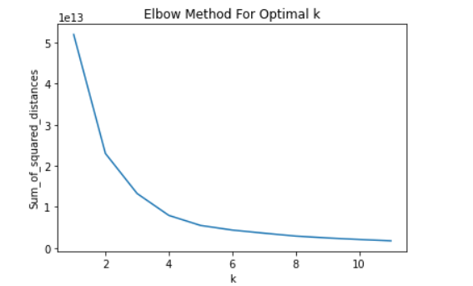
Cluster Analysis-
In our analysis we used k-means and implement Elbow Method to Determine Optimal Clusters
3 optimal clusters are
transaction_amt -how translation amount is different in different different city transaction_qty -what are the quantity being purchased on the amount
Customer Age - How it is determining its transaction-Amount and Quantity
based on above we decided to have our hypothesis

Slide 4
Hypothesis -
-We used t-test to analyze our hypothesis
H1:
Amount of transaction in Moscow is Higher than Saint Petersburg
proved statically significant
H2:
-Transaction amount of customers less than age 30 is less than transaction amount of customers between 30 to 50 age
proved statically significant
H3:
-Transaction amount of customers who have mobile app is higher than transaction amount without mobile app
did not prove statically significant

Slide 5
Some Important KPIs-
1- Amount of Transaction-Particular location we can identify which location is better in terms of flow of transaction
2- TargetGroup- Can understand which age group needs to be targeted for maximize the profit or make an marketing strategy accordingly
3-Communication Channel- How profits affects in different communication channels for example if someone has mobile phone or app how they are affecting overall growth

Slide 6
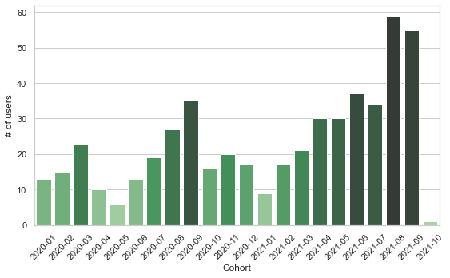
Cohort Analysis
1) clients for cohort analysis based on their transactions were chosen
2) 507 users did purchase at the same day as they registered
Dynamics of Clients who made purchase in the same day after registration

Slide 7
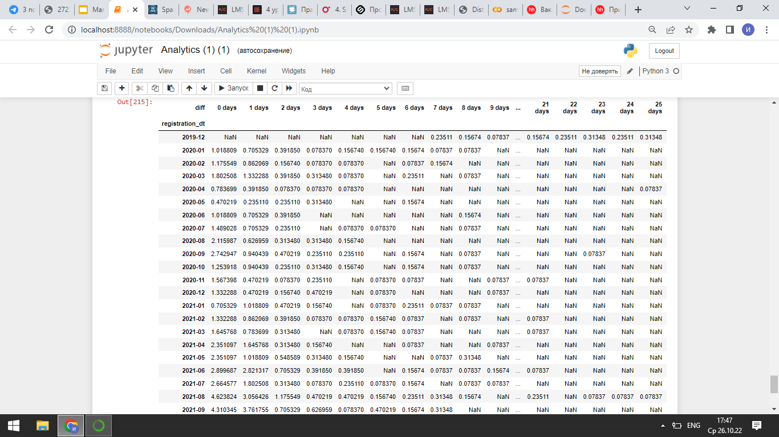
Cohort Analysis
We checked whether our clients made purchases for first 31 days after registration or not. And this pivot table represents the results

Slide 8
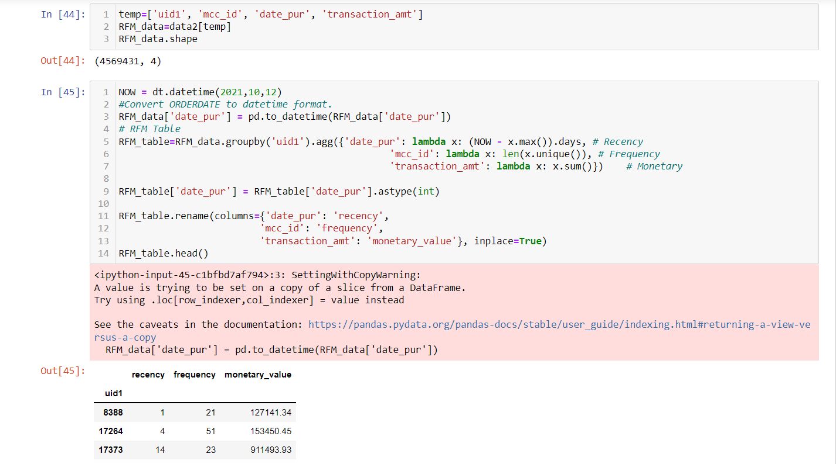
RFM Analysis
In the dataset the latest date is 2021/10/12, we use the date as “NOW” to calculate recency.
We convert date of purchase to datetime format and then group the data by user ID.

Slide 9
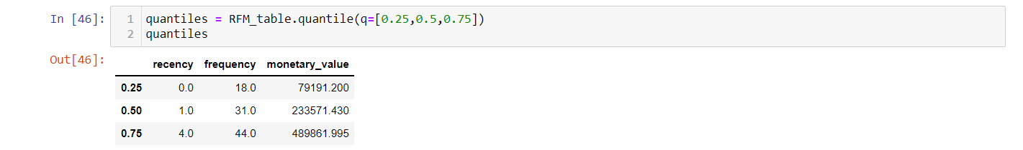
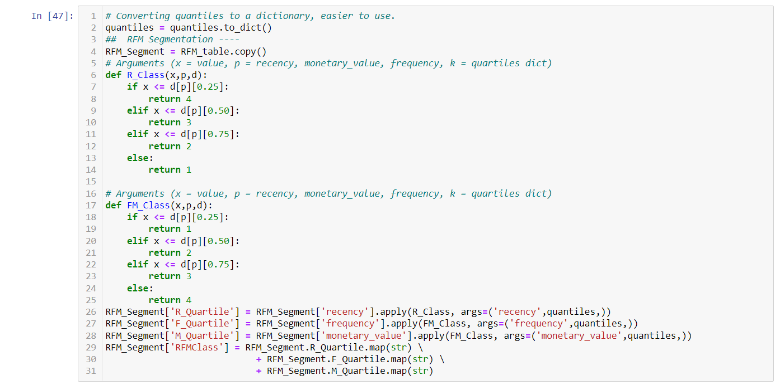
RFM Analysis
The we work on the RFM score. We have used Quintiles to make four equal parts based on available values, and we use those parts to calculate the RFM score.

Slide 10
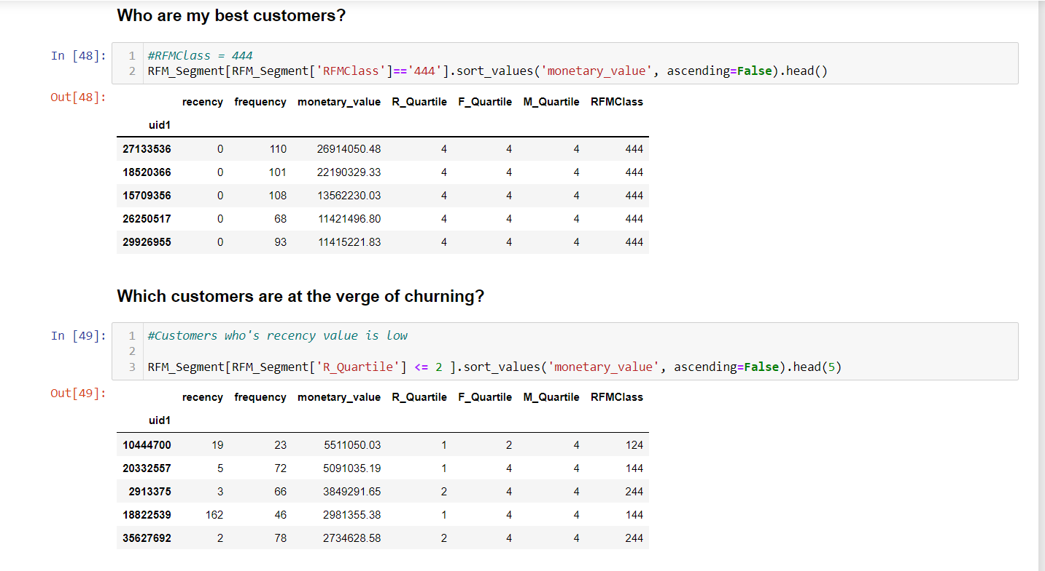
RFM Analysis: Questions could be answered

Slide 11
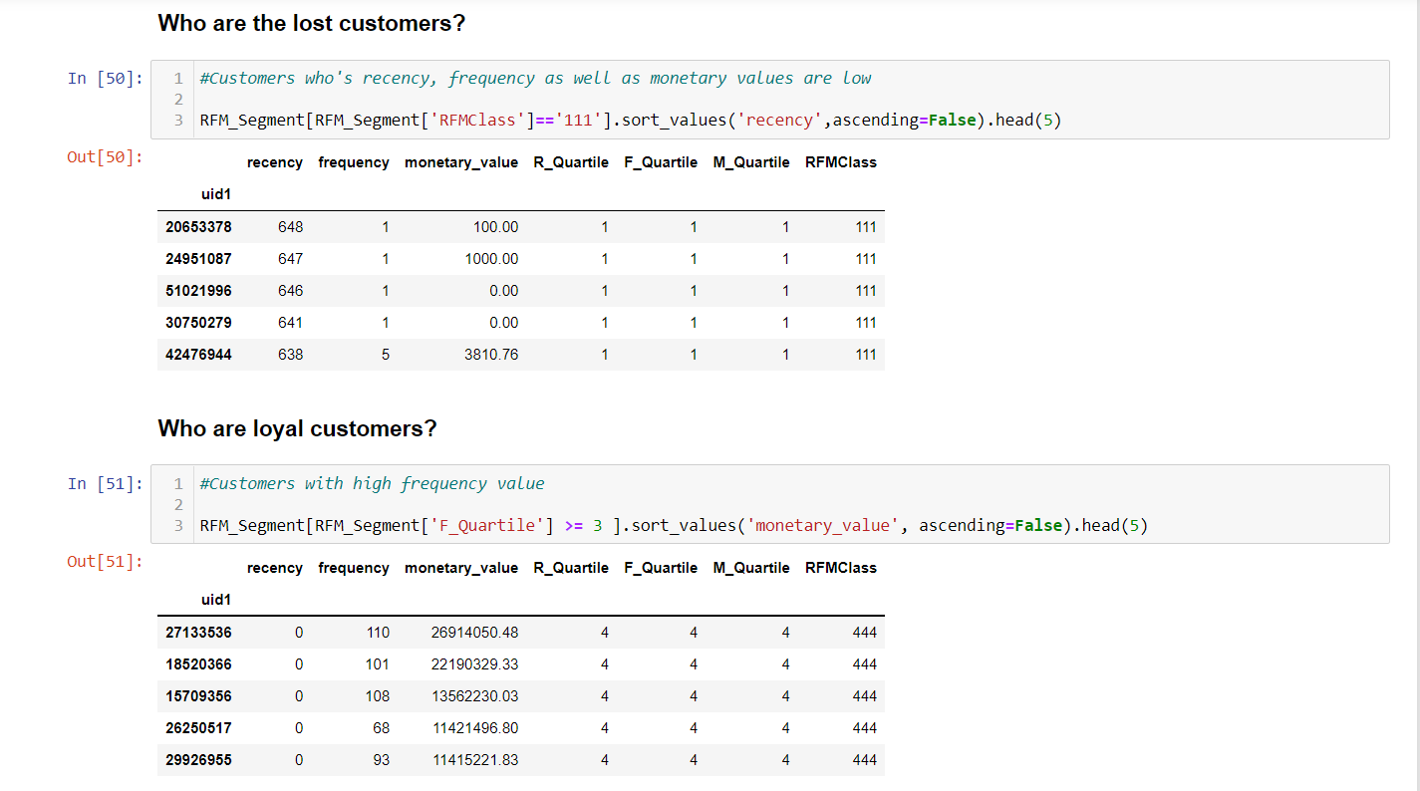
RFM Analysis: Questions could be answered

Slide 12
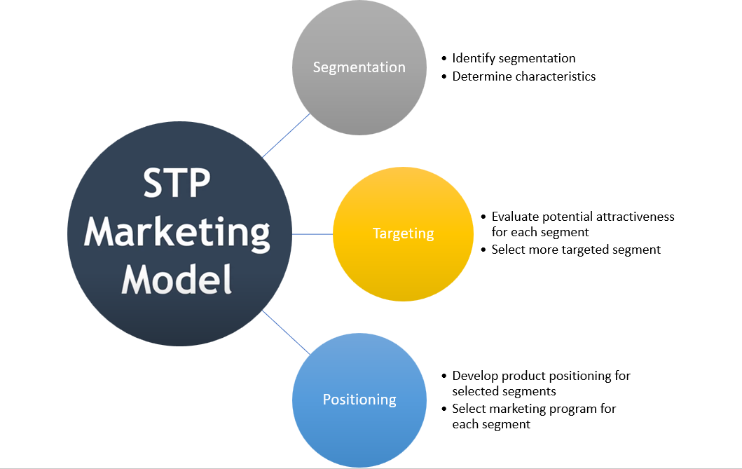
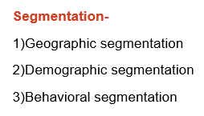
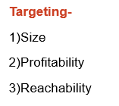
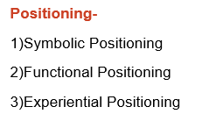
Marketing Strategy

Slide 13
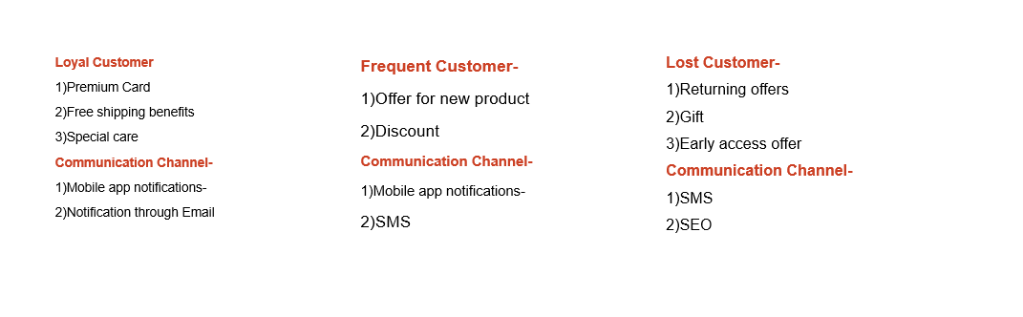
Key Learning

Slide 14
Thank you for your Attention!!

