Slide 1
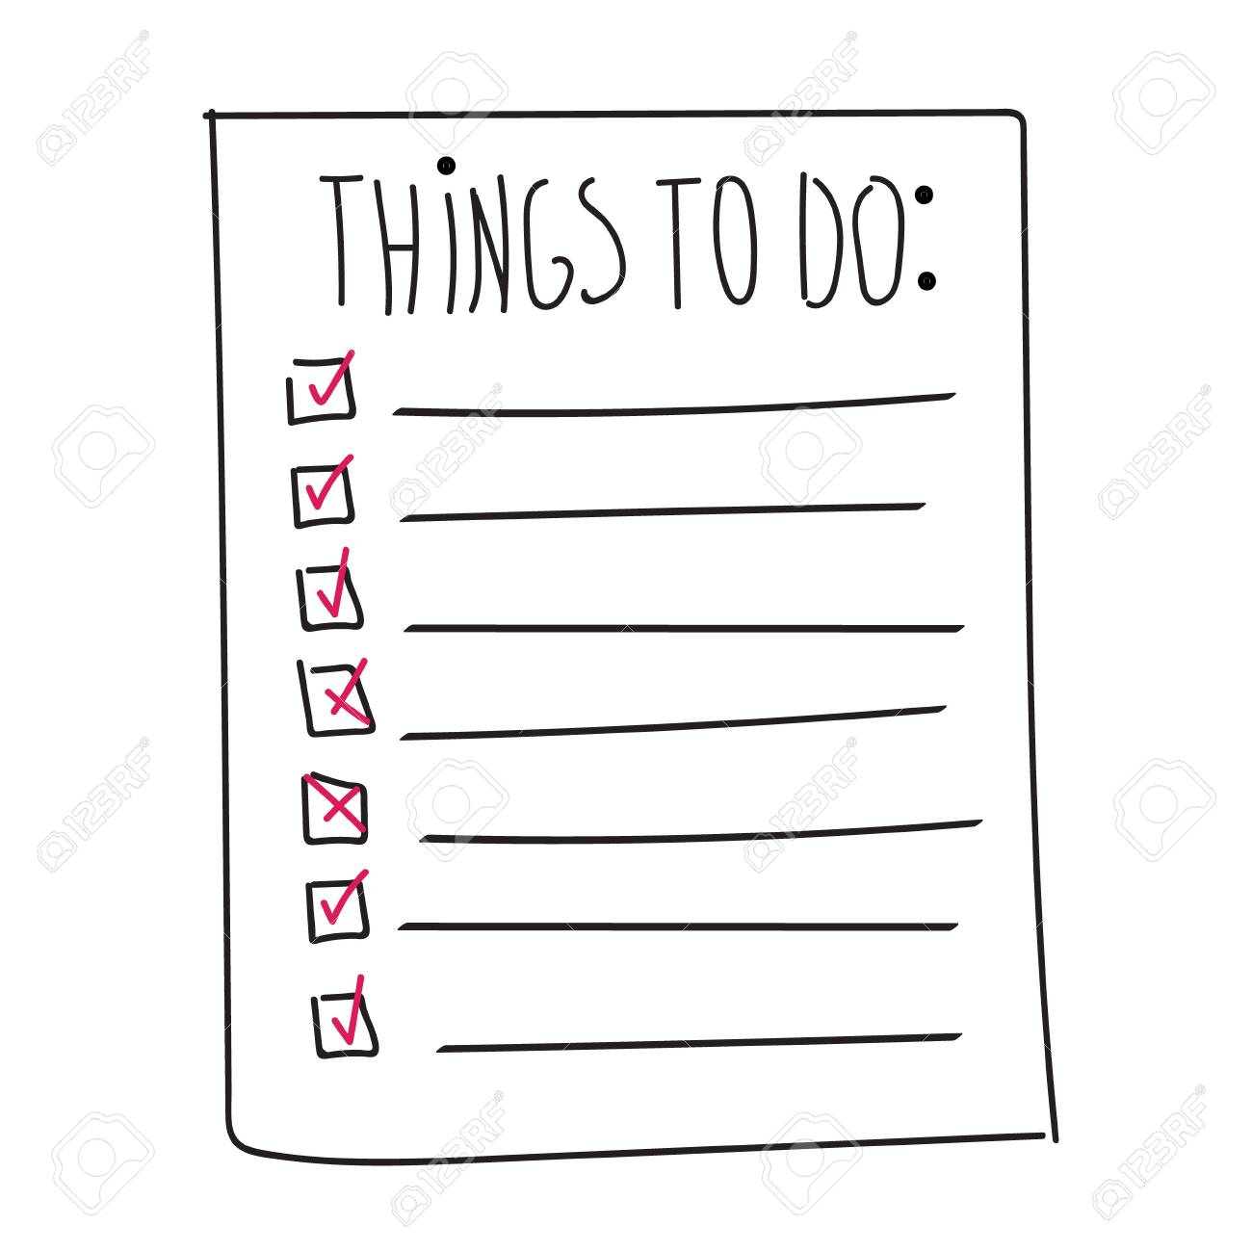

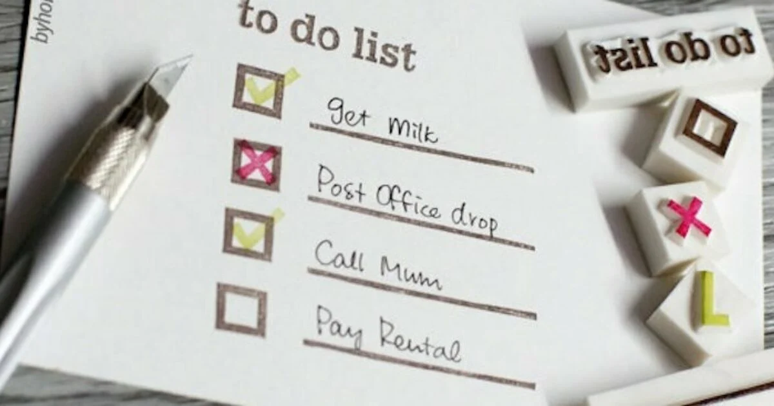
Done By:
A.Karthicraja
P.Vigneshwaran
R.Ajay

Slide 2
What is a ToDo List?
Simple tool to organise everything
It’s a list of tasks you need to complete, or things that you want to do.
Most typically, they’re organized in order of priority. Traditionally, they’re written on a piece of paper. As technology has evolved we have been able to create a todo lists with excel spreadsheets, word documents, email lists, todo list apps, microsoft to do and google to do list to name a few. You can use a to do list in your home and personal life, or in the workplace.

Slide 3
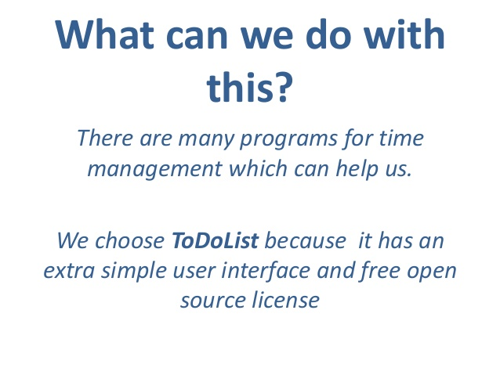

Slide 4
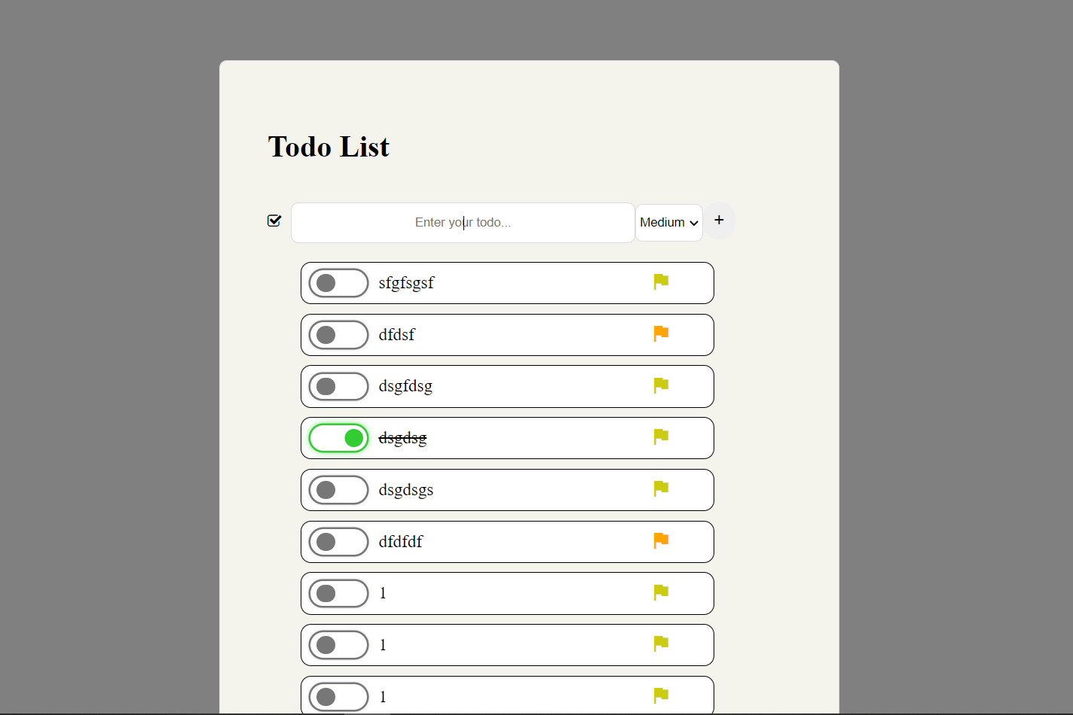
The Major tasks
Add tasks
Update tasks
Read tasks
Delete tasks
5. Prioritize tasks
6.Completed Status tasks
7.Mutiple Tasks Delete

Slide 5
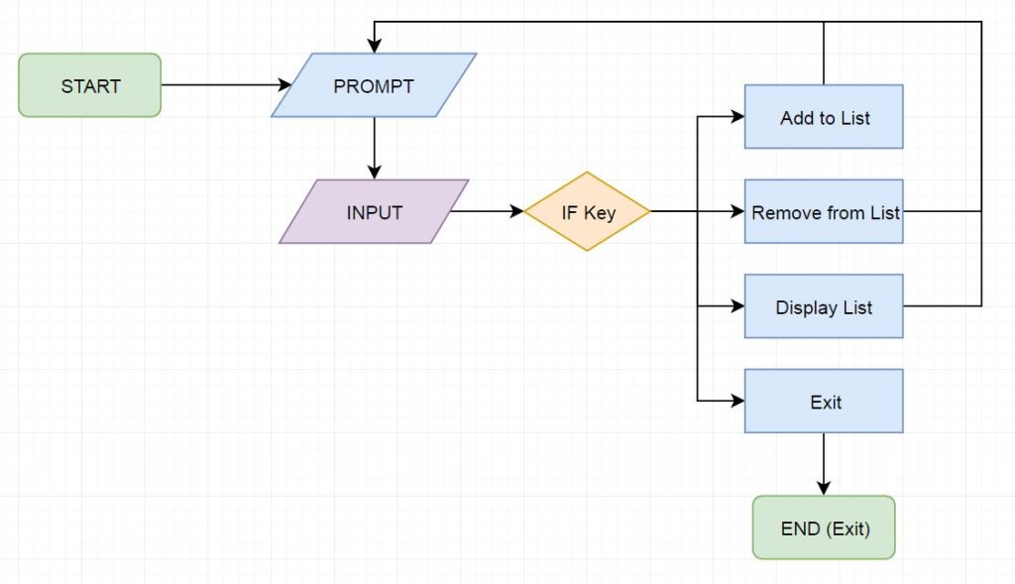
Flow Chart

Slide 6
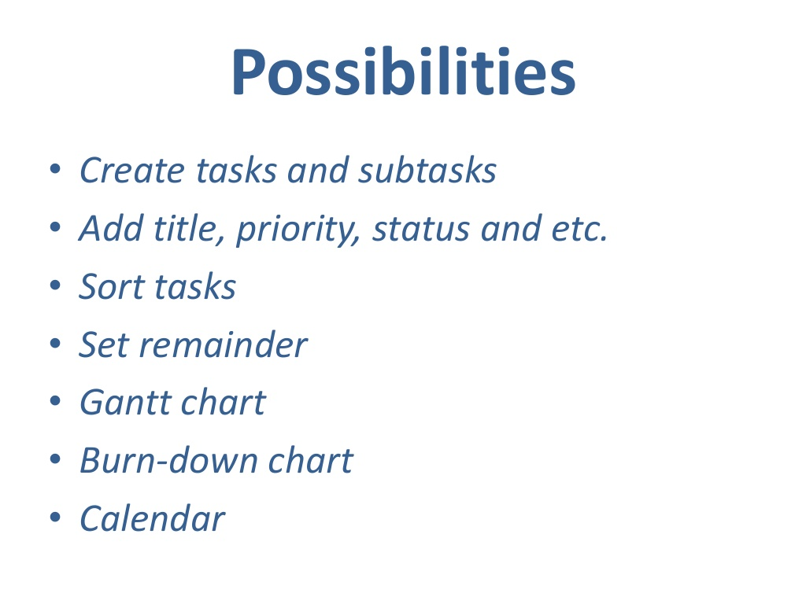

Slide 7
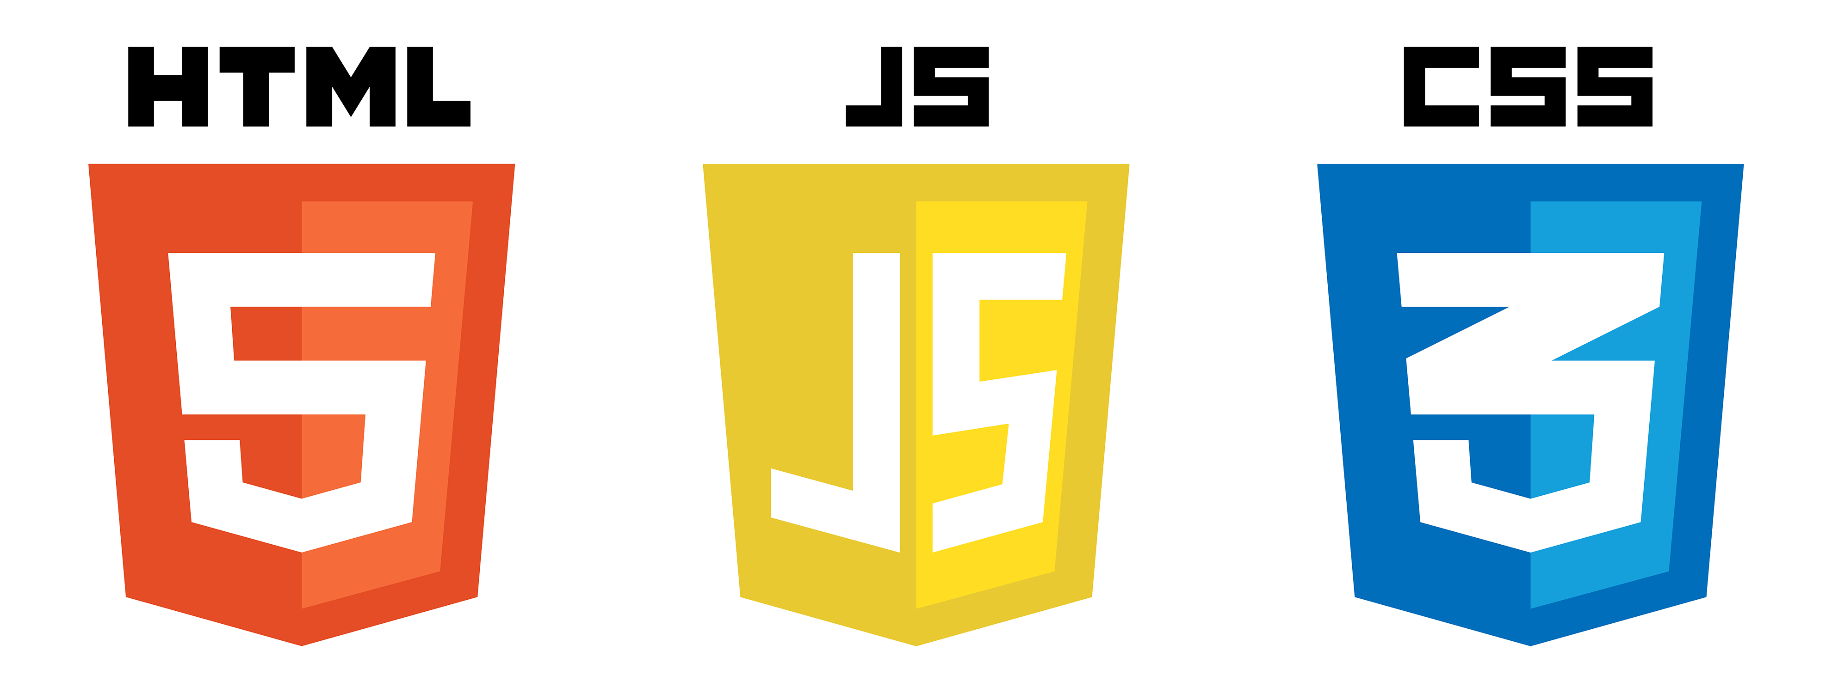
Languages
With MVC Architecture

Slide 8
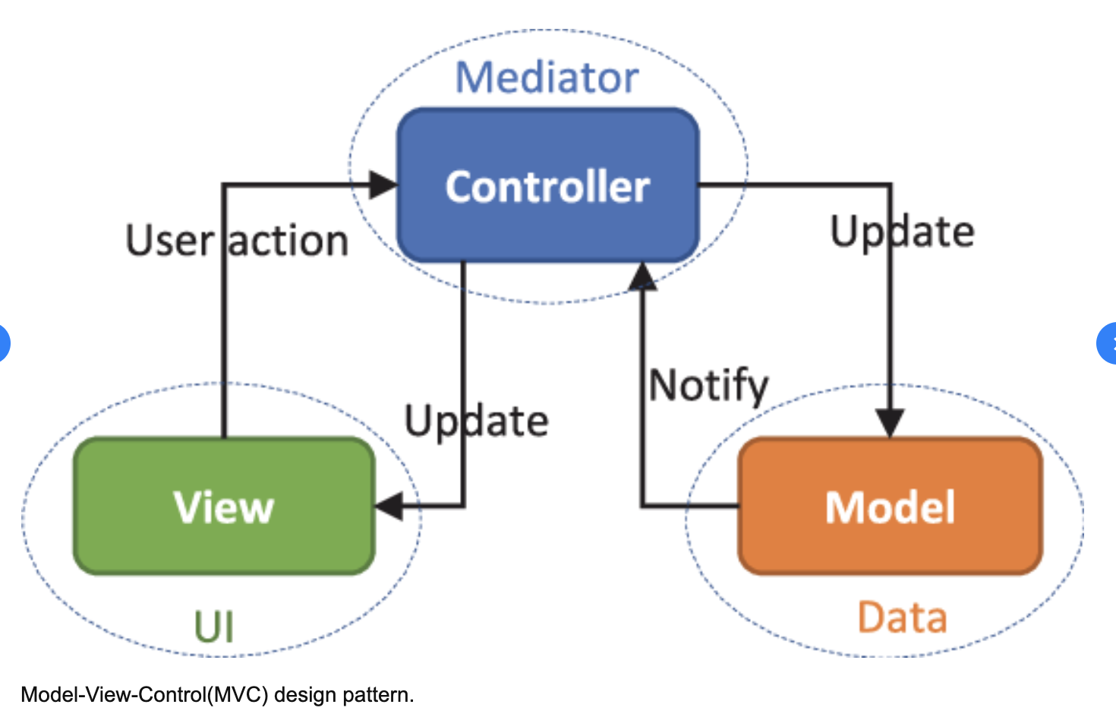
What is MVC?

