Slide 1


Chromosome 9 Variant Annotation Profiles Across Public Acute Leukemia Sequencing Datasets
Progress Ajayi¹, Aanuoluwa Temitayo Iyiola², Mehwish Fatima³,
Samson Oluwasefunmi Ejigbo⁴, Lilian Chinonso Okoro⁵, Oluomachi Nancy Uchenna⁶,
Enoch Oluwaseun Aderemi⁷, Angella Namuyanja⁸, Blessing Opeyemi Afolabi⁹
¹ Biological Sciences, Lead City University, Ibadan
² Federal University of Technology, Minna
³ Muhammad Ali Jinnah University, Pakistan
⁴ Adekunle Ajasin University, Akungba-Akoko
⁵ Laboratory Services, Iwosan Lagoon Hospitals, Lagos, Nigeria
⁶ Biochemistry, Michael Okpara University of Agriculture, Umudike, Abia State, Nigeria
⁷ Federal University, Oye-Ekiti
⁸ MRC/UVRI and LSHTM Uganda Research Unit, Entebbe, Uganda
⁹ Genomac Labs, Institute of Biochemistry, Molecular Biology and Biotechnology
Corresponding author: Blessing Opeyemi Afolabi
5th International Conference, Faculty of Natural and Applied Sciences (FASCON 2026)
Notes:
Source: Progress Ajayi Manuscript(1).docx. Title page and author affiliations.
Principal message: Descriptive chromosome 9 comparison across public sequencing runs.
Author affiliations are abbreviated for the oral presentation. Full names and affiliations follow the manuscript. The corresponding-author email is not supplied.

Slide 2
Background and Objective
Why chromosome 9?
Chromosome 9 contains leukemia-associated loci, including PAX5. Gene assignments require allele and transcript context before biological interpretation.
Study objective
Compare gene assignments, predicted coding effects, annotation-set overlap and run-level similarity across six public AML- or ALL-associated sequencing runs.
Interpret shared and group-restricted profiles alongside biological provenance and chromosome coverage.
AML: acute myeloid leukemia. ALL: acute lymphoblastic leukemia.
Context: Lysenkova Wiklander et al. (2023, 2024).
5th International Conference, Faculty of Natural and Applied Sciences (FASCON 2026)
Notes:
Source: Progress Ajayi Manuscript(1).docx. Introduction; Background and Literature Review.
Principal message: Interpret chromosome 9 annotation differences in their sequencing context.

Slide 3
Sequencing Datasets
Run | Accession | Biological material | Platform
ALL-1 | SRR22444744 | REH | PromethION
ALL-2 | SRR22805329 | REH | PacBio Sequel II
ALL-3 | SRR23704824 | REH | Illumina HiSeq X
AML-1 | SRR1207242 | ML-2 | Illumina HiSeq 2000
AML-2 | SRR24350313 | HL-60 apoptotic DNA fragments | Illumina NovaSeq 6000
AML-3 | SRR13483248 | AML-associated bone-marrow DNA | Illumina HiSeq 2000
The three ALL runs share BioSample SAMN13831871. They are repeated measurements of one biological source.
Analytical unit: sequencing run. This is a descriptive comparison, with no patient-level prevalence estimate.
5th International Conference, Faculty of Natural and Applied Sciences (FASCON 2026)
Notes:
Source: Progress Ajayi Manuscript(1).docx. Methods §3.1.1; Table 1; Results §3.2.1.
Principal message: Six runs represent four BioSamples; all ALL runs measure one REH source.
The three ALL runs share SAMN13831871. AML-1: SAMN02709918; AML-2: SAMN34434777; AML-3: SAMN17383328. ML-2 originates from a control/decitabine comparison, HL-60 from an apoptotic fragmentomics library and AML-3 from sparse sequencing for copy-number quantification.

Slide 4
Methods and Reference Coverage
Sequence processing and annotation
Quality assessment and trimming, assembly and assembly checks.
Geneious alignment to GRCh38.p14 chromosome 9 (NC_000009.12), followed by reference annotation transfer.
Descriptive summaries and hierarchical clustering using correlation distance and average linkage.
ALL-1 reference coverage: 0.8%
Pairwise identity was 91.4% and maximum coverage was 3. High identity within aligned sequences does not establish adequate chromosome representation.
5th International Conference, Faculty of Natural and Applied Sciences (FASCON 2026)
Notes:
Source: Progress Ajayi Manuscript(1).docx. Methods §§3.1.2–3.1.4; Results §3.2.1.
Principal message: Chromosome coverage limits interpretation of annotation profiles.
Manuscript methods: FastQC; Trimmomatic, Q30 and minimum length 50 bp; SPAdes, retained contigs at least 500 bp; QUAST; Geneious Mapper at medium sensitivity. Geneious approximate minimum variant frequency 0.6, variant P<0.001, strand-bias P threshold 10^-6; strand bias above 65% flagged. These are calling/filtering thresholds, not tests of AML/ALL differences. ALL-1: 328,321 reads, 326 assigned to assembled component, 327,995 unassembled. Clustering uses correlation distance and average linkage.

Slide 5
Annotation Counts and Gene Assignments
Annotation-record summary | ALL-associated | AML-associated
Number of sequencing runs | 3 | 3
Run-level count range | 4–4,943 | 25–8,117
Median count | 92 | 1,822
AML-associated counts were higher and more dispersed, while the ranges overlapped. No between-group significance test was performed.
PAX5-associated records occurred in both groups. NUP214 appeared in the ALL summary and NOTCH1 in the AML summary.
These are annotation records and gene assignments. They do not establish independent somatic mutations, pathogenicity or fusions.
5th International Conference, Faculty of Natural and Applied Sciences (FASCON 2026)
Notes:
Source: Progress Ajayi Manuscript(1).docx. Results §3.2.2; Figures 1–2; Table 2.
Principal message: AML-associated counts are higher and more dispersed, with overlapping ranges.

Slide 6
Predicted Coding-Annotation Patterns
Feature | ALL-associated | AML-associated
Predominant protein effect | Substitution | Substitution
Truncation representation | More prominent | Less prominent
Leading amino-acid change | Proline-to-leucine | Glycine-to-arginine
Leading codon-number label | 151 | 539
Leading coding-position label | 1074 | 1327
Proline-to-leucine, glutamate-to-lysine, alanine-to-valine and alanine-to-threonine appeared in both top-ten amino-acid-change lists.
Coding-position labels are pooled across coding sequences. They are not chromosome coordinates or demonstrated mutation hotspots.
5th International Conference, Faculty of Natural and Applied Sciences (FASCON 2026)
Notes:
Source: Progress Ajayi Manuscript(1).docx. Results §§3.2.3–3.2.4; Figures 3–4; Table 2.
Principal message: Coding summaries differ, but pooled categories do not identify recurrent alleles.
Table is a qualitative synthesis of the manuscript, not a reconstruction of numerical protein-effect proportions. Codon and coding-position labels are pooled across coding sequences.

Slide 7
Shared and Group-Restricted Annotation Sets
Set type | AML-only | Shared | ALL-only
Gene labels | 196 | 15 | 41
Variant annotation records | 742 | 4 | 551
Shared entries were few in both comparisons. These counts describe the annotation sets recovered from the included runs.
Group-restricted membership can reflect coverage or assay differences. It does not establish leukemia-specific mutations or biological absence.
5th International Conference, Faculty of Natural and Applied Sciences (FASCON 2026)
Notes:
Source: Progress Ajayi Manuscript(1).docx. Results §3.2.5; Figure 5.
Principal message: Recovered sets contain more group-restricted entries than shared entries.

Slide 8
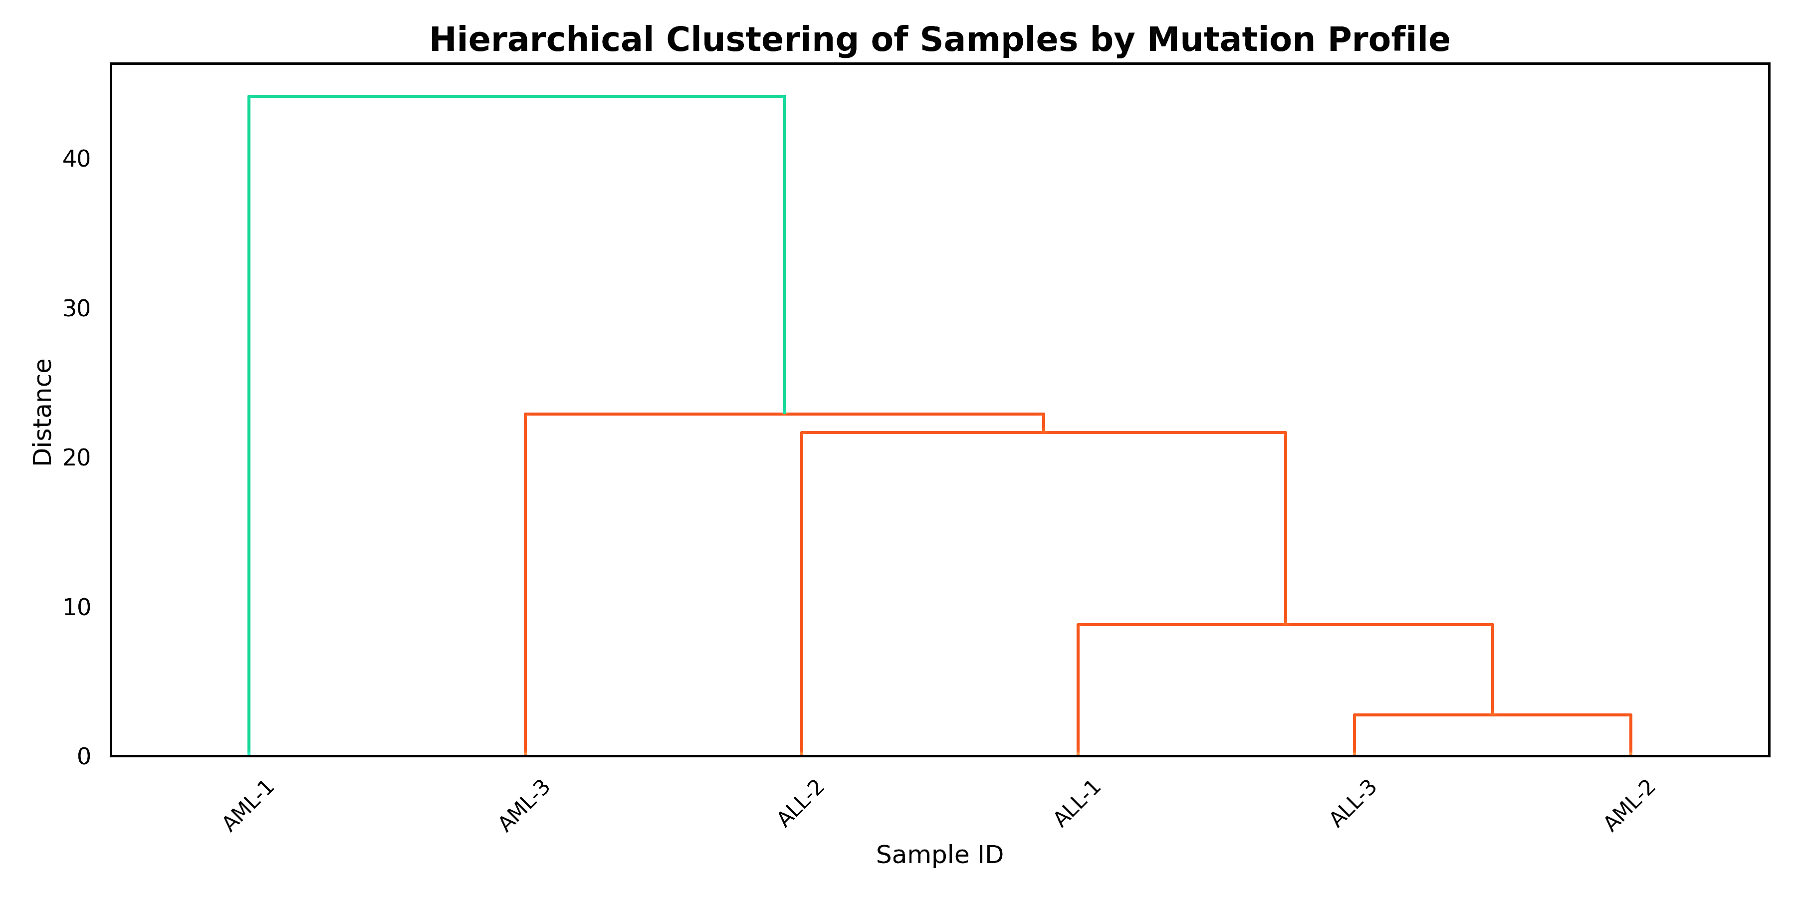
Similarity Among Run-Level Profiles
ALL-3 and AML-2 formed the closest pair. ALL-1, ALL-2 and AML-3 joined successively, with AML-1 last.
Mixed clustering does not show that AML and ALL are genomically indistinguishable. Branch height is a distance, not statistical support.
5th International Conference, Faculty of Natural and Applied Sciences (FASCON 2026)
Notes:
Source: Progress Ajayi Manuscript(1).docx. Results §3.2.6; original manuscript Figure 6; corroborated by Figure 7.
Principal message: Leukemia labels intermix in clustering, with ALL-3 and AML-2 closest.
Original Figure 6 embedded without changes to pixels. Its legacy title uses mutation profiles; the manuscript defines the analyzed entries as annotation records, not validated somatic mutations. Distances represent clustering geometry rather than statistical support. Original raster labels have no measurable PowerPoint font size. Figure 7 corroborates the ALL-3/AML-2 pair.

Slide 9
Conclusion, Limitations and Recommendations
Conclusion
Chromosome 9 profiles varied across the six runs. Annotation-set overlap was limited, while clustering intermixed leukemia labels.
Interpretation limits
Small collection, one shared ALL source, heterogeneous assays and sparse ALL-1 coverage. No matched normal comparison, functional validation or clinical outcomes.
Next steps
Use independent biological samples, suitable platform-specific processing, justified callable regions and allele-level validation before evaluating candidate biomarkers.
Contribution: a descriptive chromosome-focused comparison of publicly identifiable sequencing inputs.
5th International Conference, Faculty of Natural and Applied Sciences (FASCON 2026)
Notes:
Source: Progress Ajayi Manuscript(1).docx. Discussion; Conclusion.
Principal message: Descriptive annotation differences need controlled biological validation.

Slide 10
Major References
Lysenkova Wiklander, M., et al. (2023). Genomic, transcriptomic and epigenomic sequencing data of the B-cell leukemia cell line REH. BMC Research Notes, 16, 265. https://doi.org/10.1186/s13104-023-06537-2
Lysenkova Wiklander, M., et al. (2024). A multiomic characterization of the leukemia cell line REH using short- and long-read sequencing. Life Science Alliance, 7, e202302481. https://doi.org/10.26508/lsa.202302481
Chen, Y. A., et al. (2025). Toward streamline variant classification: Discrepancies in variant nomenclature and syntax for ClinVar pathogenic variants across annotation tools. Human Genomics, 19, 70. https://doi.org/10.1186/s40246-025-00778-x
Zhu, D., et al. (2023). Circulating cell-free DNA fragmentation is a stepwise and conserved process linked to apoptosis. BMC Biology, 21, 253. https://doi.org/10.1186/s12915-023-01752-6
5th International Conference, Faculty of Natural and Applied Sciences (FASCON 2026)
Notes:
Source: Progress Ajayi Manuscript(1).docx. Selected entries copied from manuscript References.
Principal message: Selected provenance, annotation and chromosome 9 literature.
Selected references are reproduced from the supplied manuscript, without an independent bibliographic audit. Full author lists remain in the manuscript.

