Slide 1
Biology Lab 1107: Meiosis and sexual life cycle
Instructor: Mrs. Oyawale
BIO 1107 | Principles of Biology 1

Slide 2
Meiosis and sexual life cycle:
Class 1

Slide 3
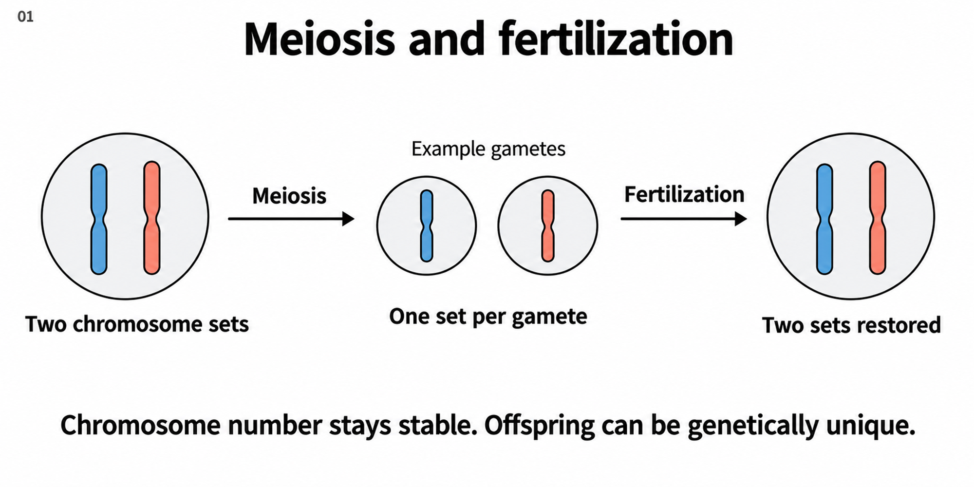
Meiosis and fertilization together maintain chromosome-set balance
Meiosis and fertilization together maintain chromosome-set balance.
Meiosis halves the chromosome sets in gametes. Fertilization brings two sets together again, maintaining chromosome number while allowing genetic variety.

Slide 4
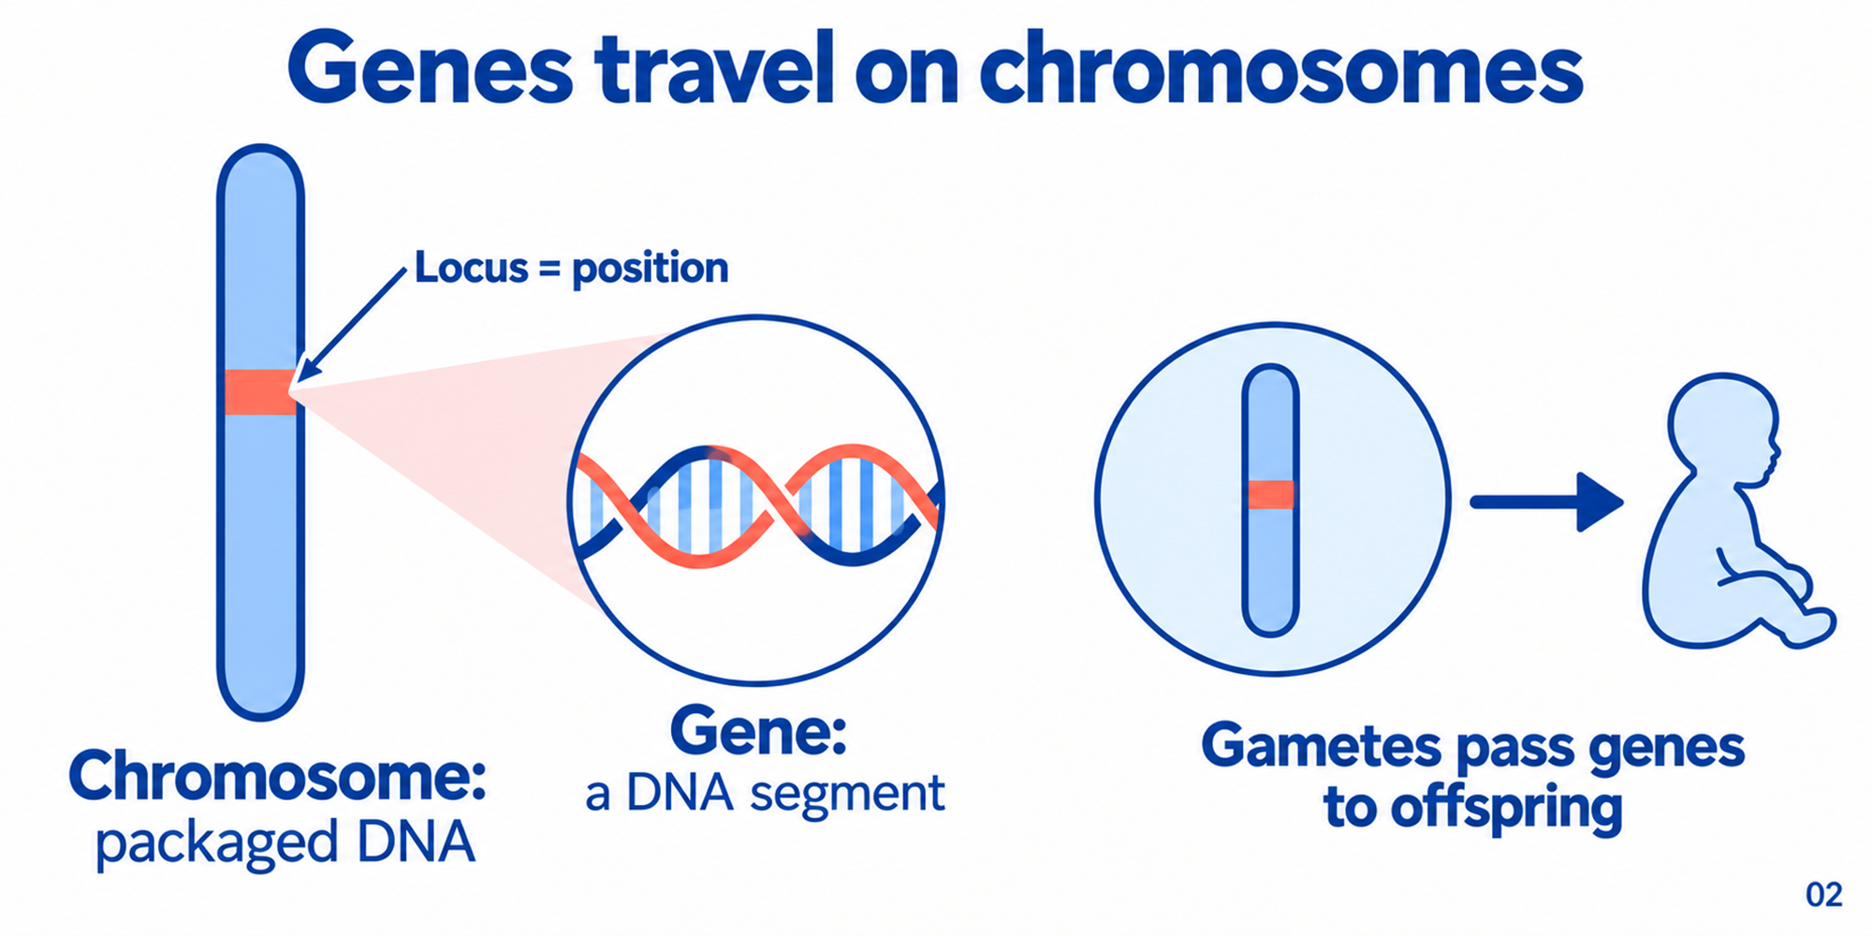
Chromosomes carry genes at defined positions called loci
Chromosomes carry genes at defined positions called loci.
Genes are DNA segments carried on chromosomes. Their location is called a locus, and gametes pass this genetic information to offspring.

Slide 5
Thought Questions
Q1: What term is given to the specific, defined position that a gene occupies on a chromosome?
Locus
Centriole
Nucleolus
Ribosome

Slide 6
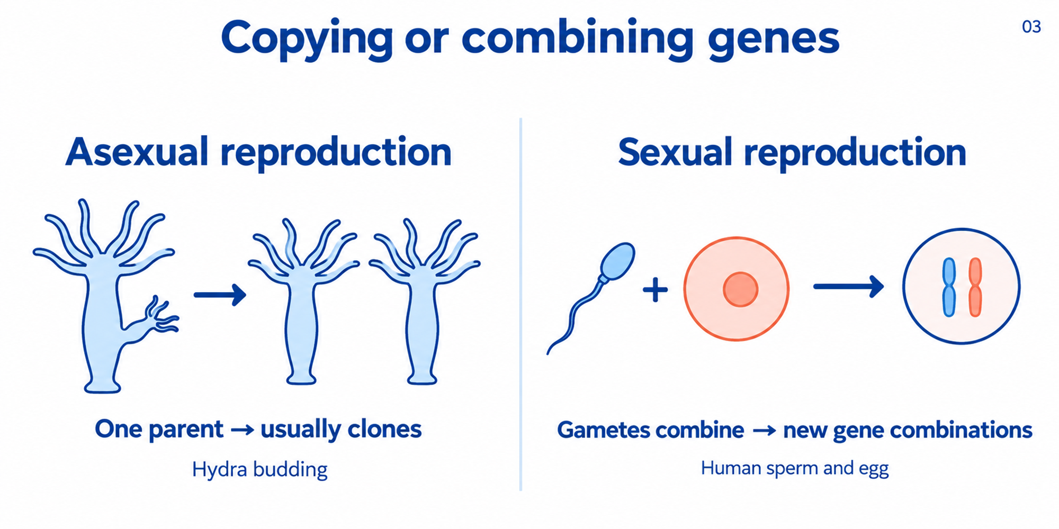
Sexual reproduction recombines genetic information from gametes
Sexual reproduction recombines genetic information from gametes.
Asexual reproduction usually produces clones from one parent. Sexual reproduction combines gametes, producing new combinations of inherited genes.

Slide 7
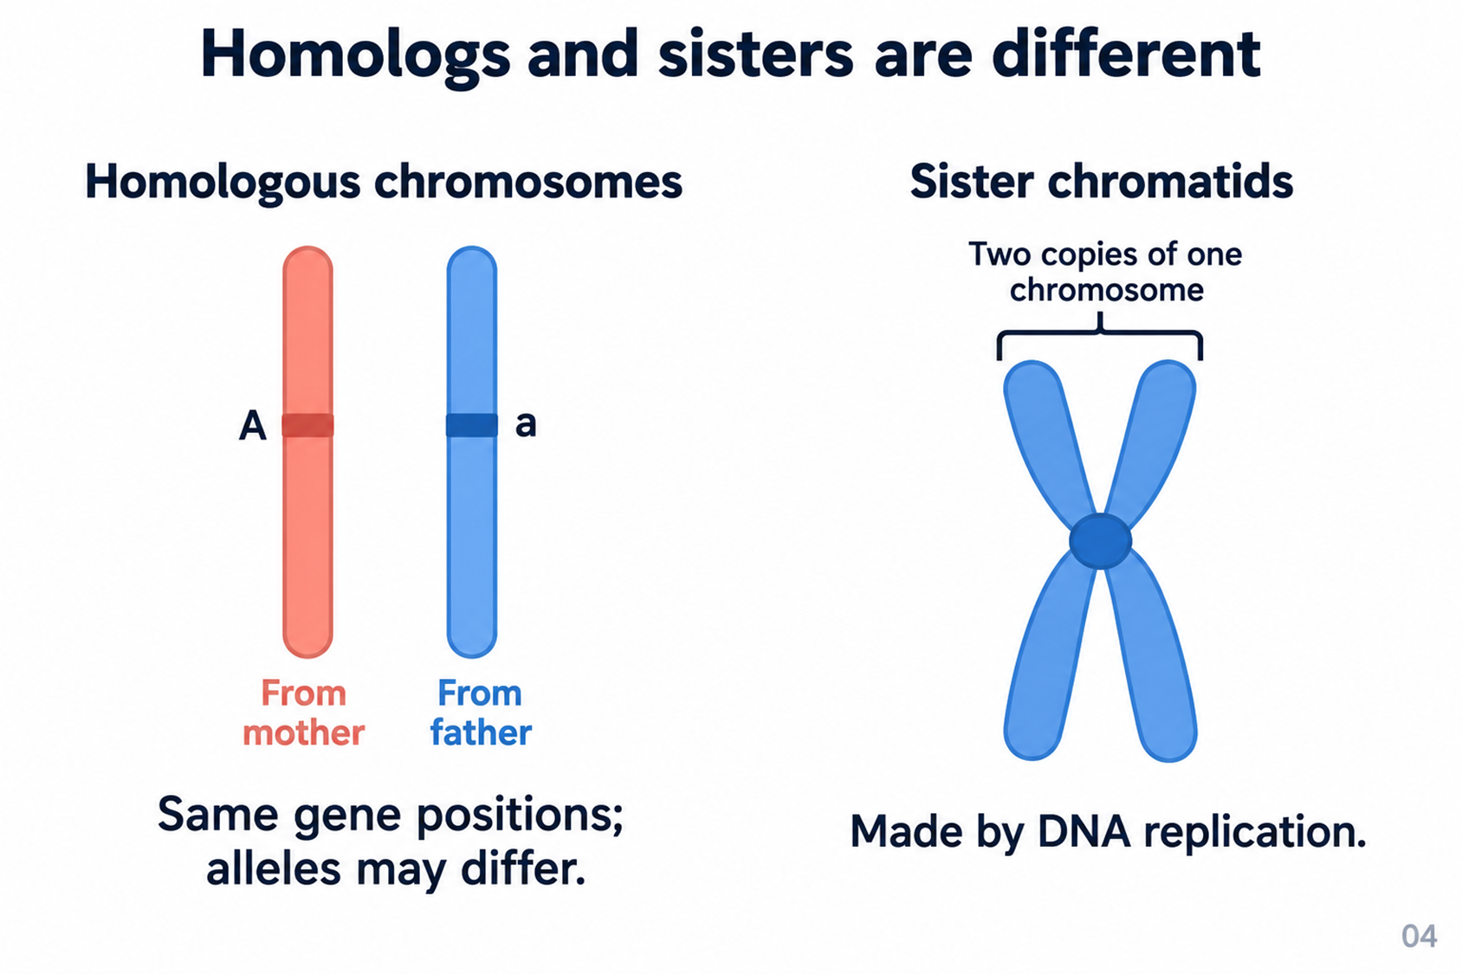
Homologs are parental counterparts; sisters are replication copies
Homologs are parental counterparts; sisters are replication copies.
Homologs come from different parents and carry corresponding gene positions. Sister chromatids are the replicated copies of one chromosome.

Slide 8
Thought Questions
Q2: Where do the two members of a pair of homologous chromosomes typically originate from in a diploid organism?
Both chromosomes come from the mother during gamete formation
One chromosome comes from the mother and the other from the father
Both chromosomes are synthesized via independent DNA replication in the zygote
One chromosome is inherited entirely from asexual budding while the other is lost

Slide 9
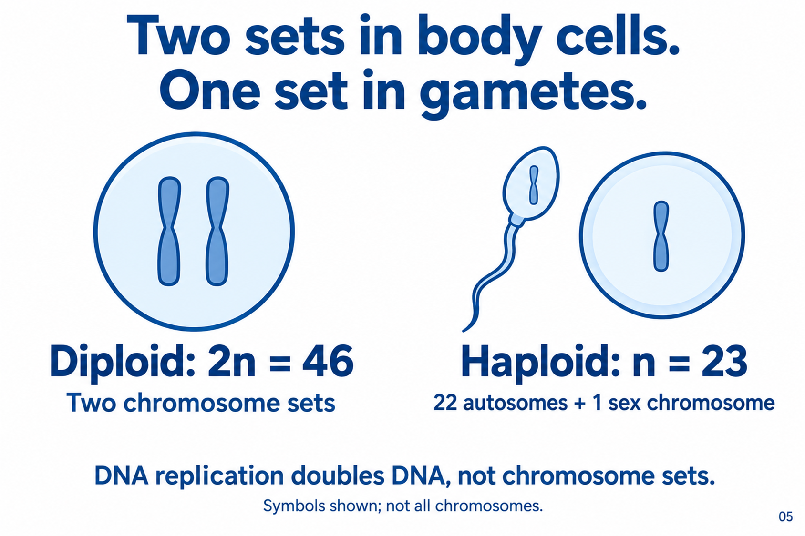
Diploid and haploid describe chromosome sets, not DNA quantity
Diploid and haploid describe chromosome sets, not DNA quantity.
Typical human body cells have 46 chromosomes in two sets. Gametes have 23 in one set, and DNA replication does not change set number.

Slide 10
Thought Questions
Q3: A standard human sperm cell contains (n = 23) chromosomes. How are these 23 chromosomes specifically categorized?
22 autosomes and 1 sex chromosome
23 autosomes and 0 sex chromosomes
21 autosomes and 2 sex chromosomes
44 autosomes and 2 sex chromosomes

Slide 11
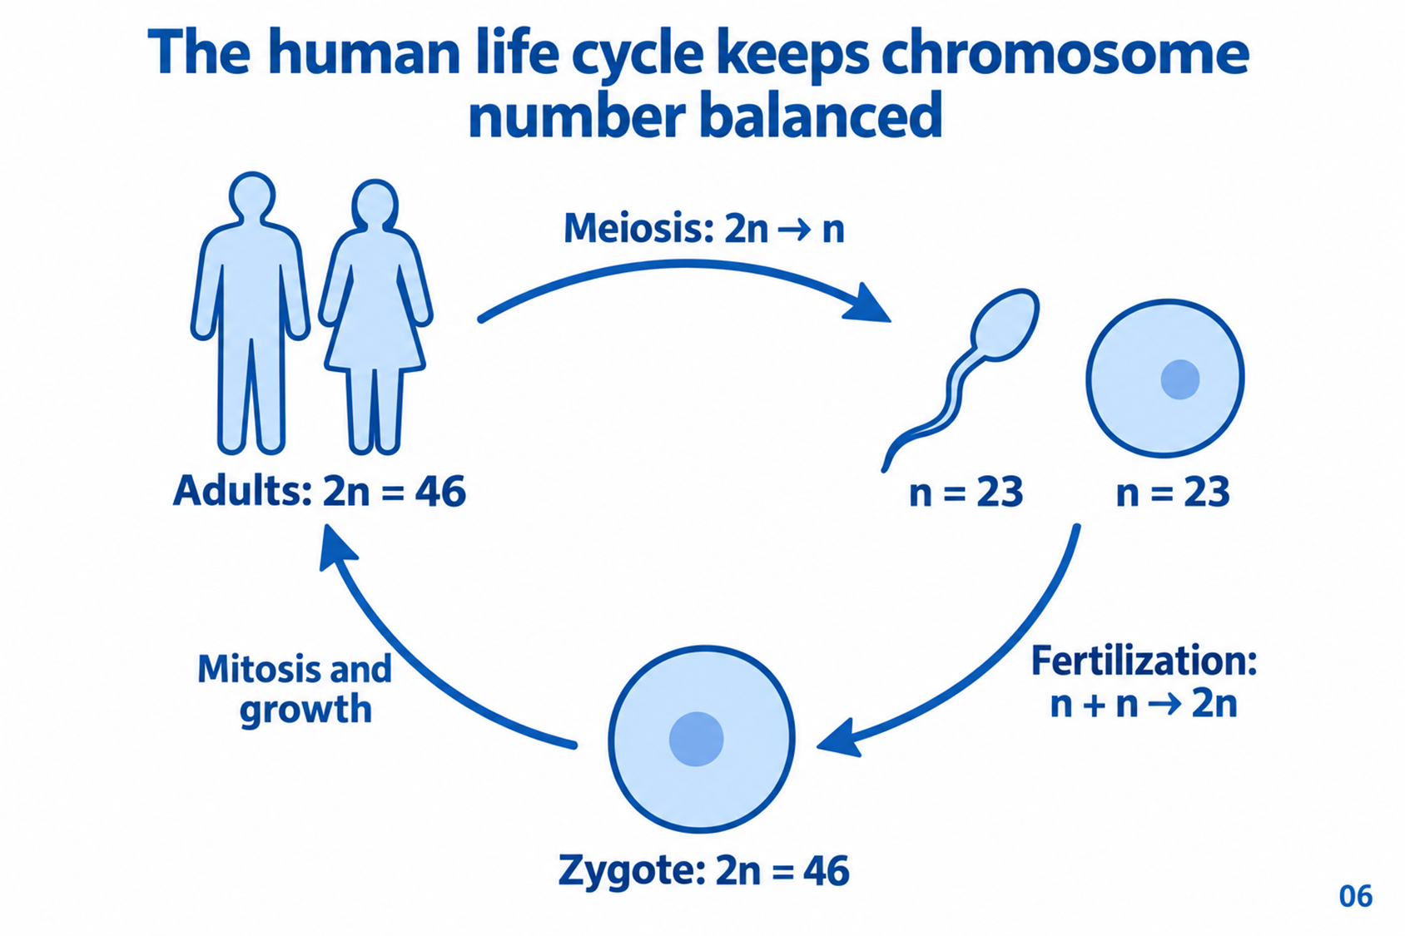
Meiosis reduces sets, fertilization restores them, and mitosis supports growth
Meiosis reduces sets, fertilization restores them, and mitosis supports growth.
The human cycle alternates diploid adults and haploid gametes. Fertilization restores diploidy, and mitosis supports growth without changing chromosome-set number.

Slide 12
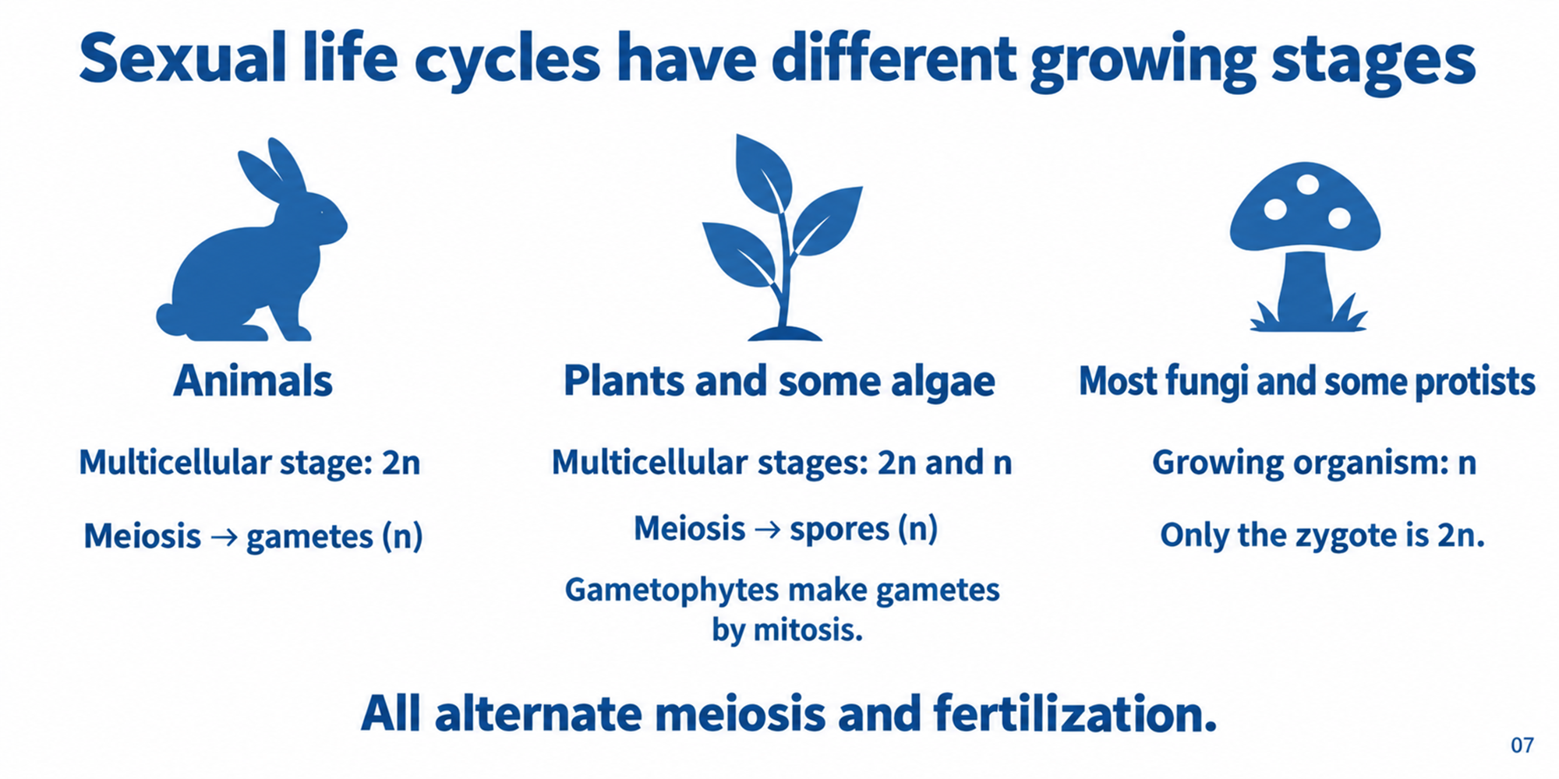
The growing stage differs across sexual life-cycle patterns
The growing stage differs across sexual life-cycle patterns.
Sexual life cycles differ in which stages grow as multicellular organisms. Plants include haploid and diploid generations, while the animal example emphasizes diploid adults.

Slide 13
Thought Questions
Q4: In animals, what is the ploidy level of the multicellular adult stage, and what type of reproductive cells are produced directly by meiosis?
Haploid (n); spores
Diploid (2n); spores (n)
Diploid (2n); gametes (n)
Haploid (n); zygotes (2n)

Slide 14
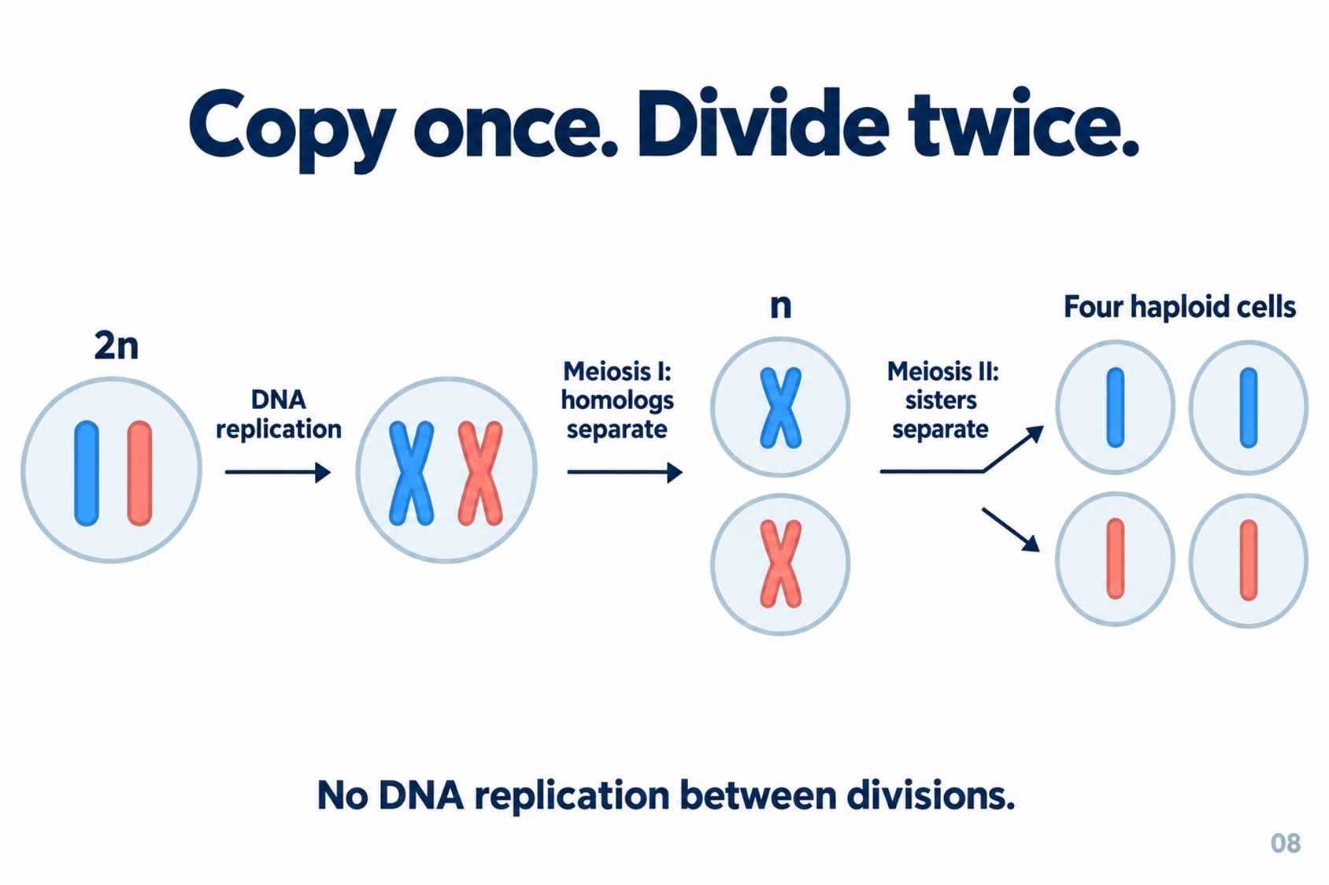
One replication supports two successive meiotic divisions
One replication supports two successive meiotic divisions.
Meiosis copies DNA once and divides twice. Homologs separate first, sisters separate second, producing four haploid cells in the general sequence.

Slide 15
Thought Questions
Q5: How many rounds of DNA replication occur in support of the two successive divisions of meiosis?
Two rounds, to prepare for both divisions separately
Three rounds, matching the final number of cell stages
One round, which supports both Meiosis I and Meiosis II
Zero rounds, as meiosis only involves division without replication

