Slide 1
Biology Lab 1107: Meiosis and sexual life cycle
Instructor: Mrs. Oyawale
BIO 1107 | Principles of Biology 1

Slide 2
Meiosis and sexual life cycle:
Class 2

Slide 3
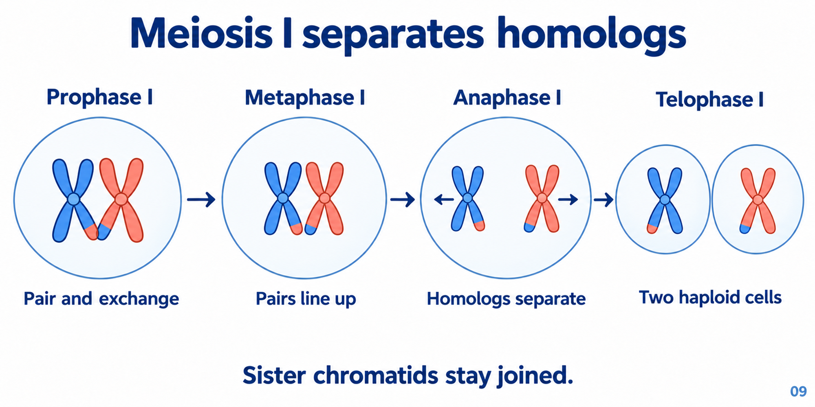
Meiosis I separates homologs while sisters remain joined
Meiosis I separates homologs while sisters remain joined.
During meiosis I, homologs pair, line up and separate. Each resulting cell is haploid, but its chromosomes still contain joined sister chromatids.

Slide 4
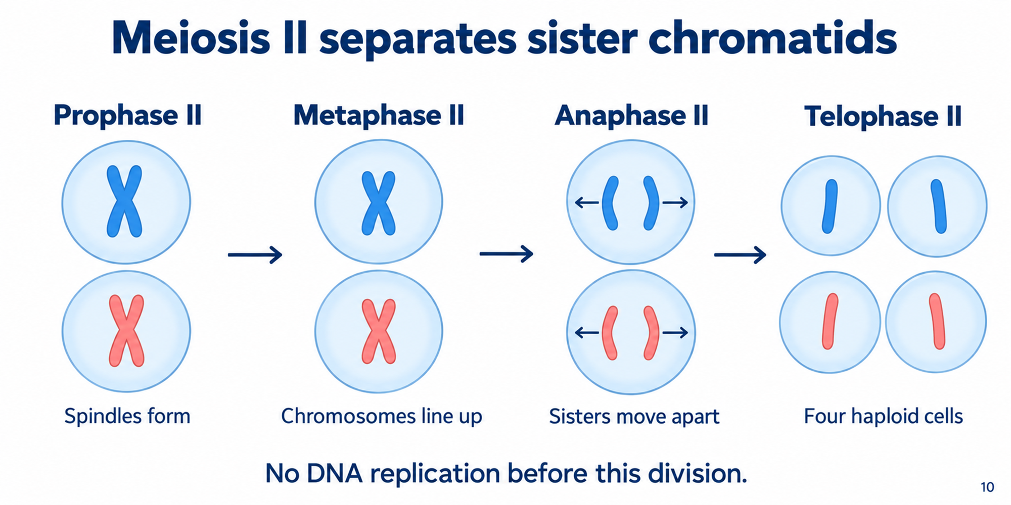
The second division separates sisters without another DNA replication
The second division separates sisters without another DNA replication.
Meiosis II separates the sister chromatids within each haploid cell. The general result is four haploid cells with unduplicated chromosomes.

Slide 5
Thought Questions
Q1: Does DNA replication occur immediately before Meiosis II begins?
Yes, complete DNA replication occurs to ensure all chromosomes are doubled
No, Meiosis II takes place without another round of DNA replication
Yes, but only for sex chromosomes
Only partial replication happens to reduce chromosome number

Slide 6
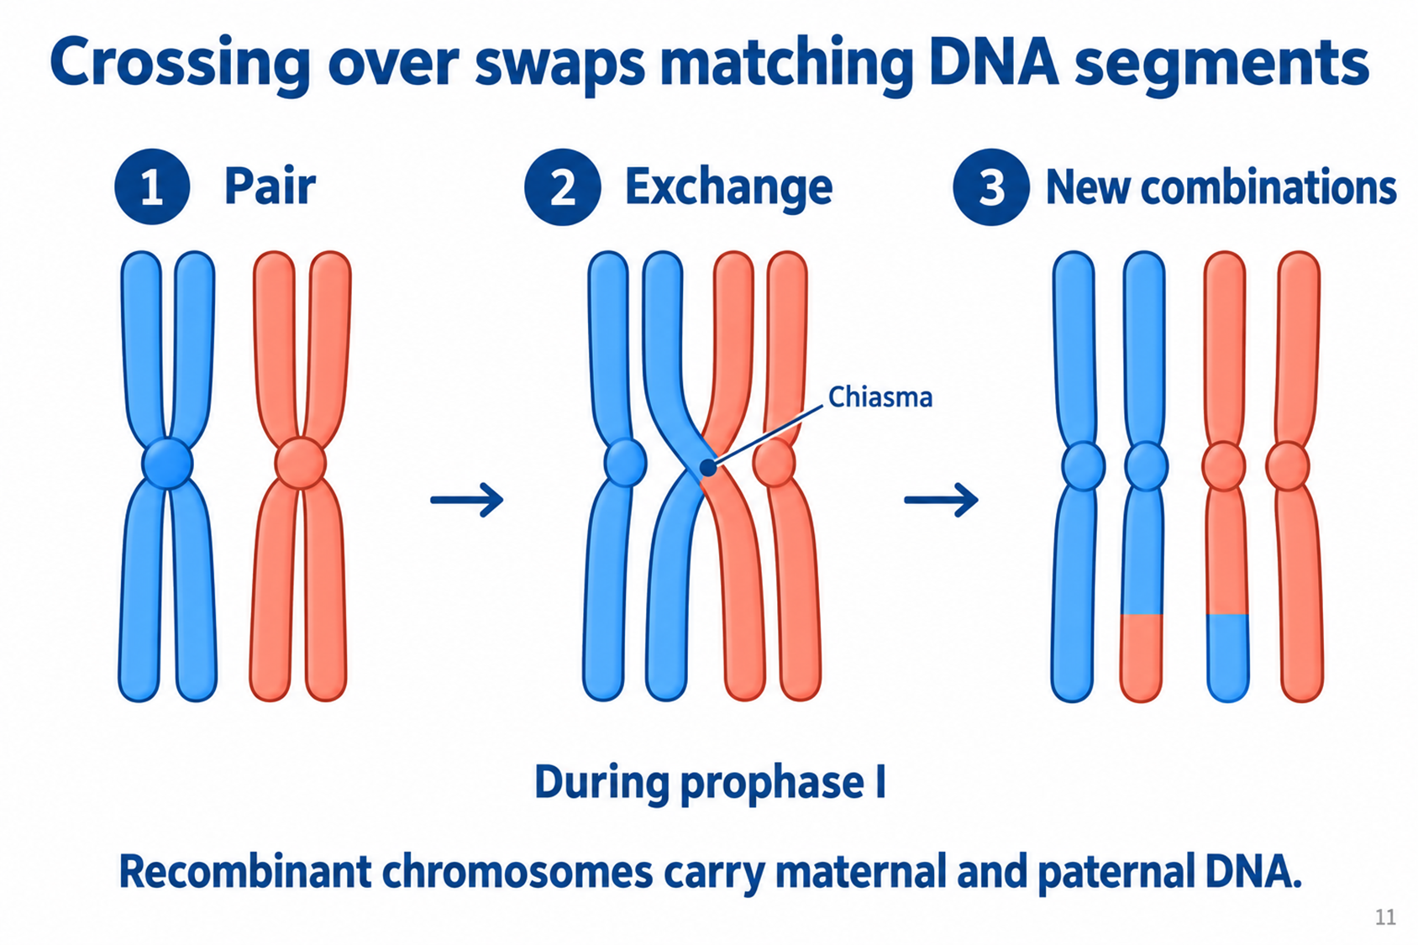
Crossing over rearranges alleles within chromosomes
Crossing over rearranges alleles within chromosomes.
Crossing over exchanges corresponding DNA between nonsister chromatids in prophase I. The recombinant products carry new combinations of maternal and paternal DNA.

Slide 7
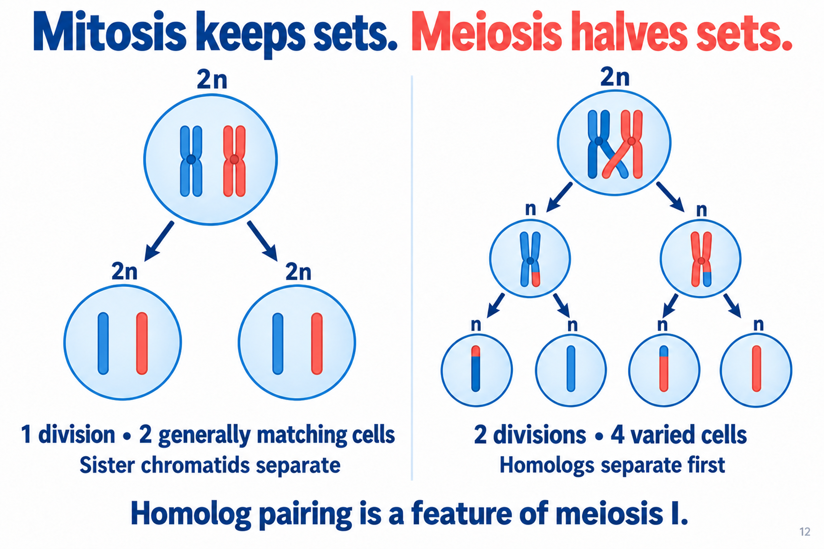
Mitosis preserves set number, while meiosis reduces it
Mitosis preserves set number, while meiosis reduces it.
Mitosis produces two generally matching cells while preserving chromosome sets. Meiosis uses two divisions to produce four haploid products with genetic variation.

Slide 8
Thought Questions
Q2: What happens to the chromosome set number in a cell undergoing mitosis compared to one undergoing meiosis?
Mitosis halves the chromosome set number, while meiosis preserves it
Mitosis preserves the chromosome set number (diploid to diploid), while meiosis halves it (diploid to haploid)
Both mitosis and meiosis halve the chromosome set number
Both mitosis and meiosis preserve the chromosome set number.

Slide 9
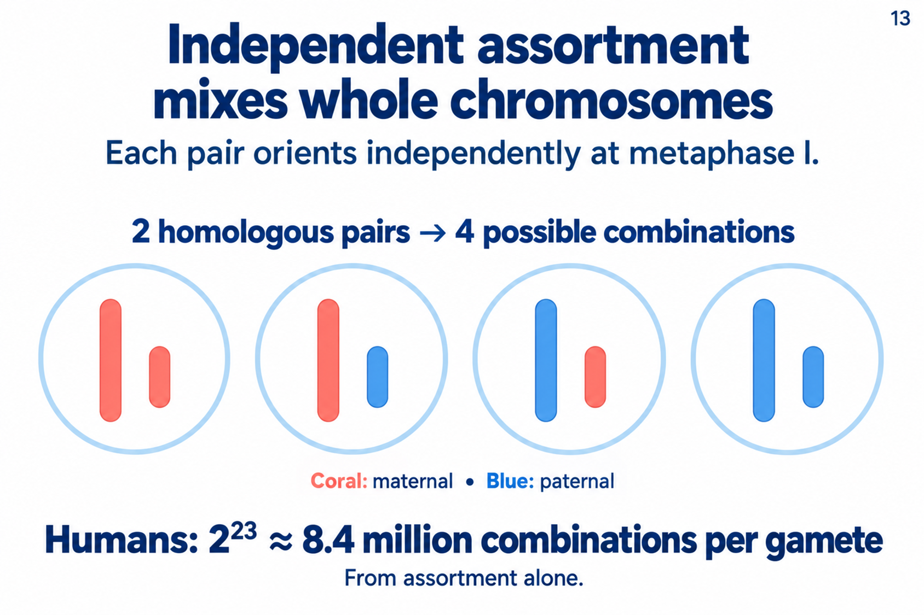
Independent assortment generates many combinations of whole chromosomes
Independent assortment generates many combinations of whole chromosomes.
Each homologous pair orients independently. Two pairs allow four possible combinations, and 23 human pairs allow about 8.4 million before counting crossing over.

Slide 10
Thought Questions
Q3: What primary outcome is generated by the independent assortment of whole chromosomes during meiosis?
The exact replication of maternal chromosomes only
The permanent fusion of homologous chromosome pairs
A large variety of distinct whole-chromosome combinations in gametes
A reduction in the total number of chromosomes in somatic cells

Slide 11
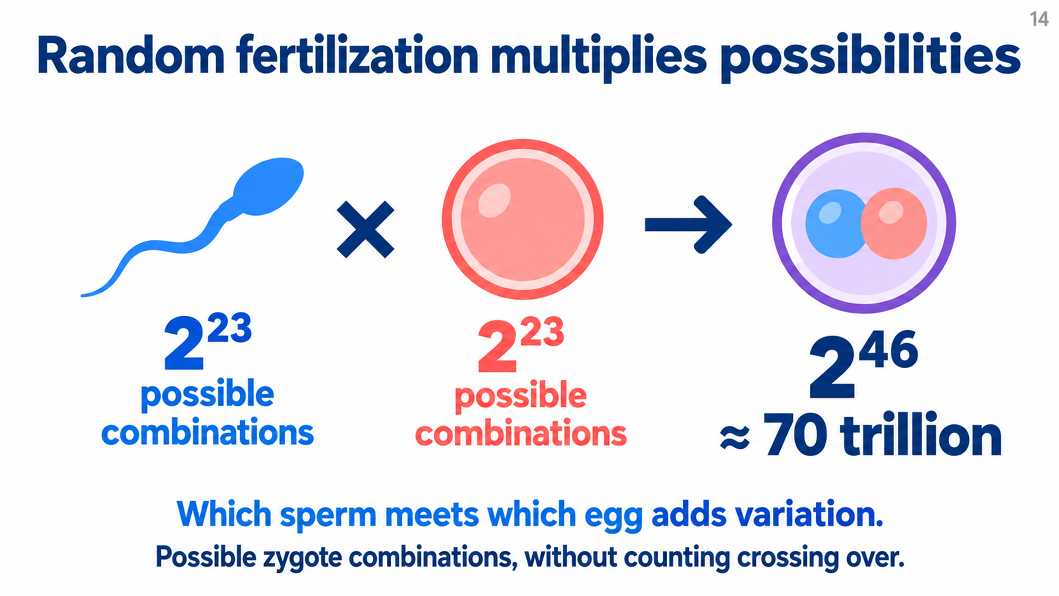
Random fertilization multiplies the assortment possibilities of two gametes
Random fertilization multiplies the assortment possibilities of two gametes.
Combining sperm and egg possibilities gives about 70 trillion possible human zygote combinations. That estimate still excludes the extra variation from crossing over.

Slide 12
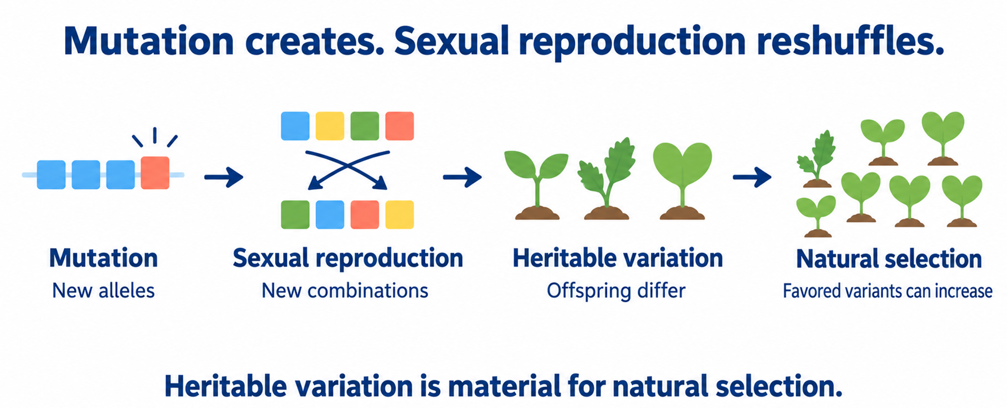
New alleles and new combinations play different roles in variation
New alleles and new combinations play different roles in variation.
Mutation supplies new alleles, and sexual reproduction reshuffles them. The resulting heritable variation provides material on which natural selection can act.

Slide 13
Thought Questions
Q4: Why is heritable variation described as the "material" for natural selection?
Because natural selection requires phenotypic differences that can be passed down to offspring to favor certain variants
Because it prevents any future mutations from occurring in the population
Because it ensures every individual in the population is genetically identical
Because it completely replaces the need for sexual reproduction

Slide 14
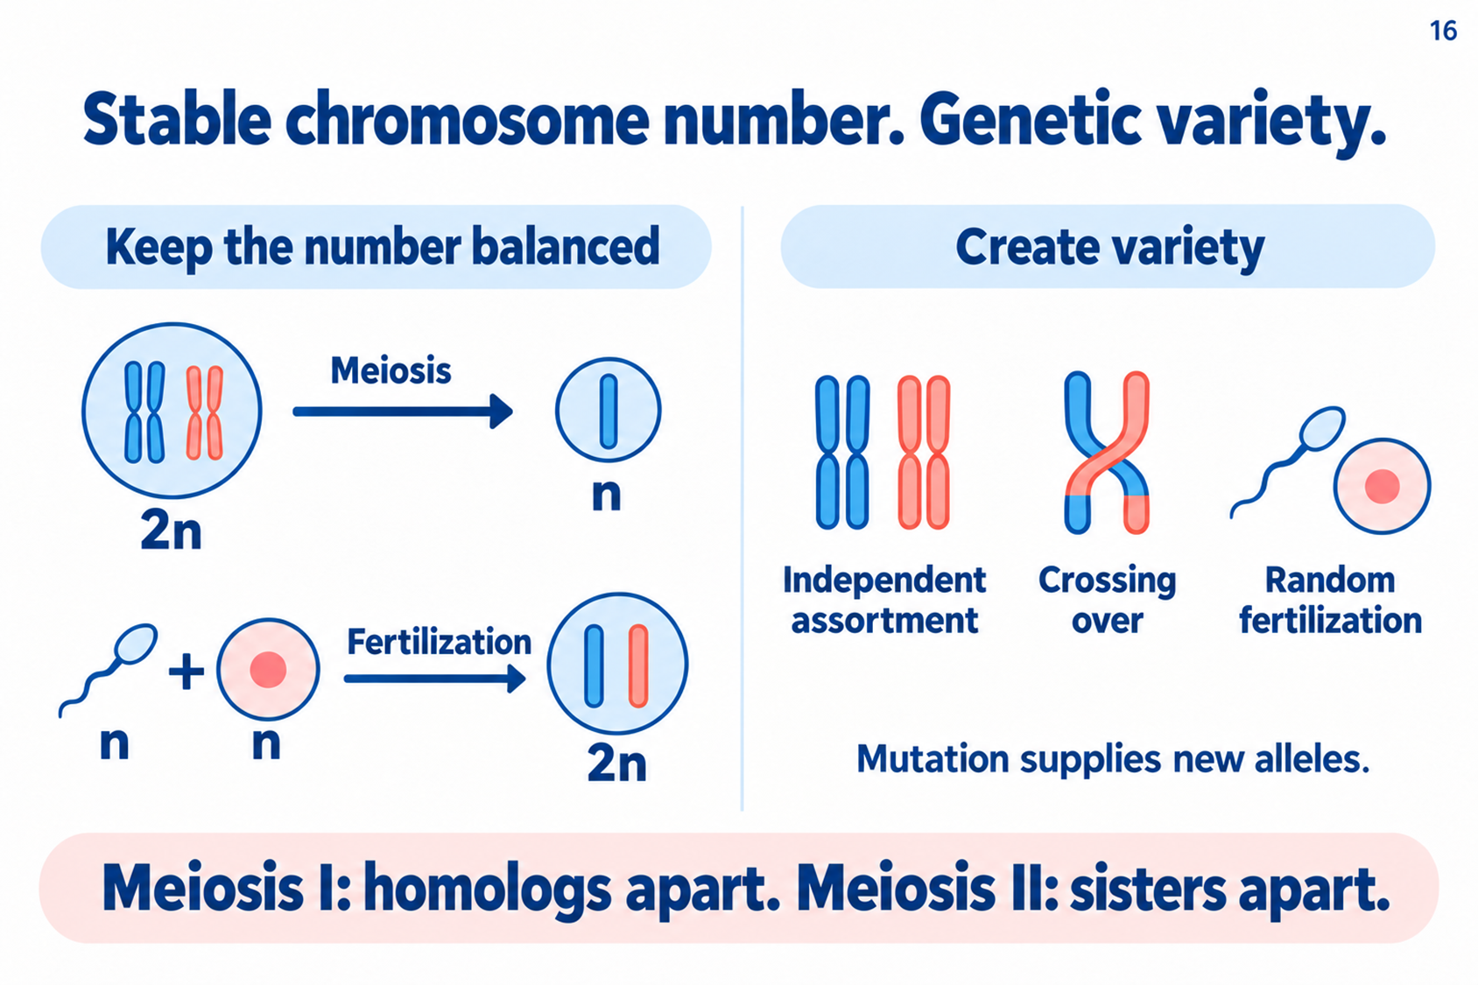
Stable chromosome number and genetic variety can occur together
Stable chromosome number and genetic variety can occur together.
Meiosis and fertilization balance chromosome sets. Assortment, crossing over and random fertilization create variety, while mutation supplies new alleles.

Slide 15
Thought Questions
Q5: What is the primary change in chromosome ploidy level that occurs during the process of meiosis?
From haploid (n) to diploid (2n)
From diploid (2n) to haploid (n)
From diploid (2n) to tetraploid (4n)
From haploid (n) to haploid (n)

