Slide 1
ZS Campus Beats 2021 Case Challenge
This document is solely for the use of client personnel. No part of it may be circulated, quoted or reproduced for distribution outside of the client organization without prior written approval of ZS.

Slide 2
Team details
Team Opportunity
IIT (ISM) Dhanbad
AJAY JAGANNATH
ABDUL MUHSHEEN S
AMARA VENKATA SAI SRUJAN

Slide 3
scenario one

Slide 4
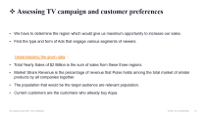
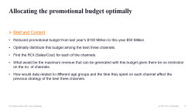
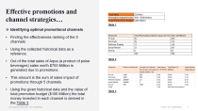

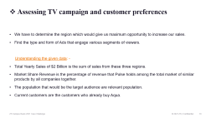
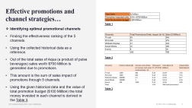
Table of content
Effective promotions and channel strategies
Assessing TV campaign and customer preferences
Allocating the promotional budget optimally

Slide 5

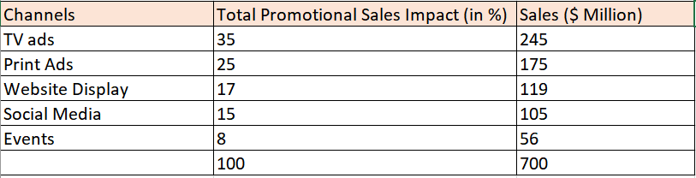
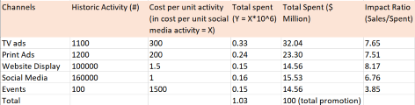
Effective promotions and channel strategies…
Table 1
Identifying optimal promotional channels
Finding the effectiveness ranking of the 5 channels.
Using the collected historical data as a reference.
Out of the total sales of Aqua (a product of pulse beverages) sales worth $700 Million is generated due to promotions.
This amount is the sum of sales impact of promotions through 5 channels.
Using the given historical data and the value of total promotion budget ($100 Million) the total money invested in each channel is derived in the Table 3.
Table 2
Table 3

Slide 6
This impact ratio gives us the priority order (ranking) of channels to focus on: -
The above ranking comes as a result of the historical data. Let’s see what happens when we take into consideration the Access Rating (AR) and Popularity Rating (PR) into consideration.
These ratings are a result of post – COVID survey.
Website Display | 1
TV Ads | 2
Print Ads | 3
Social Media | 4
Events | 5

Slide 7
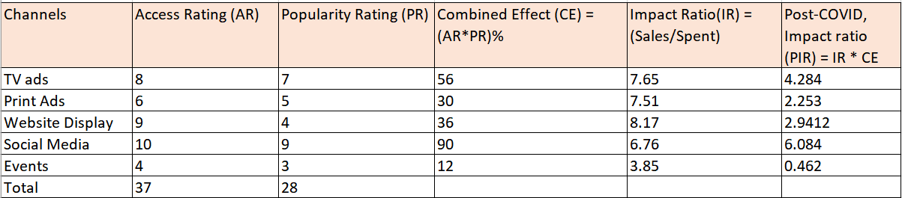
Let’s understand the process with an example.
Suppose there were 100 sales as an impact of TV Ads as per the historic data.
Now only 8 out of every 10 people have access to TV Ads. Thus the 100 sales reduce to 80.
The ratings also show that the popularity of TV Ads is 70% (i.e. 7/10). Thus out of those 80 sales only 70% would happen, and that is 56 sales ( 80*7/10).
From the above method we find that sales got reduced to 56 from 100, i.e. 56% of historic data. As Impact ratio is directly proportional to this combined effect it is multiplied with IR to get PIR.
This gives us a new rank list, top 3 channels for promotions in this list are according to their PIR: -
Social Media | 1
TV Ads | 2
Website Display | 3

Slide 8
Some points to keep in mind while for deciding the content for chosen channels ( The top 3 according to PIR ): -
There shouldn’t be any content where people are sharing the drink.
Price shouldn’t be mentioned in case it is some premium drink or it’s cost is higher than the market standards according to the people.
Hygiene has become a norm at least in people’s thought but might not be in practise. Thus none of our content should display anything that is unhygienic.
If any content that shows the person drinking it gets a fresh feeling or gets energised, put it in the context of work from home and not activities that involve outdoor.

Slide 9
Table of content
Effective promotions and channel strategies
Assessing TV campaign and customer preferences
Allocating the promotional budget optimally

Slide 10
Assessing TV campaign and customer preferences
We have to determine the region which would give us maximum opportunity to increase our sales.
Find the type and form of Ads that engage various segments of viewers.
Understanding the given data: -
Total Yearly Sales of $2 Billion is the sum of sales from these three regions.
Market Share Revenue is the percentage of revenue that Pulse holds among the total market of similar products by all companies together.
The population that would be the target audience are relevant population.
Current customers are the customers who already buy Aqua.

Slide 11
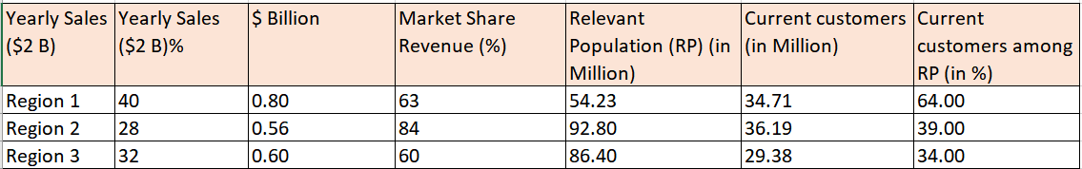
The above table will help us identifying a region for TV campaign.
There are three segments of people in each region: -
Seg:1) Current Customers Seg:2) Customers of other companies Seg:3) Those who are not a part of this market.
Out of Seg:2 and Seg:3 we take an assumption that the impact of the TV Campaign would be higher on Seg:2 people as they are already a part of this market ecosystem.
Thus Region 2 is ruled out as it already has a huge market share and thus very few Seg:2 people.
Though Region 1 has comparatively lesser market share the percentage of current customers among the relevant population is considerably higher than the other two, thus leading to the least possibility in attracting Seg:3 people into the market.
Which leaves us with Region 3 as the best option. Lowest market share and highest attraction possibility of Seg:3 people.

Slide 12
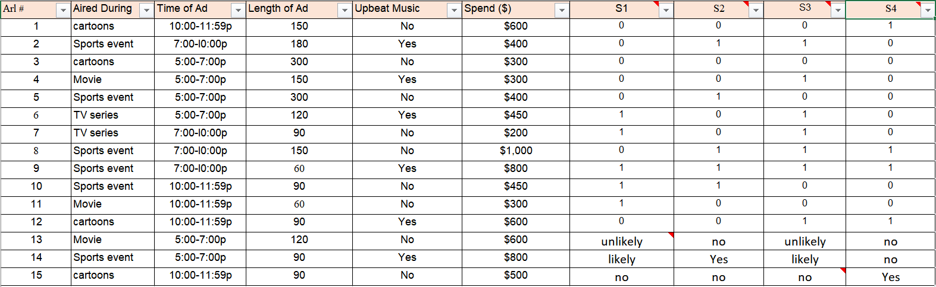
Engagement of three new Ads

Slide 13
Segment wise details and patterns: -
S1: - Ad length 60 – 120 seconds. No pattern in upbeat music. Doesn’t watch cartoon.
S2: - Views only & all the Ads aired during sports telecast.
S3: - Strictly sports during 7 – 10 pm. Doesn’t watch an Ad without an Upbeat Music during 5 – 7 pm and 10 -12 pm. Fan of TV series.
S4: - Doesn’t view any Ad before 7pm. Doesn’t miss sports during 7 – 10 pm and cartoon during 10 -12 pm.
Some insights for the 3 new Ads: -
Out of the three the sports Ad will probably gain the most engagement, would most likely be viewed by people of S1, S2 & S3.
The Ad aired during the movie would be the most uncertain to be viewed.
The Ad aired during cartoon would most probably be viewed only by S4.
Strategy to bring Aqua Lite into the market: -
Referring to the name “Lite” the type of product should be a lesser quantity version of Aqua maybe 200ml.
In this way we can show the cost lower than half the aqua.
Channel as that of Social Media and TV as they are popular would spread he word faster.

Slide 14
Table of content
Effective promotions and channel strategies
Assessing TV campaign and customer preferences
Allocating the promotional budget optimally

Slide 15
Allocating the promotional budget optimally
Brief and Content
Reduced promotional budget from last year’s $100 Million to this year $50 Million.
Optimally distribute this budget among the best three channels.
Find the ROI (Sales/Cost) for each of the channels.
What would be the maximum revenue that can be generated with this budget given there be no restriction on the no. of channels.
How would data related to different age groups and the time they spent on each channel affect the previous strategy of the best three channels.

Slide 16
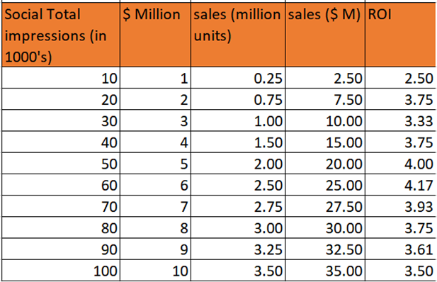
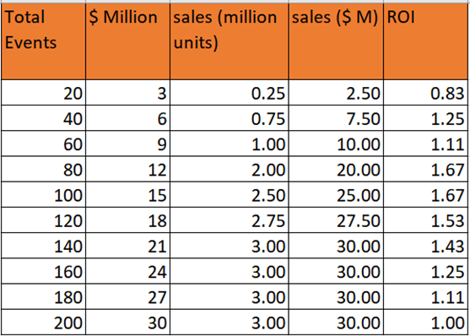
Table 3.1
Using the average cost per channel and the analysis data provided these tables are formulated.
1 Unit sales = $10.
ROI for values in each row is calculated by dividing sales ($ M) by $ Million.
Better the ROI better is the revenue generated.
From the data in these tables it is found out that the highest ROI that can be generated is through Website Advertising.
That is ROI = 6. This value holds true only when the money invested ($ Million) is either $45 Million or $50 Million. (from Table 3.4)
If we invest the whole amount of $50 Million in one channel we won’t be able to spread the budget across 3 channels, thus we would invest $45 Million in Website Ads to get the highest ROI.
The remaining $5 Million would be divide between the next two best ROI options.
Table 3.2

Slide 17
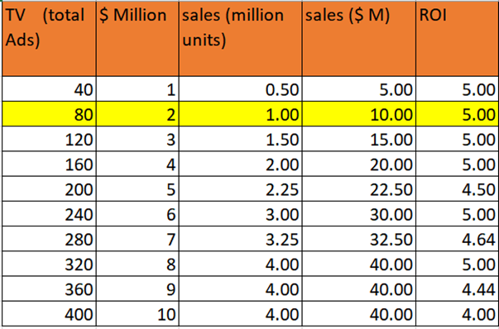
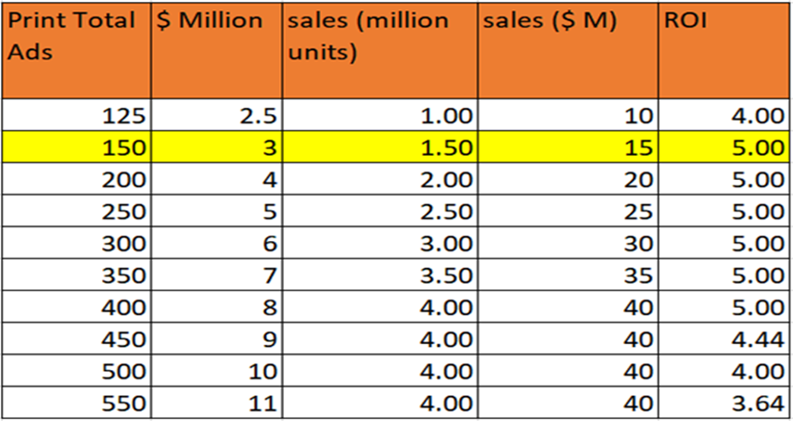
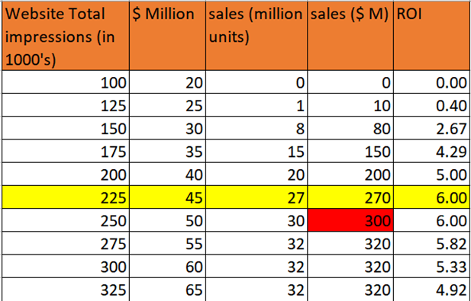
These are TV Ads and Print Ads both have the same highest ROI as 5.
From the values in the table the possible split of $5 Million is $3 Million to Print Ads and $2 Million to TV Ads. (Revenue = $295 Million).
Maximum possible revenue is when we invest the whole budget $50 Million into Website which would give $300 Million revenue.
Table 3.3
Table 3.5
Table 3.4

Slide 18
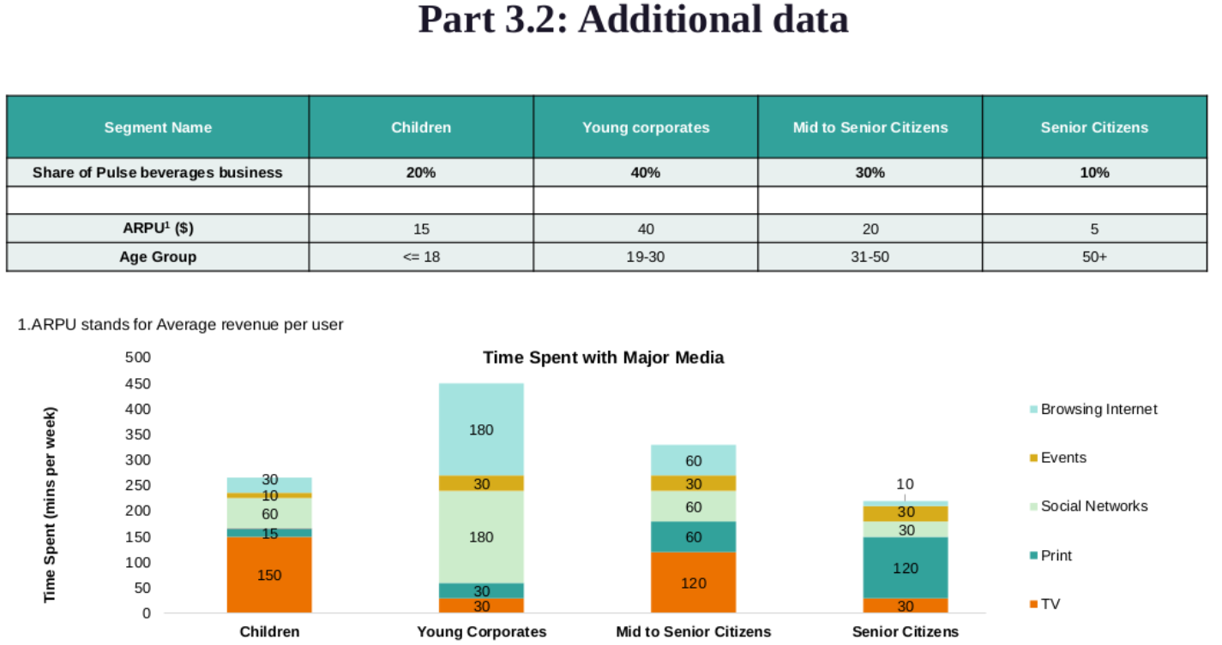
This additional data shows that Young corporates is one of the most revenue generating segment and they spend 40% of their time on social media, thus as a change to our previous strategy of using the top three ROI channels we should include social media Ads to target this segment and optimize the budget distribution accordingly.

Slide 19
scenario TWO

Slide 20
Introduction
Pulse Beverages is a leading nutrition drink manufacturer and seller in the US and India.
A few years ago, the company introduced its drink Aqua Orange which is now well-established in the market.
Aqua currently comes in ready-to-drink packaging, in bottles of 250ml, 500ml, 1000ml and 2000ml.
The company has employes Sales Managers to boost the sales of its product in India, and their bonus is computed on the basis of performance against the sales target set.

Slide 21
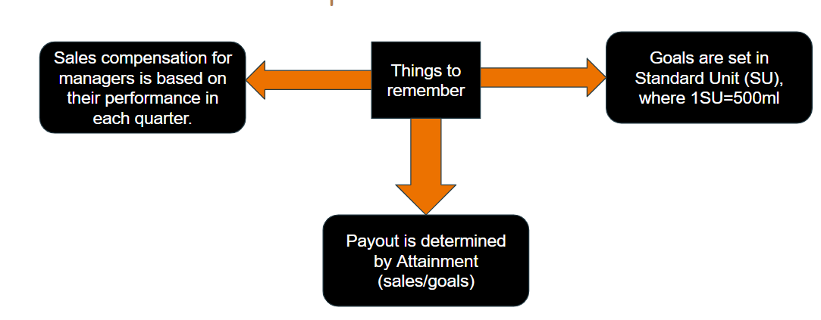
Part 1: Calculate quarter earnings for each representative

Slide 22
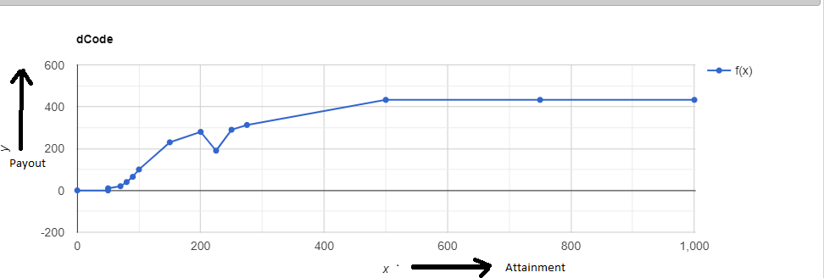
Q)1.Attainment vs payout curve
.

Slide 23
Attainment | Payout
0% | 0%
49.90% | 0%
50% | 10%
70% | 20%
80% | 40%
90% | 65%
100% | 100%
150% | 230%
200% | 280%
225% | 190%
250% | 290%
275% | 313%
500% | 433%
750% | 433%
1000% | 433%

Slide 24
Assumption taken for curve making
Since values are not fitting in any curve. The best suited curve is made by joining a straight line between the given points
If any other curve is drawn from the given points taking attainment in x axis and payout in Y axis then the curve obtained doesnot give the value given in the attainment table also.
Payout is calculated from the graph made in above slide.suppose for calculating payout for attainment of 407.30% just find the equation of line (275,313) and (500,433) which is 0.533x+166.33 feeding value of x as 407.30 payout is coming 383.54% so the money he got is 383.54 million rupee.similarly calculated for other person.
Calculation for SU example 500ml bottle considered as a SU so 250 ml bottle considered as 0.5 SU and 1000ml bottle considered as 2SU

Slide 25
Data are for Q3
Manager Name | City | Q3 2020 goals -(SU) | 250 ml bottle purchased | 500 ml bottle purchased | 1000 ml bottle purchased | 2000 ml bottle purchased | Standard unit considered 500 ml bottle as a SU | Attainment=(Sales/Goals)*100
Rahul S | Gangtok | 235,000 | 36630 | 18210 | 20880 | 219720 | 957165 | 407.3042553
Kirti S | Coimbatore | 160,000 | 26350 | 18850 | 22710 | 25740 | 180405 | 112.753125
Vishwa P | Mumbai | 190,000 | 25510 | 22390 | 29370 | 21310 | 179125 | 94.27631579
Kalpana K | Amritsar | 200,000 | 26300 | 20550 | 22290 | 26000 | 182280 | 91.14
Ram S | Chandigarh | 225,000 | 24730 | 24410 | 28510 | 25710 | 196635 | 87.39333333
Kirti S | Goa | 145,000 | 13360 | 22730 | 24270 | 11800 | 125150 | 86.31034483
Taran S | Durgapur | 170,000 | 17650 | 22410 | 21800 | 15690 | 137595 | 80.93823529
Abhishek S | Hyderabad | 250,000 | 24680 | 31250 | 18430 | 22550 | 170650 | 68.26
Rakesh S | Agra | 170,000 | 10580 | 17250 | 13330 | 12790 | 100360 | 59.03529412
Ankit J | Chennai | 180,000 | 11000 | 18350 | 15900 | 10720 | 98530 | 54.73888889

Slide 26
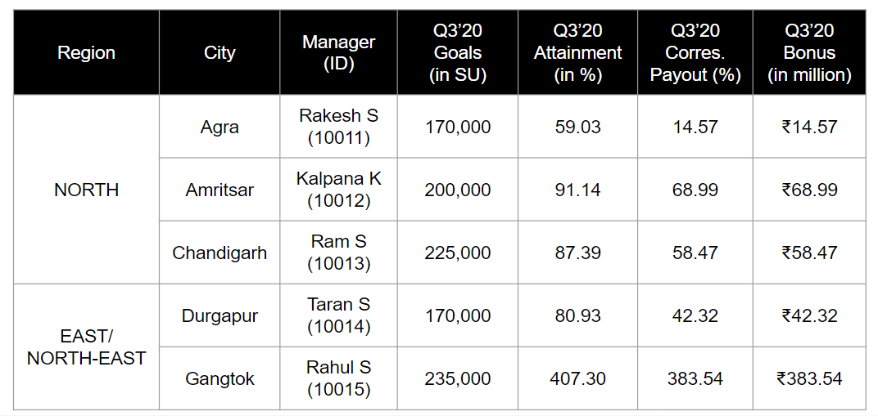
1.2

Slide 27
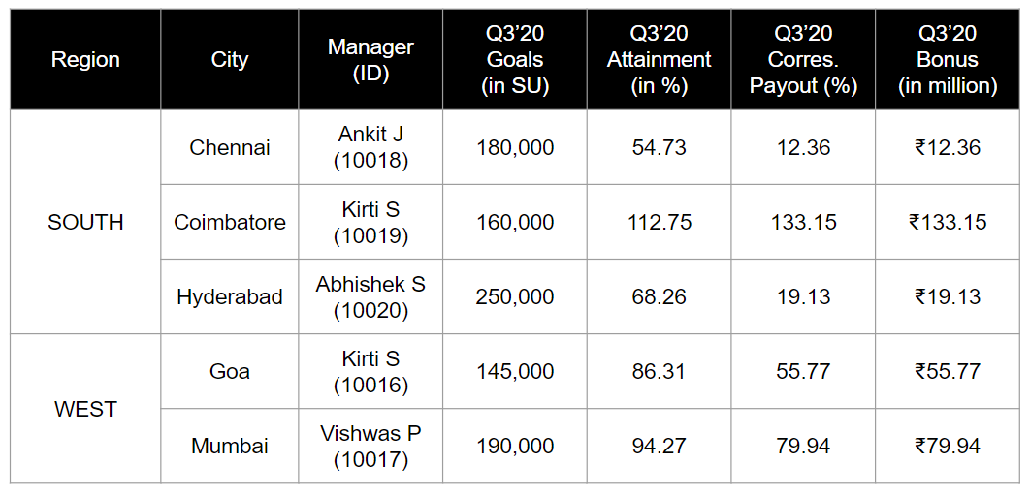
1.2

Slide 28
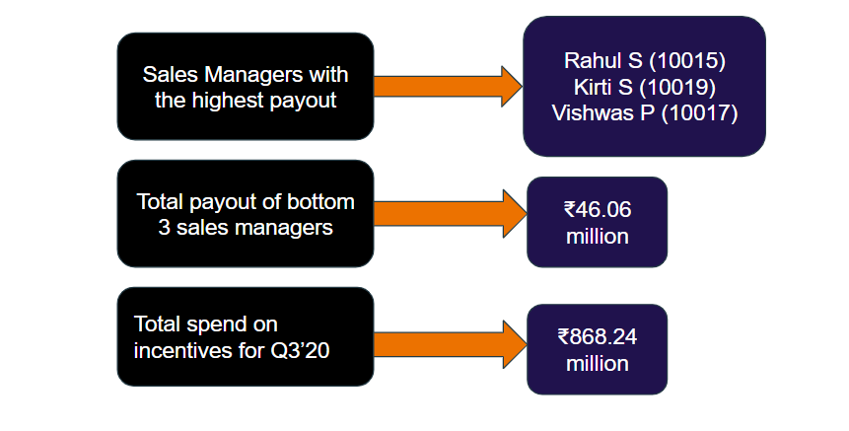
1.2, 1.3

Slide 29
Part 2: Assess the current methodology for performance evaluation and identify the reasons for Sales Managers’ concerns

Slide 30
 |  | For Rahul |  |  | For Kriti
Column1 | Column2 | Column3 | Column4 | Column5 | Column6 | Column7
 | Quarter 1 | Quarter 2 | Quaeter 3 | Quarter 1 | Quarter 2 | Quaeter 3
250 ml bottle purchased | 2625 | 2534 | 36630 | 2324 | 3370 | 26350
500 ml bottle purchased | 2348 | 3047 | 18210 | 1776 | 3943 | 18850
1000 ml bottle purchased | 2230 | 4410 | 20880 | 1882 | 3748 | 22710
2000 ml bottle purchased | 906 | 4920 | 219720 | 1988 | 4517 | 25740

Slide 31
Observation drawn from previous data
It is clearly seen that sales at quarter 3 is much much higher than quarter 2 and quarter 1 and sales at quarter 2 is higher than at quarter 1

Slide 32
Q2.2
According to the give dataset,
No of tier 1 cities=3(Chennai, Hyderabad, Mumbai)
No of tier 2 cities= 7(Rest)
Let’s take the sales target for tier 1 and tier 2 is x1 and x2 respectively
Let’s take the National Forecast of sales of the Nation as y
We assume that the sales forecast for tier 1 cities should be thrice
of tier 2 cities.
So
3*x1+7*x2=y
x1=3*x2
Hence
7* x2+9*x2=y
16*x2=y
x2=y/16
x1=3y/16

Slide 33
Pros
This is the first step towards meeting the nation forecast of sales for the nation
Though these may not be the most suitable they give ball park figure has to be achieved
Cons
Assuming that each of tier 1 and tier 2 cities would have the same yearly sales
is valid only in theory
In practice sales depend on population, demography, culture and many other factors which are widely varying in a diverse country such as india.

Slide 34
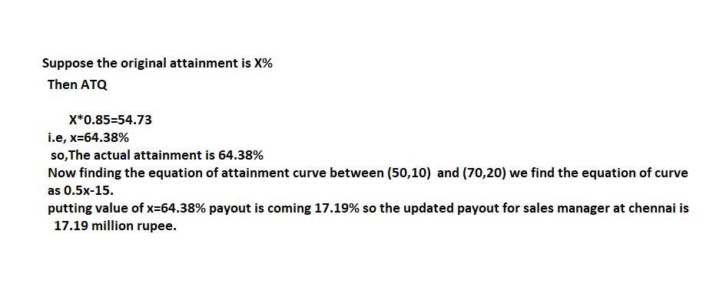
Solution of question 2.3
.

Slide 35
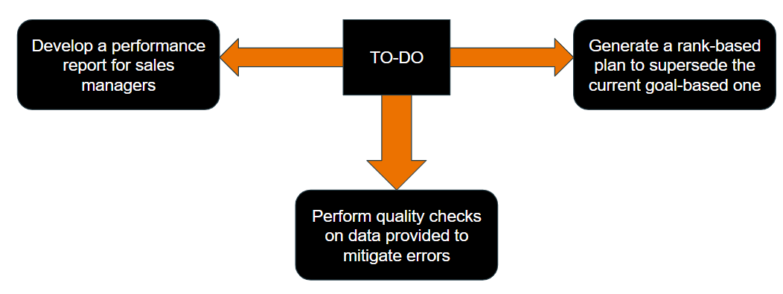
Part 3: Communicating Performance

Slide 36
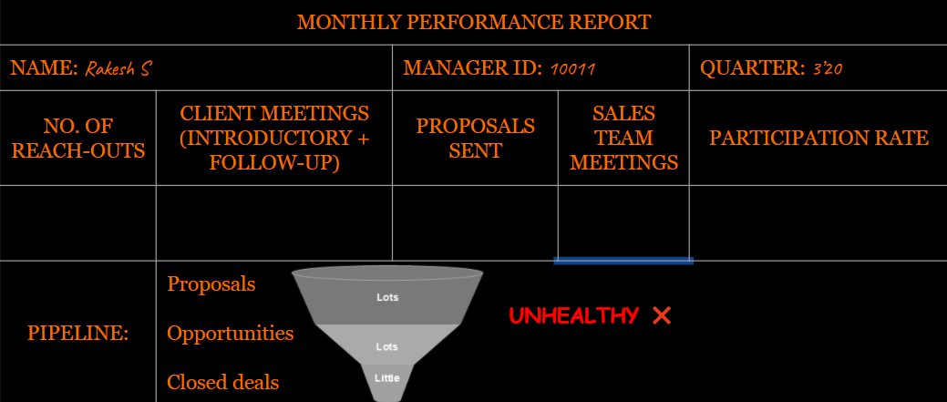
3.1 – Performance Report

Slide 37
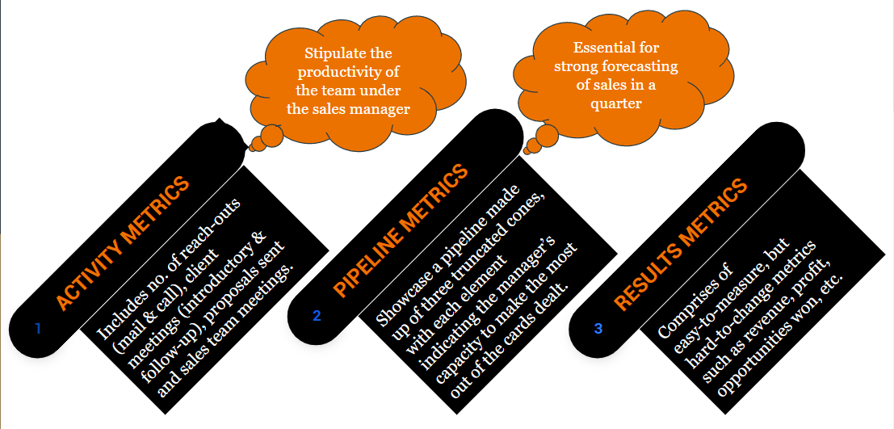
3.1 – Key Fields

Slide 38
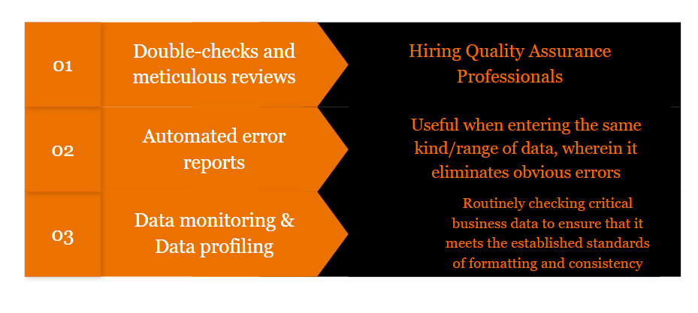
3.2 – Quality Checks

Slide 39
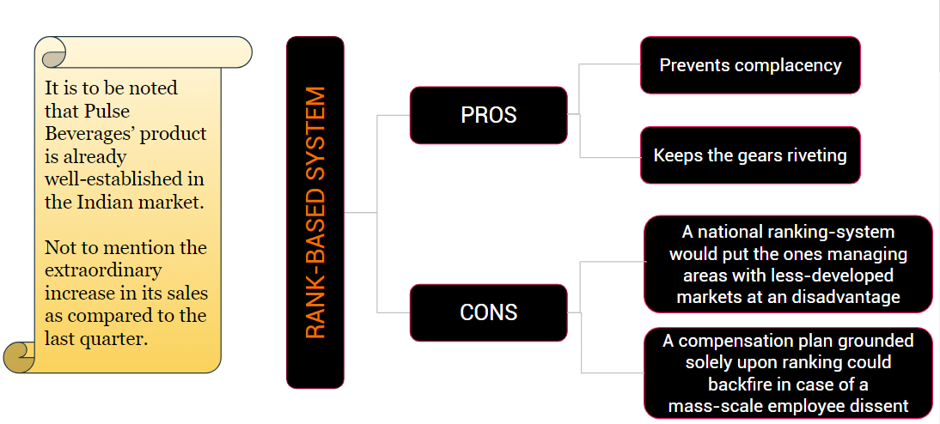
3.3 – Rank-based System

Slide 40
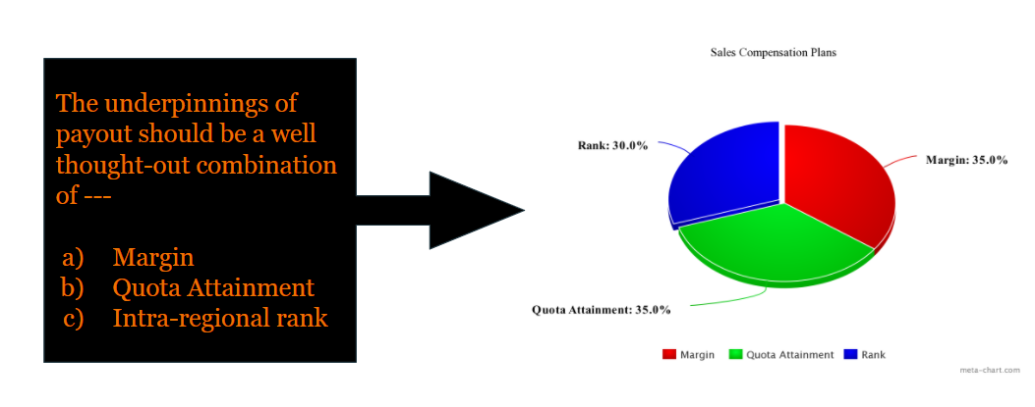
3.3 - Suggestions

Slide 41
scenario THREE

Slide 42
Analysis and Take away
Aqua is a well established drink produced by pulse beverages, a leading nutrition drink manufacturer and seller in the US market which comes in 3 flavours of 3 sizes each.
The company’s newly developed IT system TechProX uses various information regarding the sales of aqua as shown in the data tables attached.
With the information provided and by using logical deductions and inferences, we as a member of ZS team attempt to bring up approach and solution to the questions presented
ASSESSING DATA TABLES AND CREATING REPORTS
We use the help of SQL to formulate the required dataset using the available database. It is assumed that the data provided is only a small snippet of the complete data and the queries are designed such that they work for the complete dataset.
SALES INVENTORY REPORT DATA
The data provided is studied and checks are made to determine the quality of the data. Basis the result of observation of the data, we determine changes to the data and additional information to be outsourced in order to improve the data analysis.

Slide 43
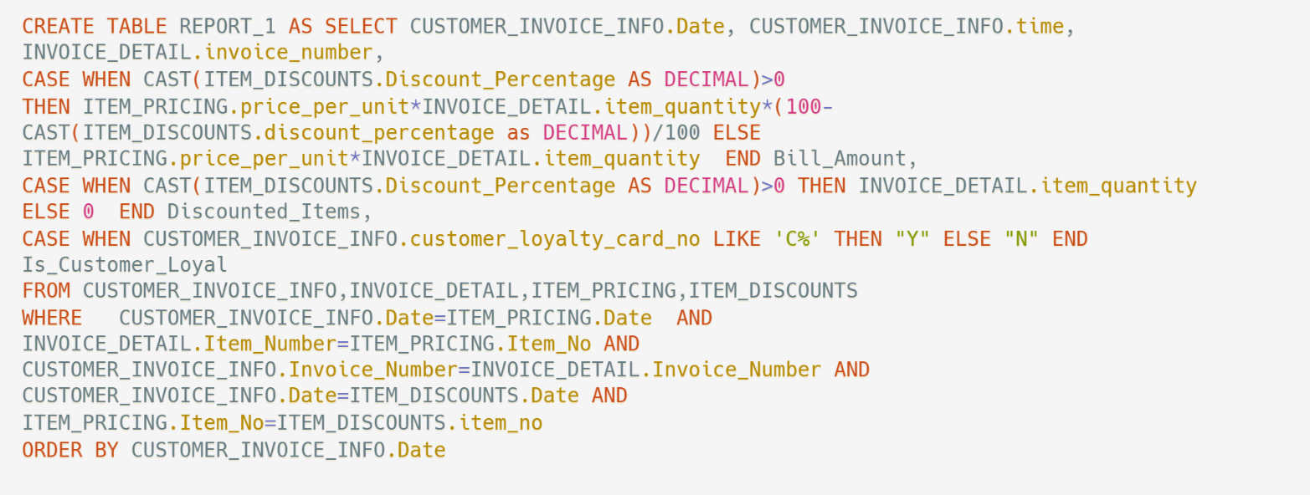
Assessing Data Tables And Creating New Table
I
II
III
IV
V
Creating a new table named Report_1
Getting data such as date , time , Invoice Number
Calculating Bill Amount considering discount factor
Linking all the given table by common headers
Order them by date
Then, finding no. of discounted items in the bill
VI

Slide 44
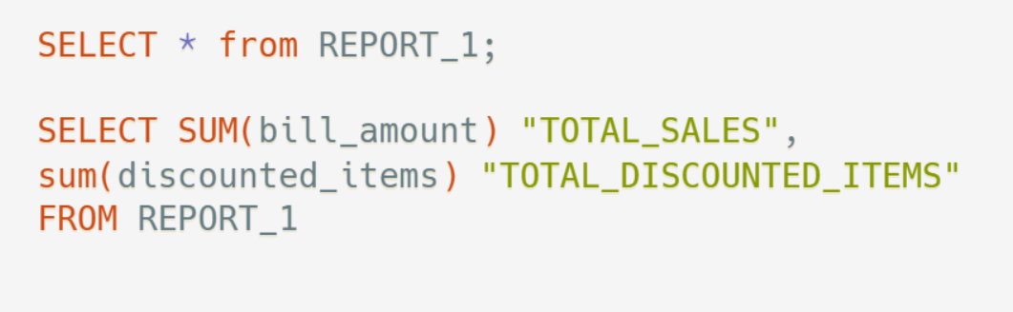
Creating Report
Then in order to total sales and total discounted item
We use the created table Report_1
And then finally find the sum of the column in the created table

Slide 45
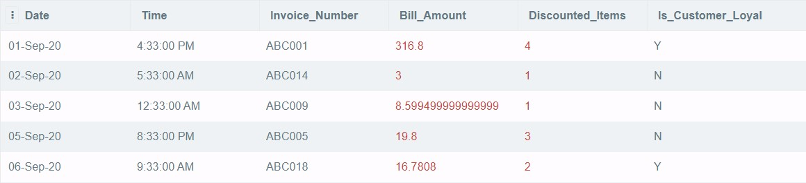
Marketing Team Report

Slide 46
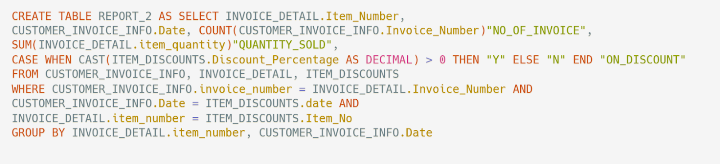
Assessing Data Tables And Creating New Table
I
II
III
IV
Creating a new table named Report_2
Getting no. of invoices and quantities sold on a specific date
Linking all the given table by common headers
Group them by date as we required sum of data on a specific date

Slide 47
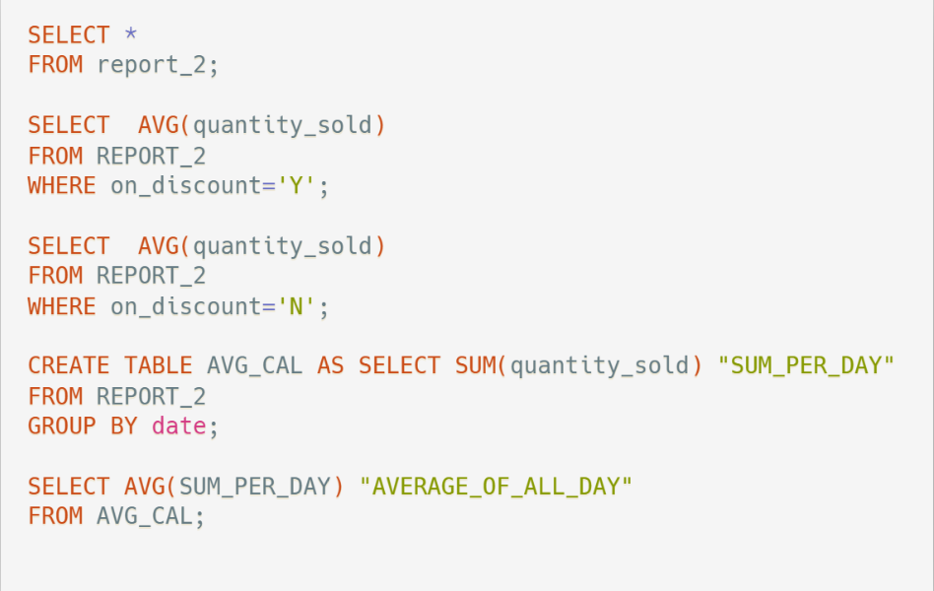
Creating Report
Using the Report_2 to find what is required
Finally find average sum per day
Then create another table using the queries used in Report_2
Finding average quantity sold with or without discount

Slide 48
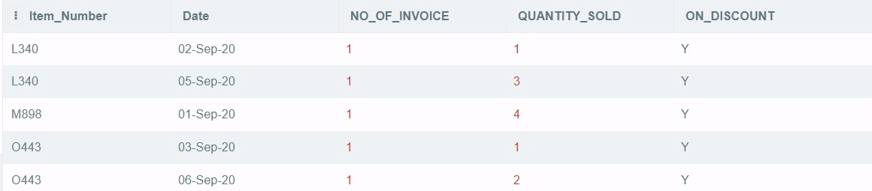



Sales Inventory Report

Slide 49
Data Checks
SELLING PRICE = ORIGINAL PRICE - DISCOUNT PRICE
A given data is erroneous when this condition is not satisfied as seen in the data occurring on 12-Sep-20.
CHECK FOR NULL
A given data is erroneous when any of its columns is empty.
CHECK FOR UNIQUE INVOICE NUMBER
Invoice number generated at each sale of an item is an incremented value from the previous number, meaning that the sequence is unique and increasing with time.
We consider this incomplete, as seen in the data occurring on 8-Sep-20, with no invoice number.
FIX UPPER AND LOWER BOUND OF ALL COLUMNS
Done so that large errors/outliers have little to no impact on the key attributes of the dataset such as sum, avg, etc.,
We consider this incomplete, as seen in the data occurring on 8-Sep-20, with no invoice number.
CHECK FOR UNIQUE INVOICE NUMBER
Invoice number generated at each sale of an item is an incremented value from the previous number, meaning that the sequence is unique and increasing with time.
SELLING PRICE INCREASING WITH PRODUCT SIZE
If the cost of product of size(M) post discount is lesser than the cost of the product of size(N) (N<M), then it makes the latter redundant.

Slide 50
Factors Causing Significant Impact On Data Quality
DATA INTEGRITY
DATA VALIDATION
What?
DATA CONSISTENCY
the reliability and the correctness of data. Describes the state of the data or the process of ensuring and preserving the validity and accuracy of data.
Neck break corporate decisions rely on the correctness of the data up to the last decimal for devising the most cost, time and labour efficient methods.
What?
It is the consistency in measurement of variables throughout the datasets
Why?
The difference in units and scaling between different sources can disrupt any meaningful interpretation of the data.
What?
checking the accuracy and quality of source data before using it.
Why?
Without validating data, you run the risk of basing decisions on data with imperfections that are not accurately representative of the situation at hand.
Why?

Slide 51
Ways To Improve The Data Structure
INVOICE NUMBER AS THE PRIMARY KEY
In an error free data set, the invoice numbers are a set of unique numbers identifying each purchase of an aqua product.
DROPPING ORIGINAL PRICE COLUMN
Since the dataset contains only 9 unique products of aqua, there exists only 9 different original prices which can be maintained separately. Each record’s price can then be obtained by matching the product size and flavour.
FIXING COLUMN HEADERS TO FACILITATE SQL USE
If column names contain any characters except letters, numbers, and underscores, the name must be delimited by enclosing it in back quotes (`), other it is considered to be erroneous.
COMBINING PRODUCT SIZE AND FLAVOUR TO SINGLE COLUMN
This can be done by allotting codes to the various products. L,M,O can be used to depict the three flavours and 1,2,3 to depict the three sizes. Hence 9 distinct codes can be obtained that represent the various products. [L1,L2,L3,M1,M2,M3,O1,O2,O3]
DROPPING PRODUCT TYPE AND FLAVOUR COLUMNS
As per the previous step, if a new column is added, it makes both product type and flavours column redundant. They can hence be removed to reduce the total size of the dataset, while not losing any information.

Slide 52
Additional Data For Better Data Analysis
VENDOR ID
Unique codes to identify each and every vendor authorised to sell aqua by pulse beverages. This information can be used to analyse the performance dependence basis the location and size of each store.
ZONE ID
Unique codes to categorize/cluster a group of vendors in the vicinity of each other into zones. This information can be used to analyze the performance dependence basis the demographic of a particular area.
PRODUCTS PURCHASED WITH AQUA
Collecting data of products bought by customers/consumers along with aqua. This information can be used to facilitate Market Basket Analysis and cross promotion of products with other companies.

Slide 53
THANK YOU! ☺

